Slide 1

2023 Idaho Legislative Energy Summit
November 30, 2023

Slide 2
Idaho’s Energy
Landscape
Idaho Governor’s Office of Energy and Mineral Resources
Richard Stover, Administrator
November 30, 2023

Slide 3



Office of Energy and Mineral Resources (OEMR)
Mission: Develop and utilize Idaho’s energy and mineral resources in an efficient, effective, and responsible manner that serves to enhance the state’s economy and sustain the quality of life for its citizens.
Our focus: reliable, affordable, and sustainable power in Idaho
Idaho’s clearinghouse for energy and mineral information
Idaho’s energy and mineral planning and policy development agency
Administrative arm of the Idaho Strategic Energy
Alliance (ISEA)
Notes:
Idaho’s energy and mineral planning and policy development agency
Lead agency for NEPA involvement on energy and mining issues
Idaho’s clearinghouse for energy and mineral information
Administer loan & financial assistance programs
Administrative arm of the Idaho Strategic Energy
Alliance (ISEA)

Slide 4
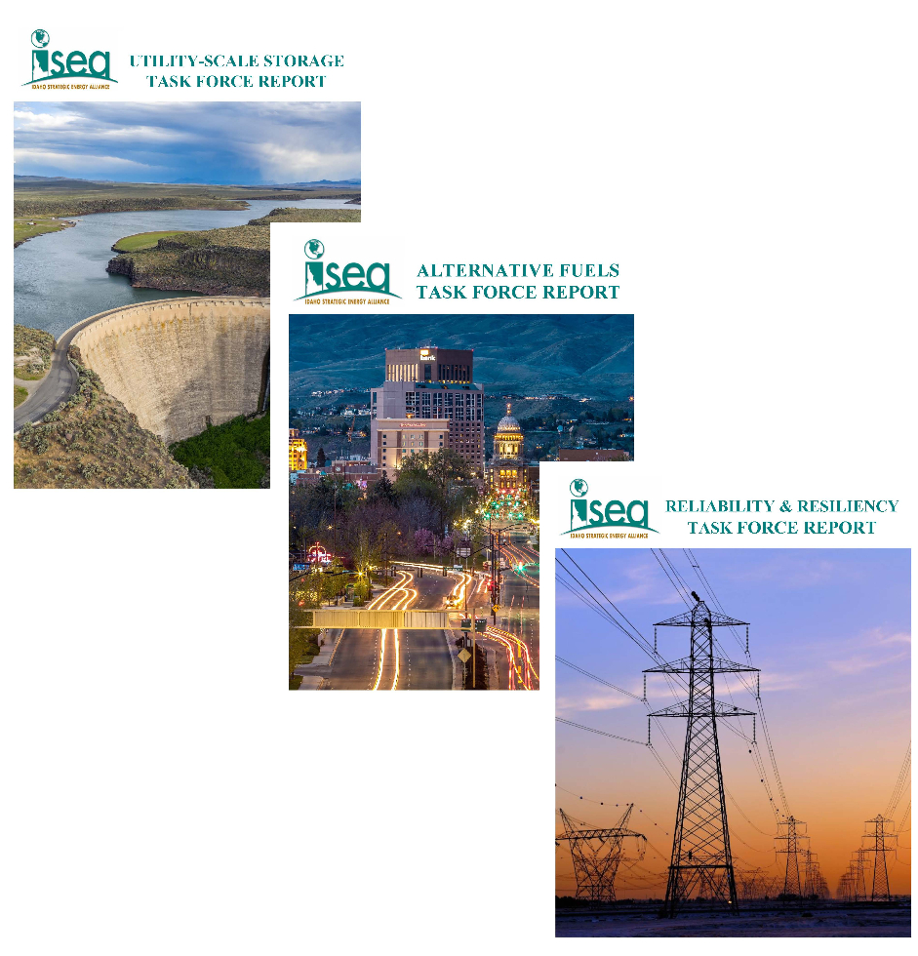
Idaho Strategic Energy Alliance (ISEA)
Broad stakeholder group
Promote the development of the state’s energy resources to increase energy supply in an economically efficient manner while maintaining the integrity of Idaho’s natural resources
Increase awareness and understanding of Idaho’s diverse energy resources
Improve cooperation, collaboration and communication among Idaho’s public and private-sector entities
Work groups provide recommendations

Slide 5
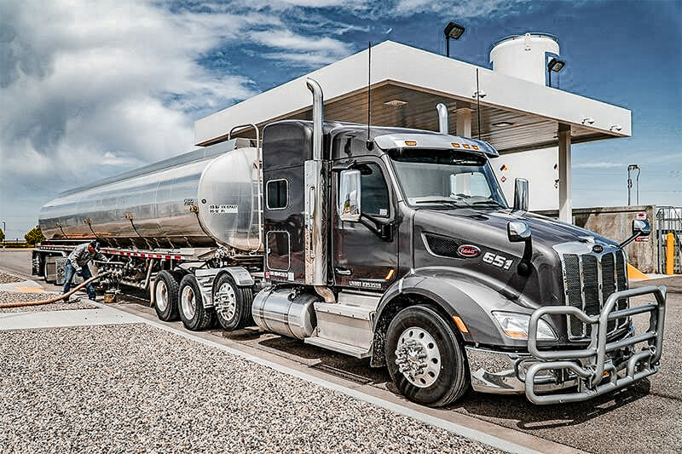
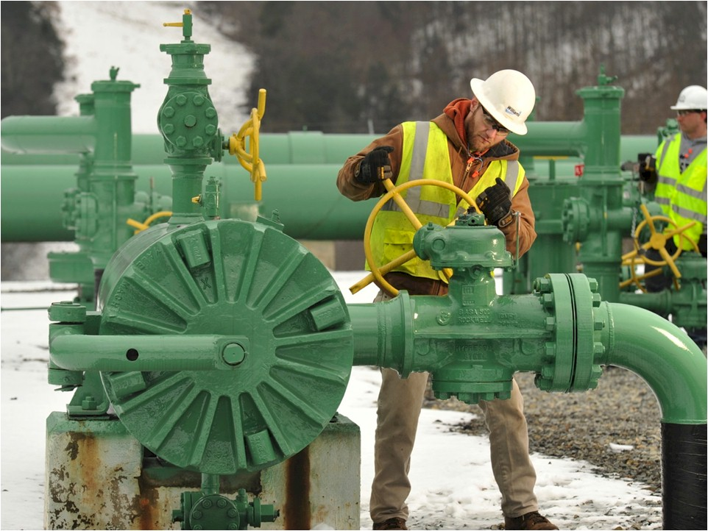
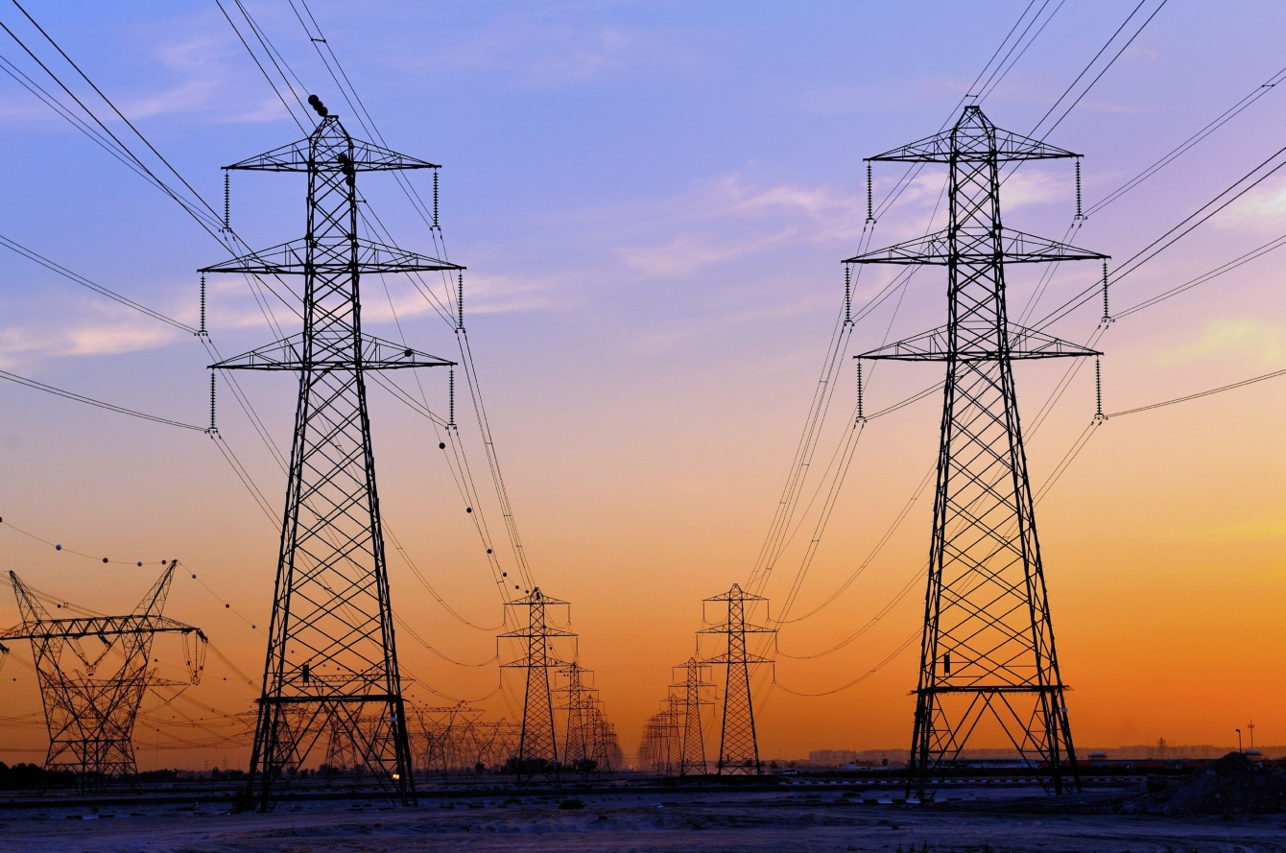
What is Energy?
Transportation fuels
Heating fuels
Electricity

Slide 6
Energy Production and Consumption (1990-2021)
Idaho requires significant energy imports, approximately 4/5 of demand, to meet its energy needs.
Net energy imports (demand)
In-state energy generation (supply)

Slide 7
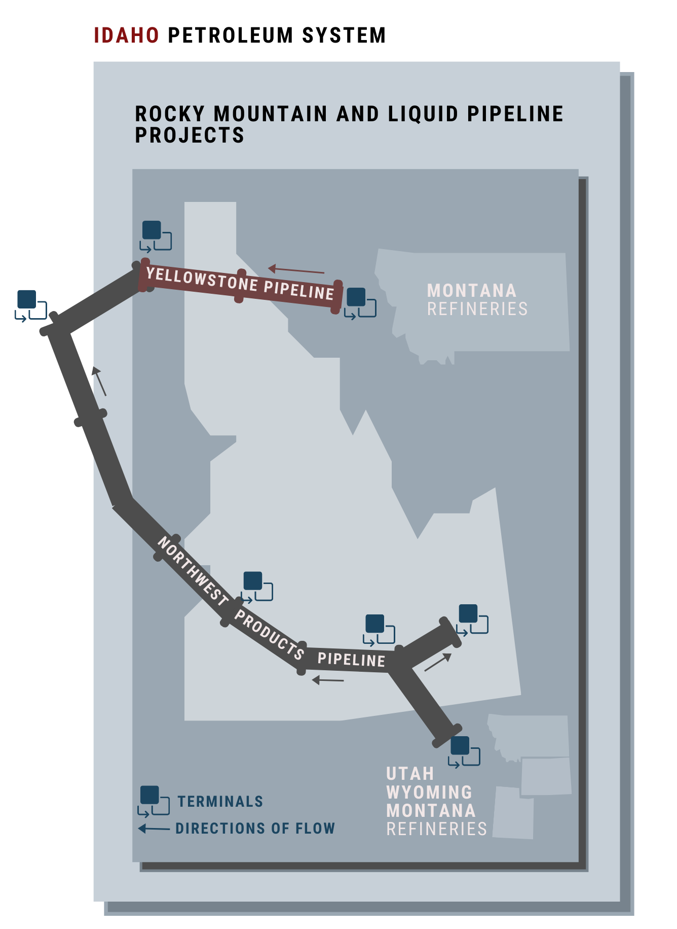
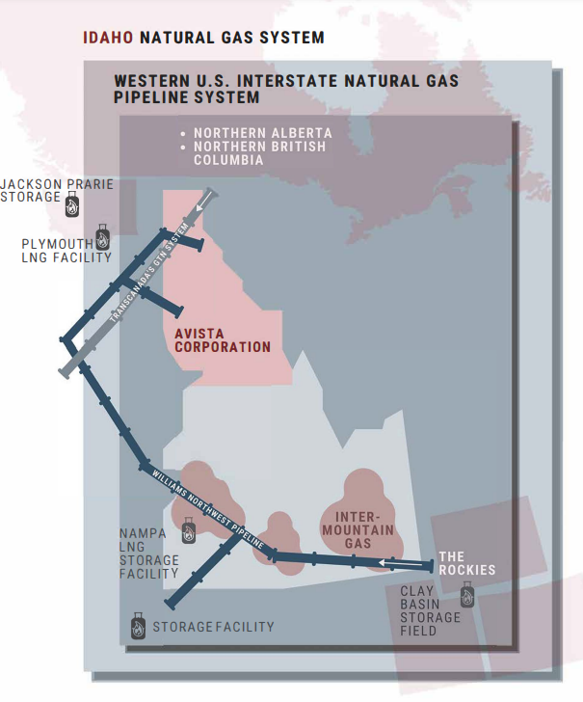

Slide 8
Natural Gas Rates (2021)
In 2021, Idaho had the lowest natural gas rates in the U.S.

Slide 9
Electric Utilities
Three large investor-owned electric utilities supply about four-fifths of the state's electricity.
About two dozen municipal utilities and rural electric cooperatives provide the rest.

Slide 10
Idaho’s Electricity Generation by Resource (2023)
Renewable energy, primarily hydropower, generated over 71% of the electricity in Idaho.

Slide 11
Idaho’s Electricity Consumption by Resource (2021)
Notes:
fix

Slide 12
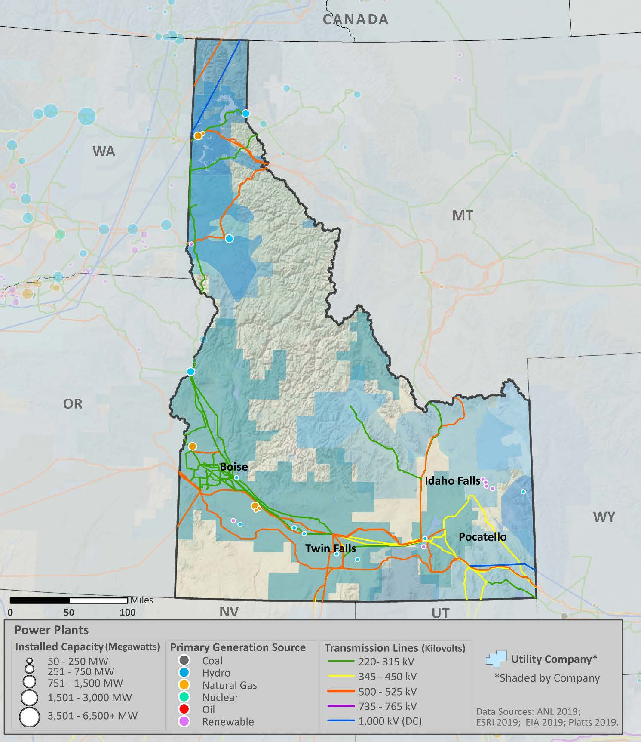
Map of Existing Transmission

Slide 13
Electricity Rates (2022)
In 2022, Idaho had the 3rd lowest electricity rates in the U.S.

Slide 14
Energy 101
2023 Idaho Legislative
Energy Summit
November 30, 2023

Slide 15
2023 IRP Overview
Idaho Energy Summit
Jared Hansen – Resource Planning, Idaho Power

Slide 16
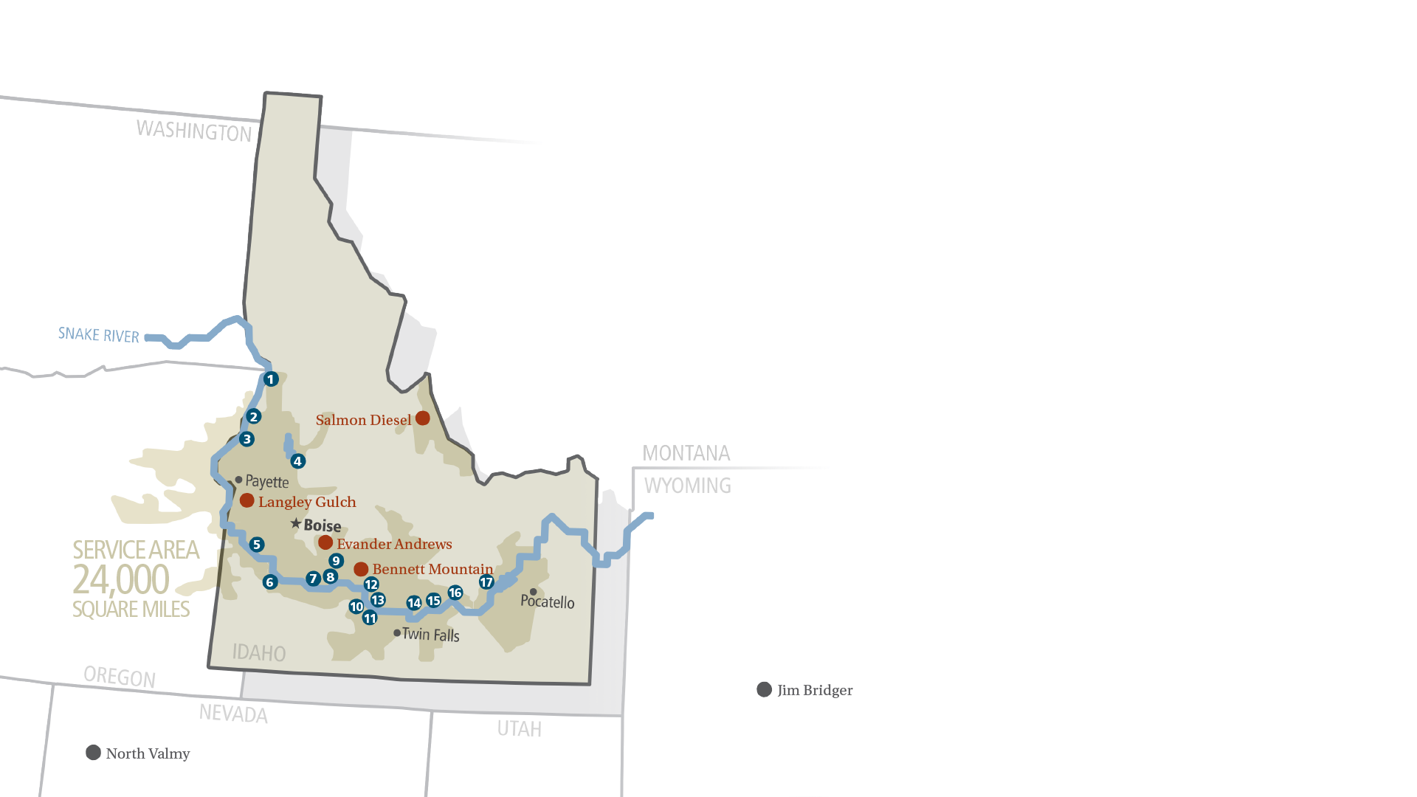
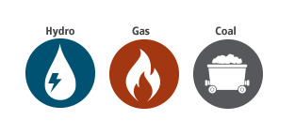
Communities We Serve
1
2
3
4
5
6
7
8
9
10
11
12
13
14
15
16
17
Hells Canyon
Oxbow
Brownlee
Cascade
Swan Falls
C.J. Strike
Bliss
Lower Malad
Upper Malad
Lower Salmon
Upper Salmon
Thousand Springs
Clear Lake
Shoshone Falls
Twin Falls
Milner
American Falls
1391,500 kW
1 190,001 kW
1 675,000 kW
1 12,420 kW
1 27,170 kW
1 82,800 kW
1 75,038 kW
1 13,500 kW
1 8,270 kW
1 60,000 kW
1 34,500 kW
1 6,800 kW
1 2,500 kW
1 14,729 kW
1 52,898 kW
1 59,448 kW
1 92,340 kW
Peak Demand: 3,751 MW
MORE THAN
620,000
CUSTOMERS
Notes:
Idaho Power’s service area covers 24,000 square miles in southern Idaho and eastern Oregon. With 17 low-cost, clean hydroelectric projects as the core of our generation sources, Idaho Power’s more than 620,000 customers pay some of the nation’s lowest energy prices.
Coal facilities:
Jim Bridger
North Valmy
Diesel and natural gas facilities:
Evander Andrews (Danskin)
Bennett Mountain
Salmon diesel
Langley Gulch

Slide 17
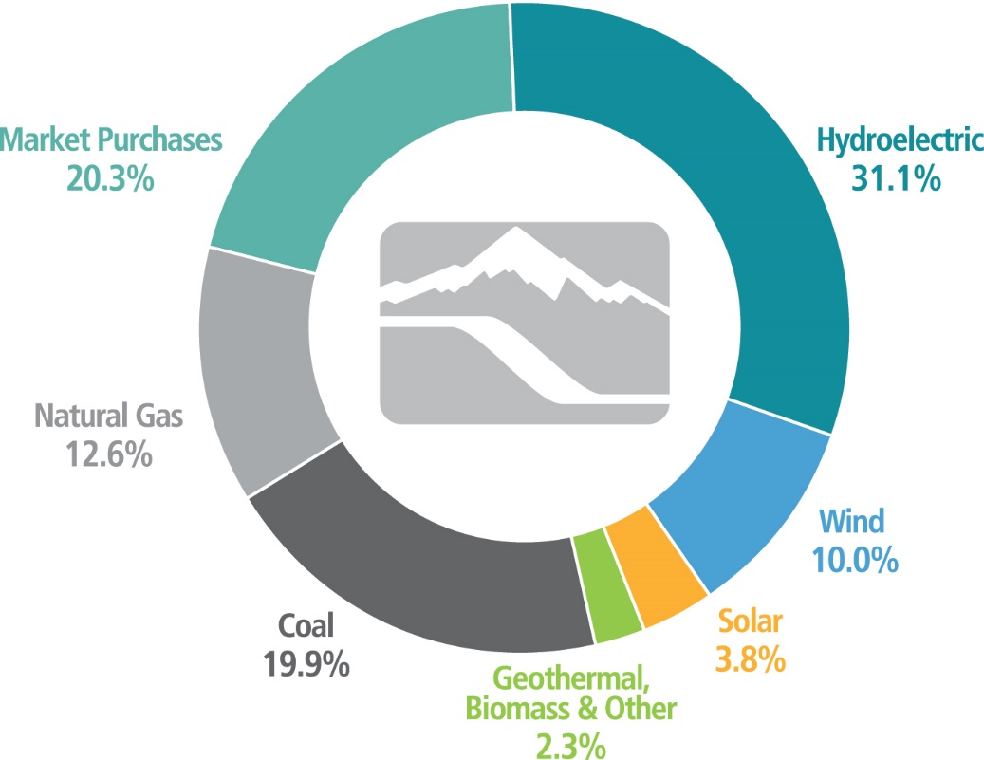
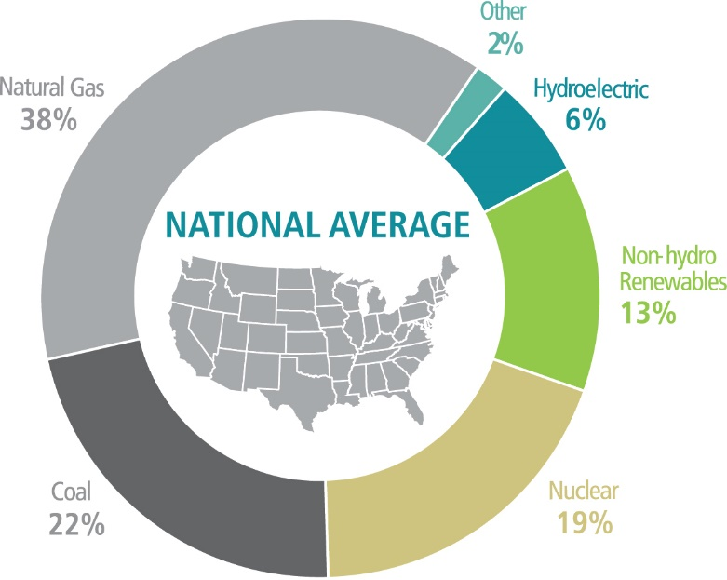
Clean Energy
2022 Energy Mix
Notes:
This shows the energy we generate from company-owned resources and energy we buy through long-term contracts with wind, solar, biomass, geothermal and small-scale hydro generators.

Slide 18
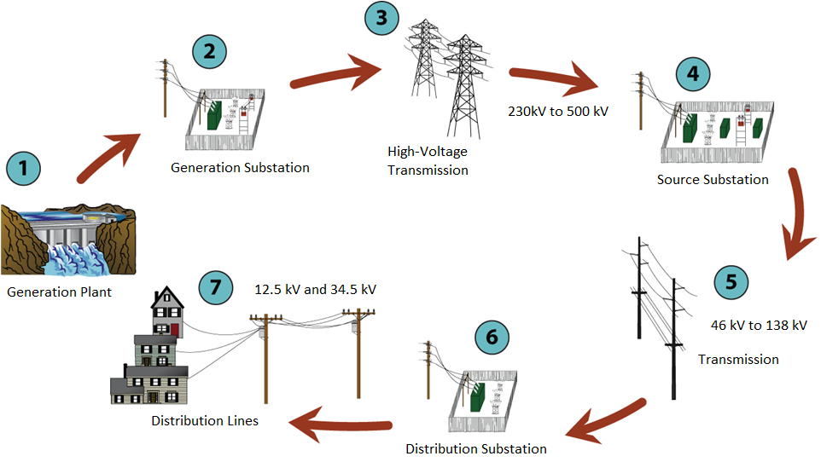


Slide 19
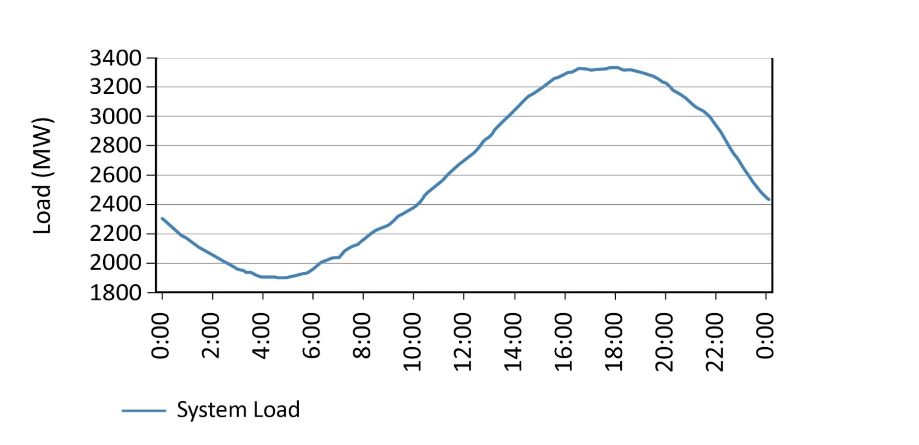
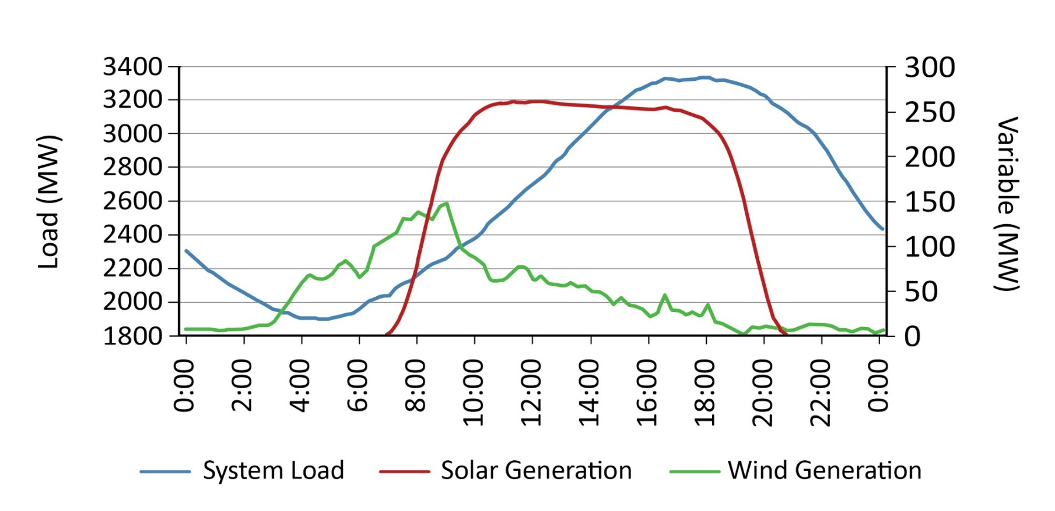

Summer
Battery
Notes:
Here’s how planners at Idaho Power see the summer.
System load or energy usage, gets higher as the day gets hotter, backs off and dips down through the night.
Solar comes and goes with the sun. Wind does its own thing. These are now inexpensive energy resources and they provide significant amounts of energy to our customers.
We worry about this time in the day. Solar drops off fast. What replaces it? People are still using a lot of energy.
That’s where flexible resources come in. We use hydro, coal, gas, and now batteries.
Batteries can capture inexpensive energy produced by wind and solar when we don’t need it and shift it to a time in the day where we do need it and when it would be expensive to produce.

Slide 20
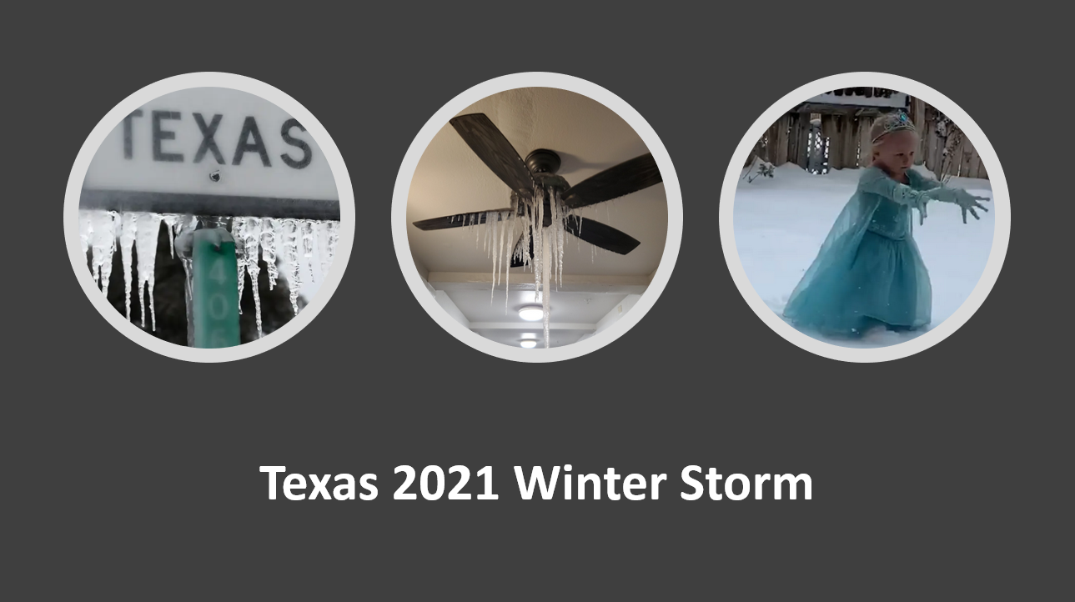

Slide 21
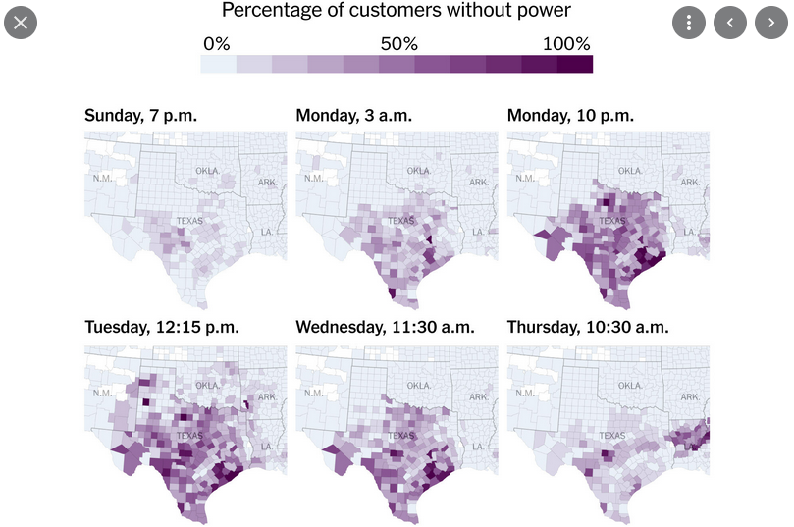

Slide 22
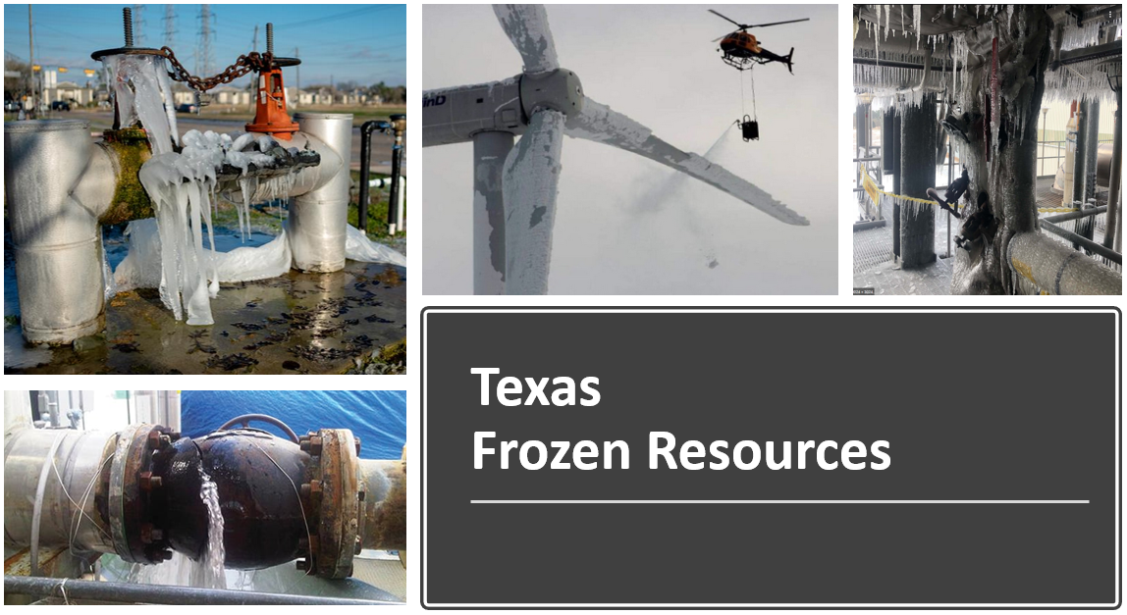

Slide 23
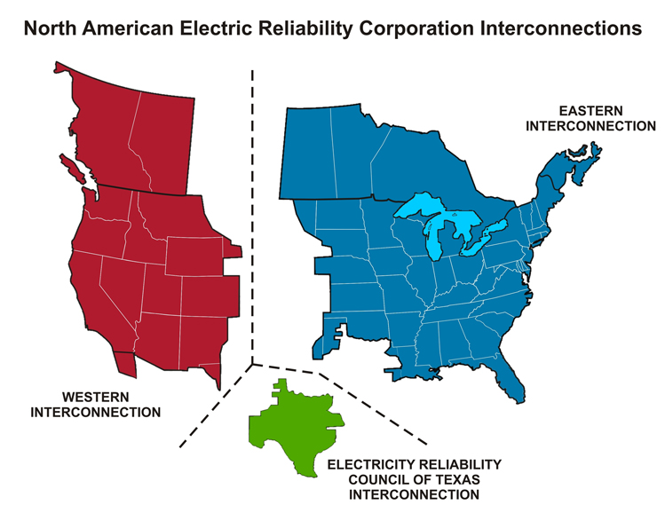
Isolation

Slide 24


Slide 25
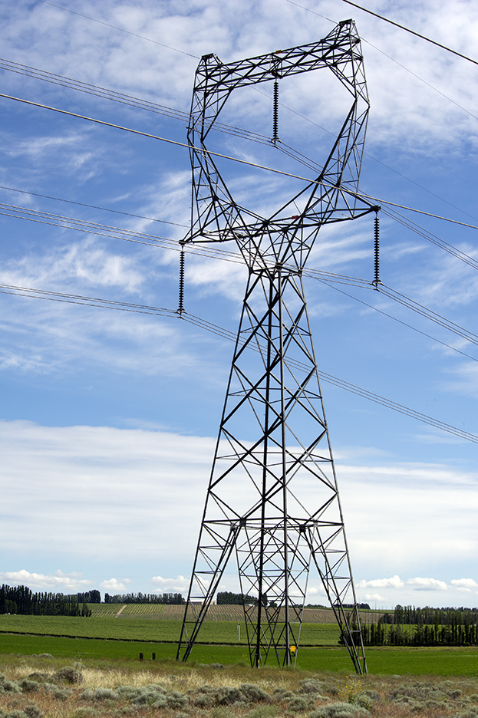

Slide 26
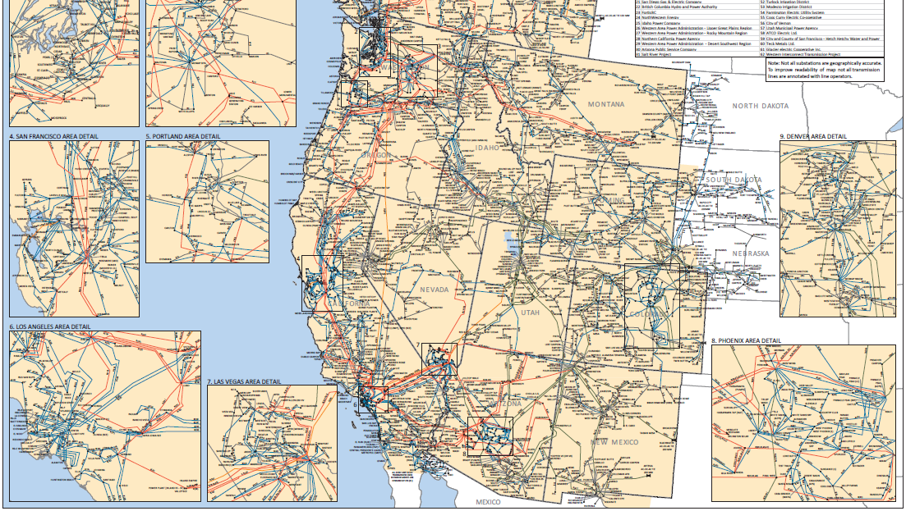

Slide 27
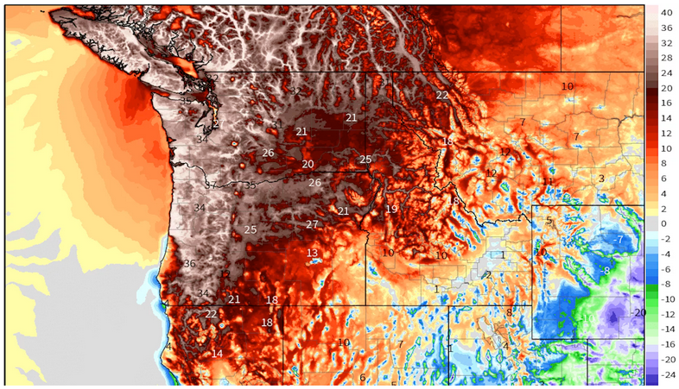
2021 Pacific Northwest Heat Dome
Denver –
77 degrees

Slide 28

How Do We Do This?

Slide 29
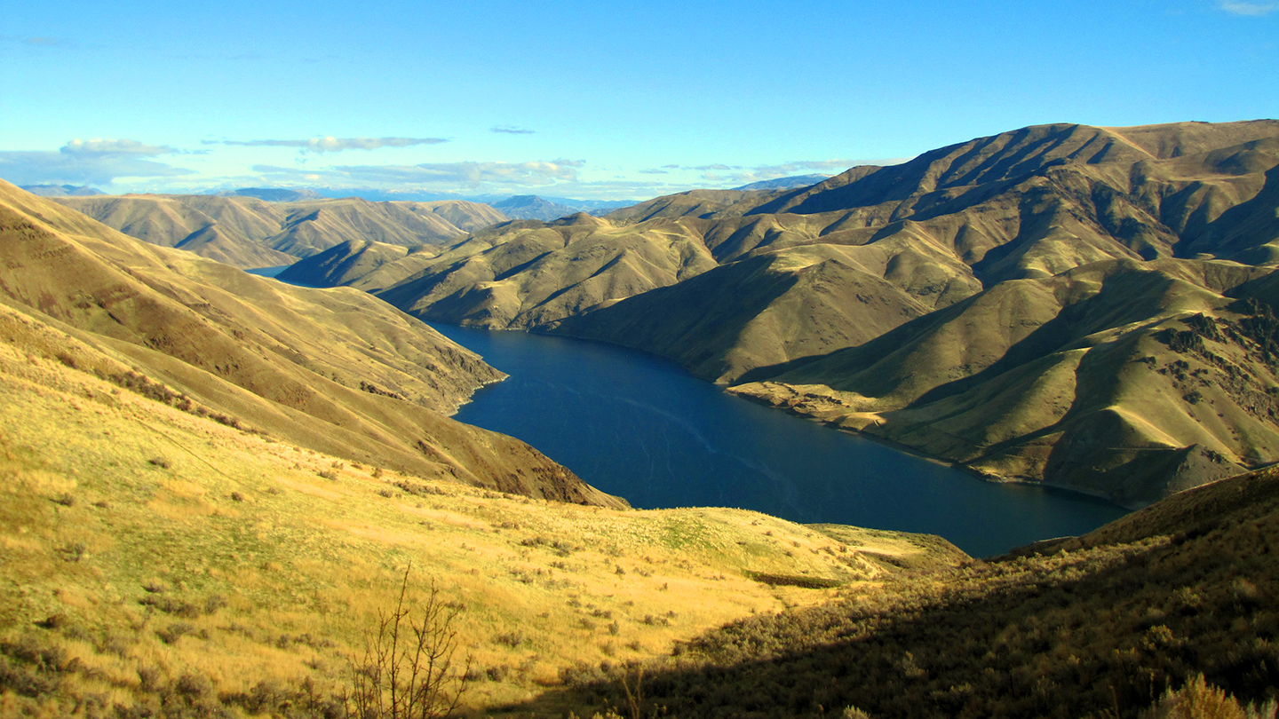
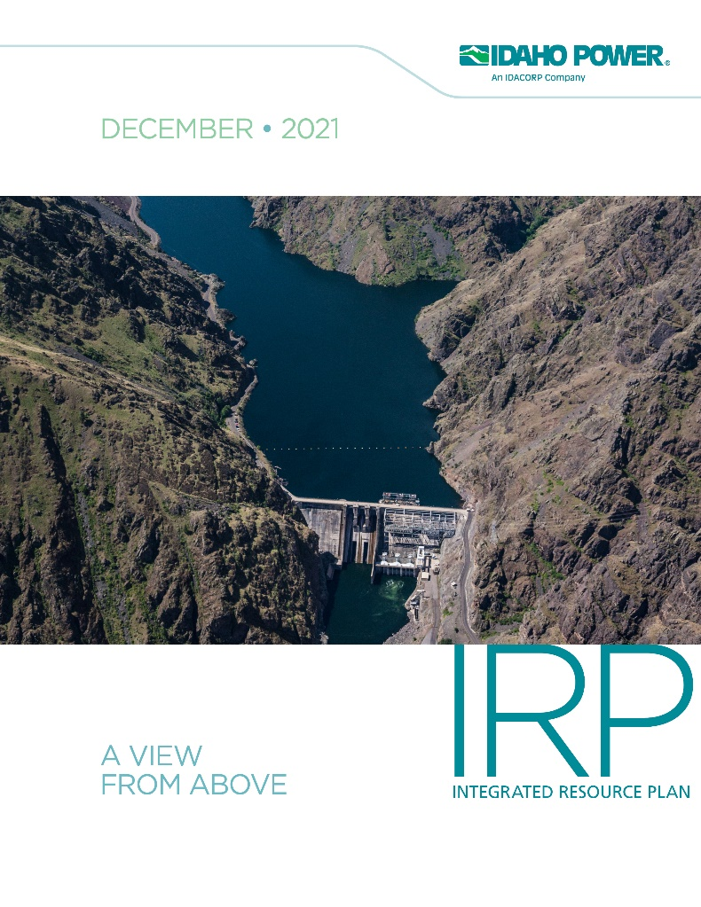
Filed Sept. 29, 2023
Next IRP in June 2025
idahopower.com/irp

Slide 30


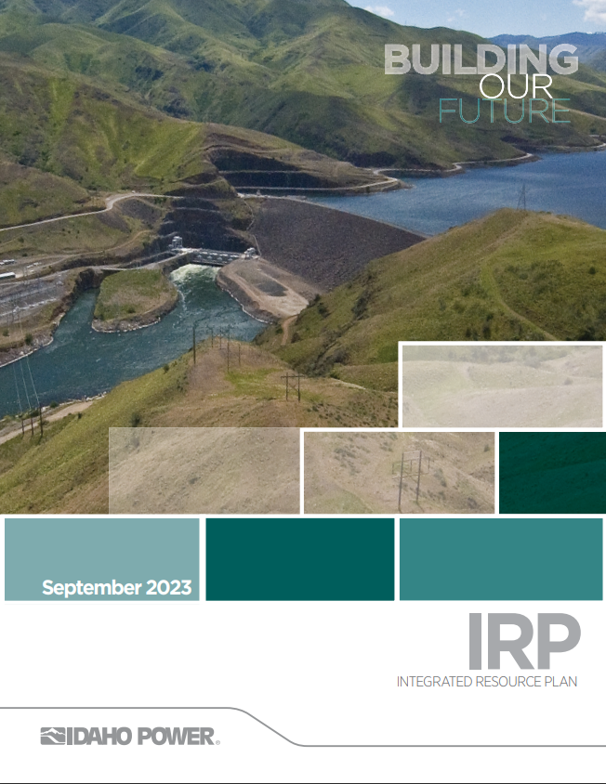

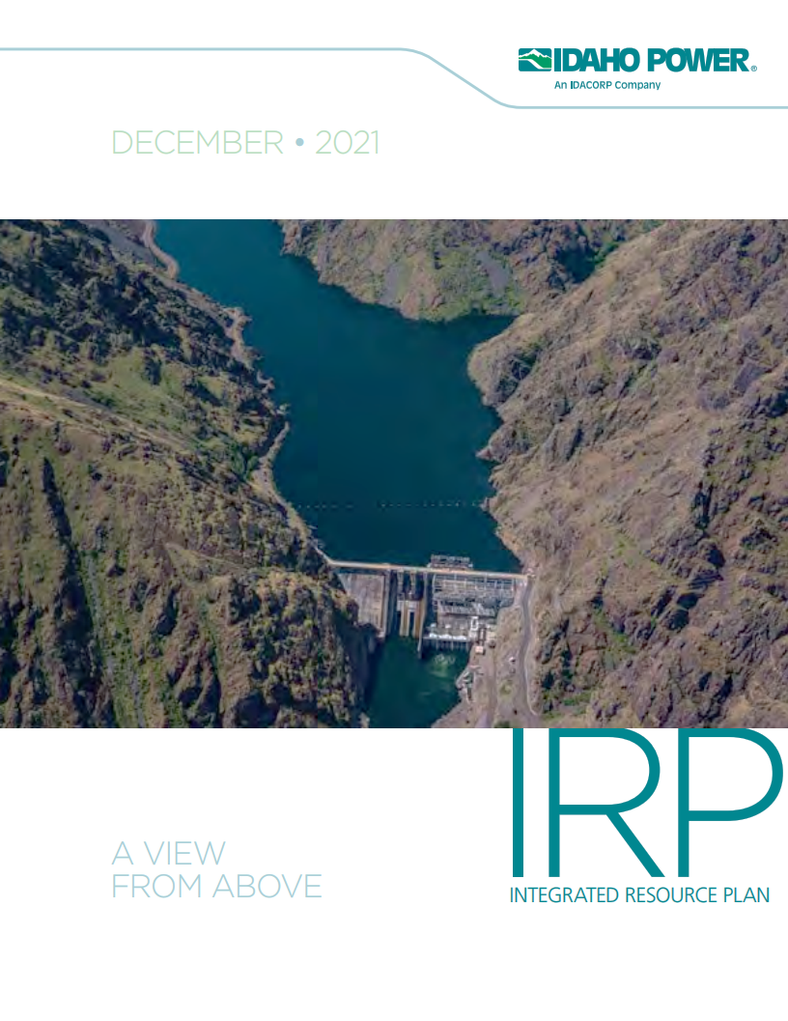




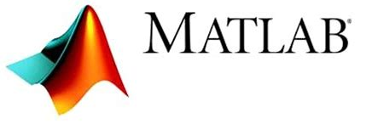


2023 IRP Introduces New Methods
Generation
ELCC
LOLE Portfolio Reliability Hurdle
Effective Load Carrying Capability
R-CAT
LOLE
LTCE
Reliability & Capacity
Assessment Tool
Loss of Load Expectation
Long-Term Capacity Expansion
PRM
L&R
Load
Planning Reserve Margin
L&R Balance
Notes:
Not just the LTCE. We calibrate the model with our reliability tool and then ensure the selected resources are sufficient

Slide 31
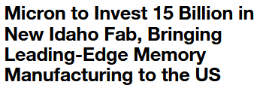

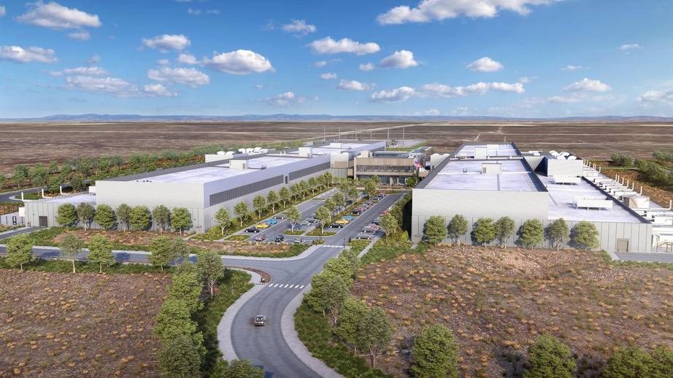
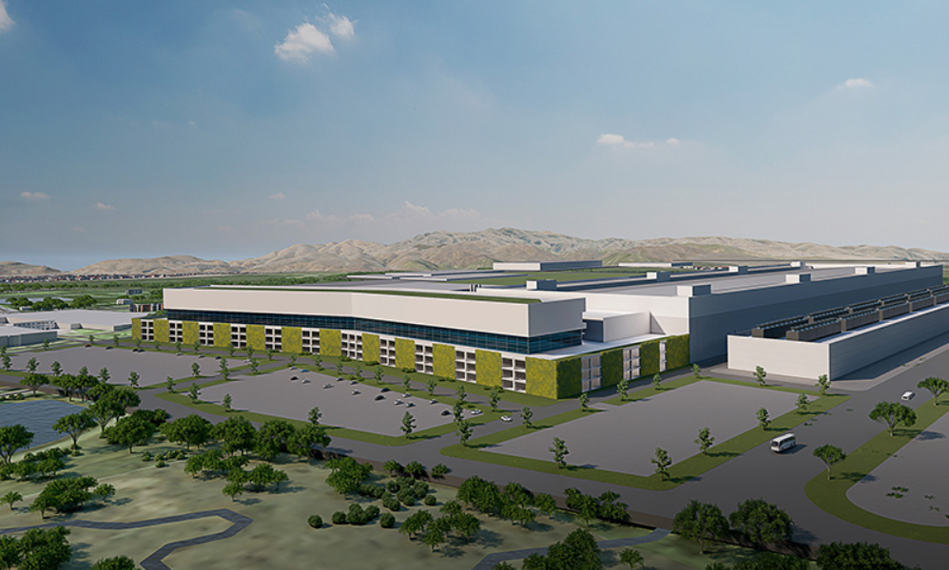
New Future Demand

Slide 32





Shifting Economic Resources
6
Notes:
Outside Resources: Gas vs WECC resources are reflective of the direction the industry is going

Slide 33

The Preferred Portfolio
TOTAL -834 961 0 1,800 1,925 808 0 0 30 40 199
Peak Demand: 3,751 MW (2021) – ~4,847 MW (2033 estimate)

Slide 34

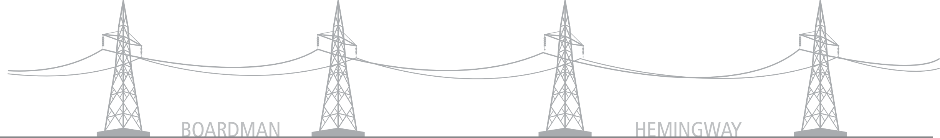
Boardman to Hemingway
A Clean-Energy Pipeline
Seattle
WASHINGTON
Olympia
Portland
Salem
OREGON
Boise
IDAHO
Notes:
One specific transmission project in our area that is key to Idaho Power’s clean energy future is the Boardman to Hemingway transmission line.
B2H will increase connectivity with surrounding regions.
A more connected grid will move energy from intermittent sources (wind and solar) to customers who need it, when they need it.
Today, few connections tie together regions like the Pacific Northwest, Mountain West and Southwest.
Projects like B2H and Gateway West (GWW) will help empower a future with cleaner, more resilient energy.
B2H and other transmission projects will make energy supply more reliable and affordable.
Idaho Power, PacifiCorp and BPA will use the line to buy affordable, clean energy from dozens of providers to meet customer needs.
B2H will deliver up to 1,000 MW of power in both directions.
This connection improves the availability of energy across multiple regions, make energy even more reliable.
Another transmission line project Idaho Power is working on is called Gateway West, which will go across southern Idaho and Wyoming.

Slide 35
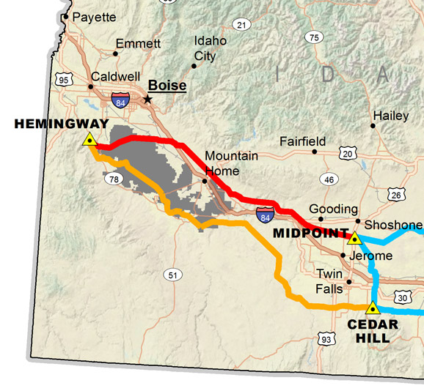
Gateway West Evaluation
Gateway West
Phase 1
Gateway West
Phase 2
6

Slide 36
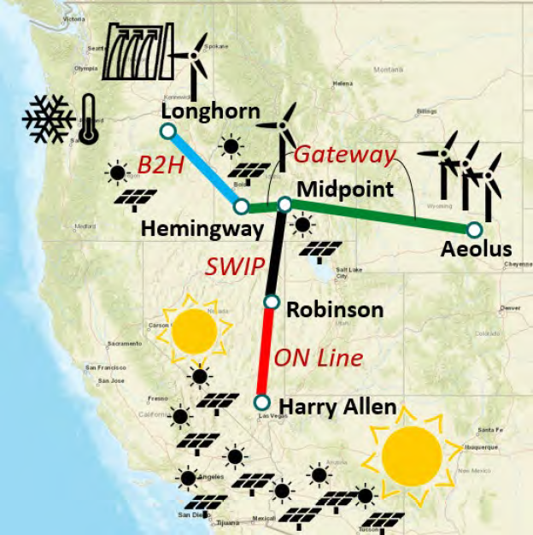
Interregional Connectivity
Interregional Connectivity
Geographical Diversity
  Demand Diversity
  Resource Diversity
Partnerships to Meet Clean Energy Goals

Slide 37
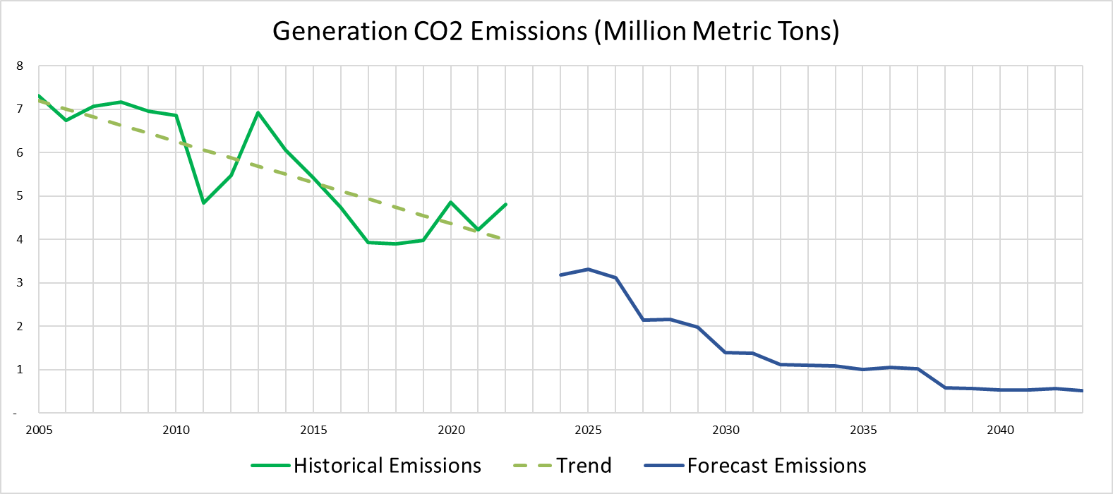
Forecast Carbon Emissions
8

Slide 38
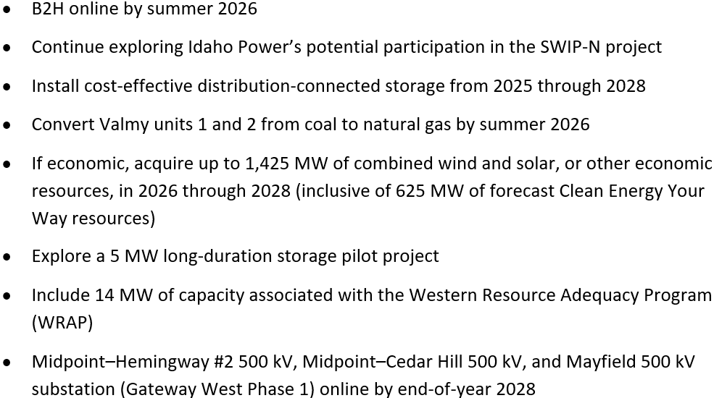
2023 IRP Decisions
9

Slide 39
Rocky Mountain Power Idaho
Notes:
Choose from three different title slide designs by selecting “New Slide.” These slides are suitable for residential customer presentations.

Slide 40
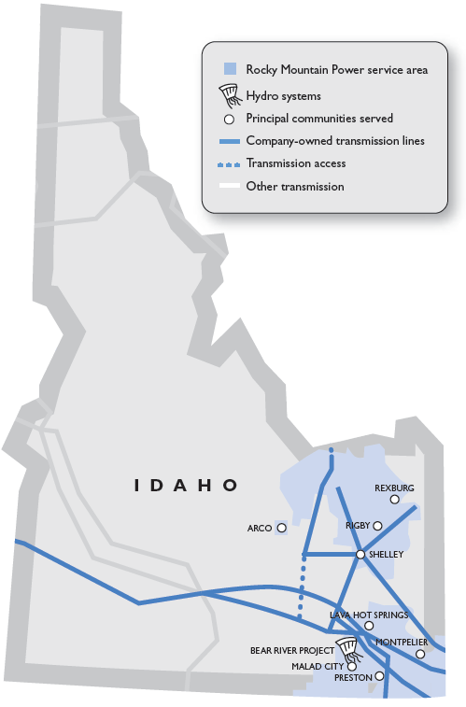
Idaho Overview
Idaho customers: 77,623
Line miles
Transmission, all states: 16,600
Distribution, all states: 64,600
Number of employees
168 Idaho employees with payroll of $16.9 million
Idaho grants and charitable donations in 2022
Corporate: $70,050
Rocky Mountain Power Foundation: $136,030
Notes:
This is intended as an agenda slide template. Choose from different slide layouts by selecting “New Slide”

Slide 41
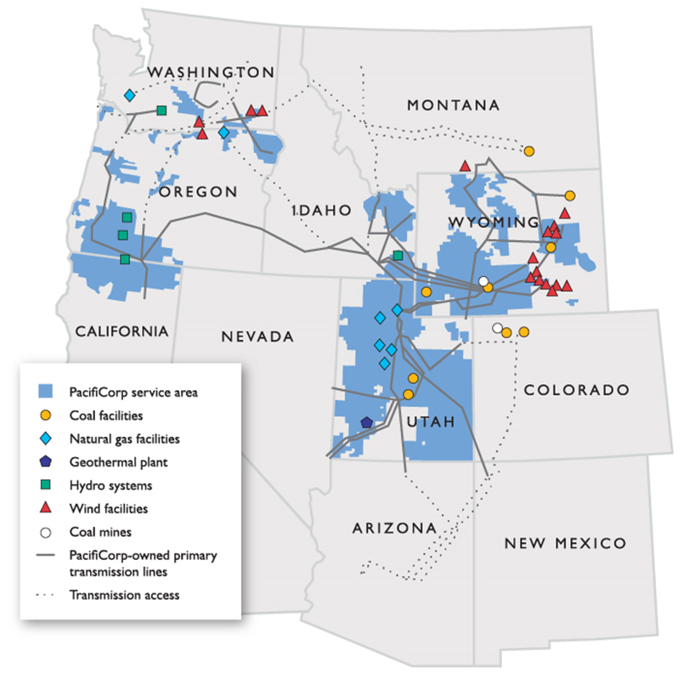
PacifiCorp Overview
Two divisions – Rocky Mountain Power and Pacific Power
Approximately 4,800 Employees
2 million electricity customers
141,000 square miles of service territory in six states
17,457 miles of transmission
Generating capacity by fuel type
10,887 MW owned generation capacity
  Coal 44%
  Natural Gas 25%
  Hydro 12%
  Wind, geothermal and other 19%

Slide 42
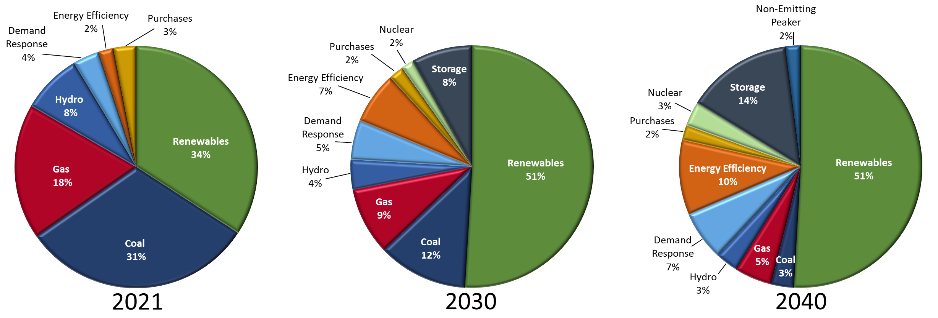
PacifiCorp’s Projected Energy Mix
Note: PacifiCorp system resource mix
The 2021 system resource mix is based on its 2021 Integrated Resource Plan data. The “system resource mix” is intended to demonstrate how PacifiCorp’s system energy and nameplate capacity mix is projected to change over time. In developing these figures, purchased power is reported in identifiable resource categories where possible.
Notes:
From an overall energy supply perspective, today a sizeable portion of our energy is supplied by coal. Based on one view of the future extracted by our Integrated Resource Plan, you can see that the portion of coal based energy is expected to decline with a sizeable increase in forecasted gas based generation and Demand Side Management. Like many utilities we have plans to shut down a few of our coal units.

Slide 43
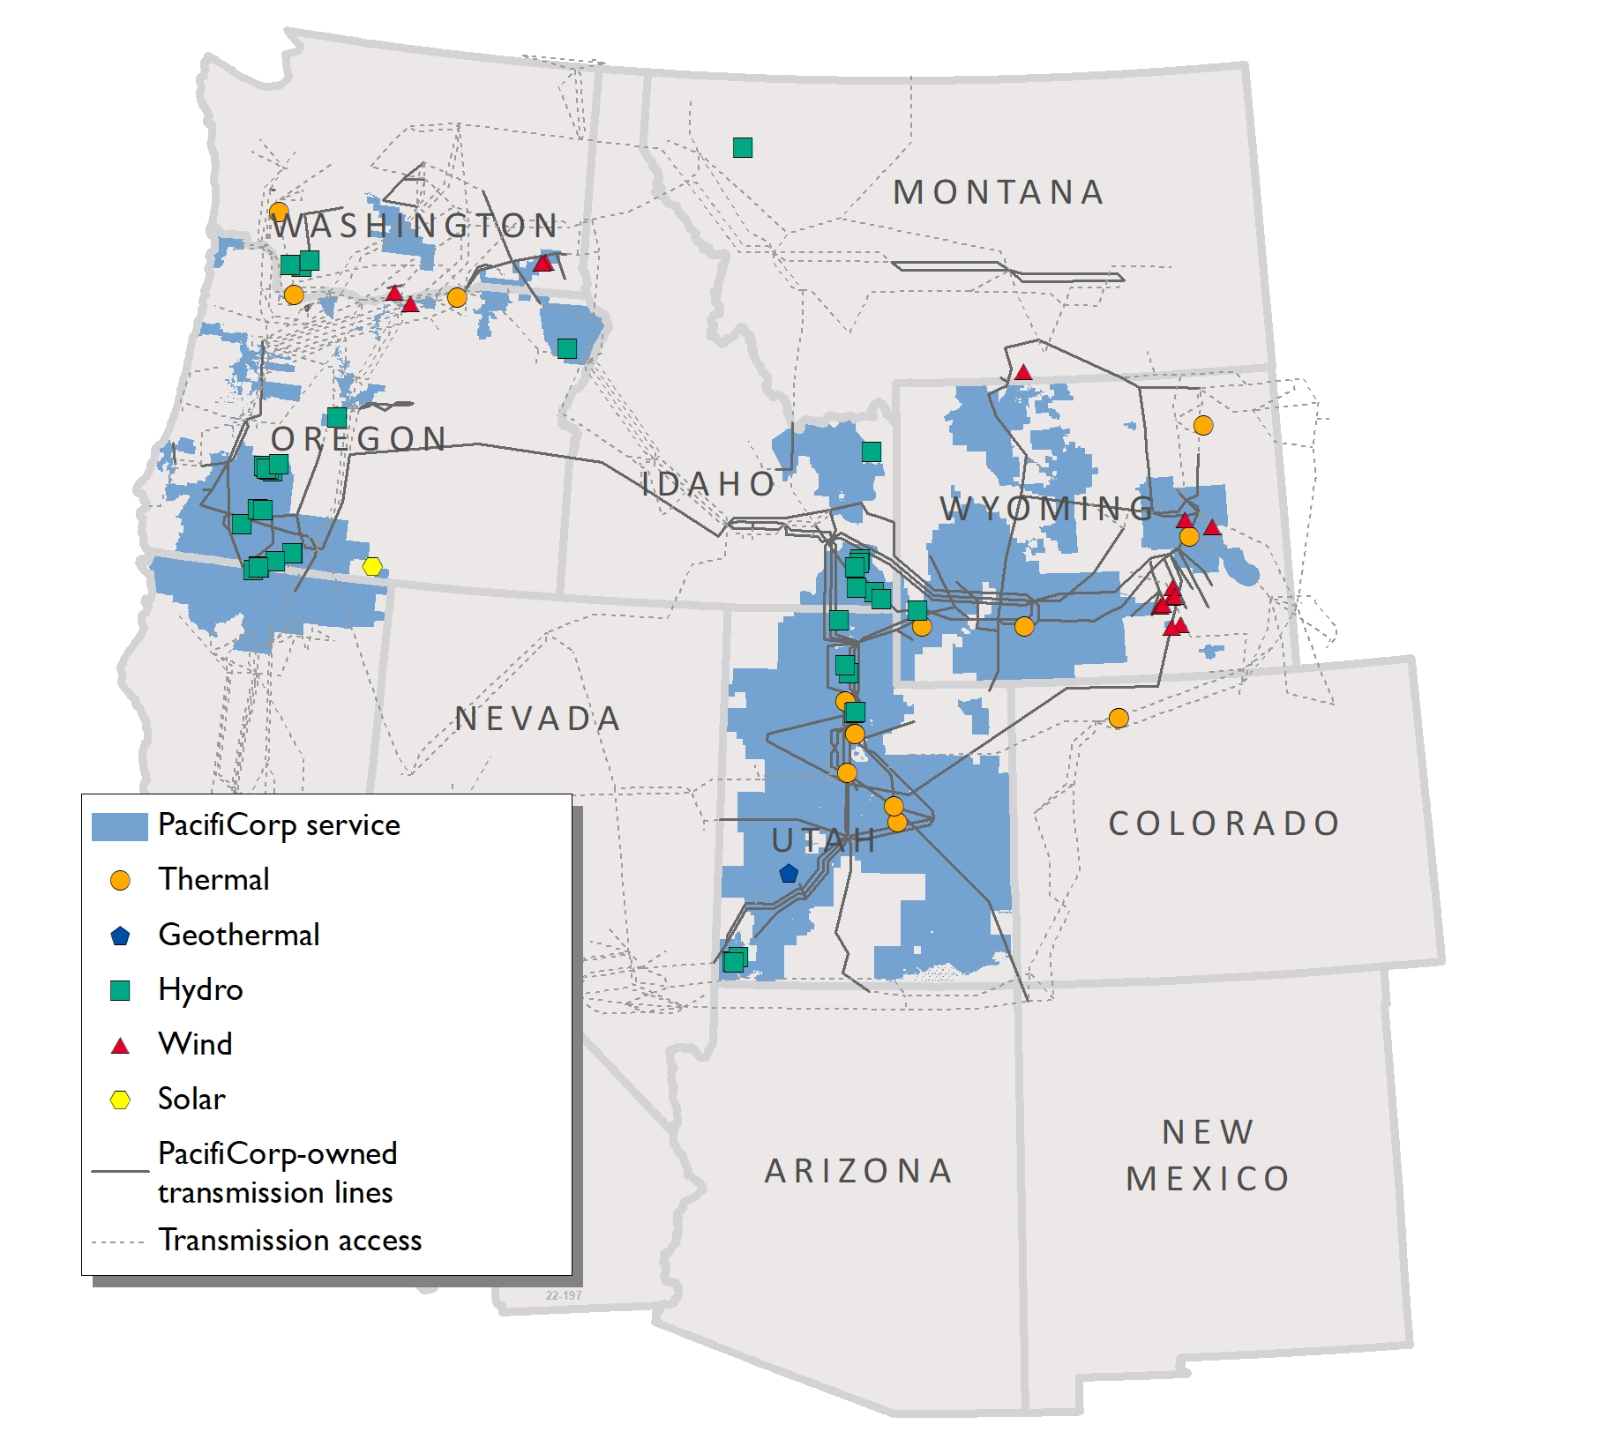
Interconnected Transmission System
Notes:
Transmission

Slide 44
Protecting Reliable, Affordable, & Resilient Power in Idaho
2023 Idaho Legislative
Energy Summit
November 30, 2023

Slide 45
Western Power Pool
Idaho State Legislature Energy Summit
Sarah Edmonds, Western Power Pool President & CEO
November 30, 2023

Slide 46

Western Power pool (WPP) – Fast Facts
Over 80 Years of Operations/ 501(c)(6)
As of Feb 2023, Independent Board (5)
WPP d/b/a in Feb 2022 (from NWPP)
New CEO in April 2022
Approx 22+ Employees

Slide 47
WPP Grid Integration and Coordination Services
Contingency Reserve/
Frequency Response
Sharing
Grid Operator Training
Transmission Planning/Analysis (NorthernGrid)
Hydro Modeling
Western Resource Adequacy Program (WRAP)*
*FERC-Jurisdictional Service

Slide 48
Western Resource Adequacy Program (WRAP) – Basics

Slide 49
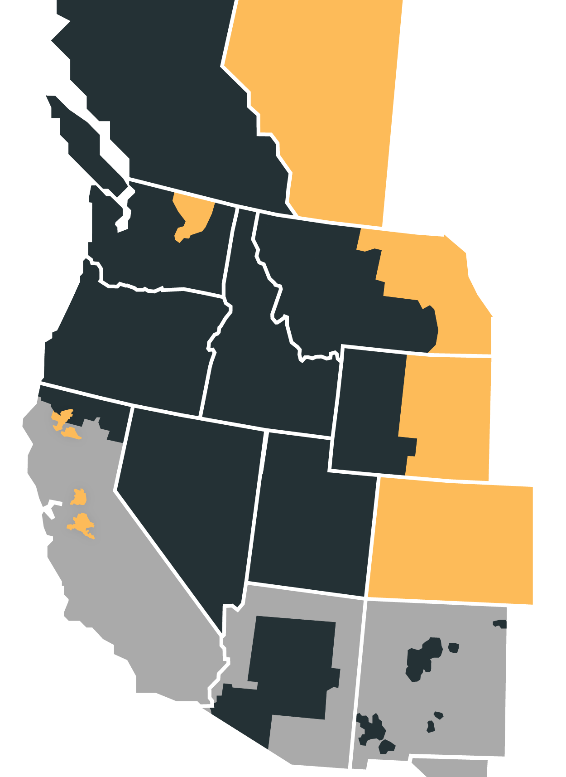
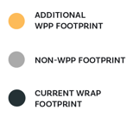
Current Load-Serving Entity Participants
Arizona Public Service
Avista
Bonneville Power Administration
Calpine
Chelan County PUD
Clatskanie PUD
Eugene Water & Electric Board
Grant PUD
Idaho Power
Northwestern Energy
NV Energy
PacifiCorp
Portland General Electric
Powerex
Public Service Company of New Mexico
Puget Sound Energy
Salt River Project
Seattle City Light
Shell Energy
Snohomish PUD
Tacoma Power
The Energy Authority
Headlines!
Recently approved FERC Tariff
New, fully independent WPP Board of Directors
Currently working to identify first binding season – between 2026 to 2028

Slide 50
WRAP VALUE PROPOSITION
  Binding forward showing requires Participants to show they have secured their share of the regional capacity need for the upcoming season using common planning and capacity accreditation metrics
  Binding operational program obligates Participants with surplus to assist Participants with a deficit in the hours of highest need using bilateral trading mechanisms
    It is the Operations program, together with modeled supply and load diversity, that enables us to safely lower the requirements in the forward showing and help inform resource selection by participants and regulators, driving investment savings for participants and their customers

Slide 51
WRAP Design Overview
Forward Showing (“FS”) Program (7 Mos Prior to Winter/Summer)
Determine Program Capacity Requirement
Determine Resource Capacity Contribution
Compliance Review of Portfolio
Operations Program (7 Days to Day-Ahead)
FS Expectation
Operational Reality
Sharing Requirement
Notes:
Establishes a regional reliability metric (1 event-day in 10 years LOLE)
Planning reserve margin (PRM) is applied to average peak load forecast
Participants use Qualifying Capacity Contribution (QCC) counting rules
Participant compliance obligation: FS applies to Two Seasons
Winter Season: November – March 15
Summer Season: June – September 15
Participant must show firm (or conditional firm) transmission rights to deliver at least 75% of their total Capacity Requirement from qualifying resources to load
Participant notified of any deficiencies 60 days after submission deadline
Participant must cure deficiencies within 60 days to avoid deficiency charge
The “Ops Program” evaluates Participants’ operational reality compared to FS expectations (for load, outages, VER performance) 7 days to Preschedule Day to determine Sharing Requirement
Participants with calculated “surplus” on Preschedule Day have a capacity Holdback Requirement which can be called on by “deficit” Participants to receive an Energy Deployment at the Total Settlement Price
Total Settlement Price (based on CAISO price for maximum import bids)
A market-based rate using average day-ahead price indexes with multipliers
Advisory sharing calculation beginning 7 days prior to operating day
Obligation is allocated pro-rata to surplus Participants
Operations Program charges also designed to encourage deficient Participants to resolve deficiencies outside of Program
calculated using same methodology as FERC approved for CAISO Order 831 Maximum Import Bid Limit
Same DA SMEC-based shaping factor
Same 110% multiplier
Uses DA HeavyLoad/Light-Load ICE indices specified in manual, e.g., Mid-C (for northern part of region); Palo Verde for southern part of region.
Total Settlement Price split into two pieces so that Participant receives at least 20% of the Total Settlement Price as compensation for its Holdback Requirement; Balance is compensation for energy delivered
Total Settlement Price is based on Holdback Requirement quantity, credit provided to extent Participant declines part of Holdback and takes less energy on OD
Surplus Participant also receives Make-Whole payment, for lost opportunity to make DA energy sales caused by Holdback Requirement
Reduction in ability to make standard time-block sales, using same DA HL/LL index as Total Settlement Price;
Offset by presumed ability to make RT sales at specified RT index price
Make-whole only applies to extent above Total Settlement Price
Price design is based on approaches the Commission has previously found adequately mitigate market power, i.e., reliance on competitive price indices and recognition of legitimate opportunity costs
Energy Deployment Price = avg Mid-C and PV x hourly shaping factor x 110% (similar to CAISO max import bid price design)
Make Whole Adjustment = Day-ahead price for block energy commensurate with the Holdback Obligation size
Failure to Deploy- 5,10,20 if the deficit is covered and 25,50 if not if the program is unable to backfill the deficit

Slide 52
Other Developments- Regional Transmission

Slide 53
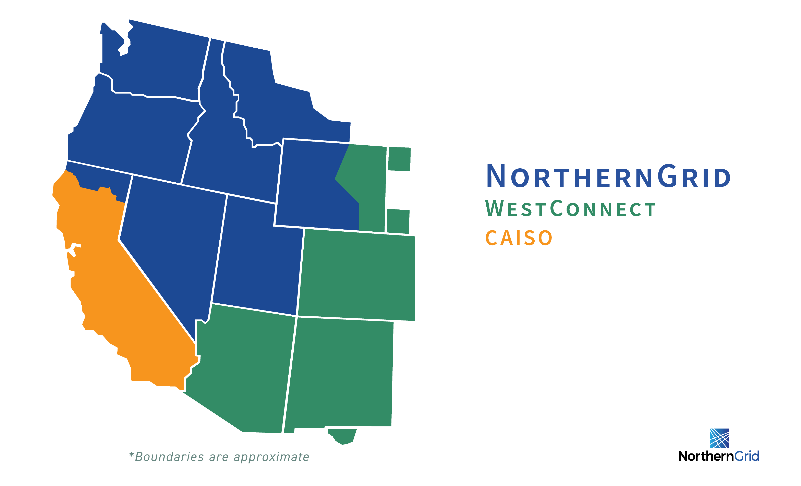
WPP is facilitating conceptual conversations about a new kind of regional planning effort called Western Transmission Expansion Coalition (WTEC).
WTEC aims to be:
» Different
» Expedient
» Inclusive in order to arrive at actionable regional transmission studies
Notes:
A proposal for WTEC was posted to the WPP website in October for comment by stakeholders.
WPP is reviewing comments with stakeholders and expects to release updated information about next steps in late November.

Slide 54
BREAK

Slide 55
Idaho’s Energy Future
2023 Idaho Legislative
Energy Summit
November 30, 2023

Slide 56
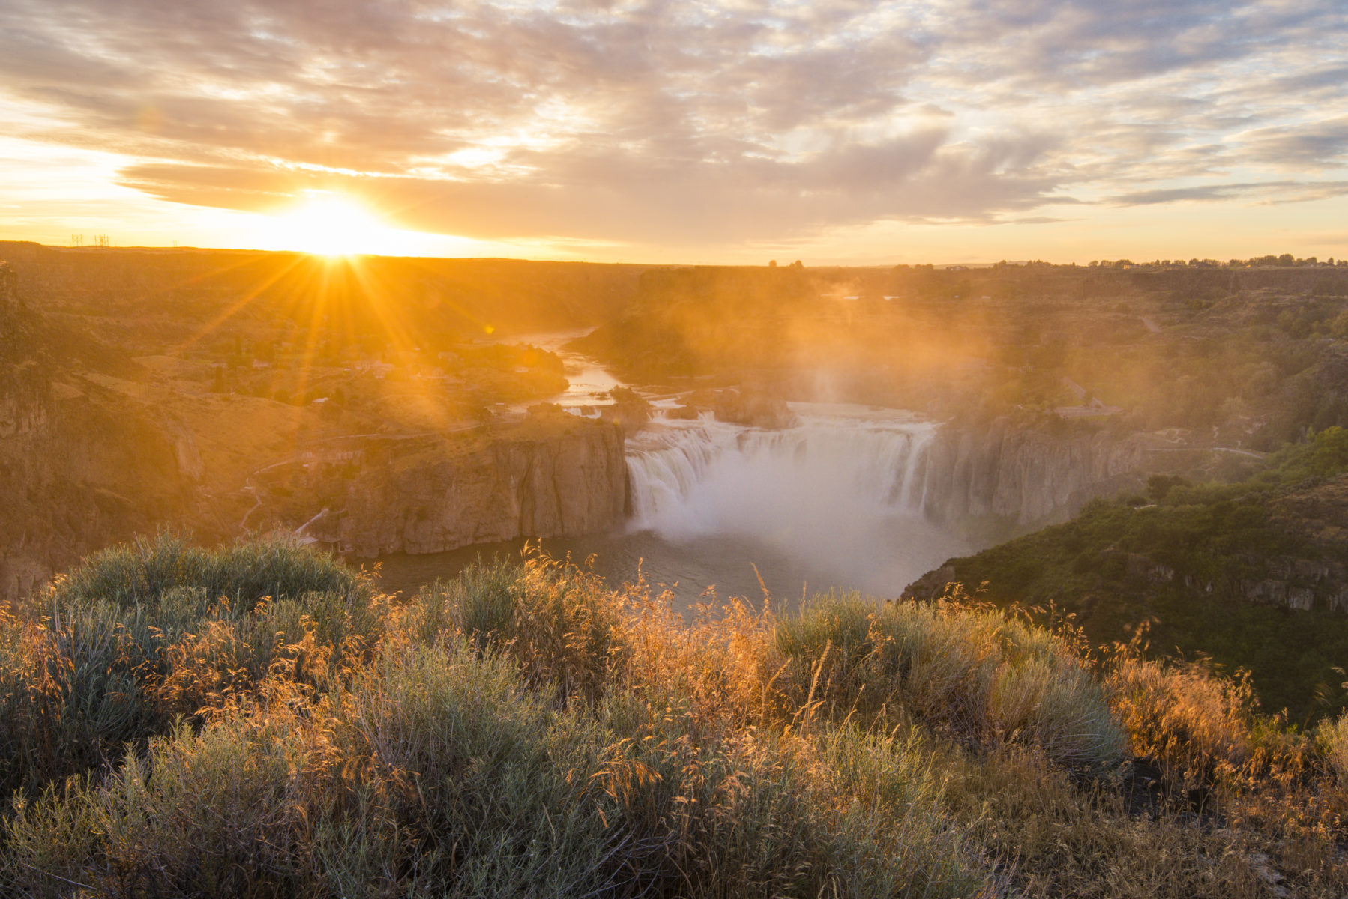
IDAHO
COMMERCE
2023 Idaho Legislative Energy Summit: Idaho's Energy Future
Tom Kealey
Director of Idaho Commerce
November 30, 2023

Slide 57
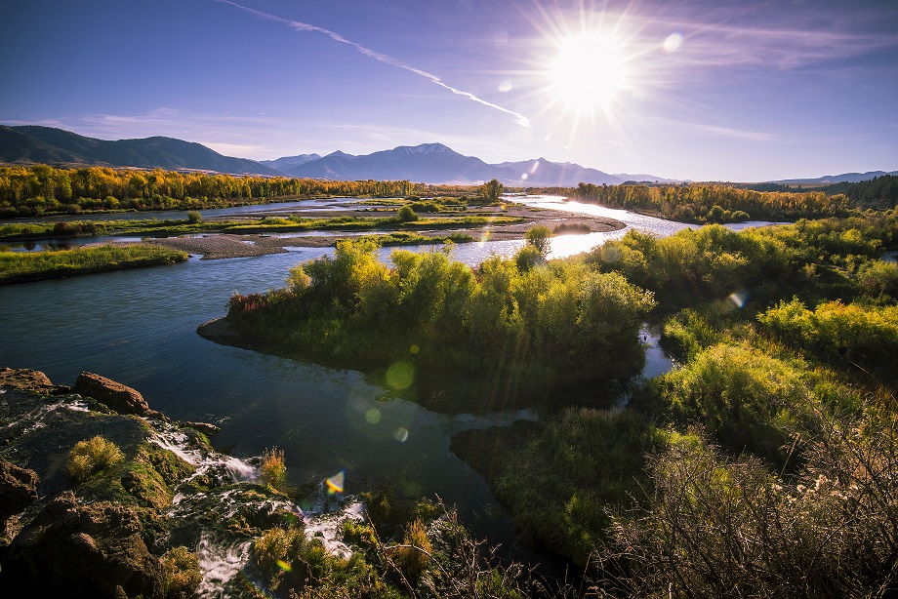


WHAT WE DO
Business Retention & Expansion
Business Attraction
Community Development
Idaho Tourism
Innovation
Semiconductors
Energy
Precision Agriculture
Cybersecurity
International Trade
Broadband & Rural Idaho

Slide 58
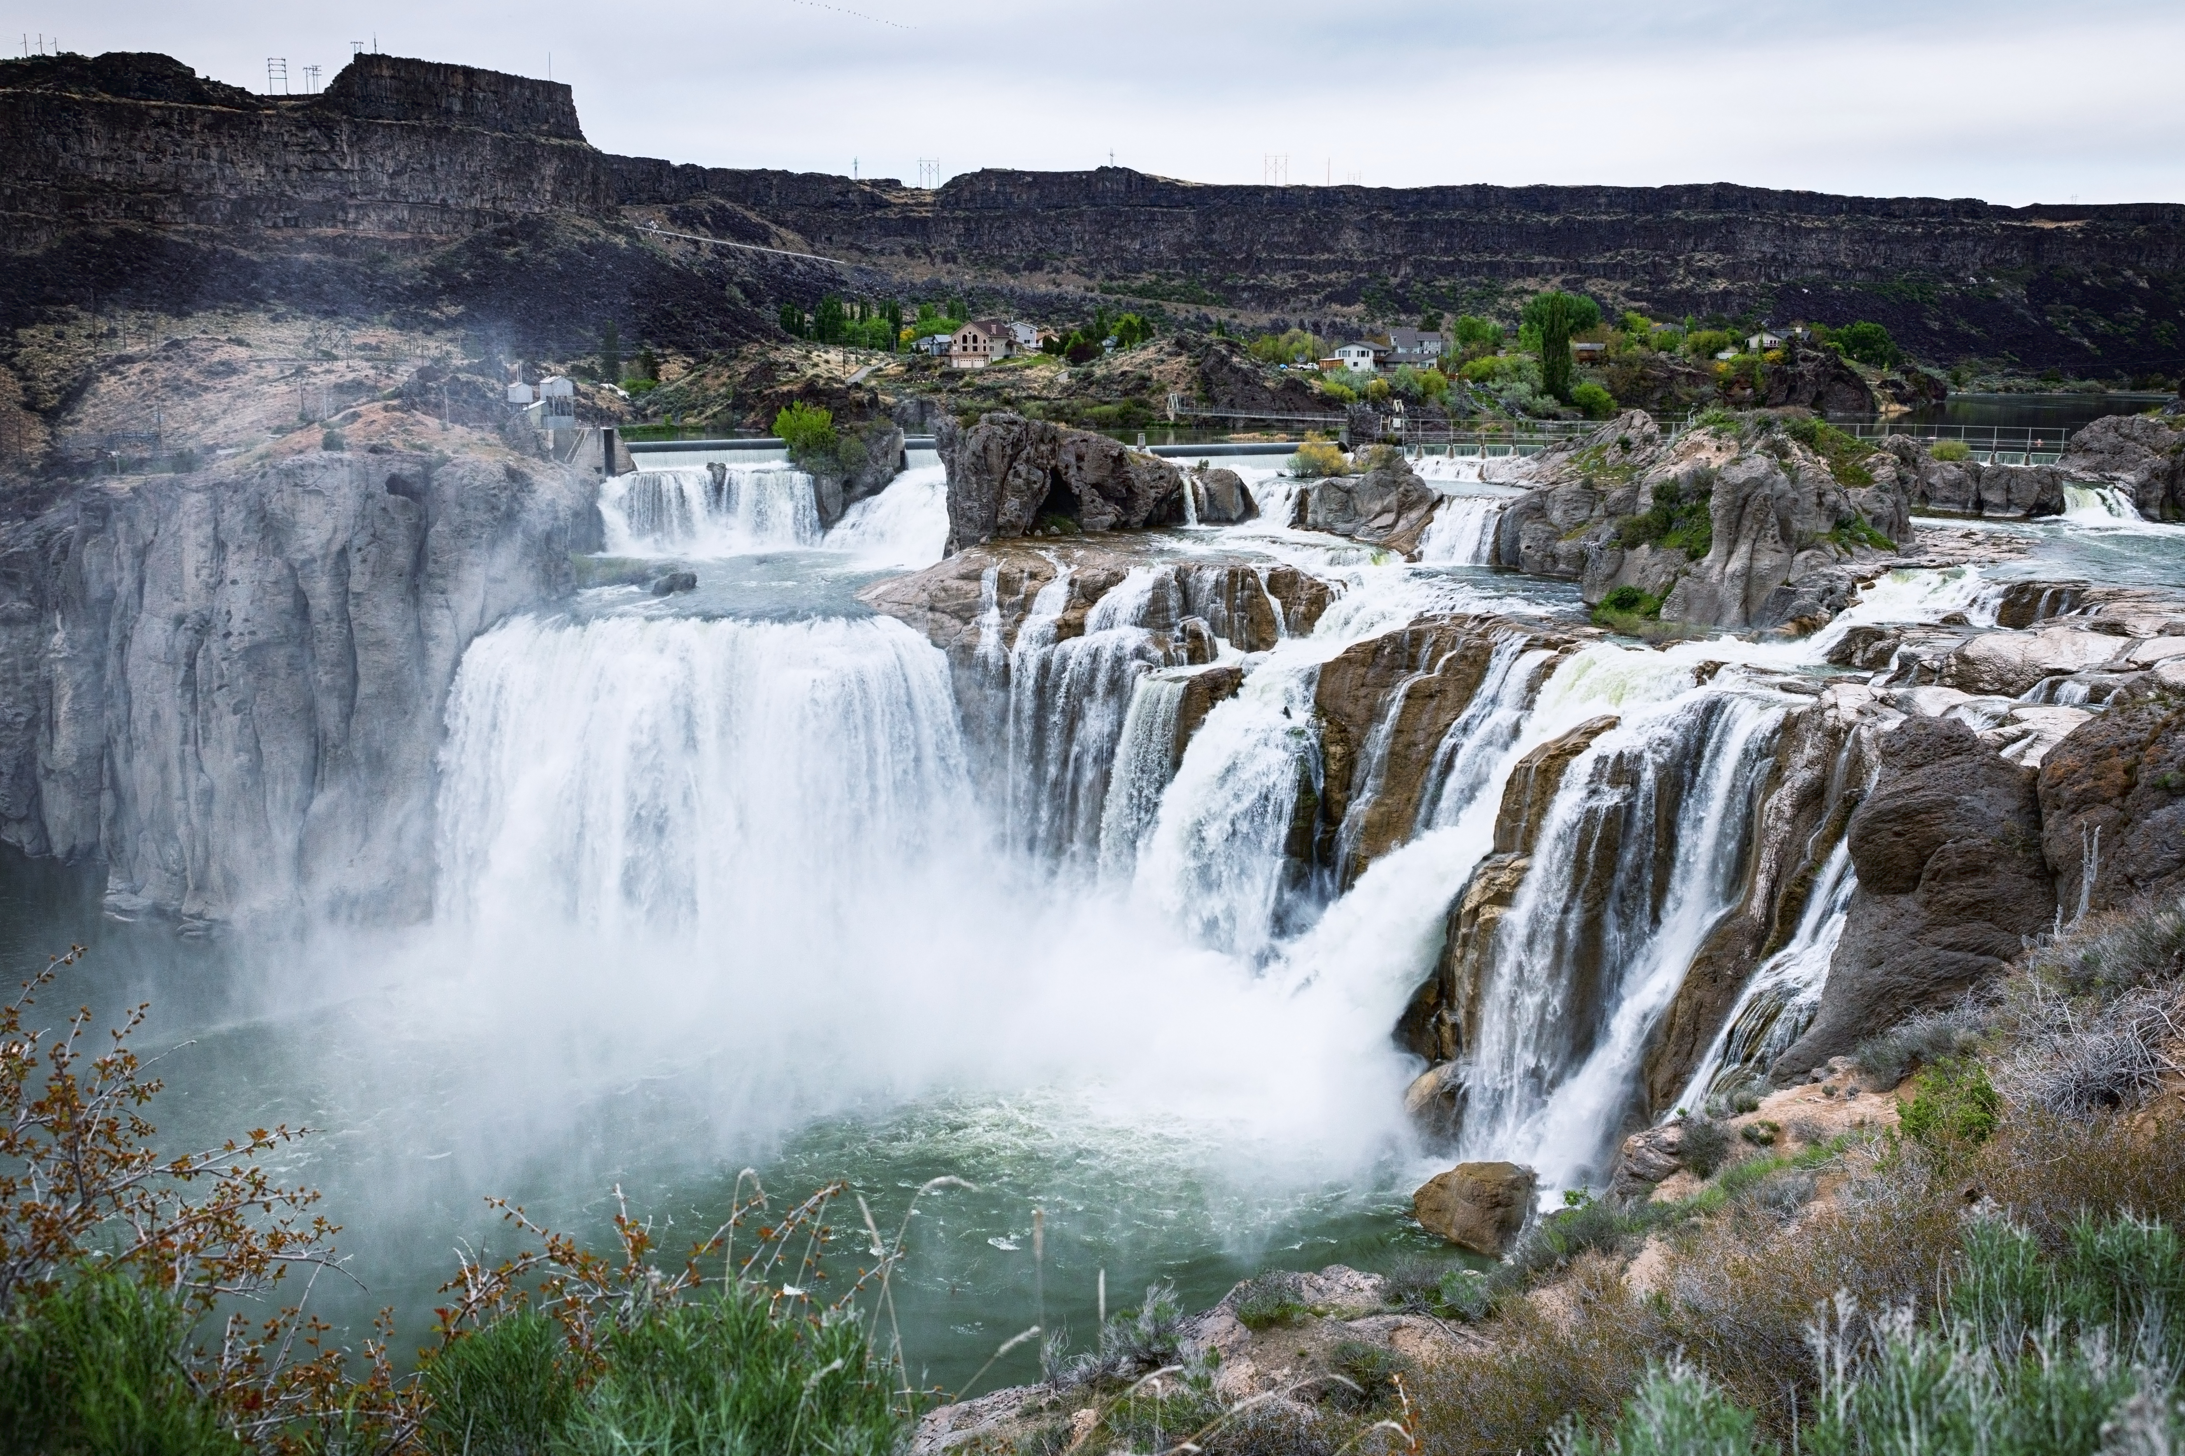
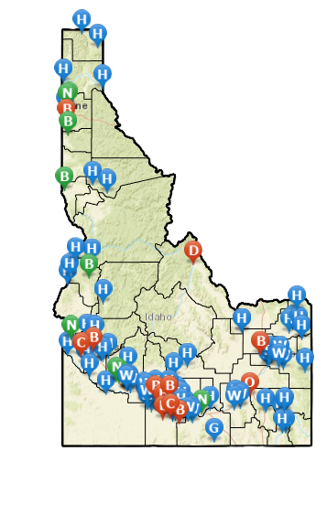
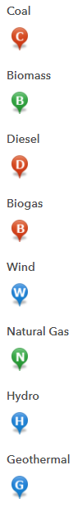
POWER
GENERATION MAP
Source: Office of Energy and Mineral Resources

Slide 59


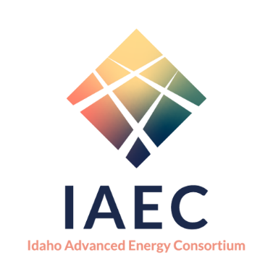

LEADING NUCLEAR AND CLEAN ENERGY
Governor leadership
Established in 2012
Enhances mission of INL and nuclear industries
Comprised of 27 members
Regulatory-friendly environment
No prohibition on nuclear energy (1982)
Tax exemption for SMR R&D (2018)
“Clean energy” additions (2023)
Policy i.e. IAEC, etc.
Governor leadership
Established in 2012
Enhances mission of INL and nuclear industries
Comprised of 27 members
Identify, plan, and act to address:
  supply chain
  Workforce
  Community,
  Infrastructure
  Security
Centers on nuclear and clean energy
Business-friendly environment
Economic development
Supply chain
Workforce
Property tax incentives
EDA Grant – IAEC

Slide 60
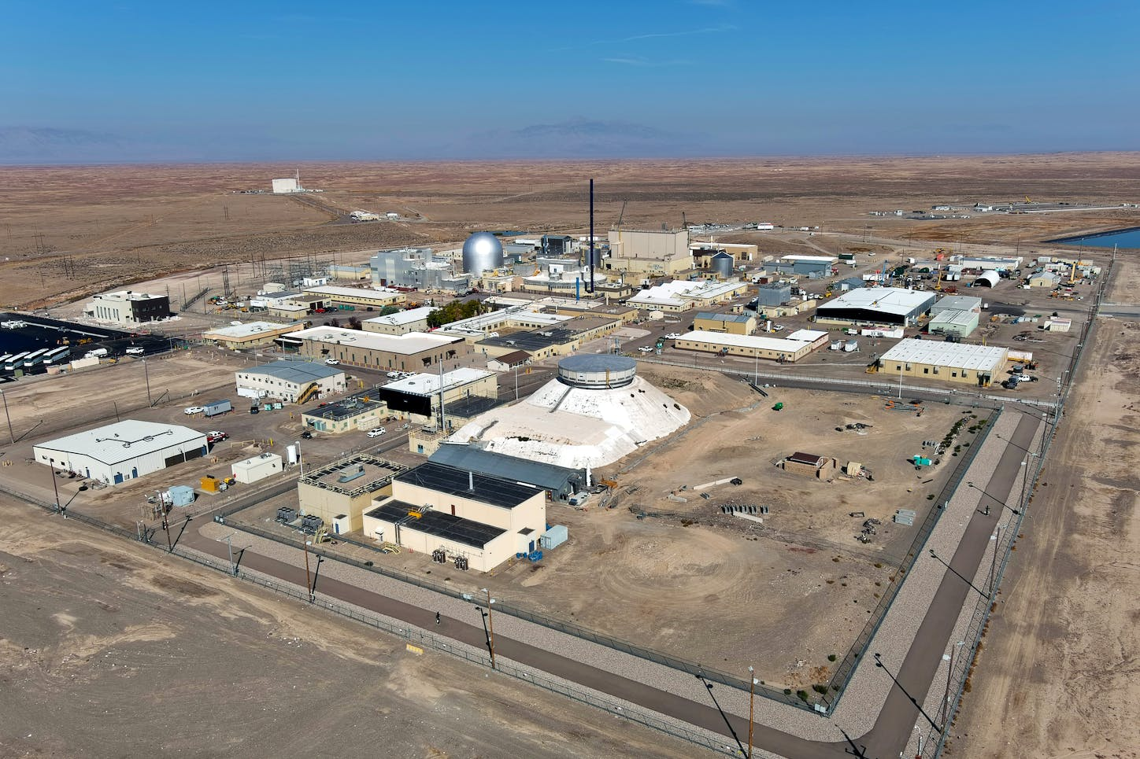


LEADING NUCLEAR AND CLEAN ENERGY
$3.38 billion of total impact in Idaho
$241 million spent with Idaho businesses
11,000 Idaho jobs dependent on INL
  5,184 INL employees living in Idaho
INL is Idaho’s sixth largest public and private employer
Focuses: Microreactors, advanced nuclear reactors, clean energy, cybersecurity and more
Source: Idaho National Laboratory 2022 Fiscal Year Report

Slide 61
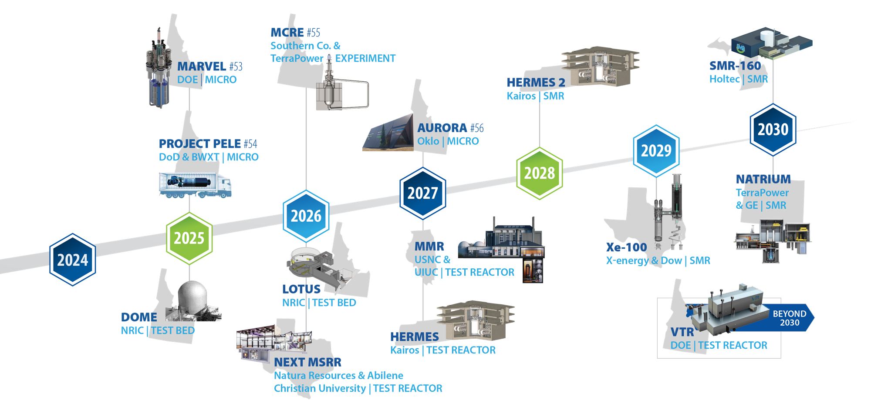
Source: Idaho National Laboratory

Slide 62
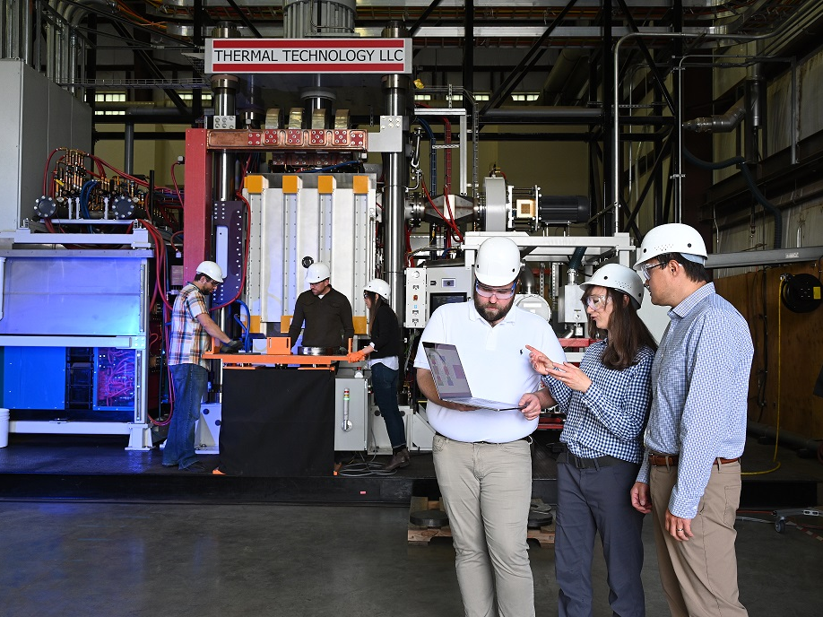
IDAHO ADVANCED ENERGY CONSORTIUM ANNUAL REPORT
Between 2020 to 2029, the total combined cost of advanced energy projects will exceed $3 billion.
Contribute $224 million to Idaho’s gross state product in FY2024 alone and $367 million by 2026.
Produce $148 million in new wages, salaries, benefits, and payroll taxes in 2024.
Create over 2,500 jobs in 2024, and over 4,600 jobs by 2026.
Project managers expect over 80% of construction work and related equipment orders will be sourced from Idaho-based businesses.
The total value of economic output from the projects is expected to reach $500 million in 2024 and nearly $815 million by 2026.
Source: Idaho Advanced Energy Consortium Annual Report

Slide 63

TEAM IDAHO
Idaho has a robust network across the state to assist based on clients’ needs
Idaho’s boots on the ground include 44 economic development professionals
Governor Little’s Rapid Response Team

Slide 64

INCENTIVES
Idaho Tax Reimbursement Incentive (TRI)
A reimbursable performance-based tax credit for companies seeking to expand or relocate to Idaho by adding new, qualifying jobs.
Business Advantage
Businesses that invest a minimum of $500,000 and create10 jobs may be eligible for a variety of incentives.
Opportunity Fund
The Opportunity Fund is a deal closing fund for
qualifying projects at the discretion of the Director.
Workforce Training and Idaho LAUNCH
The state offers a variety of resources needed to train your workforce, including a reimbursement of up to $3,000 per employee.
The state also recently released Idaho LAUNCH which will provide
The state offers a variety of resources needed to train your workforce, including a reimbursement of up to $3,000 per employee.
The state also recently released Idaho LAUNCH which will provide Idaho high school graduates with up to $8,000 to attend any Idaho university, community college, career technical or workforce training program.

Slide 65
INCENTIVES
100% Sales Tax Exemption
Production Sales Tax Exemption - Tax exemption on equipment and raw materials used directly in manufacturing, processing, mining, fabrication or logging operations; for clean rooms and semiconductor equipment manufacturing; and for equipment or material used in research activities. Processing materials, substances, or commodities for use as fuel for the production of energy are also exempt.
Utility and Industrial Fuels Sales Tax Exemption – Tax exemption on utilities and industrial fuels such as power, water, natural gas and telephone.
Cap on Property Tax
Businesses that invest a minimum of $1 billion in capital improvements, in a county, will receive a county property tax exemption on all property in excess of $400 million in value per year.

Slide 66

IDAHO TECHNOLOGY HUBS
The Economic Development Administration (EDA) designated 31 Tech Hubs – Idaho is a part of two – nuclear and aerospace.
The Intermountain West Nuclear Energy Corridor (INEC), has been awarded a $500,000 grant.
  Assist in preparing an application package for a larger award designed to further the nation’s deployment of advanced nuclear technology.
  Enables the IAEC to facilitate necessary studies, preliminary work, and collaboration across the Intermountain West to prepare for the Phase 2 EDA Tech Hub Application process.
  INEC could be awarded up to $75 million to carry out the mission of the INEC Tech Hub and jump start the nation’s global competitiveness in advanced reactor deployment in the next decade.
  The INEC is the only nuclear focused Tech Hub to receive the Development Grant.
The American Aerospace Materials Manufacturing Center (AAMMC) project in the Spokane-Coeur d’Alene region also received a Tech Hub designation.

Slide 67







CONTACT US
commerce.idaho.gov
linkup.Idaho.gov
Idaho Commerce
@idahoCommerce
Tom Kealey
Director
info@commerce.Idaho.gov
Idaho Commerce

Slide 68


IDAHO’S ENERGY FUTURE
Lori Blattner
Director, Regulatory Affairs
Intermountain Gas Company & Cascade Natural Gas Corp.

Slide 69


INTERMOUNTAIN GAS COMPANY
Natural Gas Local Distribution Company
Founded in 1950
Served its first customer in 1956
Subsidiary of MDU Resources Group since 2008

Slide 70


74 Communities Served
Over 410,000 Customers
INTERMOUNTAIN GAS COMPANY

Slide 71
THROUGHPUT BY CUSTOMER CLASS

Slide 72


Natural Gas Sources

Slide 73

What is Renewable Natural Gas?
Produced from organic materials such as manure and other ag residue
As these materials decompose, they produce methane
Capture the methane and condition it to pipeline quality

Slide 74
RNG Facilitation Plan
Idaho is the #3 milk producing state
RNG is valuable in states that have aggressive decarbonization goals
To help facilitate RNG growth, we worked with the IPUC to develop a plan
Insulates traditional customers from risk
Allows RNG developers access to interstate markets

Slide 75




Investment in Idaho
Shell has committed over $200 million in RNG projects in the Magic Valley.
Friesian
  Bovarius is the 2nd dairy-to-RNG project in Shell’s portfolio.
  As of November 2023, Bovarius has over 390,000 safe work hours.
  Friesian is the 3rd dairy-to-RNG project in Shell’s portfolio.
  As of November 2023, Friesian has delivered over 135,000 safe work hours

Slide 76

Questions?

Slide 77
November 30, 2023
Todd E. Combs, Ph.D.
Associate Laboratory Director
Energy and Environment S&T
Brief discussion on Idaho National Laboratory work
presented at the
2023 Idaho Legislative Energy Summit

Slide 78
Accelerating advanced reactor demonstration & deployment
Notes:
22-GA50114-R68*
Criteria for timeline inclusion: Reactors that can meet any 3 of the following 4 criteria should be included on the timeline
• The company is part of a cost sharing government award with a reactor as the direct outcome of that cost share project
• There is an identified and concurred on site (note necessarily a site permit or agreement, but a clearly identified site that both the company and the site location acknowledge as the site)
• There is an NRC regulatory engagement plan or similarly robust level of pre-licensing engagement with the NRC (minimum is the formal submission of something)
• INL engagement of some sort or an agreement with another National Lab
Notes:
Inclusion in the timeline is limited to reactors to be sited in the United States
Timeline dates are those publicly identified by the individual companies
MARVEL – 100 kWth, 20kWe
Pele – 5 MWth, 1 MWe
Aurora – 4 MWth, 1.5 Mwe (but Oklo may be re-branding to their larger version)
MCRE – 150 kWth (not generating energy)Xe-100 – each module 80 Mwe (can be scaled to a ‘four-pack’ up to 320 MWe)
VOYGR – each module 77 Mwe (up to 12 modules, so up to 924 MWe)
SMR-160 – 525 MWth, 160 MWe
Natrium – 840 MWth, 345 Mwe (variable output (up to 500 Mwe short-term with molten salt storage)

Slide 79

Energy Technology Proving Ground

Slide 80


Electric Vehicles & the Grid
Program Overview
Developing technology to integrate EV charging and hydrogen fueling into the broader energy system.
Our research includes data collection, modeling and simulation, cybersecurity, and real-world demonstrations.
Example Projects
  Caldera: a tool for evaluating EV charging impact on the electric grid
  Cybersecurity: EV charging as critical infrastructure must be secure to protect transportation and the grid
  Studying in-road wireless charging could remove the need for large, bulky batteries.
Notes:
Partnerships for Technical Collaboration with Rocky Mountain Power, Valley Regional Transit, Mountain Rides and Republic Services.”
We have research projects with Rocky Mountain Power to understand and improve grid impacts of EV charging
Valley Regional Transit is the transit agency for Ada & Canyon counties. Mountain Rides provides mobility services for Sun Valley. Republic Services is a waste management company operating refuse trucks in Boise. All are looking to electrify their fleets. We are collaborating in various ways -- helping them write proposals, collect data, and performing analysis and modeling for them.

Slide 82
Questions?

