Slide 1
Creating Complex Habitat in Simplified Streams
Governor’s Salmon Workgroup
July 30-31, 2019 Salmon, Idaho
Jim Gregory, Lost River Fish Ecology

Slide 2
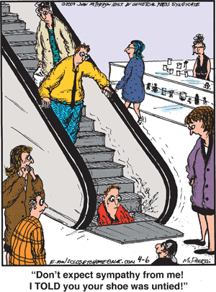

Slide 3
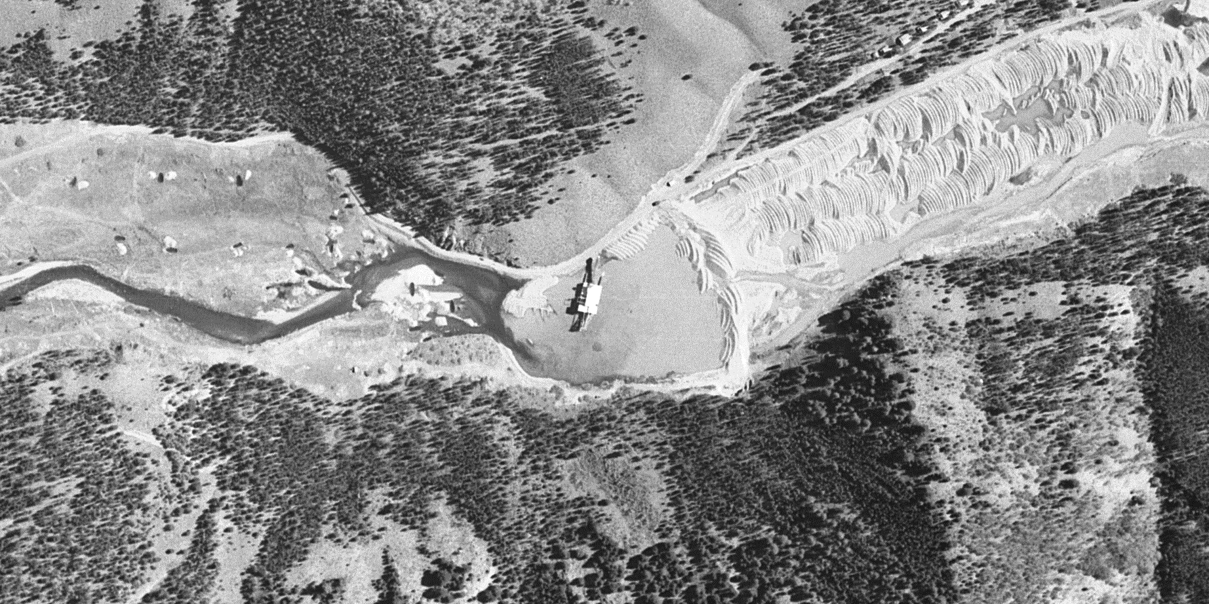
Yankee Fork
Dredge Mining: 1945 Aerial View
Dredge
After Dredging
Prior to Dredging

Slide 4
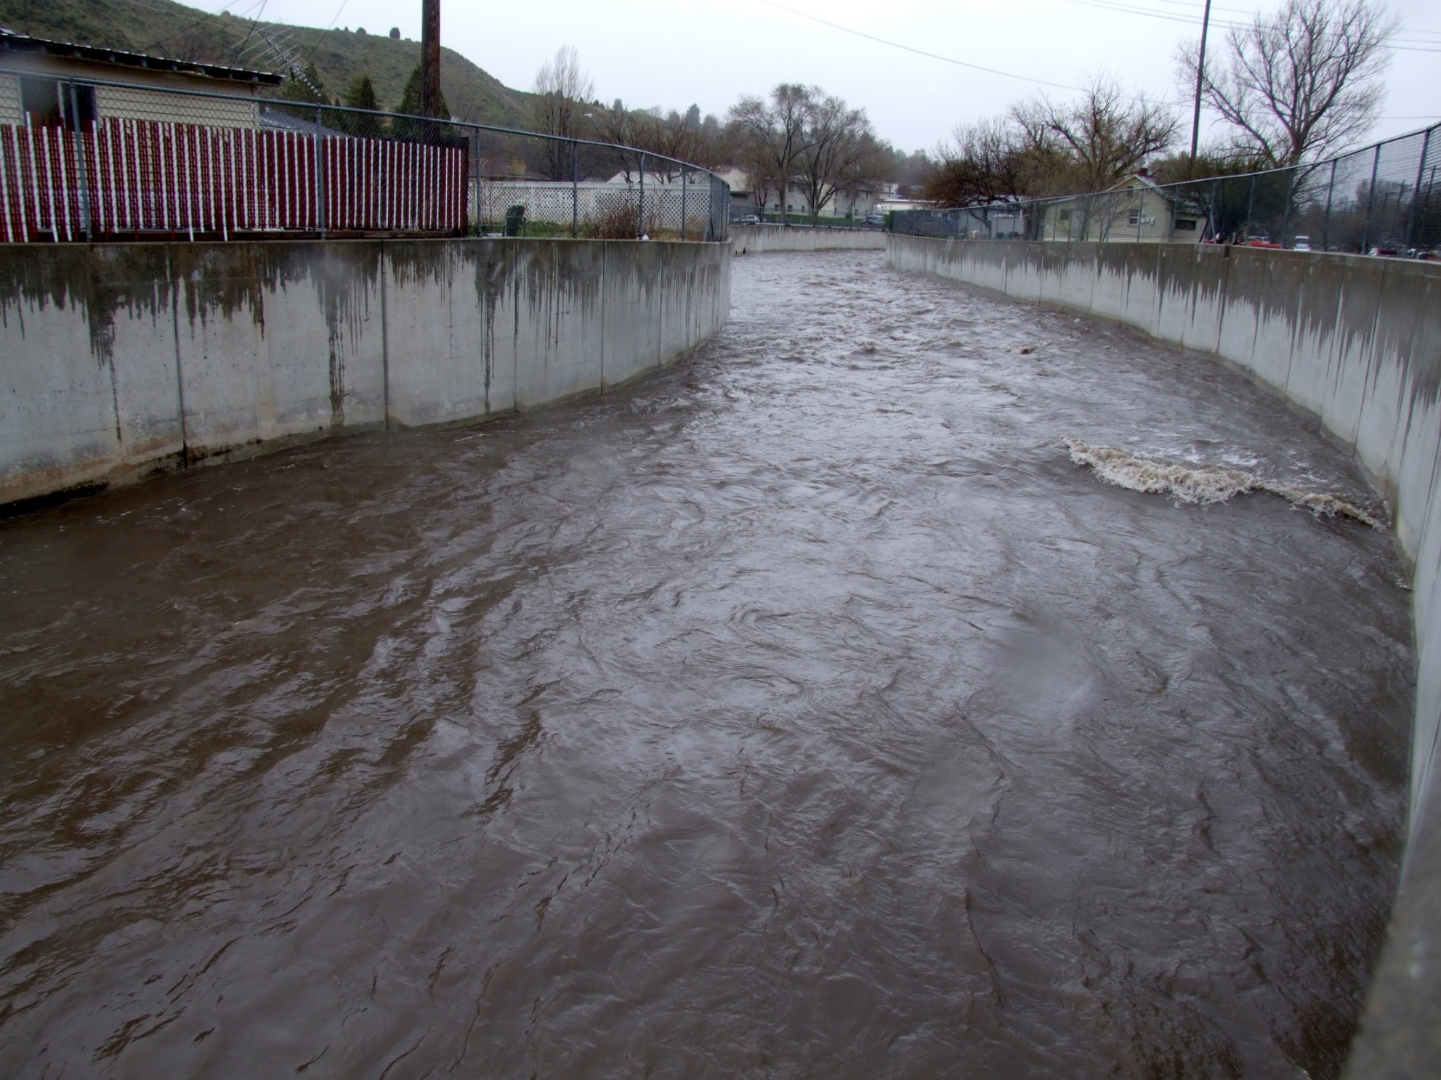
Portneuf River

Slide 5
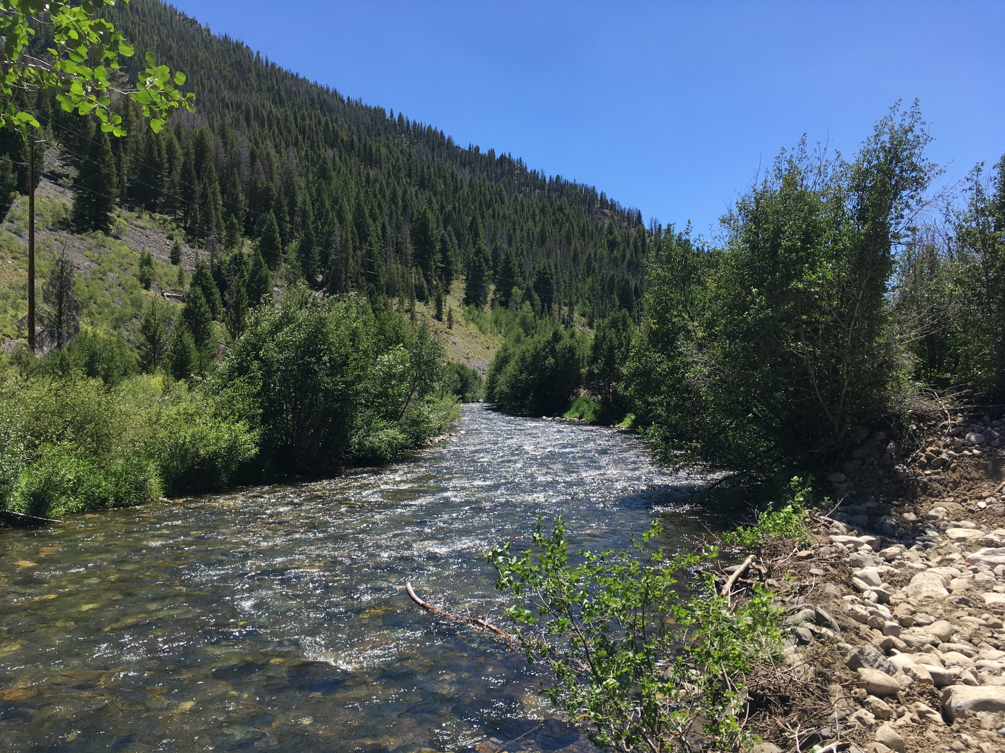
Yankee Fork

Slide 6
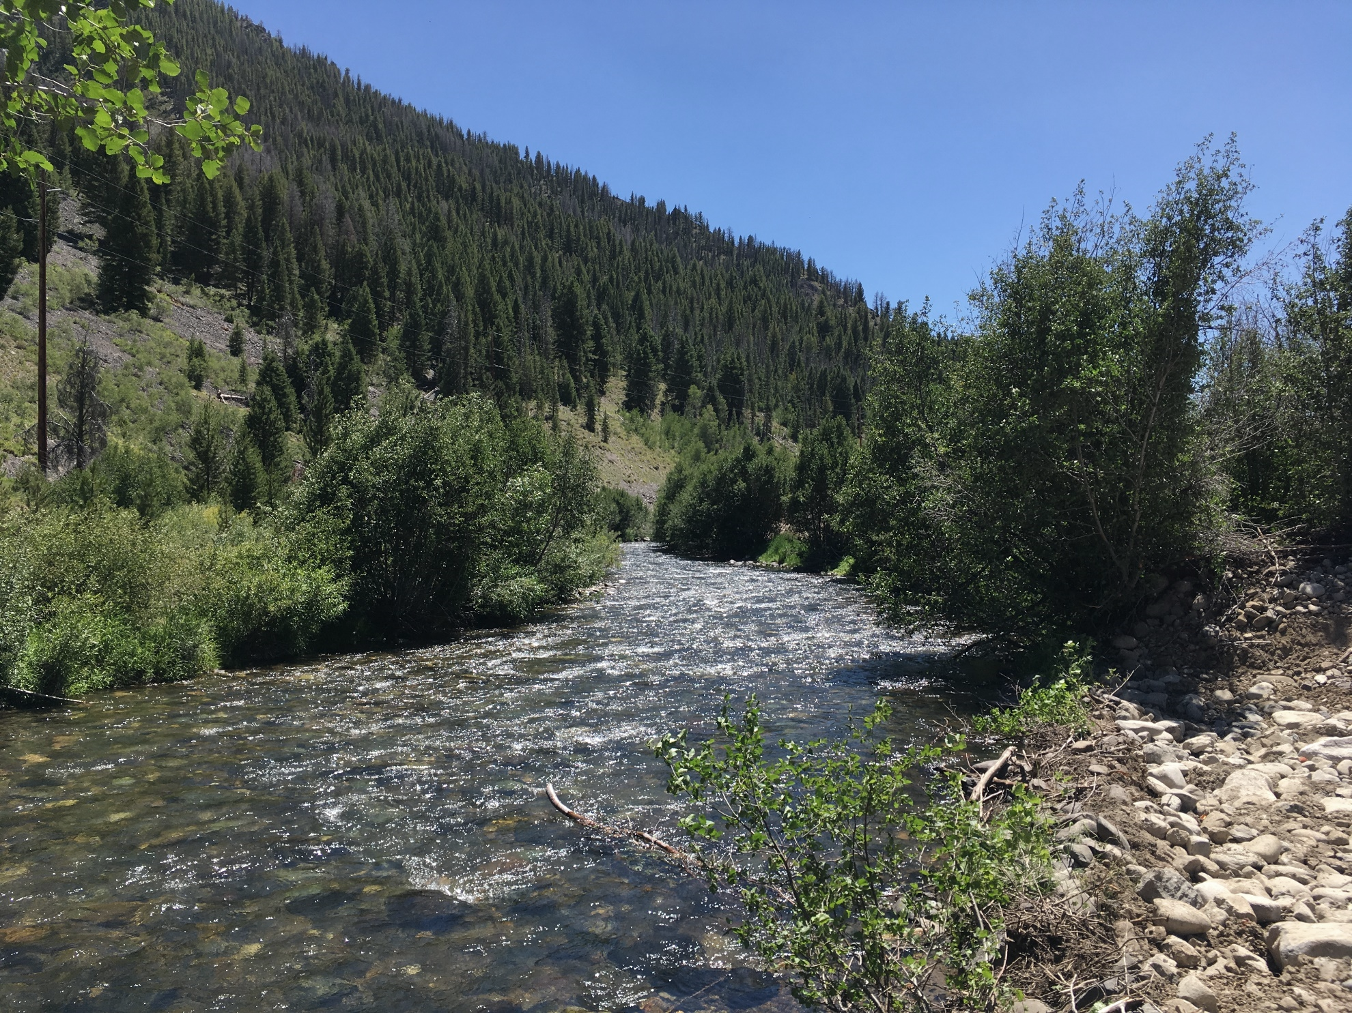
Other causes of channel simplification
Yankee Fork
Rip-rap
Dikes
River straightening
Snag removal
Beaver removal

Slide 7
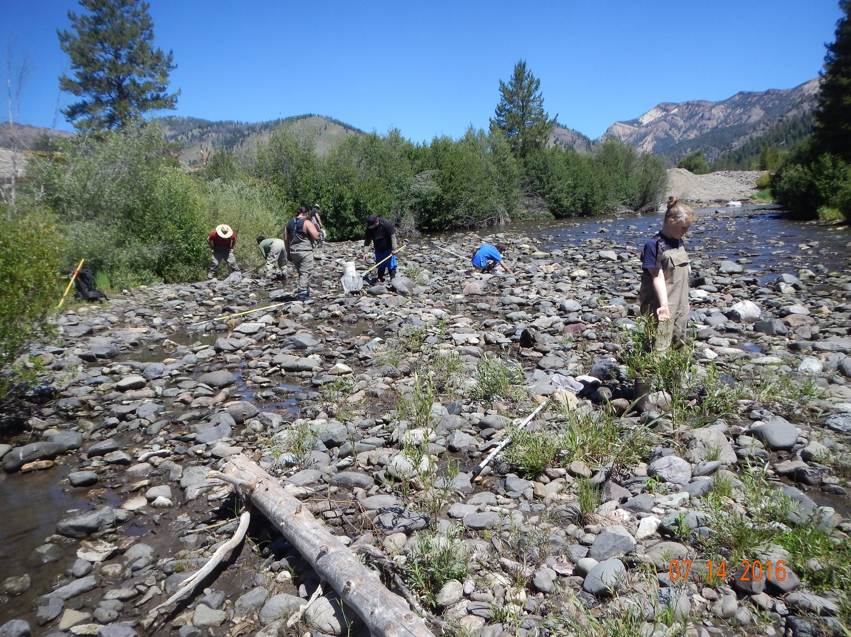

Slide 8
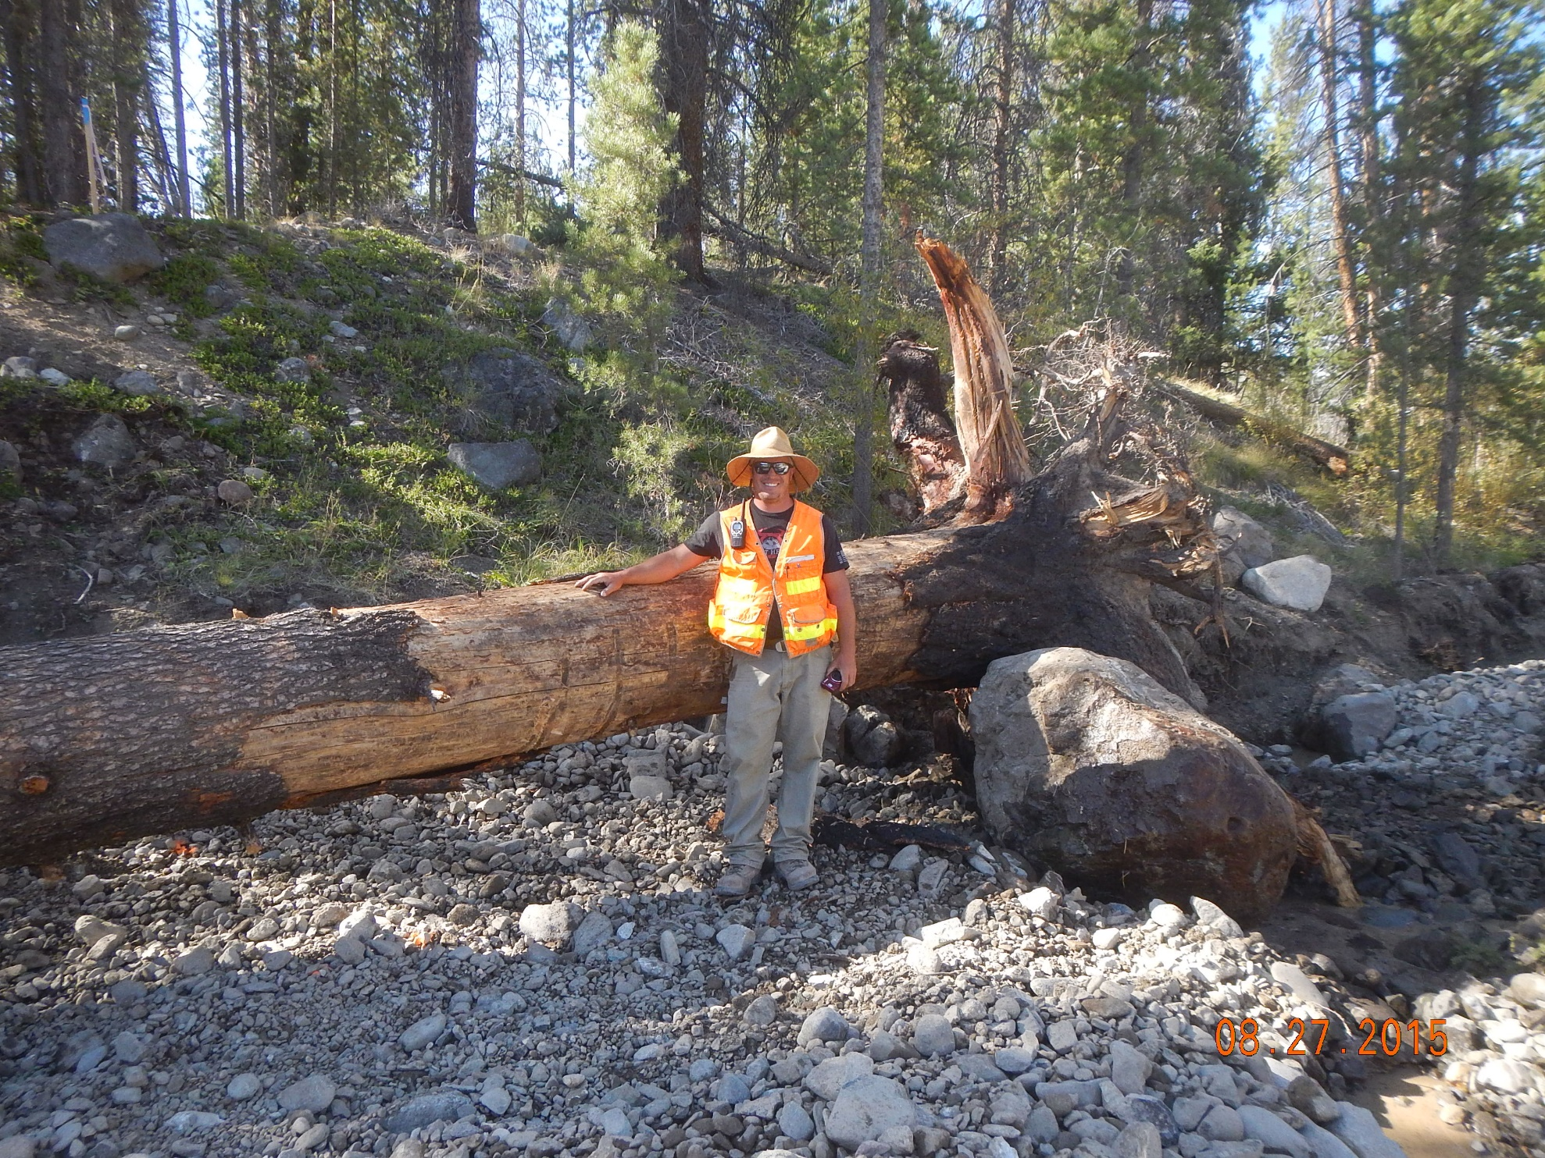

Slide 9
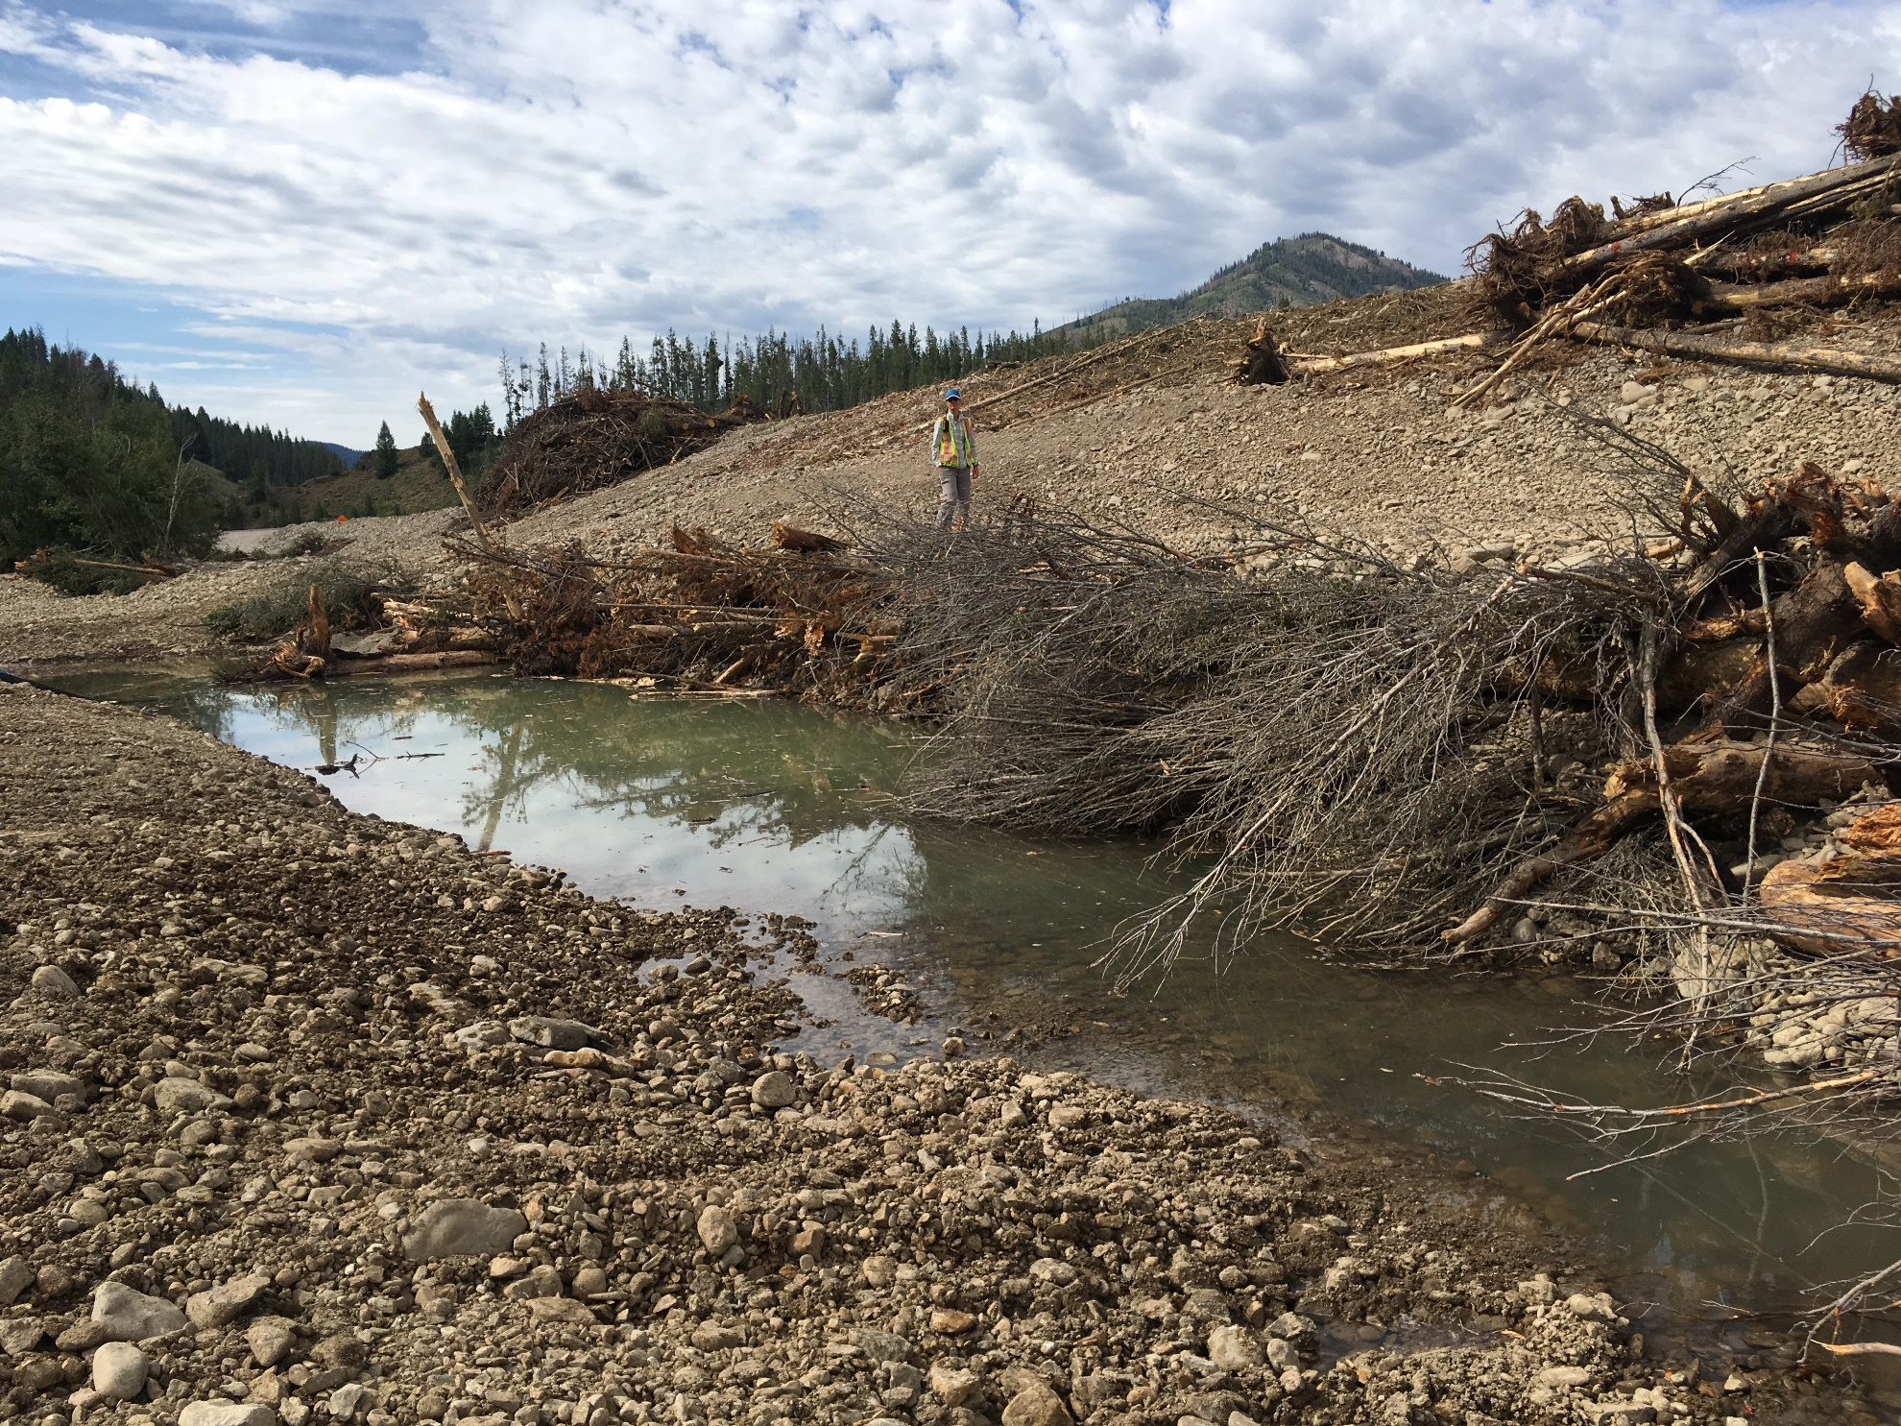

Slide 10
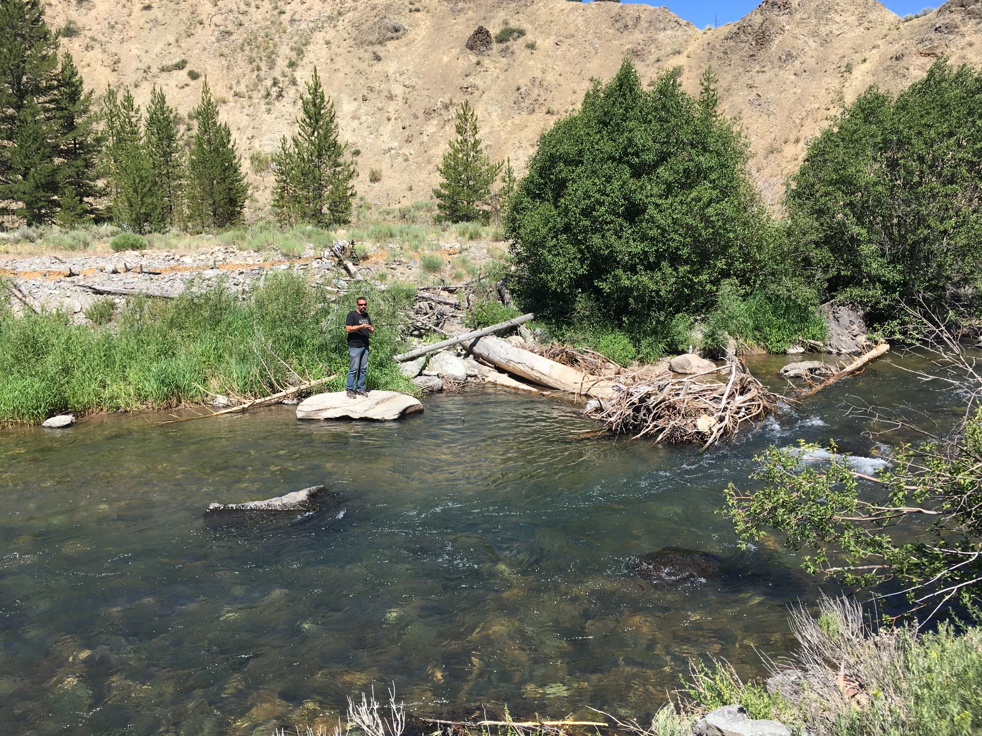

Slide 11
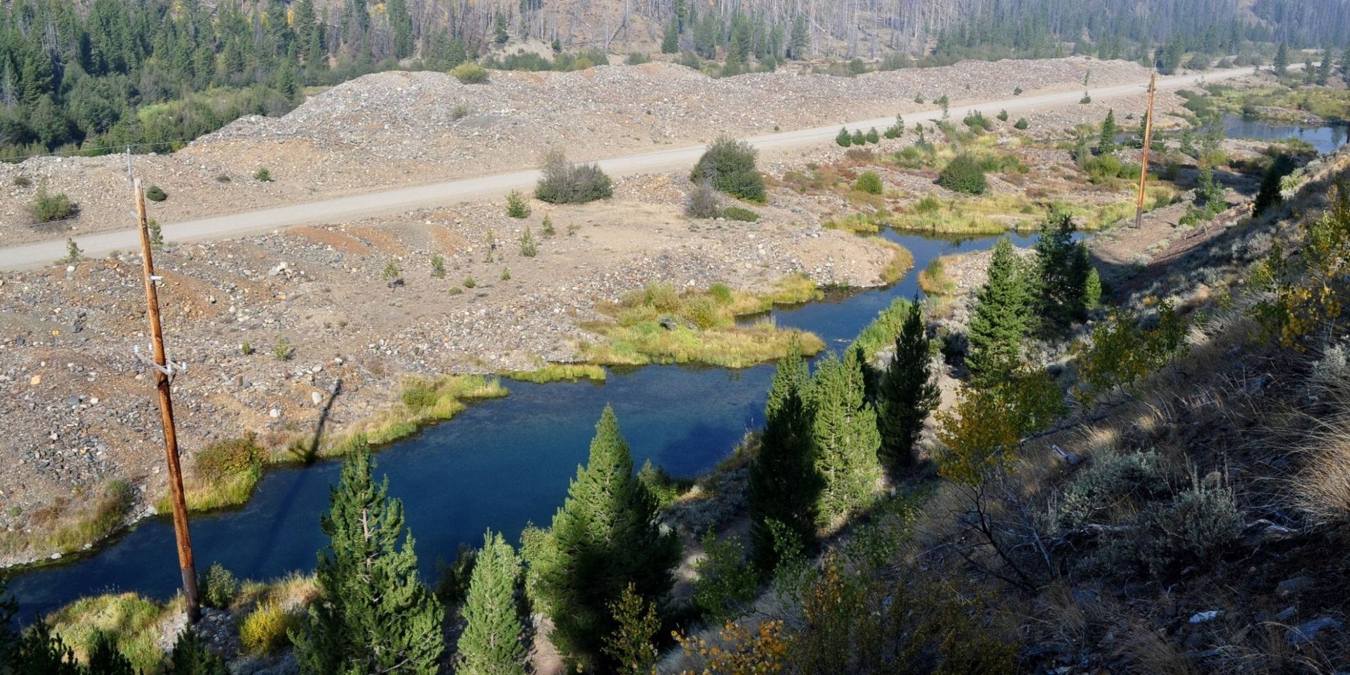
Pond Series 3
2012 (Prior to Implementation)

Slide 12
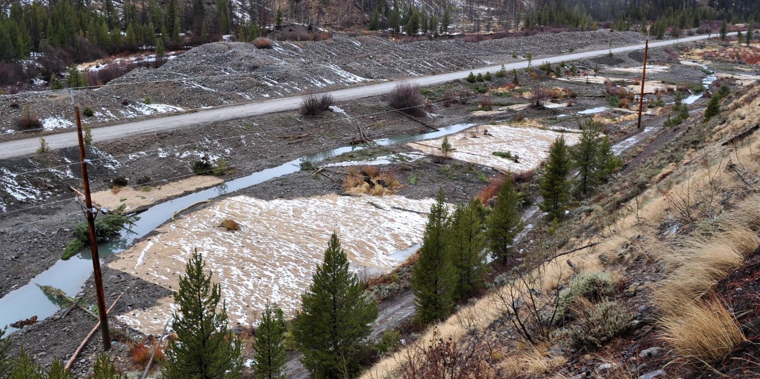
Pond Series 3
2012 (After Implementation)

Slide 13
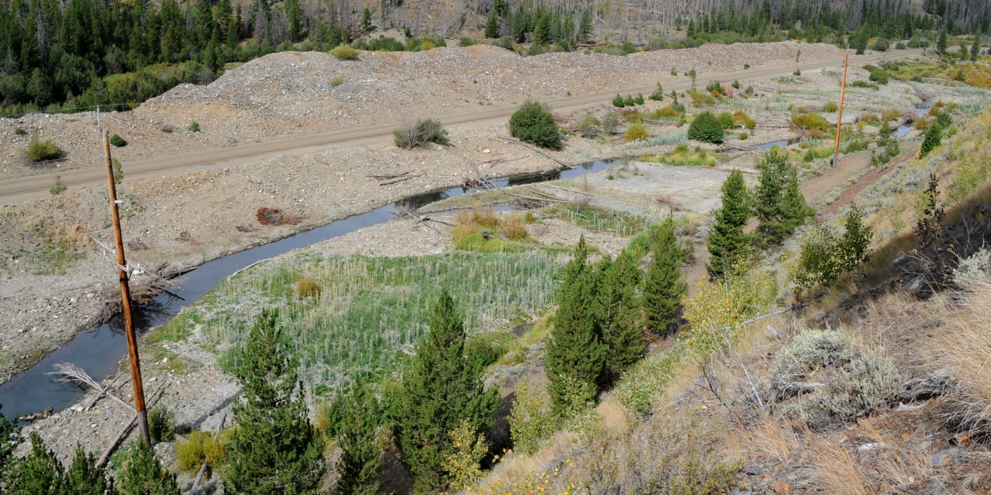
Pond Series 3
2013

Slide 14
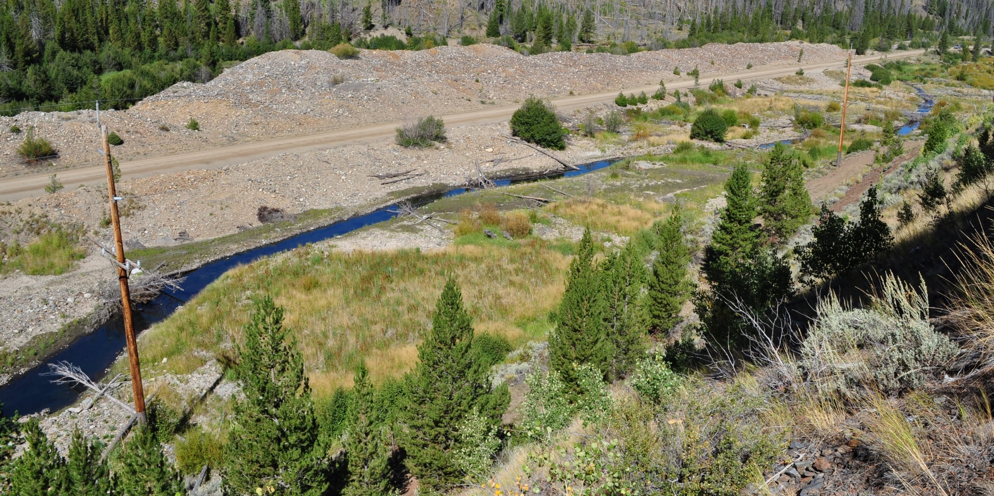
Pond Series 3
2014

Slide 15
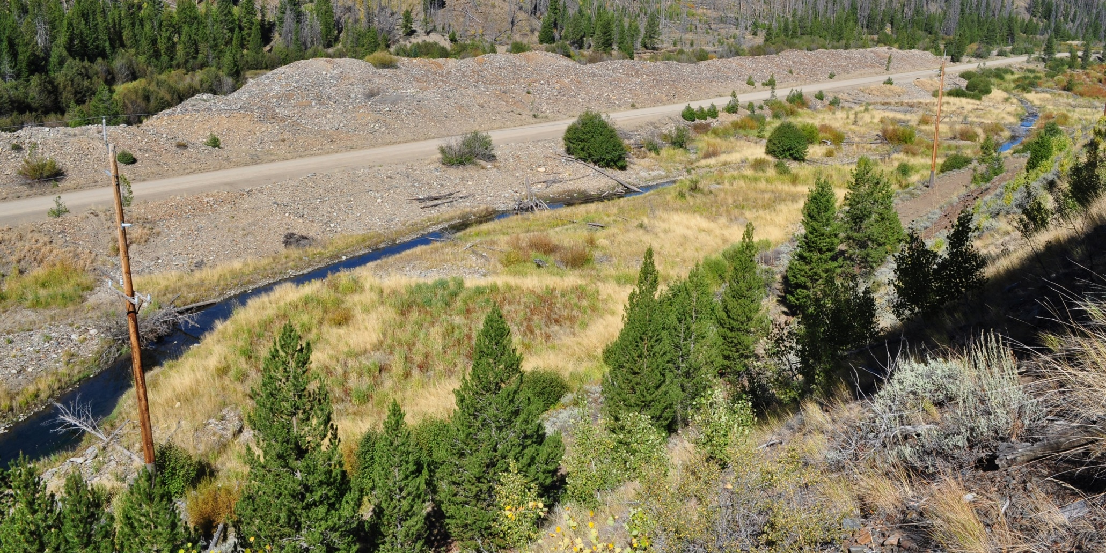
Pond Series 3
2015

Slide 16
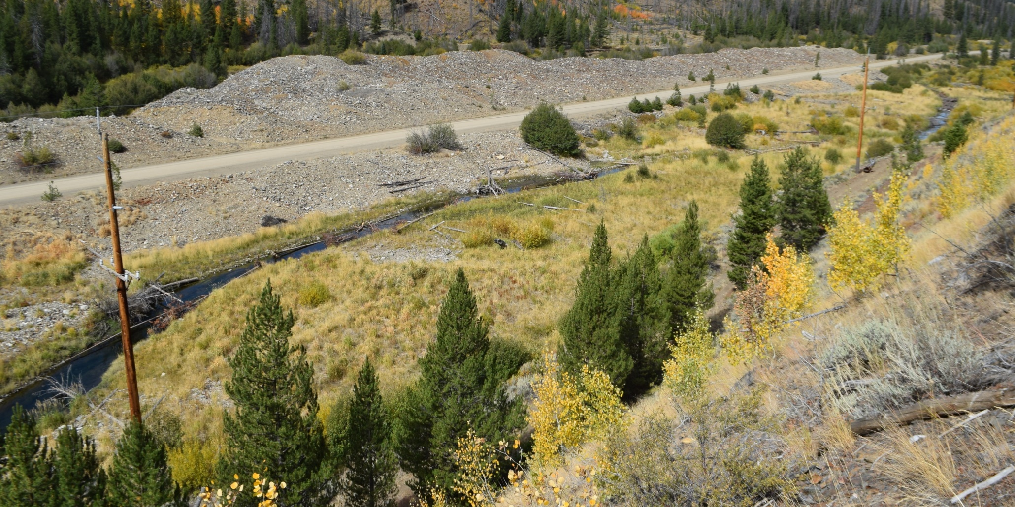
Pond Series 3
2016

Slide 17
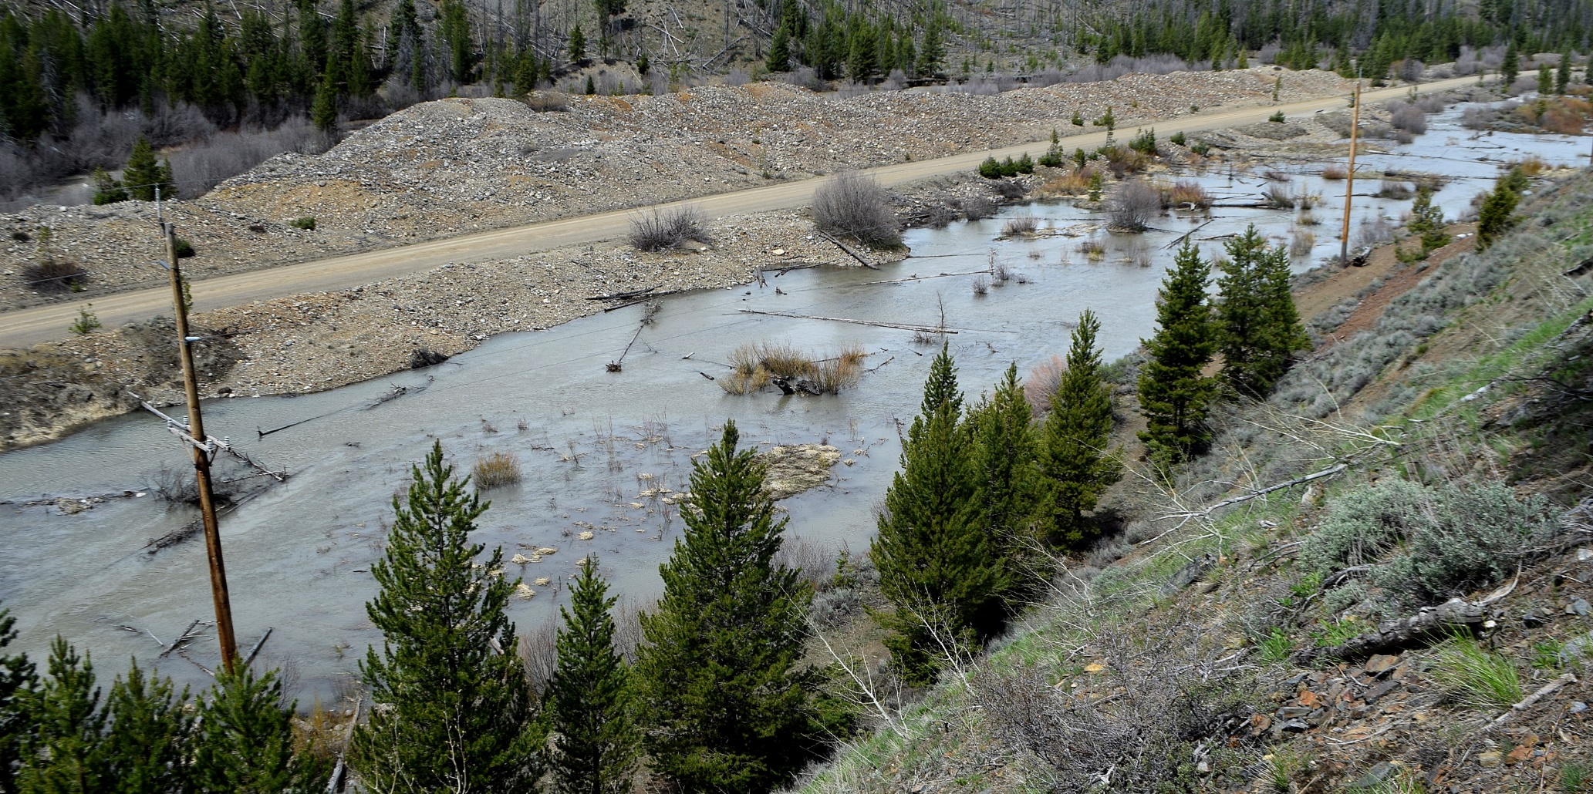
Pond Series 3
2017 (High Flows)

Slide 18
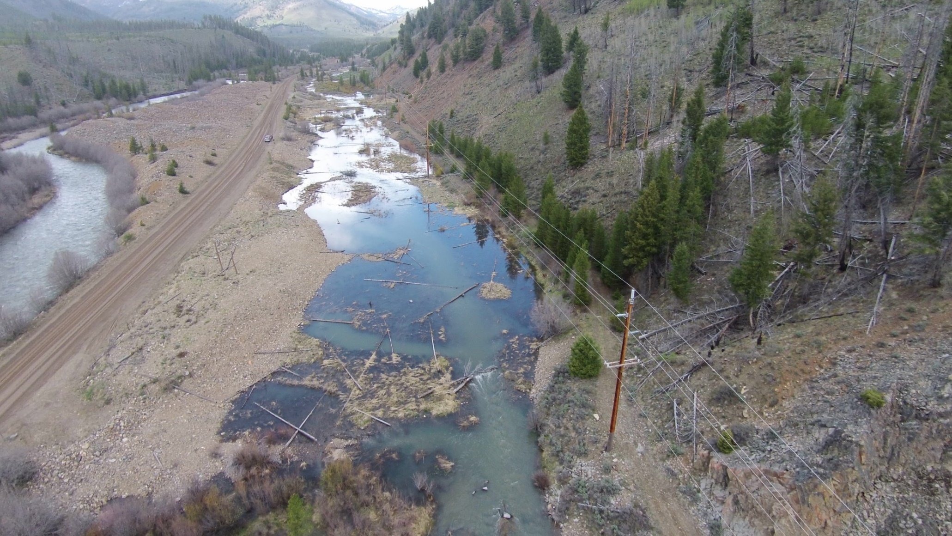
Pond Series 3
2017 (High Flows)

Slide 19
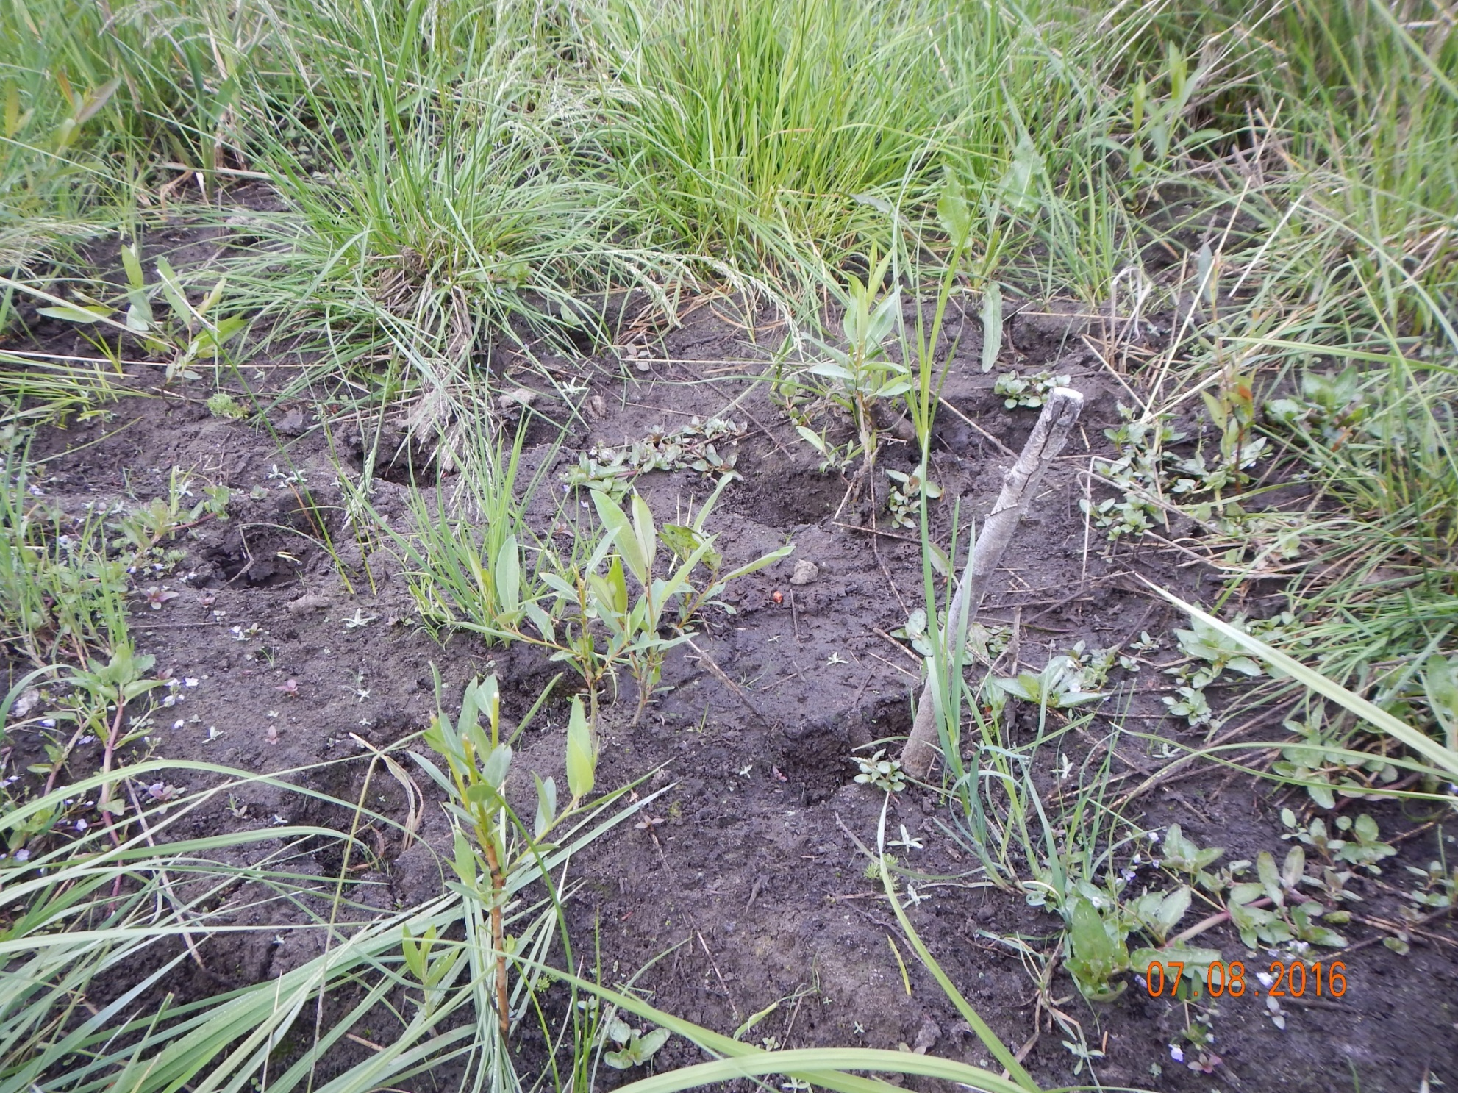
Pond Series 3

Slide 20
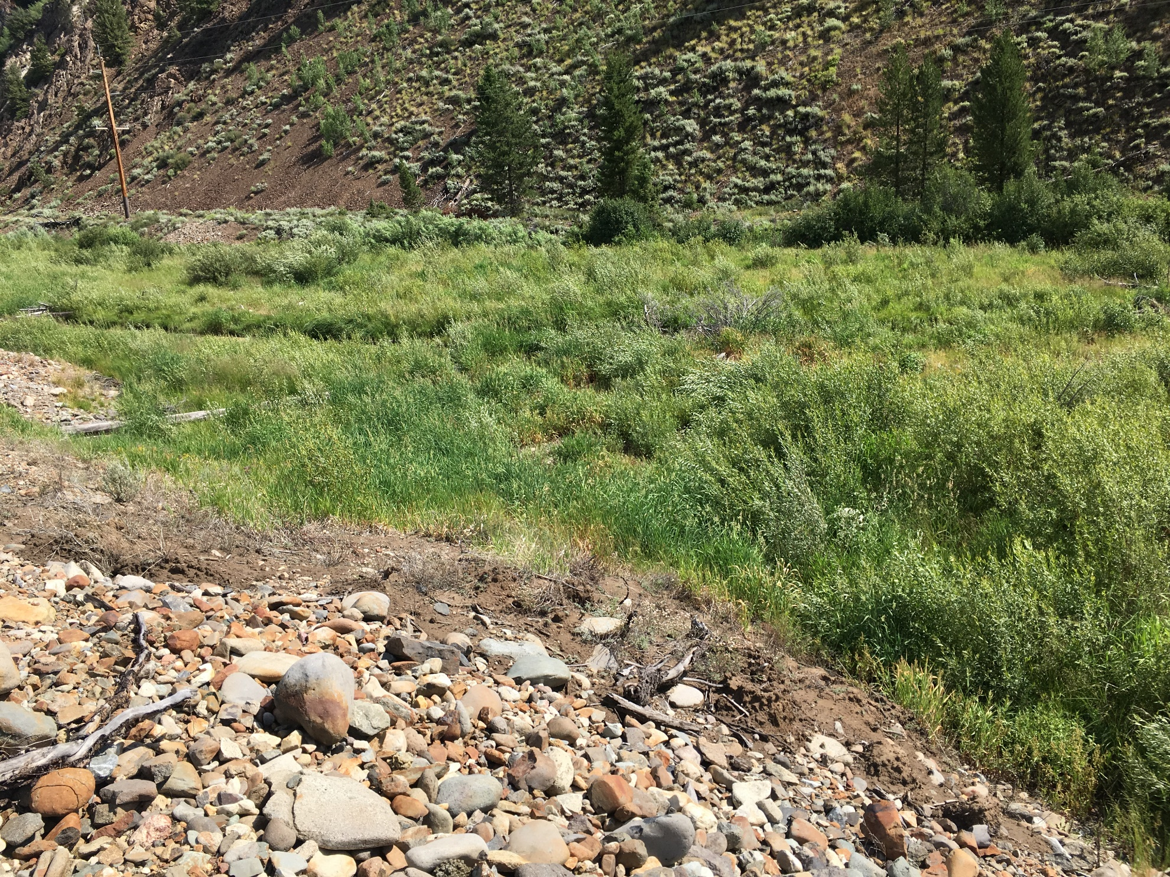
Pond Series 3

Slide 21
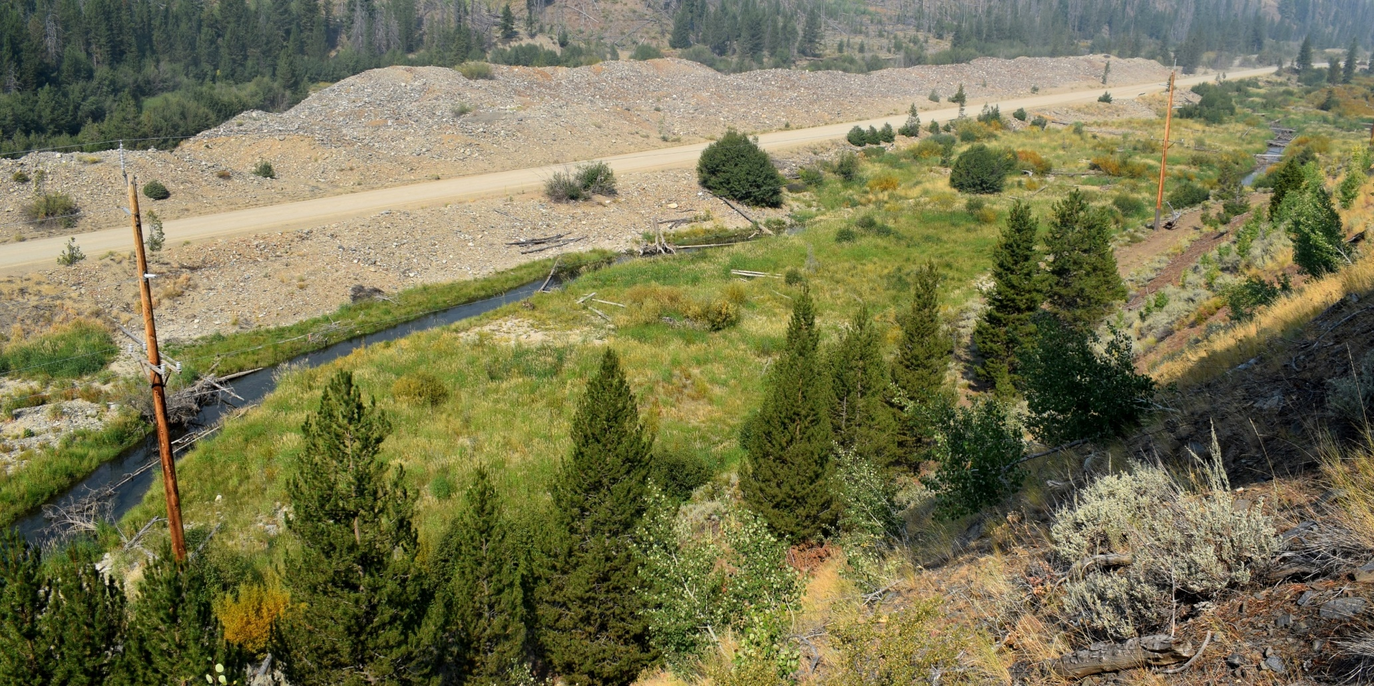
Pond Series 3
2017

Slide 22
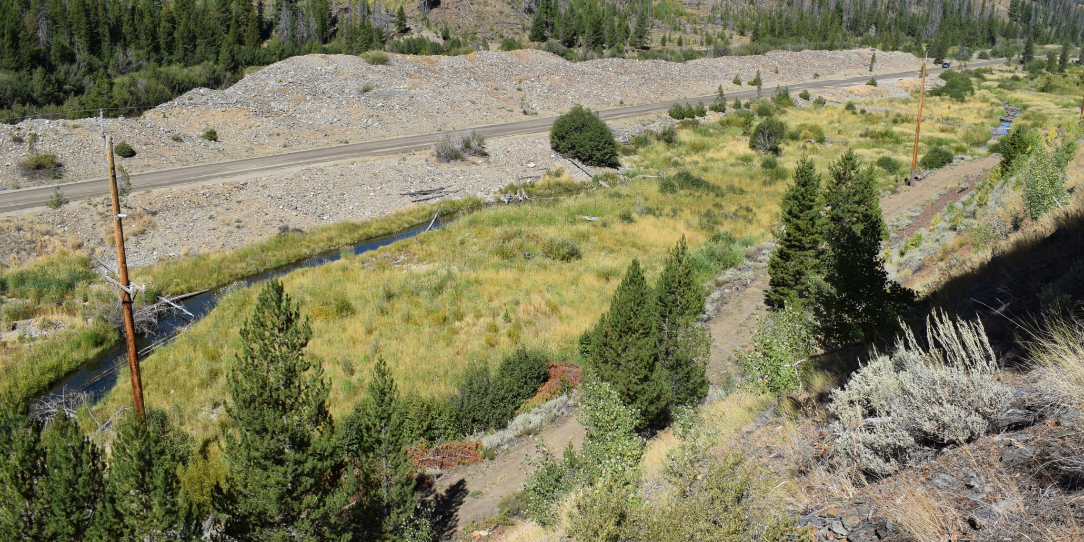
Pond Series 3
2018

Slide 23
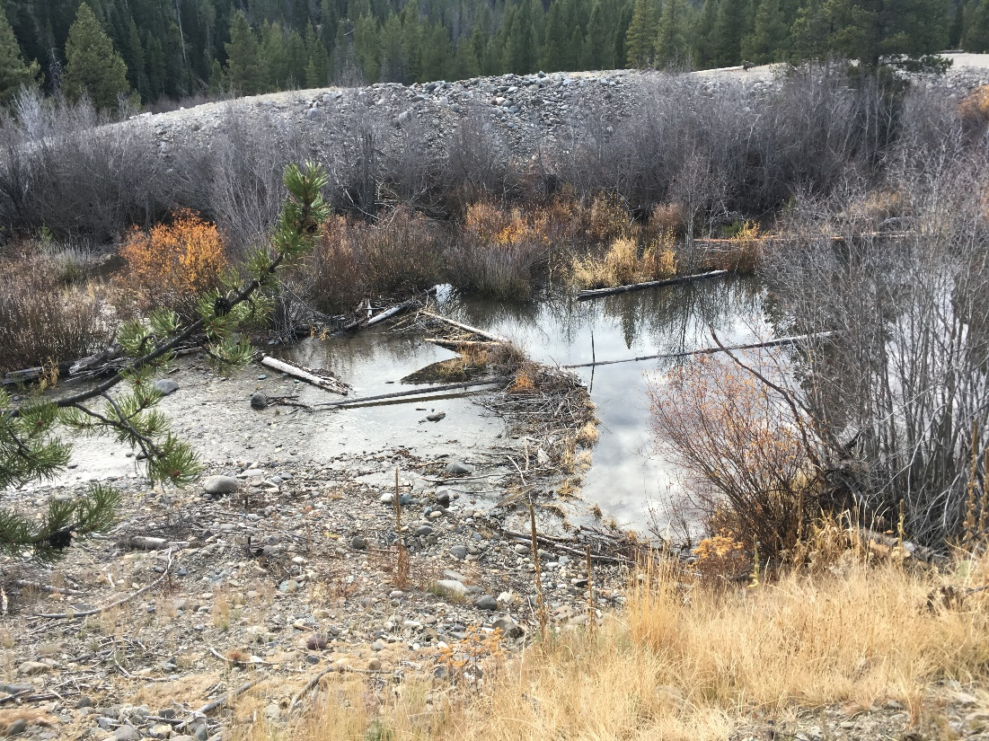
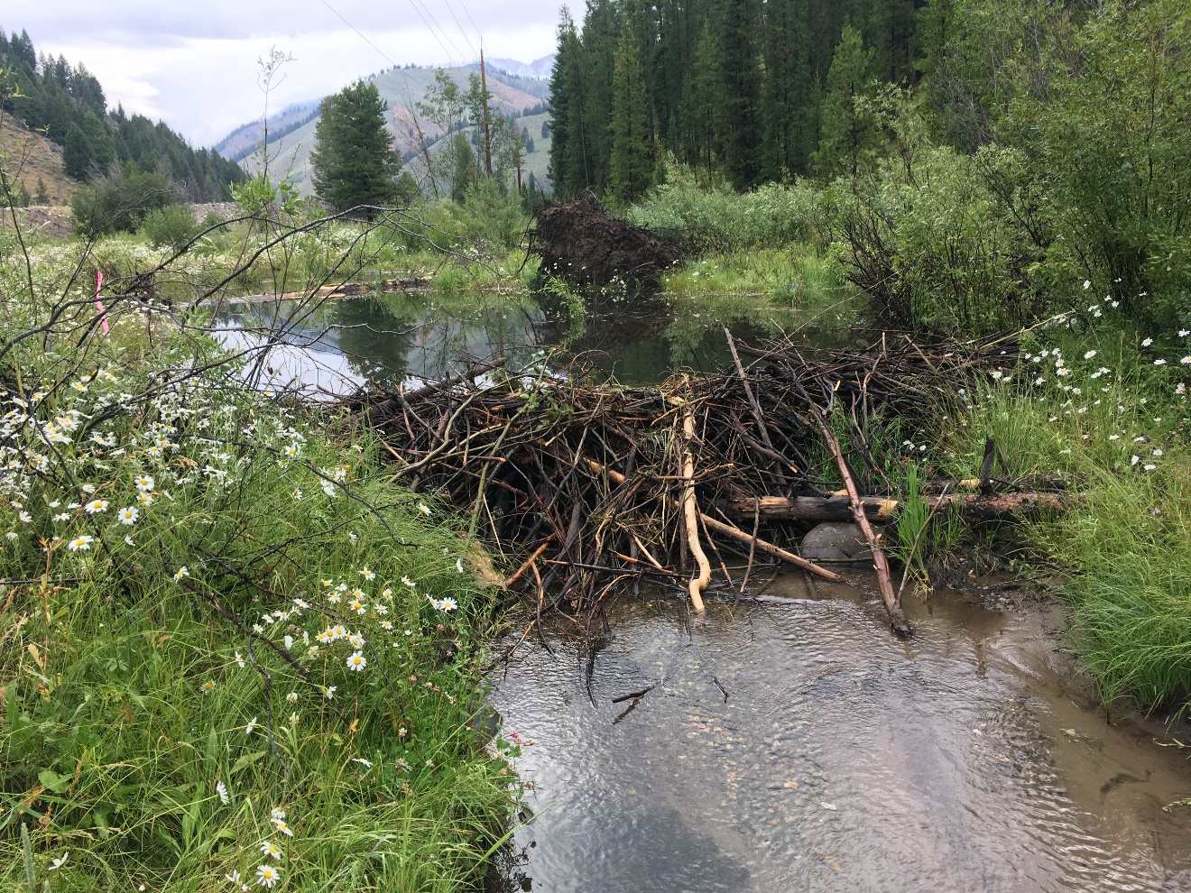
Beaver dams in newly created habitat

Slide 24
Habitat improvement approach
Highly impacted channels often take substantial effort to restore complexity and functionality
Smaller cheaper fixes in these areas may temporarily restore habitat but not functionality
Streams with smaller impacts may recover complexity and functionality naturally with removal of impacts

