Slide 1
Pacific Coastal Salmon Recovery Fund (PCSRF)
Governor’s Salmon Workgroup, July 31, 2019
Jennie Franks, PCSRF Program Coordinator

Slide 2
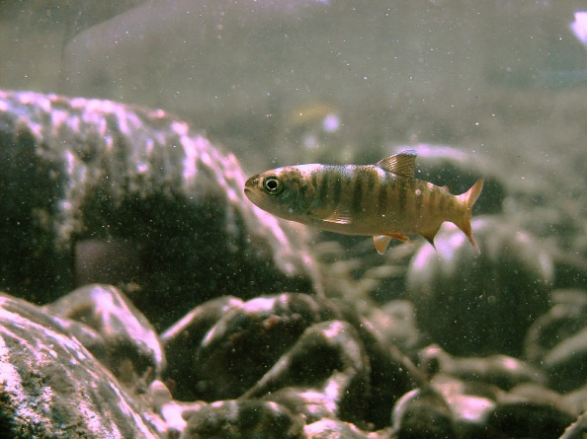
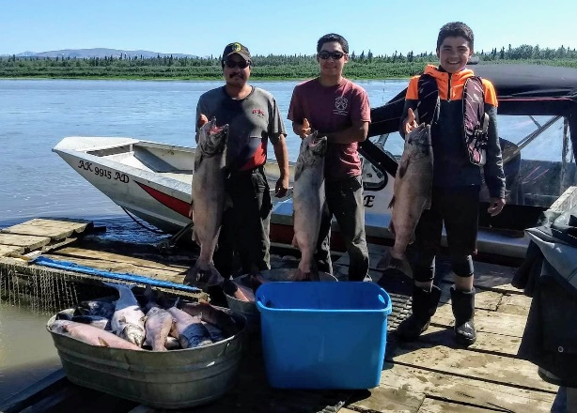
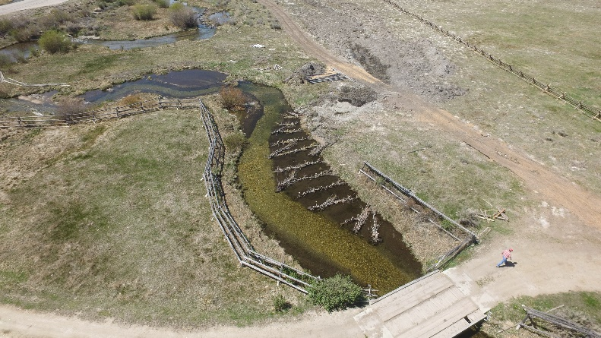
Program Overview
Pacific Coastal Salmon Recovery Fund

Slide 3
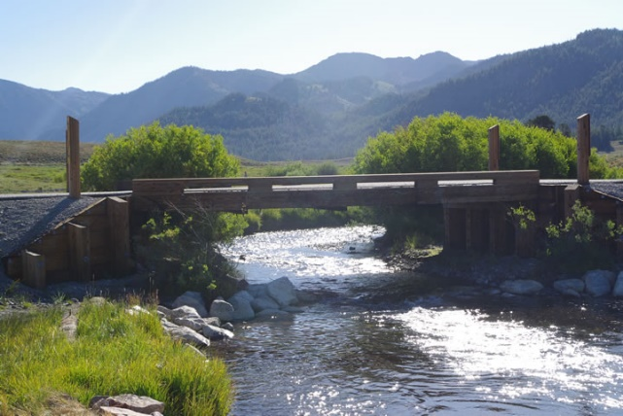
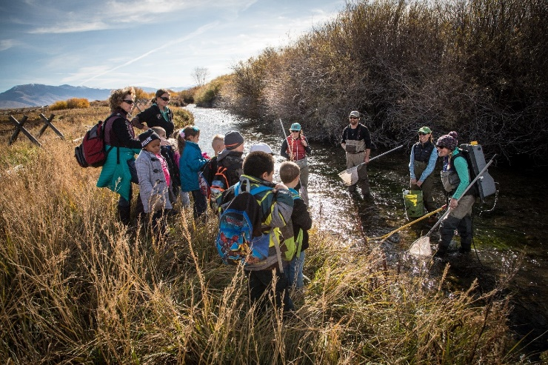
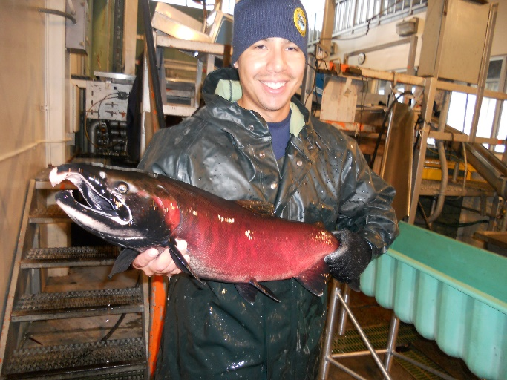
Program Priorities
Priority 1
ESA Listed or at-risk by State
Necessary for tribal treating fishing rights/native subsistence fishing
habitat restoration
Priority 2
Watershed or Larger Effectiveness Monitoring
ESA- listed population status & trend monitoring
Monitoring for tribal treaty fishing rights/native subsistence
Watershed or larger restoration planning
Priority 3
Capacity Building
Planning Coordination
Public Outreach
Assessments/Research
Small Scale Monitoring

Slide 4
Received $1.4 billion in Congressionally-appropriated funds
Awarded an average of 74 million annually
Leveraged nearly $1.7 billion in non-PCSRF contributions
Collectively have supported the implementation of more than 13,700 projects
PCSRF Awards to States and Tribes ($Millions)

Slide 5
ID FY Funds (includes all projects funded within ID)
If a project was awarded in FY17 but the majority of funds were spent in the year 2018, it will be shown here in 2018 rather than 2017. These funds include spent funds for projects completed/terminated and allocated funds for new/on-going projects.

Slide 6
$0.1
$13
$21.3
$72.8
$114.9 Million Total PCSRF & Leveraged Funds

Slide 7
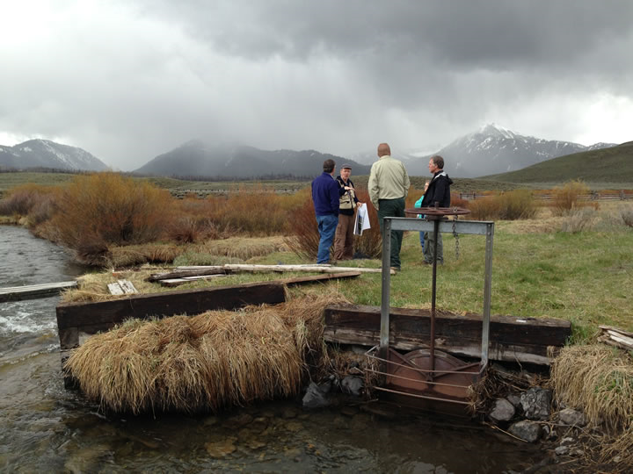
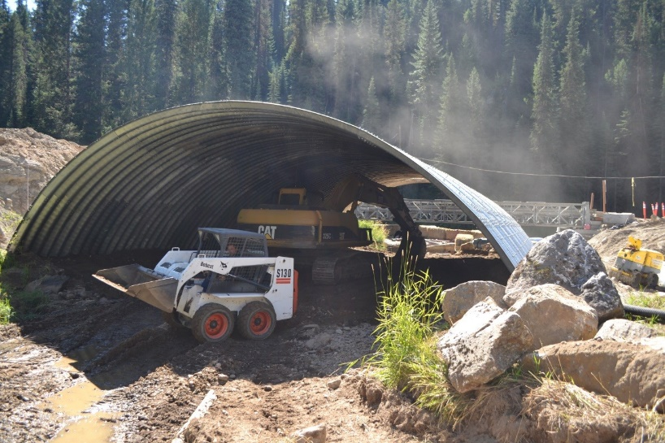
Removed 70 Fish Passage Barriers
84 road stream crossings improved
100,162 miles monitored
32 miles of streambank protected
Assessed 1,232 miles of stream
1,331,700 fry/smolt marked or tagged and released
81 instream miles of habitat treated
Treated 1,190 acres of riparian & wetland habitat
784 miles of stream made accessible
9 fish screens
Accomplishments To Date

Slide 8
Significant progress has been made … but challenges remain
8 of 28 ESA-listed West Coast salmon and steelhead lack sufficient data to assess status and trends.
However …
Of those with adequate trend data,
  5 are exhibiting increasing trends
  13 are exhibiting stable trends, and they are at less risk than when they were first listed.
  2 are exhibiting a declining trend
PCSRF-funded and other recovery efforts have helped prevent extinctions and reverse declines.

Slide 9
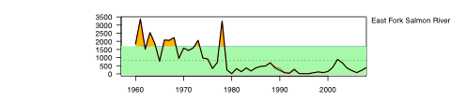
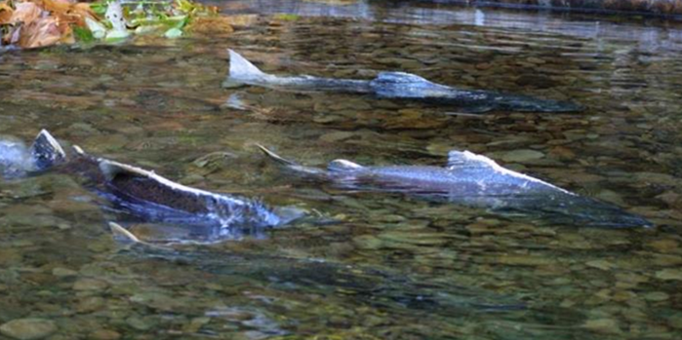
Recovery Takes Time.
    Over 6,400 recovery actions identified (so far) in NMFS recovery plans, representing $5 billion in needed actions
    Assuming a 100-year time horizon for recovery, need continued investment of ~$100 million/yr to sustain progress toward recovery
    Species & habitat trends are blurred by environmental variability
Year first listed
PCSRF Established

Slide 10



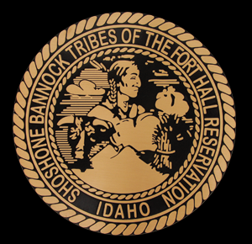
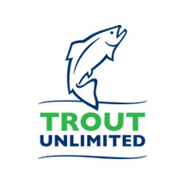
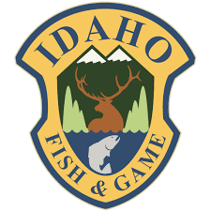
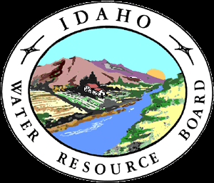

Custer County Soil & Water Conservation District
Lemhi County Soil & Water Conservation District
Upper Salmon Basin Watershed Project
Private Landowners

Slide 11
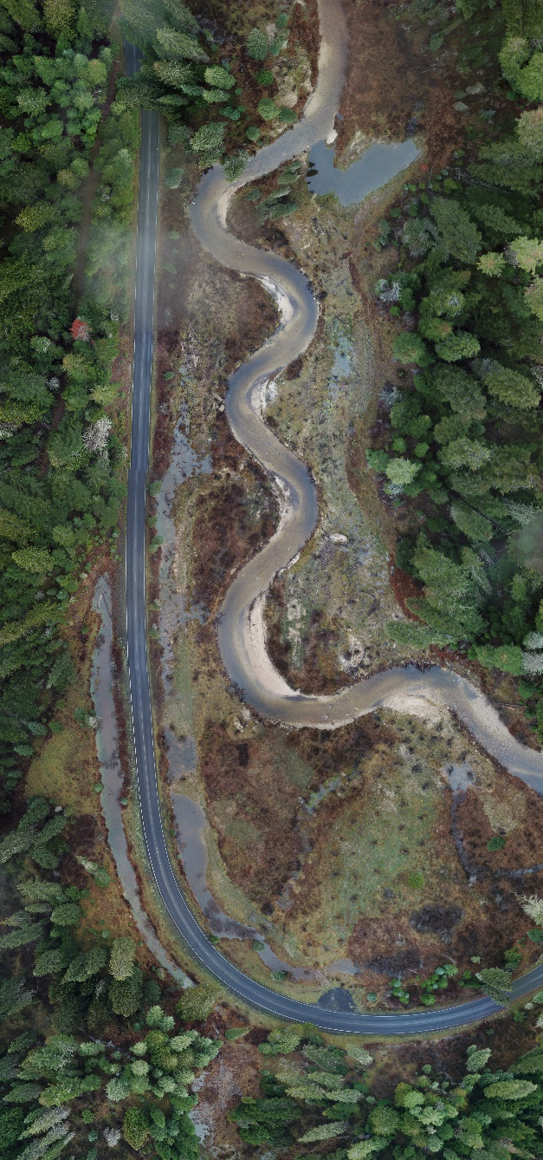
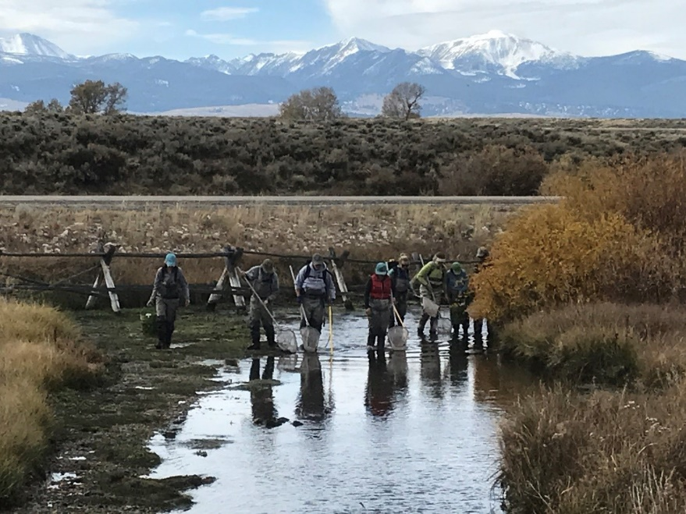
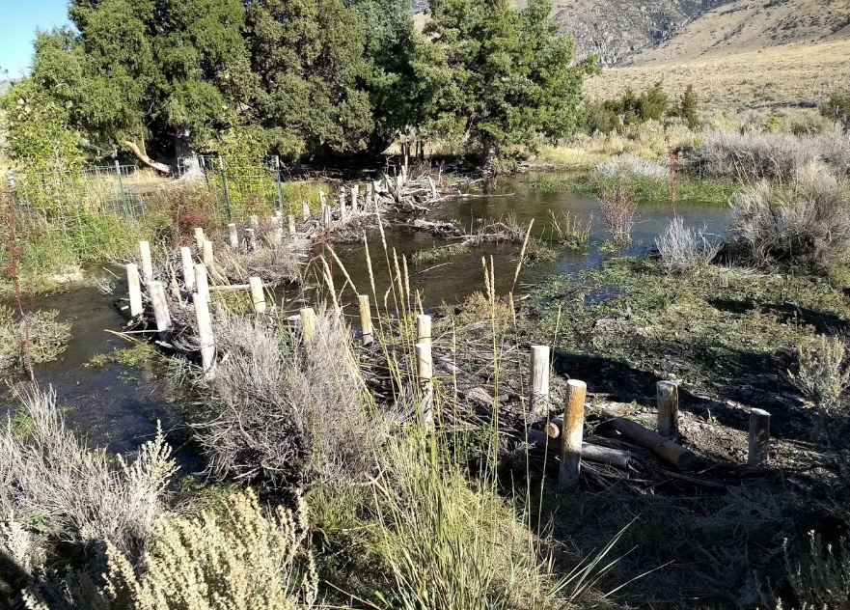

Slide 12
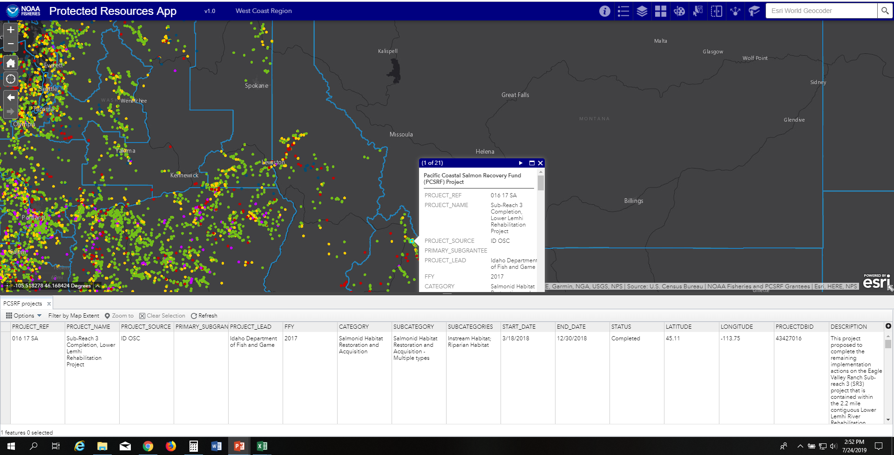
https://www.fisheries.noaa.gov/resource/map/protected-resources-app

