Slide 1
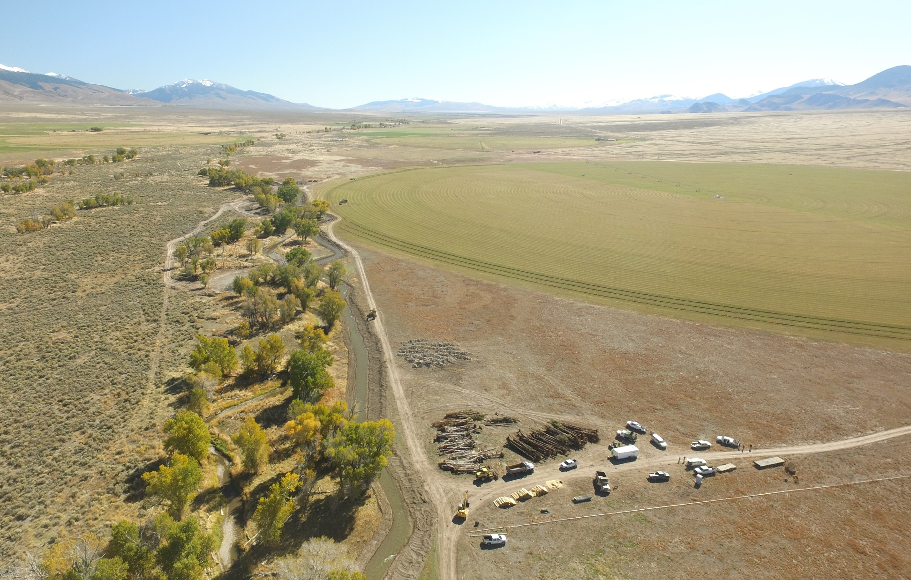
HABITAT
IMPROVEMENT
FUNDING
Photo Courtesy of Daniel Bertram, OSC

Slide 2
Congressional Funding Authority
What can Reclamation fund?
FLOW – putting water back in the channel
ENTRAINMENT – fish screens
ACCESS – passage barriers
CHANNEL COMPLEXITY – channel reconstruction, side channel reconnection, floodplain activation
Reclamation typically does not fund construction

Slide 3
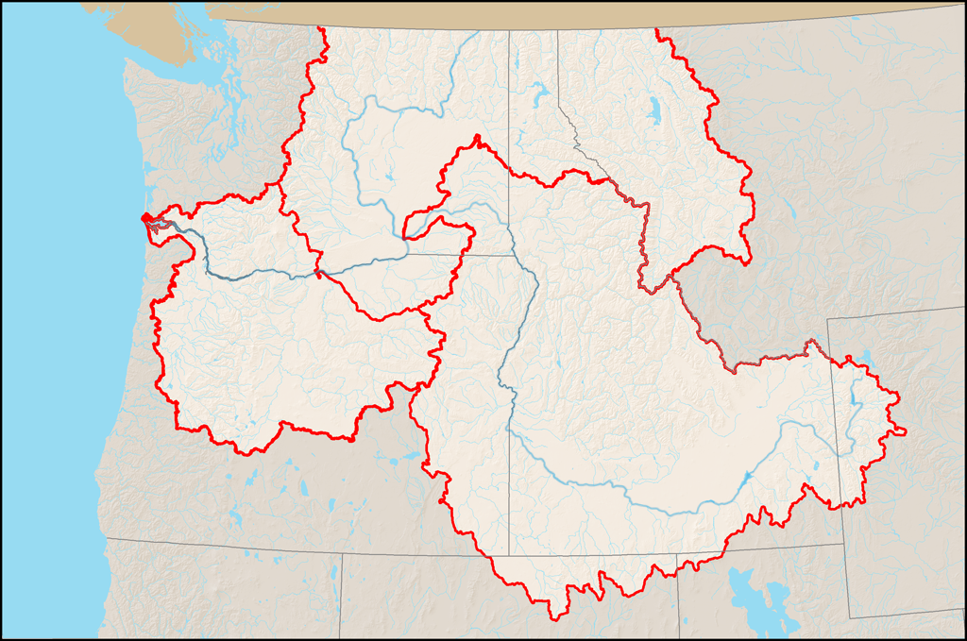
Methow
Wenatchee
Entiat
Grande Ronde
Little
Salmon
North Fork John Day
Upper
Salmon
Lemhi
Middle Fork
John Day
Upper John Day
Pahsimeroi
Reclamation is only assigned
to work in certain river basins.

Slide 4
5 Year Average of Expenditures

Slide 5
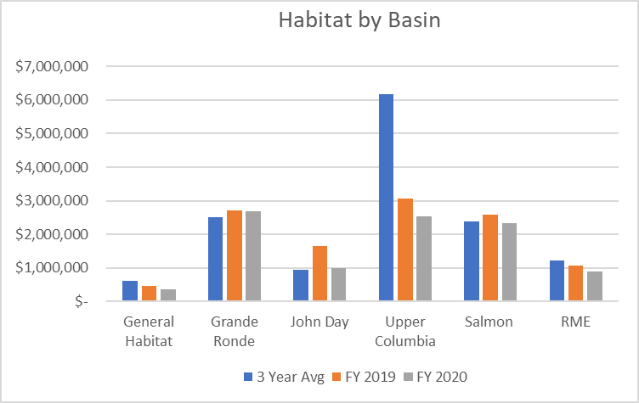
Habitat Expenditure by Basin

Slide 6

Who Do We Work With?
Private Landowners
Irrigation districts, ditch companies, etc
IDFG
State agencies
Tribes
County SWCDs
Watershed groups
Private Conservation Foundations
Land And Water Trusts
County Agencies
Other Federal agencies
Others to support BiOp Goals

Slide 7
Project Info
Currently working on about 25 projects
Projects plus base funding for sponsors results in about 80 contract actions per year (used to be 100 and 120)
We have designed more than 200 projects since 2005
Reclamation’s effort in the Salmon basin is shifting to focus on implementation of projects in the Lemhi, Pahsimeroi and the Upper Salmon above Red Fish Lake.

Slide 8
Other Info
Reclamation uses formal project management on all new projects we have a significant role in
Reclamation has the habitat program planned out down to the staff day for 3 years and we update that budget 2 times per year
Planning/prioritization efforts exist in various forms in all subbasins we work in

Slide 9
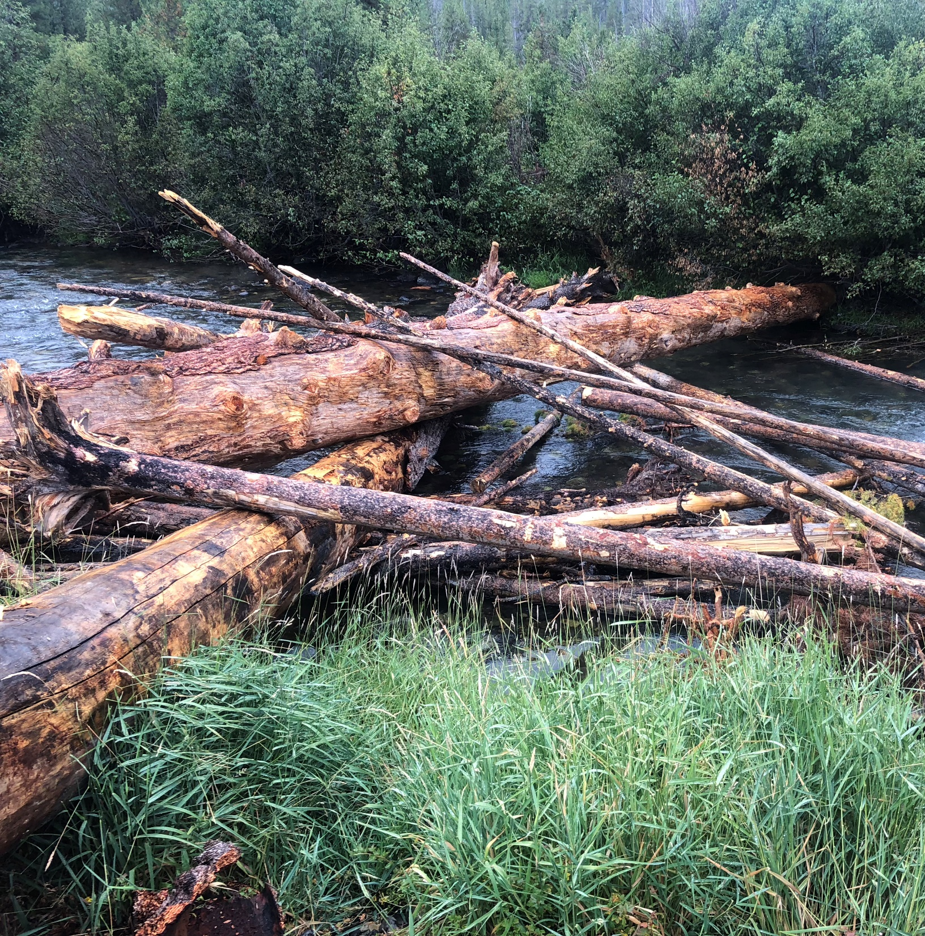
Contact Info
Kira Christensen, PE
Phone: (208) 378-5242
kchristensen@usbr.gov
Photo Courtesy of Mike Knutson, USBR

