Slide 1
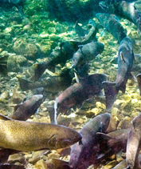
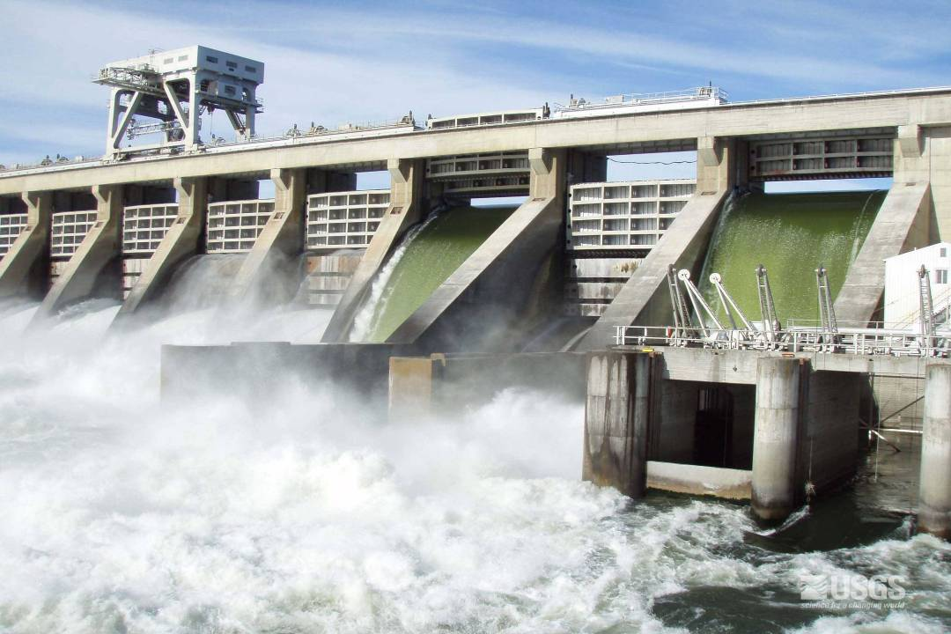
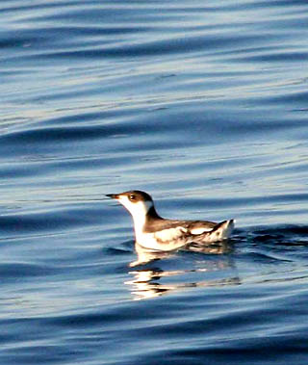
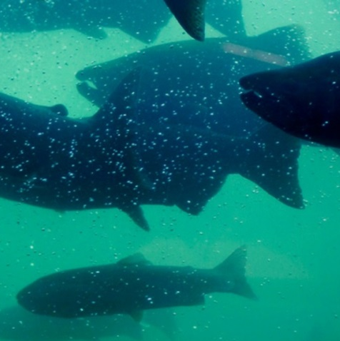
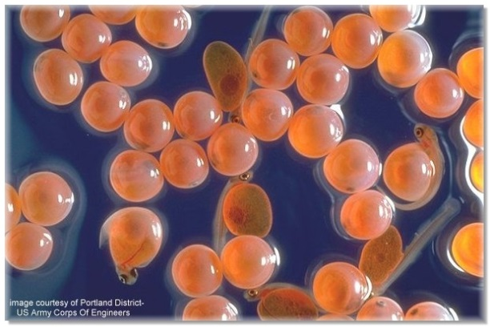

A brief overview of BPA’s Fish & Wildlife Program and Funding
Presentation for the Idaho Governor’s Salmon Taskforce
July 2019

Slide 2
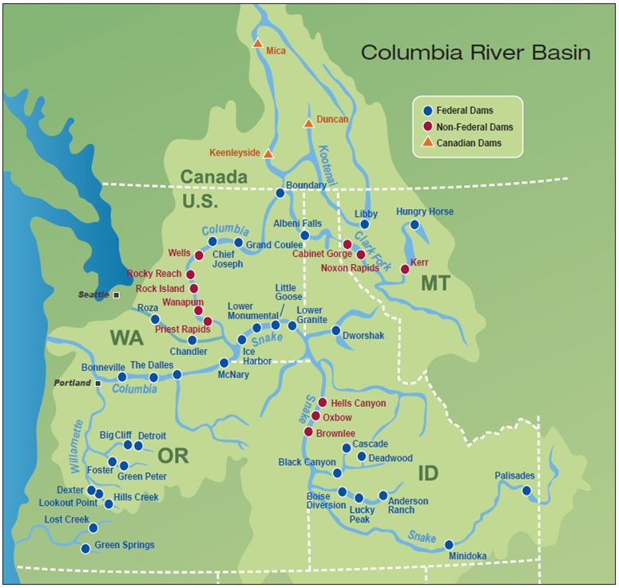
BPA overview
BPA is a federal power
marketing administration
headquartered in Portland.
Congress created BPA in 1937
to market the power produced by
Bonneville Dam.
BPA is part of the
U.S. Department of Energy,
but it is self-funded.

Slide 3
Fish and Wildlife Program
Albeni
Falls
Libby
Hungry Horse
Grand Coulee
Chief
Joseph
Wells
Rocky Reach
Pacific
Rock Island
Montana
Wanapum
Lower
Monumental
Lower Granite
Priest Rapids
Washington
Dworshak
Ocean
Little
Goose
Col
um
bia
River
Ice Harbor
The Dalles
Bonneville
John Day
McNary
River
Hells Canyon
Oregon
Chum Salmon
Chinook Salmon
Steelhead
Sockeye Salmon
White Sturgeon
Bull Trout
Oxbow
Willamette
Brownlee
Idaho

Slide 4
Legal overview of BPA’s F&W mitigation program
Pacific Northwest Electric Power Planning and Conservation Act | Protect, mitigate, and enhance fish and wildlife, including related spawning grounds and habitat, on the Columbia River and its tributaries Equitable treatment of F&W with other purposes Consistency with the Columbia Basin F&W program
Endangered Species Act | Avoiding jeopardy to listed fish and wildlife Avoiding adverse modification of critical habitat Biological opinions
Tribal treaty and trust responsibilities | The right to take fish at usual and accustomed places Government to government consultations
Clean Water Act | Comply with applicable water quality standards, to the extent practicable
National Environmental Policy Act | Assess major federal actions that may significantly affect the environment
National Historic Preservation Act | Assess federal undertakings that may adversely affect historic and cultural resources

Slide 5
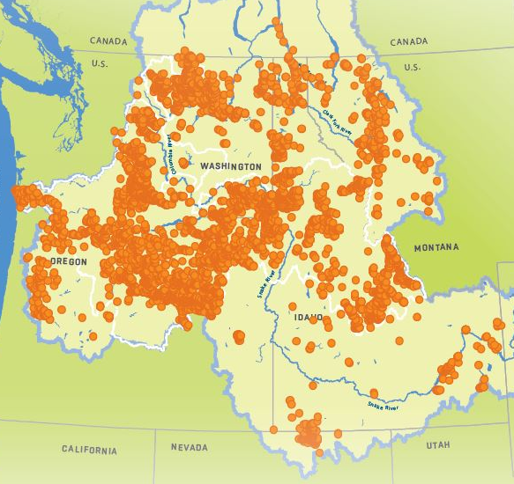
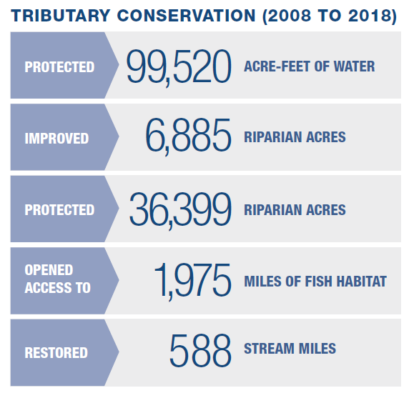
Results for fish – Restoring habitat

Slide 6
BPA’s robust Fish & Wildlife budget
Millions of $

Slide 7
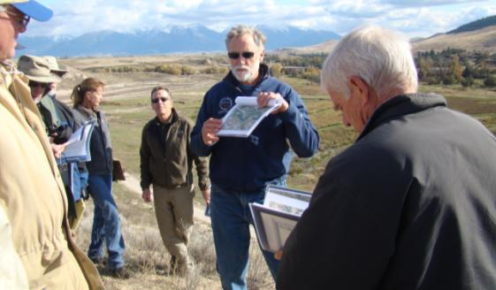
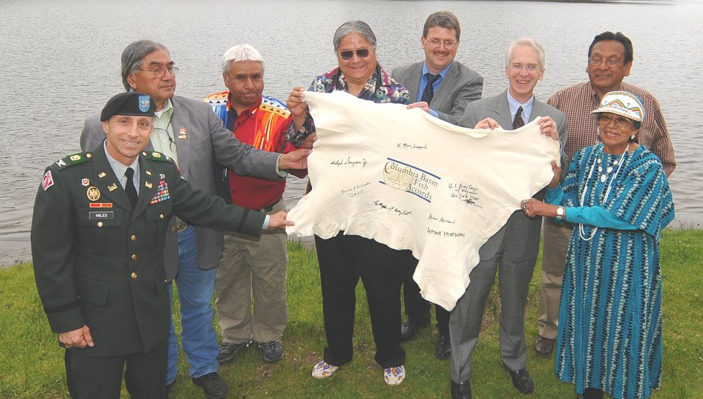
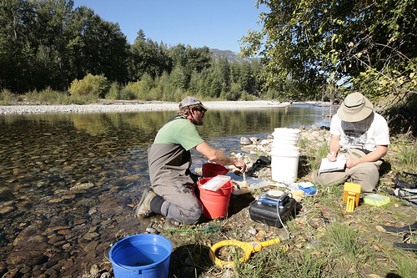
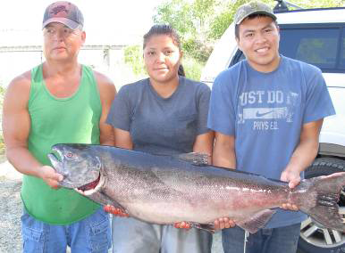
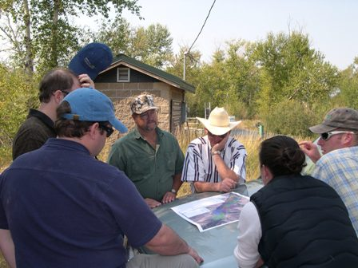
Columbia Basin Fish Accords

Slide 8
2018 Accord Extension partners
Columbia River Inter-Tribal Fish Commission
Confederated Tribes and Bands of the Yakama Nation
Confederated Tribes of the Warm Springs Reservation of Oregon
Confederated Tribes of the Umatilla Indian Reservation
Confederated Tribes of the Colville Reservation
Shoshone Bannock Tribes
Kalispel Tribe of Indians
State of Idaho
State of Montana

Slide 9
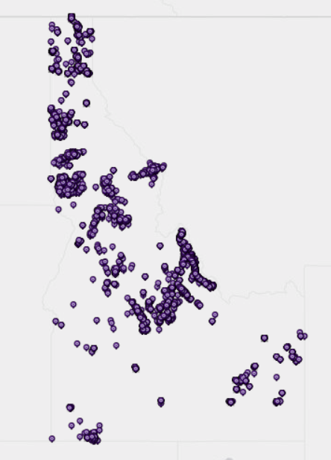
2018 Idaho Habitat Restoration
$40 Million on the ground work
2,047 Acre-feet/ year of water protected
116 Miles of habitat accessed
18 stream miles of improved complexity

Slide 10
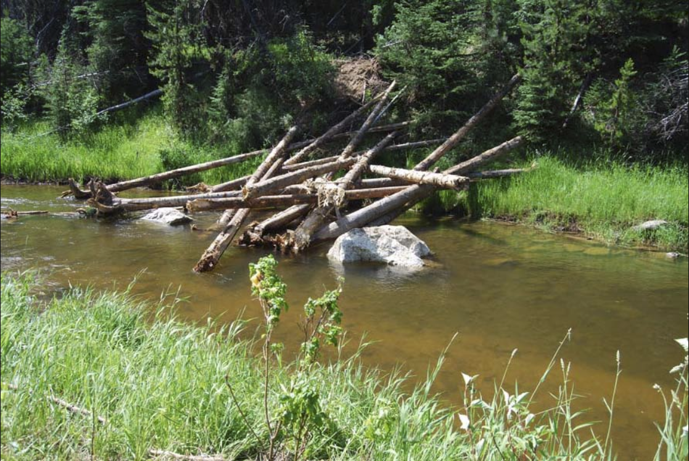

Slide 11
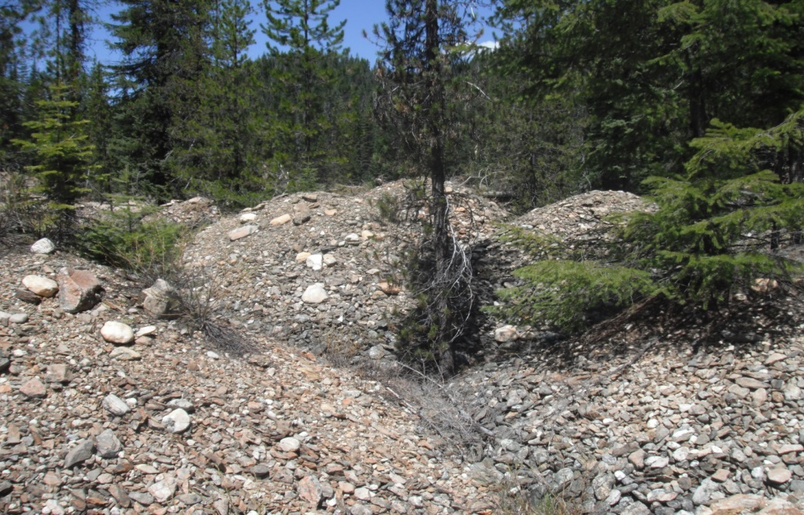
Clearwater Habitat Restoration
Newsome Creek, Tributary to South Fork Clearwater River

Slide 12
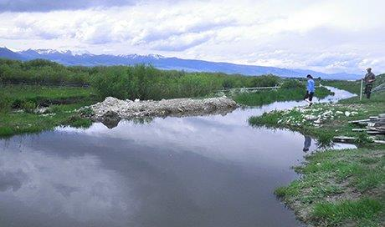
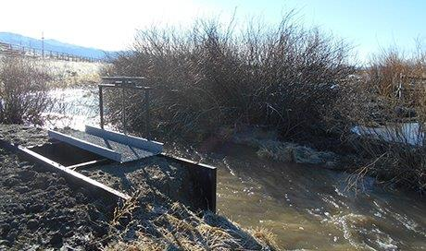
Lemhi - Eighteenmile Creek- Phase I
Before: slow moving ditch that inhibited fish passage
After: restored stream’s natural flow while still meeting irrigator’s needs
Partners: Lemhi Soil and Water Conservation District, Idaho Governor’s Office of Species Conservation, Upper Salmon Basin Watershed Program, Reclamation, BPA

Slide 13
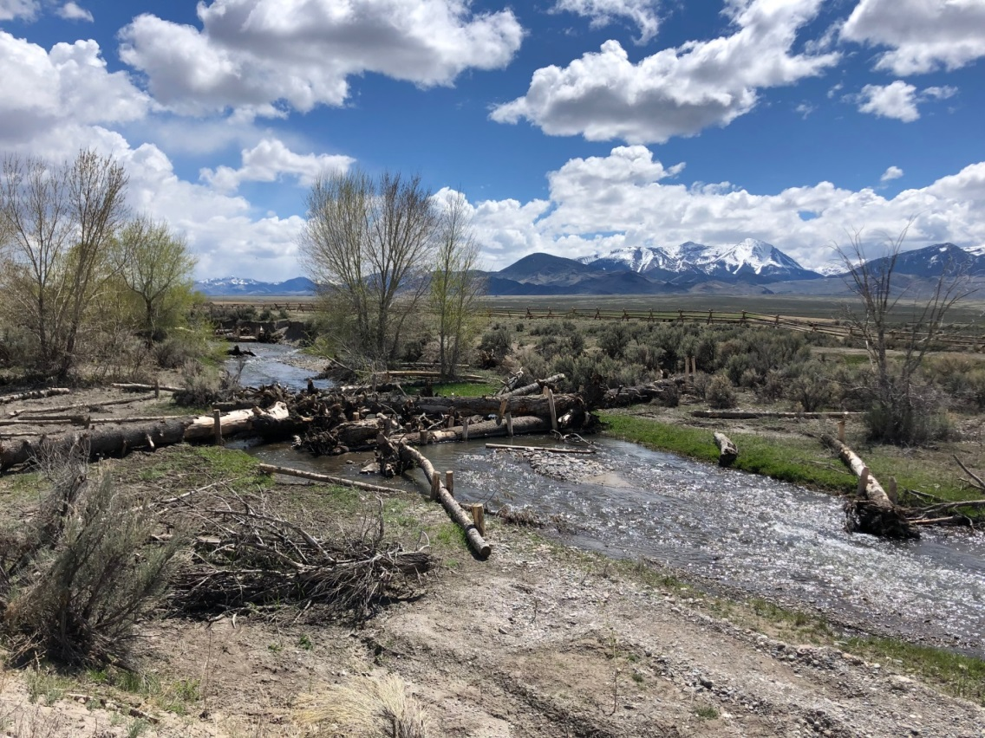
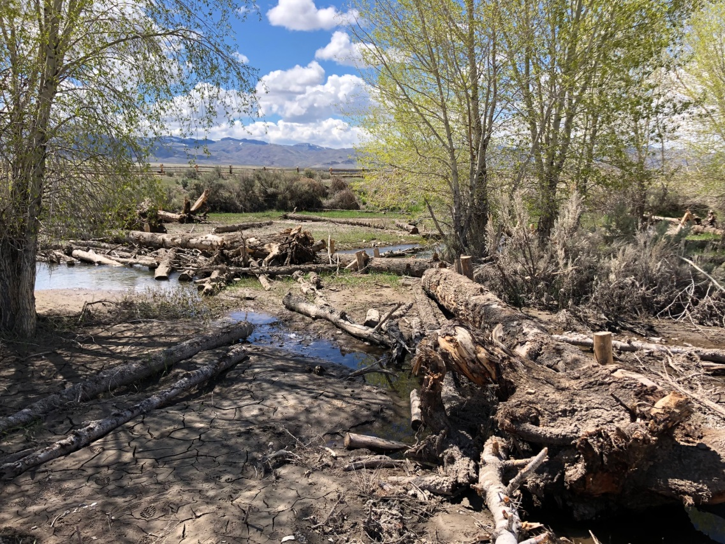
Pahsimeroi Restoration
Partners: Idaho Department of state lands, PCSRF, Custer SWCD, Idaho Governor’s Office of Species Conservation, Upper Salmon Basin Watershed Program, Reclamation, BPA

Slide 14
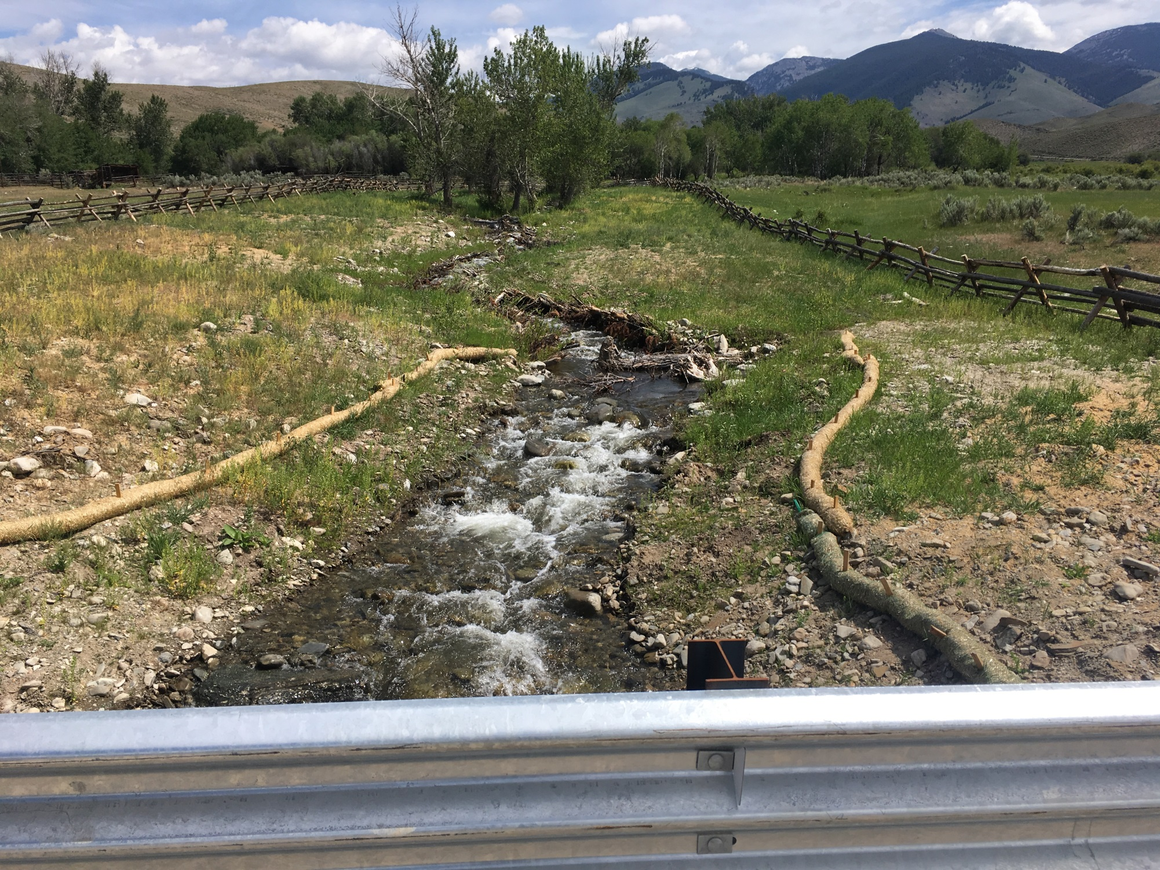
Pahsimeroi Restoration- Partnerships

