Slide 1
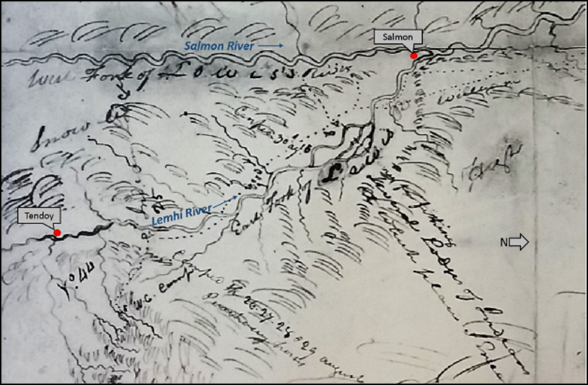
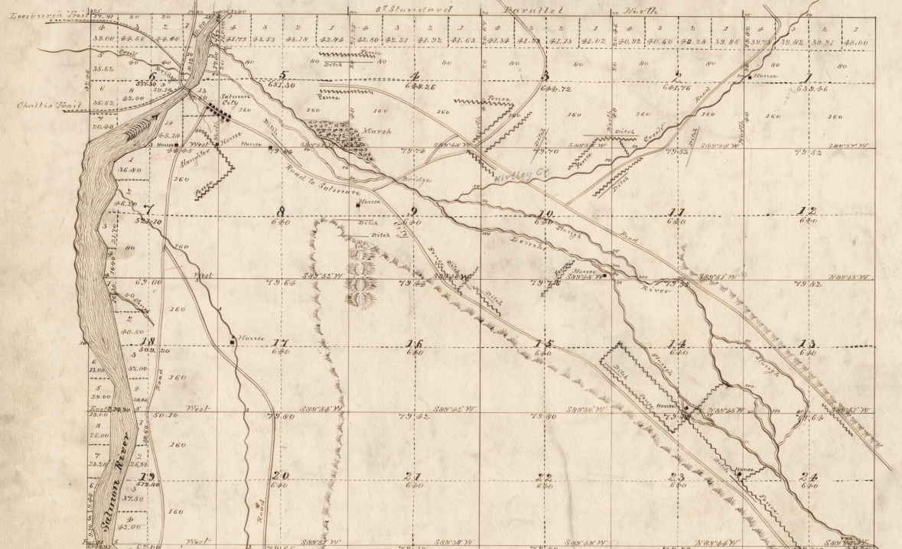
Habitat Restoration
Doing the right things in the right places
Historical Conditions
Impacts
Trends
Understand Conditions
Develop Appropriate Solutions
Restoration Design
Construction

Slide 2
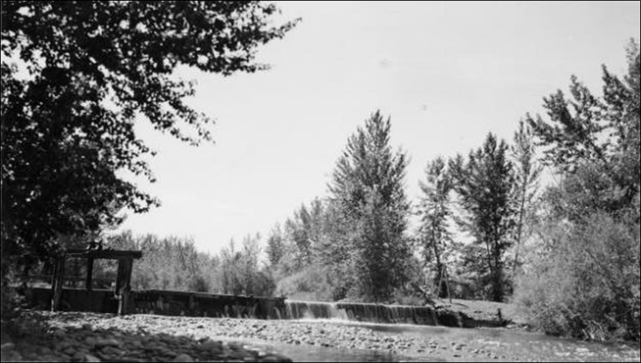
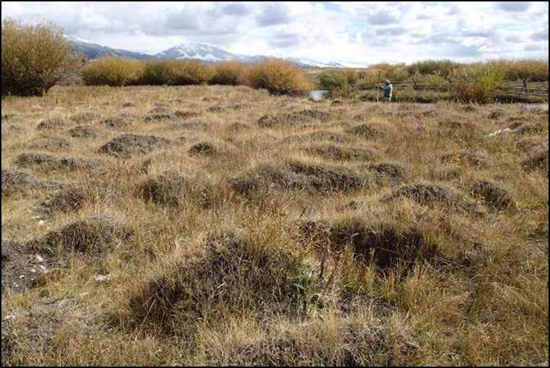
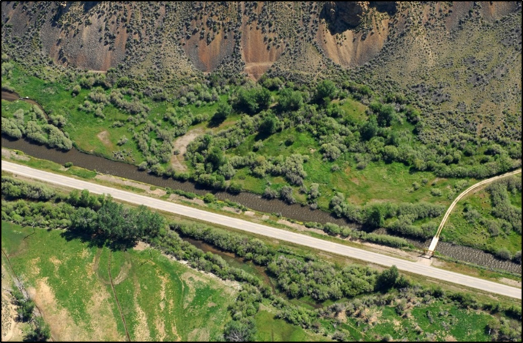
Habitat Restoration
Doing the right things in the right places
Historical Conditions
Impacts
Trends
Understand Conditions
Develop Appropriate Solutions
Restoration Design
Construction

Slide 3
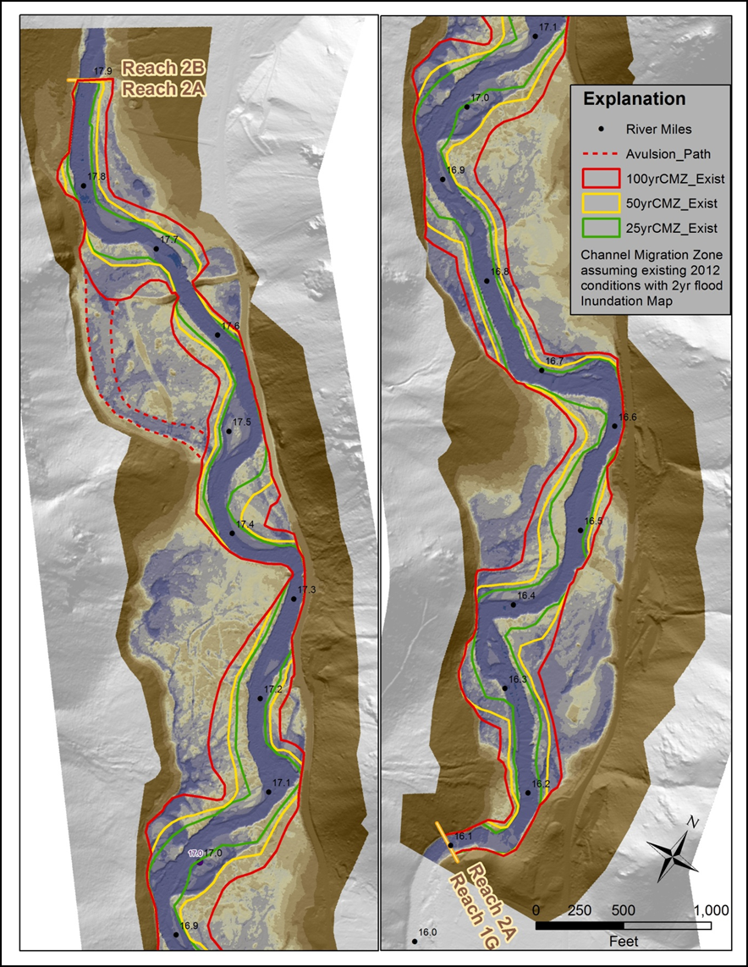
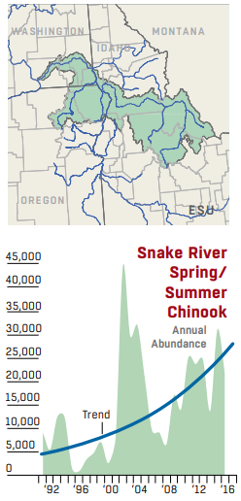
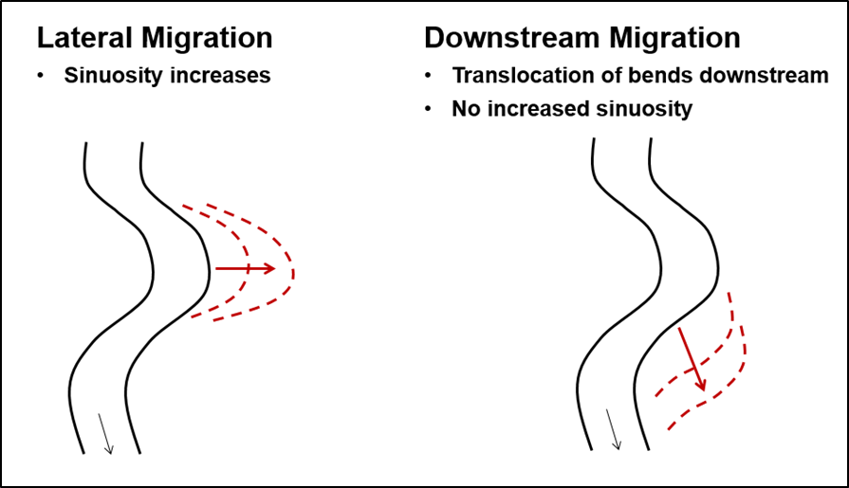
Habitat Restoration
Doing the right things in the right places
Historical Conditions
Impacts
Trends
Understand Conditions
Develop Appropriate Solutions
Restoration Design
Construction

Slide 4
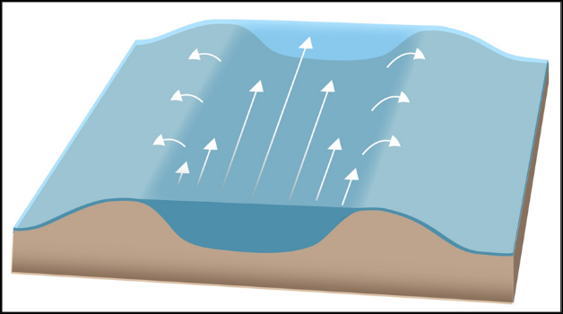
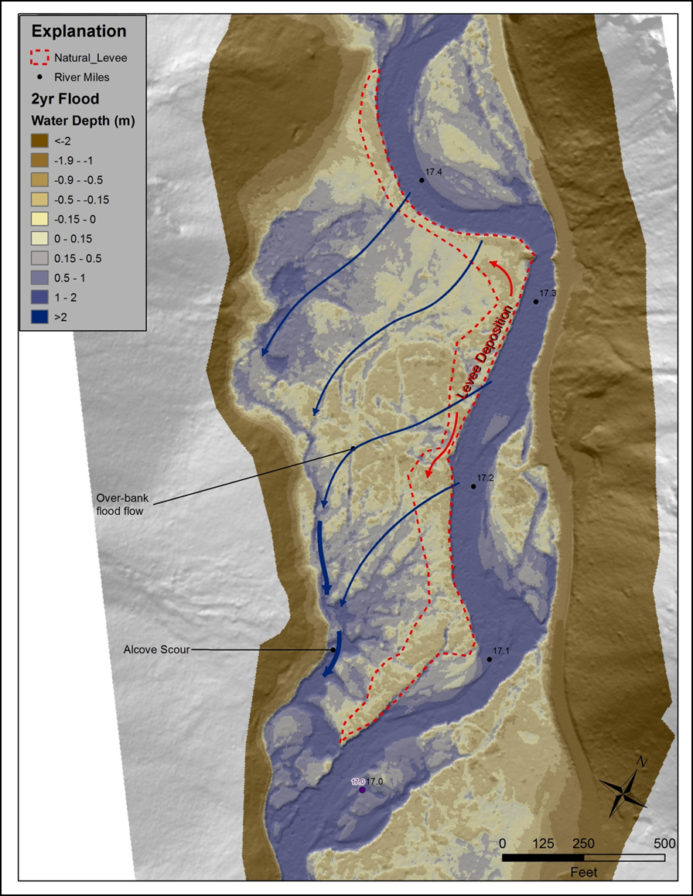
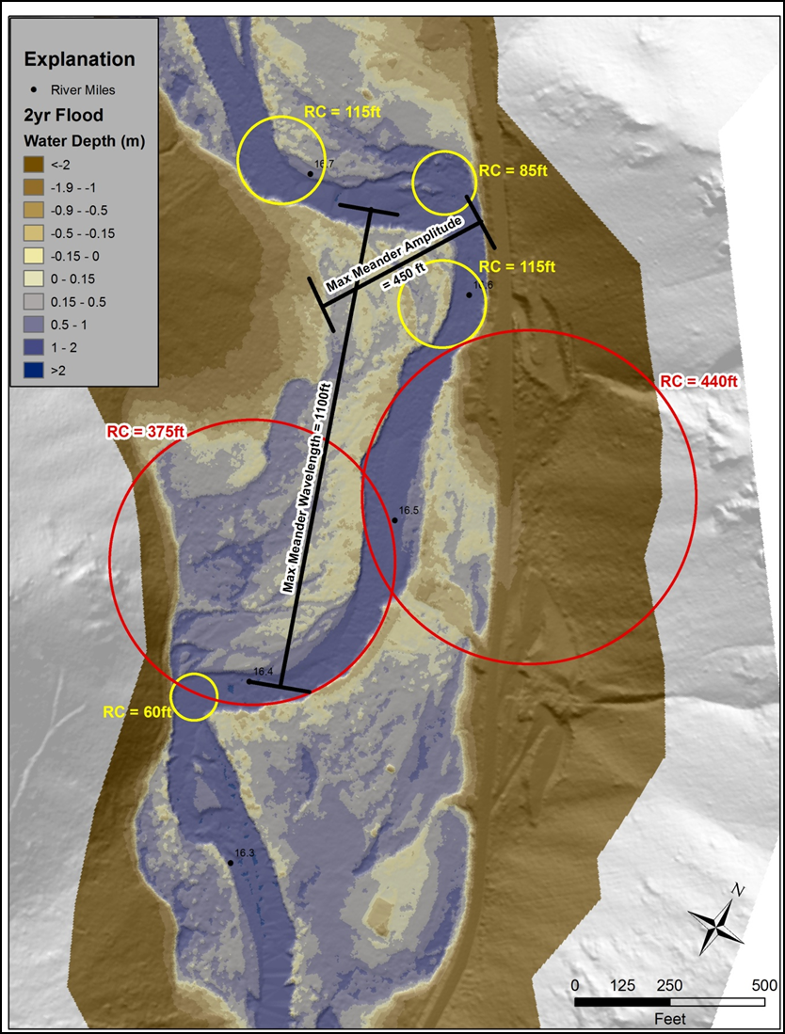
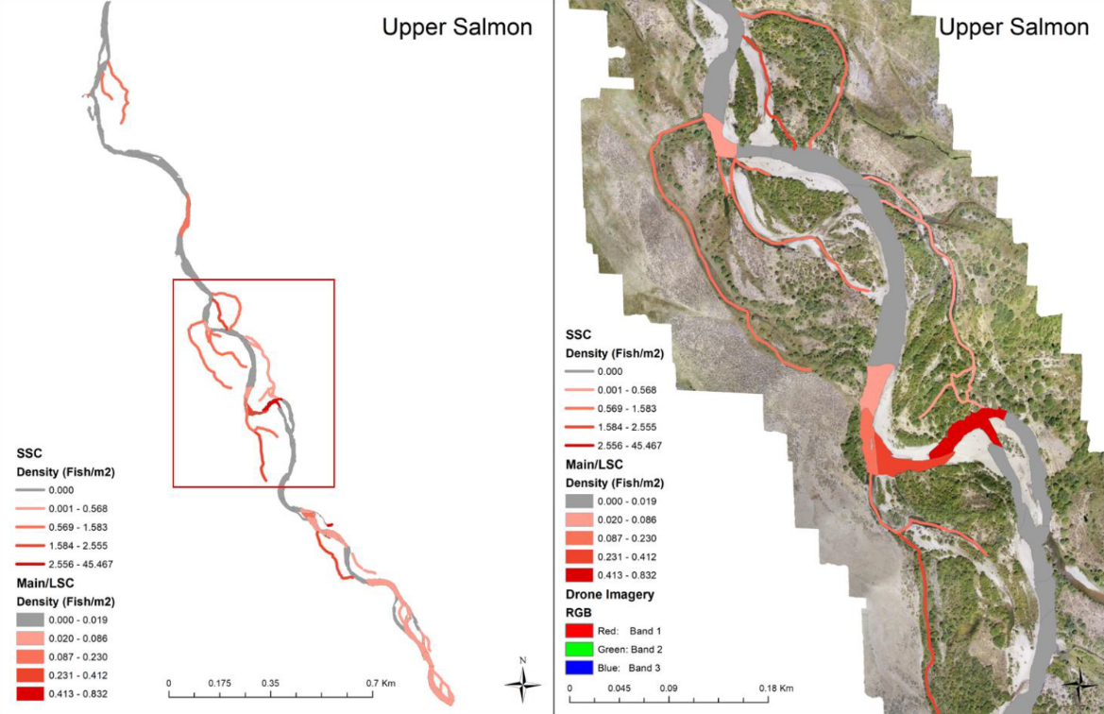
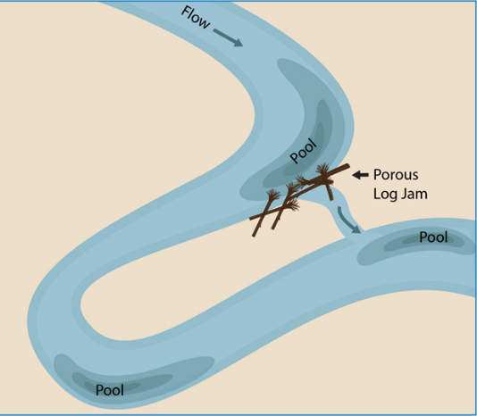
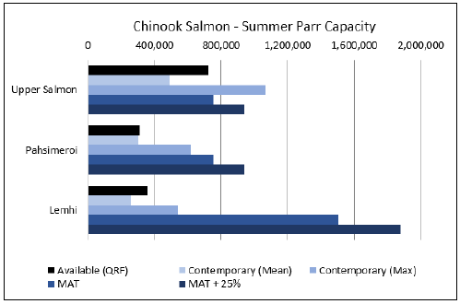
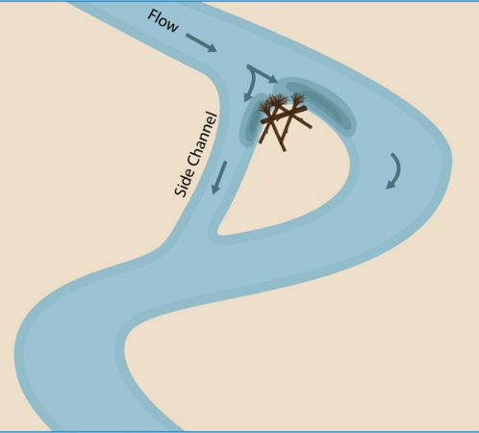
Habitat Restoration
Doing the right things in the right places
Historical Conditions
Impacts
Trends
Understand Conditions
Develop Appropriate Solutions
Restoration Design
Construction

Slide 5
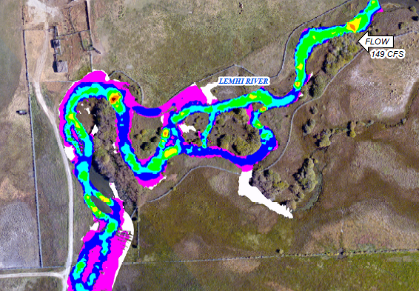
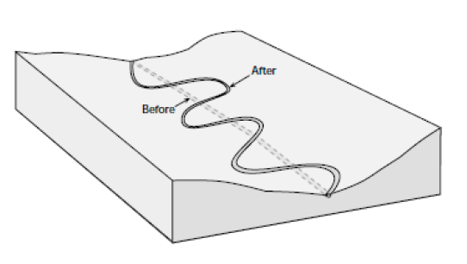
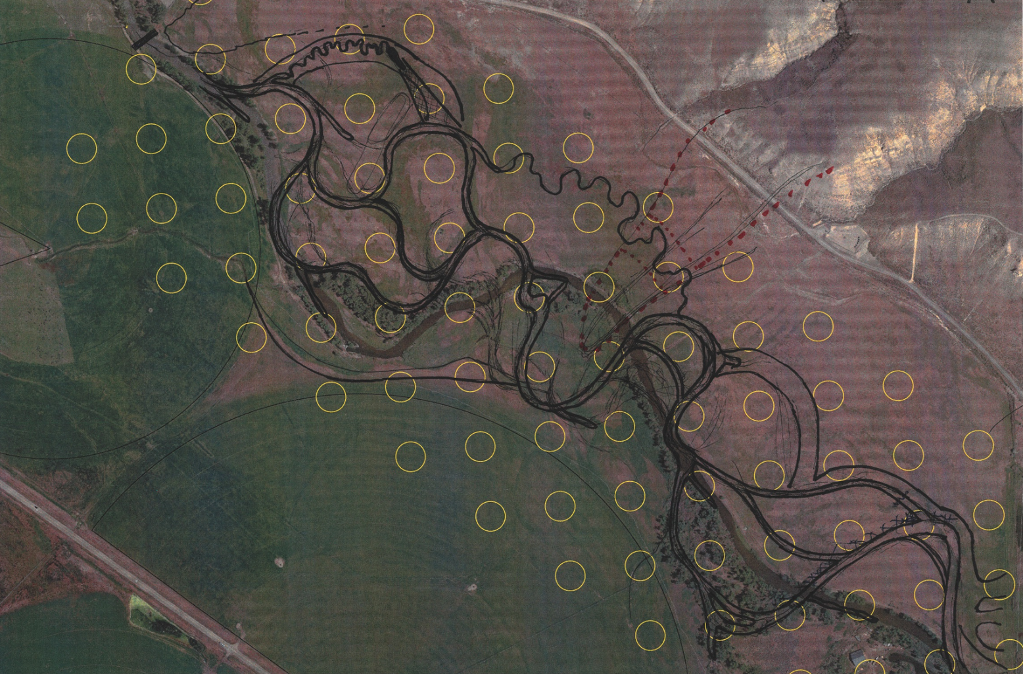
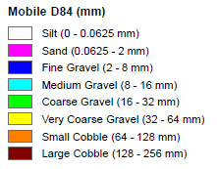
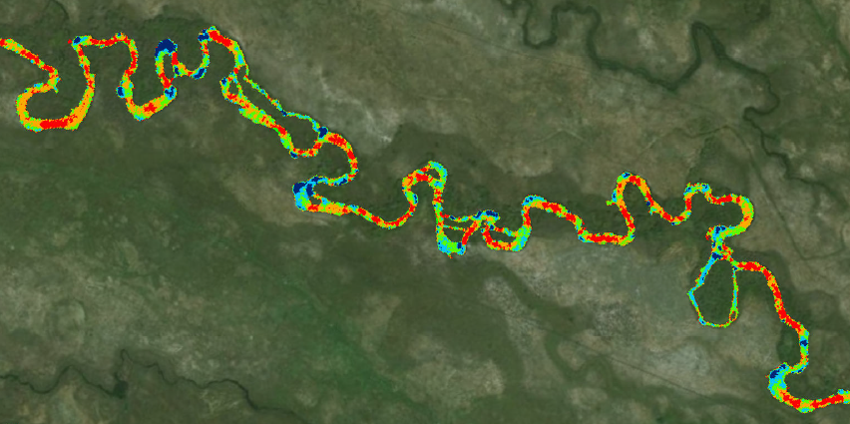
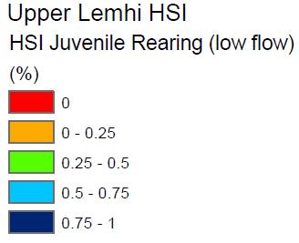
Habitat Restoration
Doing the right things in the right places
Historical Conditions
Impacts
Trends
Understand Conditions
Develop Appropriate Solutions
Restoration Design
Construction

Slide 6
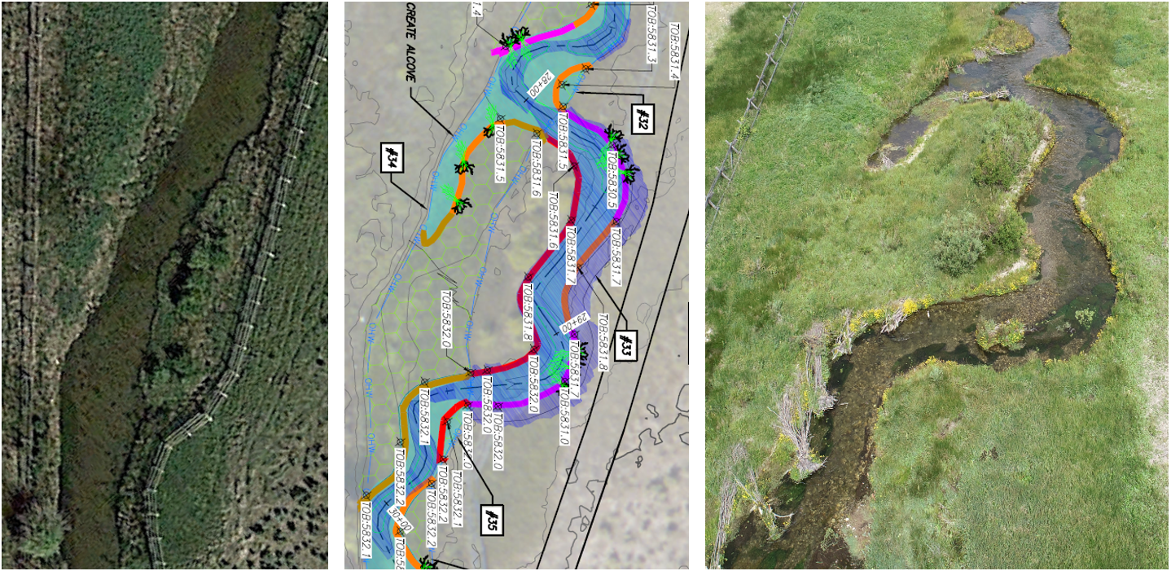
Habitat Restoration
Doing the right things in the right places
Historical Conditions
Impacts
Trends
Understand Conditions
Develop Appropriate Solutions
Restoration Design
Construction
Before
Design
After

Slide 7
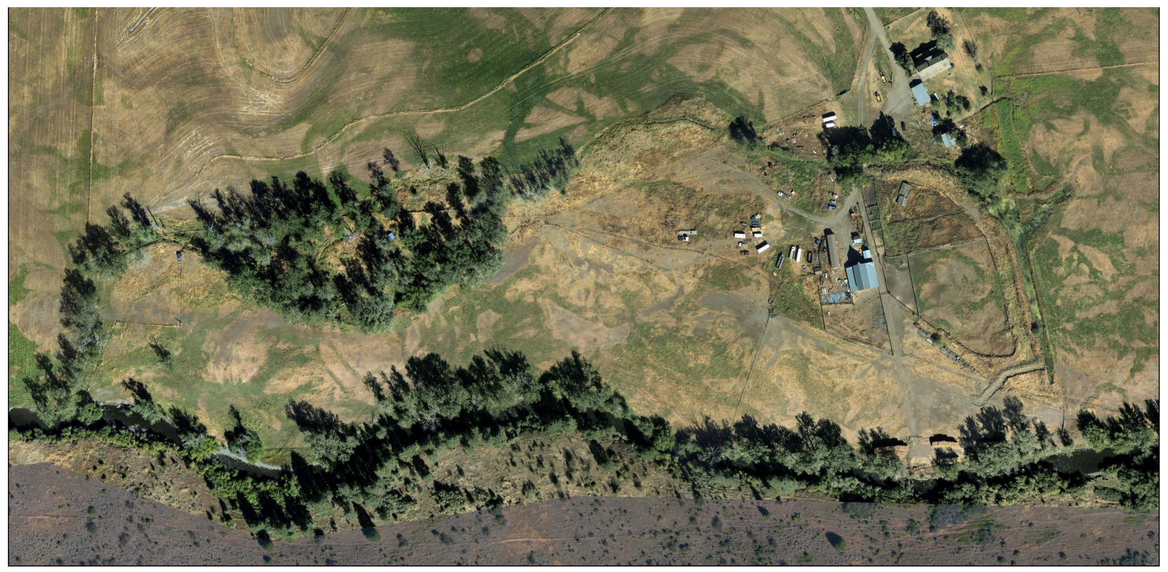
2014 Aerial Image

Slide 8
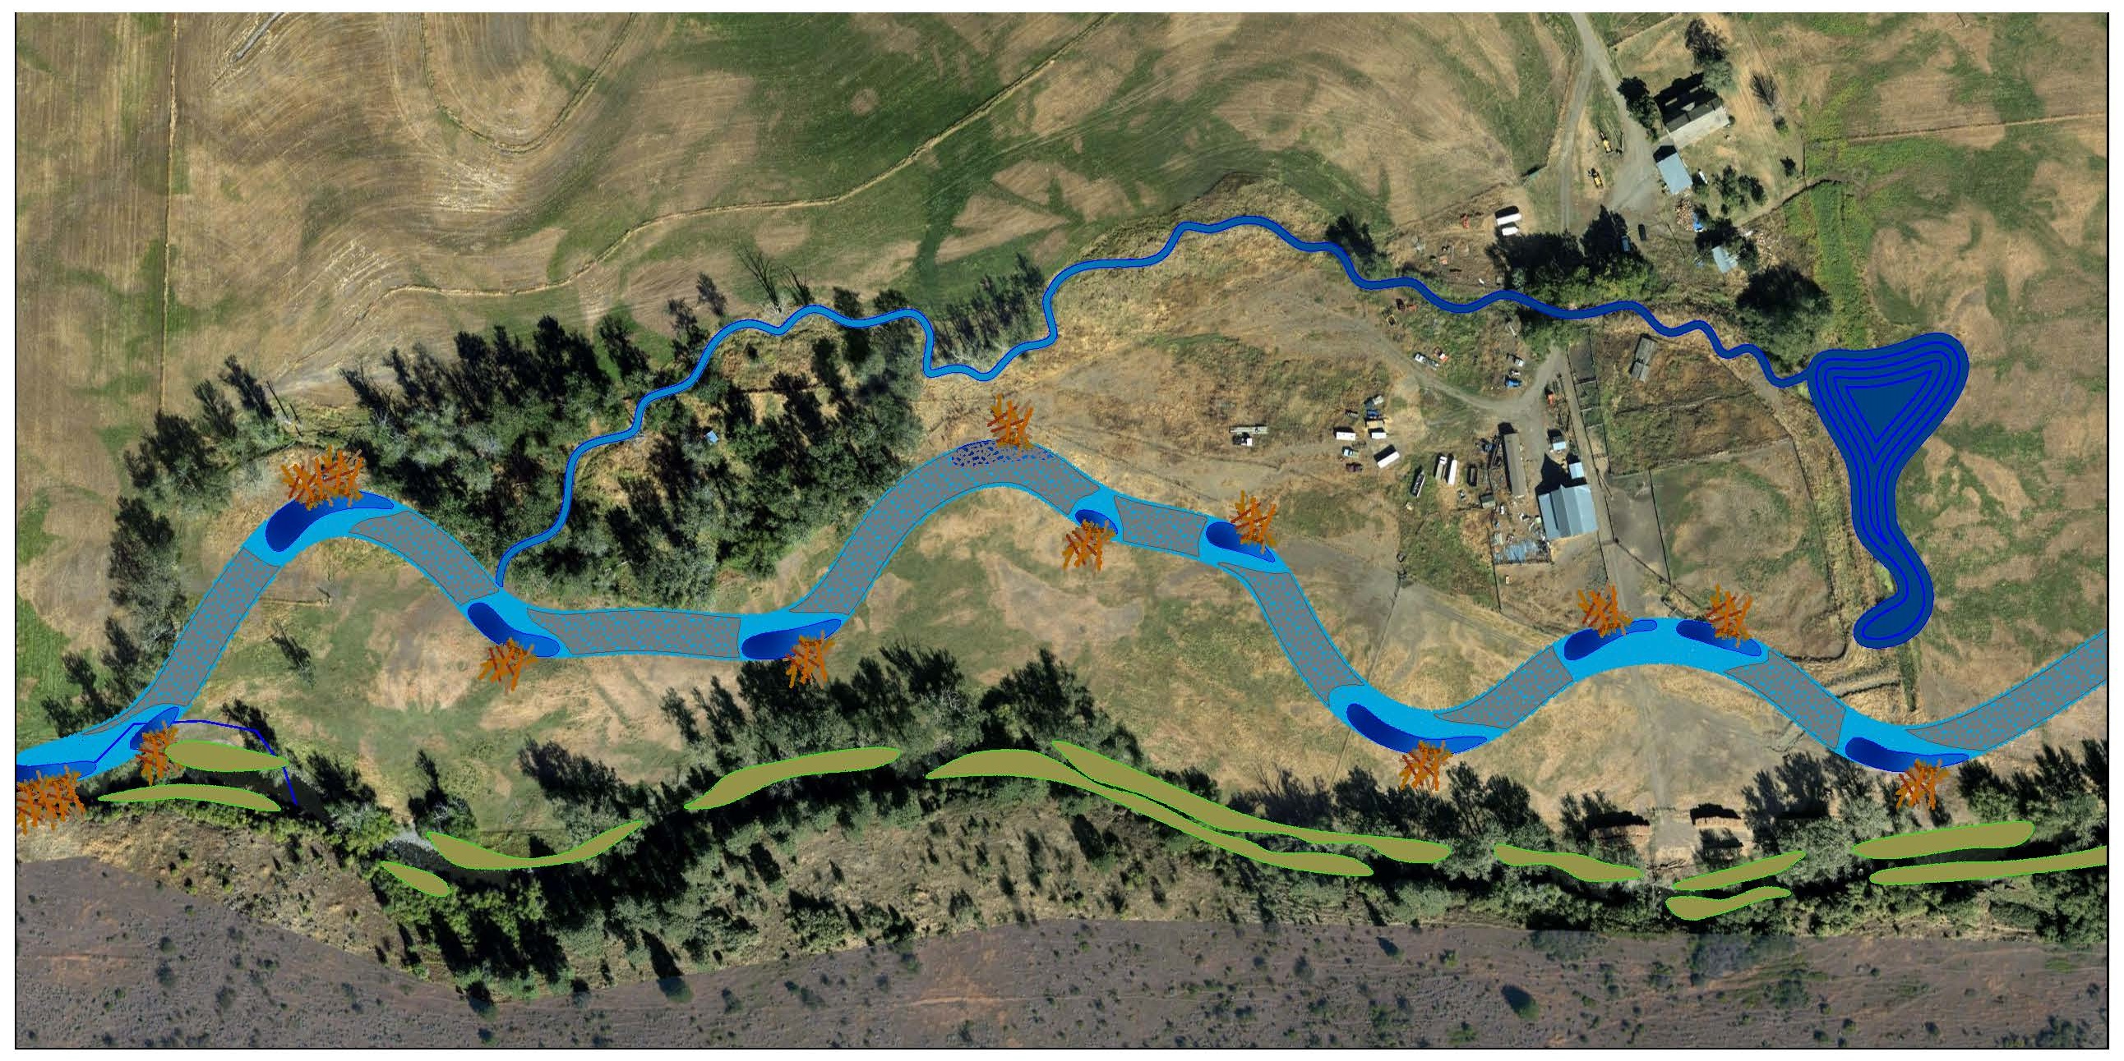
Conceptual Level Design

Slide 9
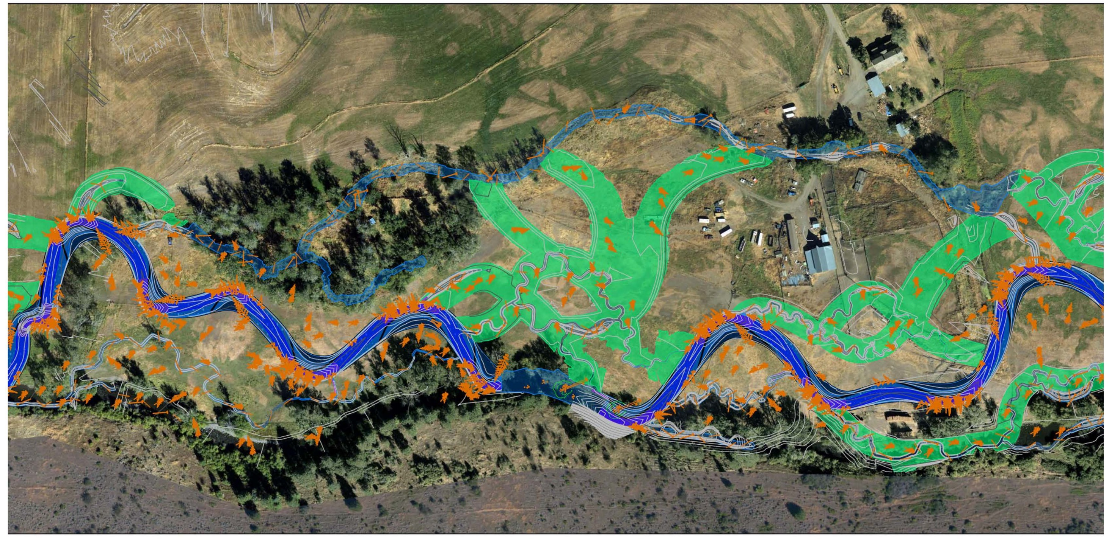
Final Design

Slide 10
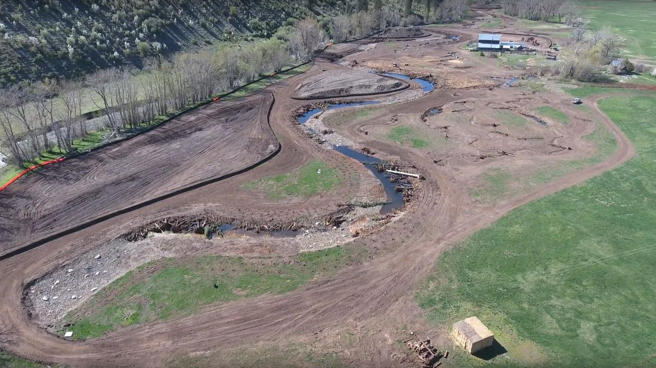
Construction

Slide 11
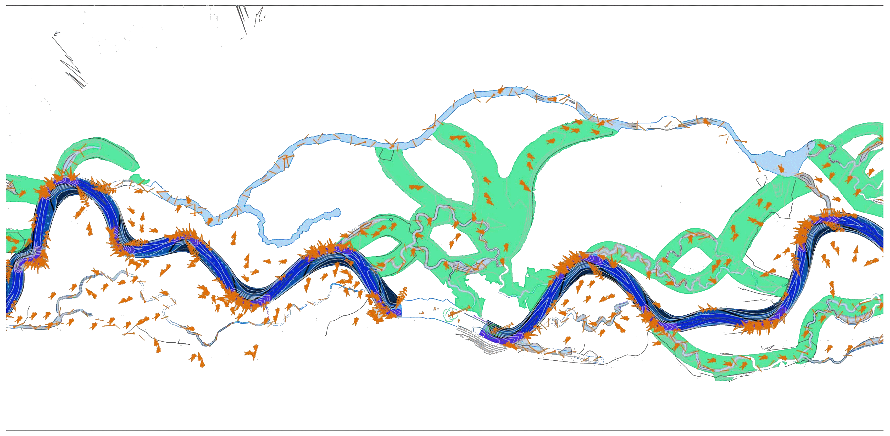
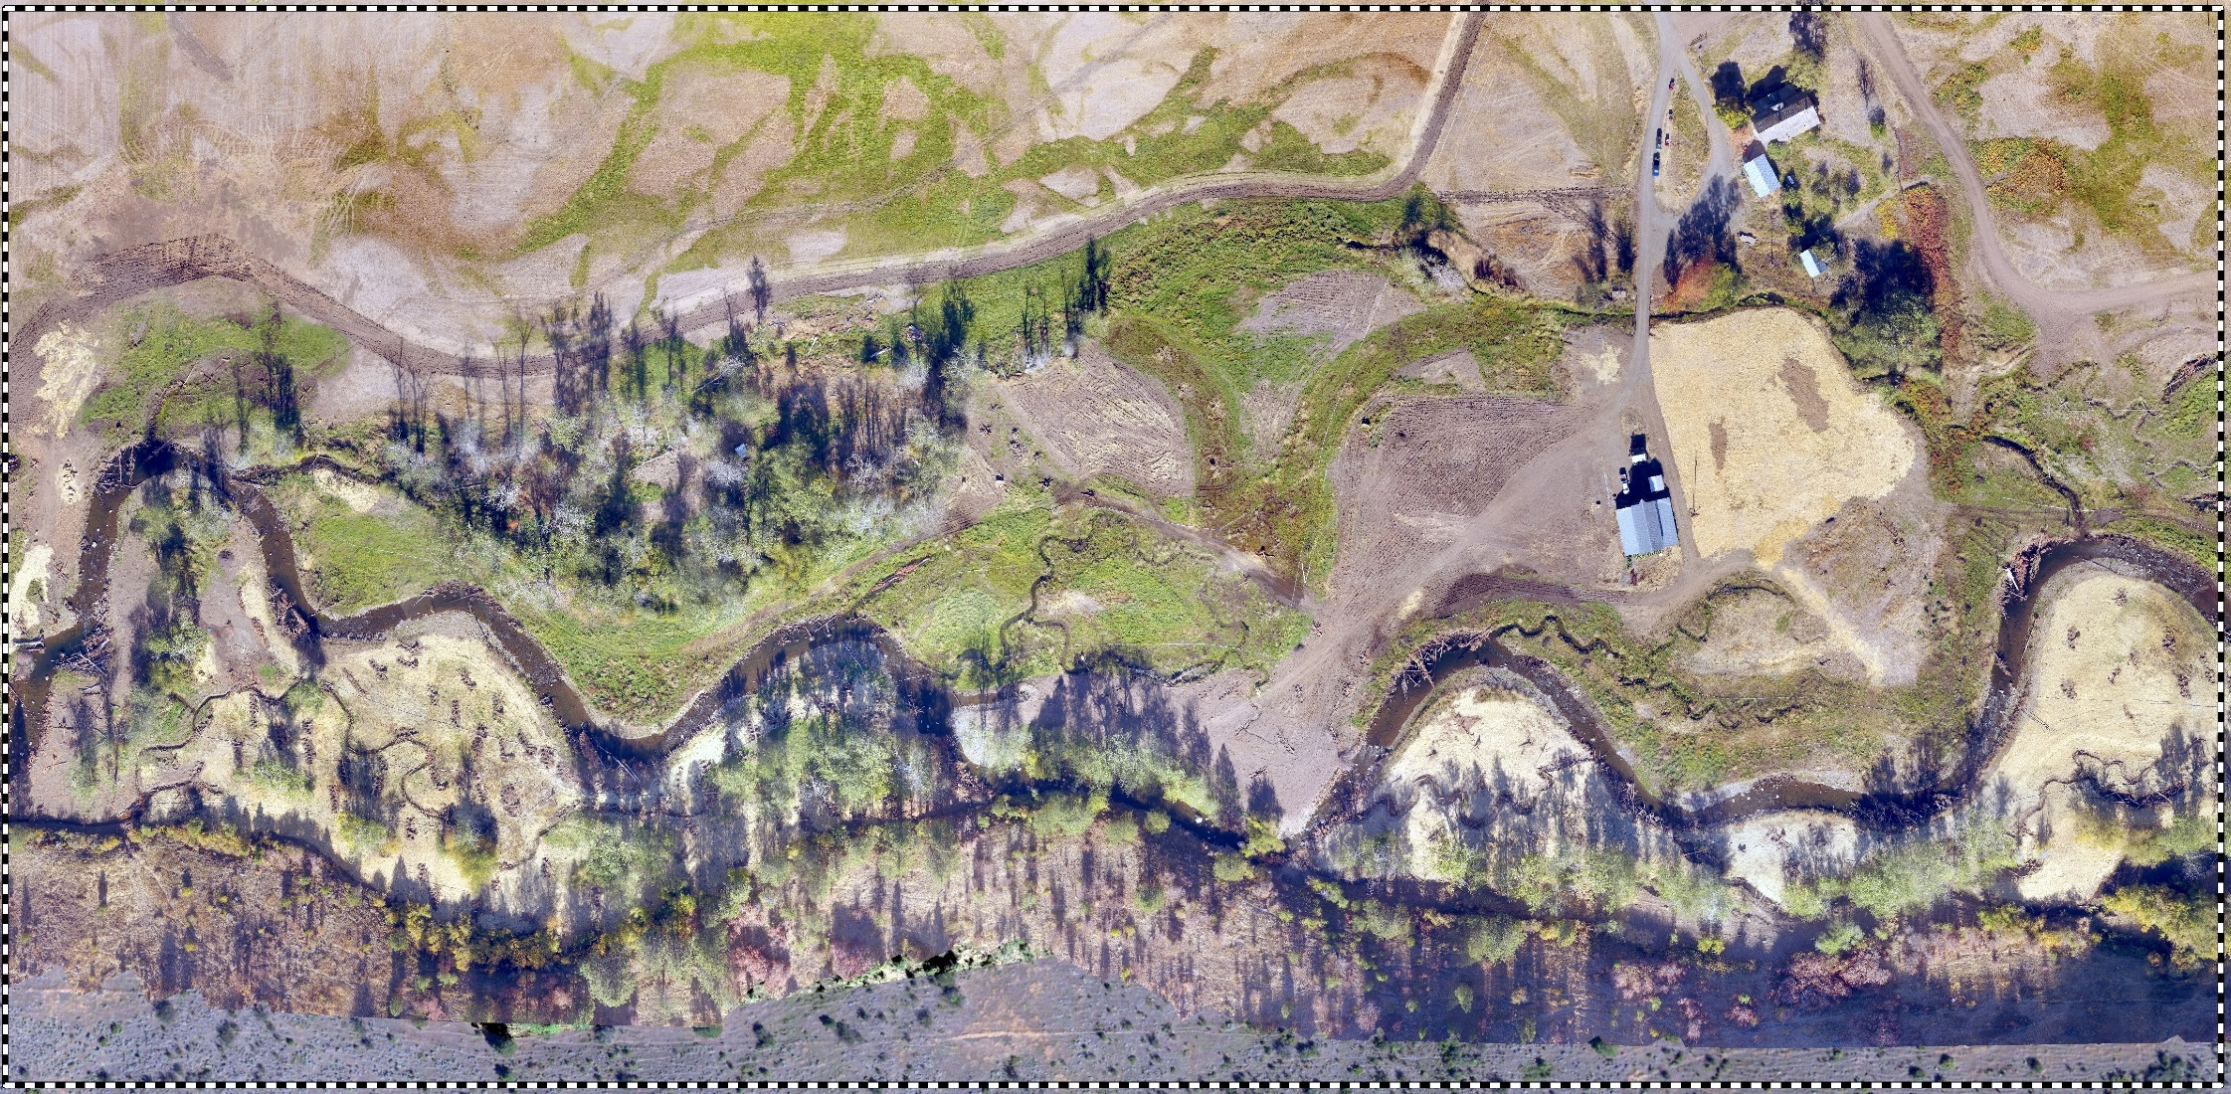
2016 Post Construction

Slide 12
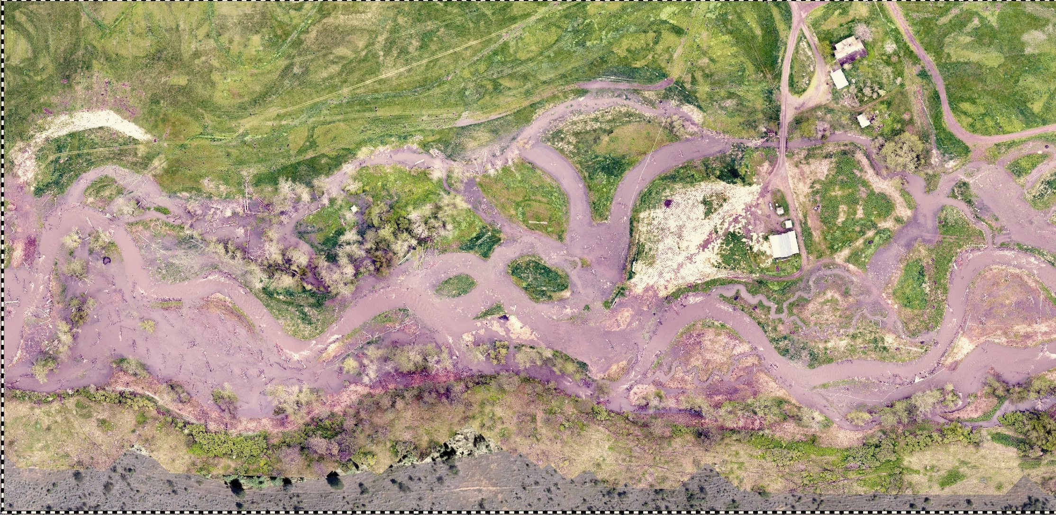
May 2017 Seasonal High Flow

Slide 13
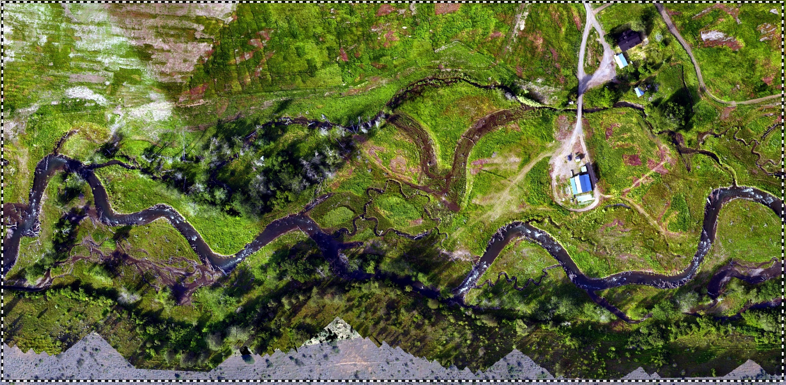
June 2018 Moderate Flow

Slide 14
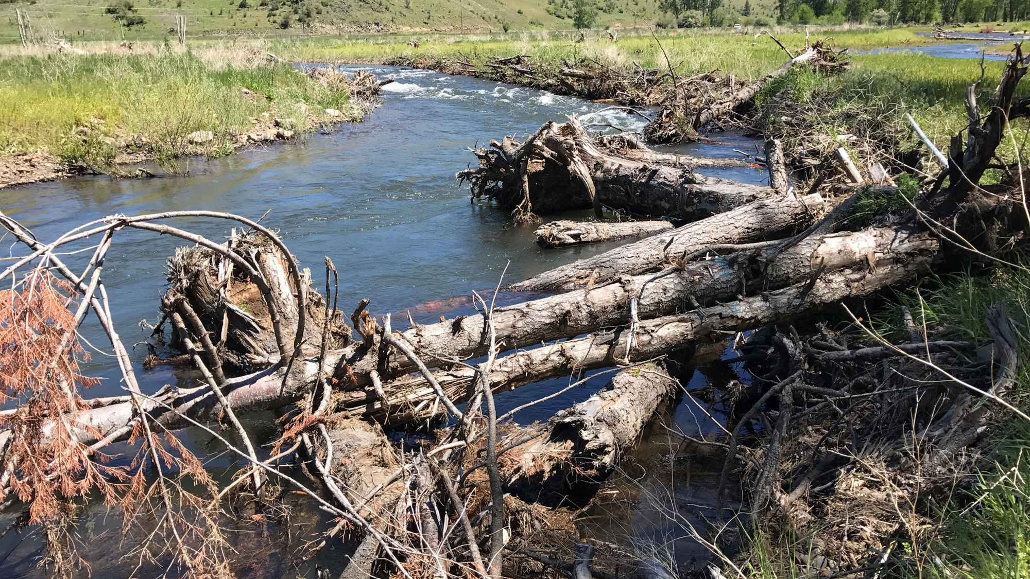
On The Ground

Slide 15
Habitat Restoration
My Perspective:
Wholistic Approach – Restoring salmon habitat in effect restores streams, riparian areas, floodplains, watersheds, and the broader environment providing benefit to the species that inhabit those areas (including people).
Incremental Steps in the Right Direction – Decades of declining habitat and watershed conditions takes time to fix. We should not discount incremental improvement because
we haven’t yet crossed the finish line.

