Slide 1
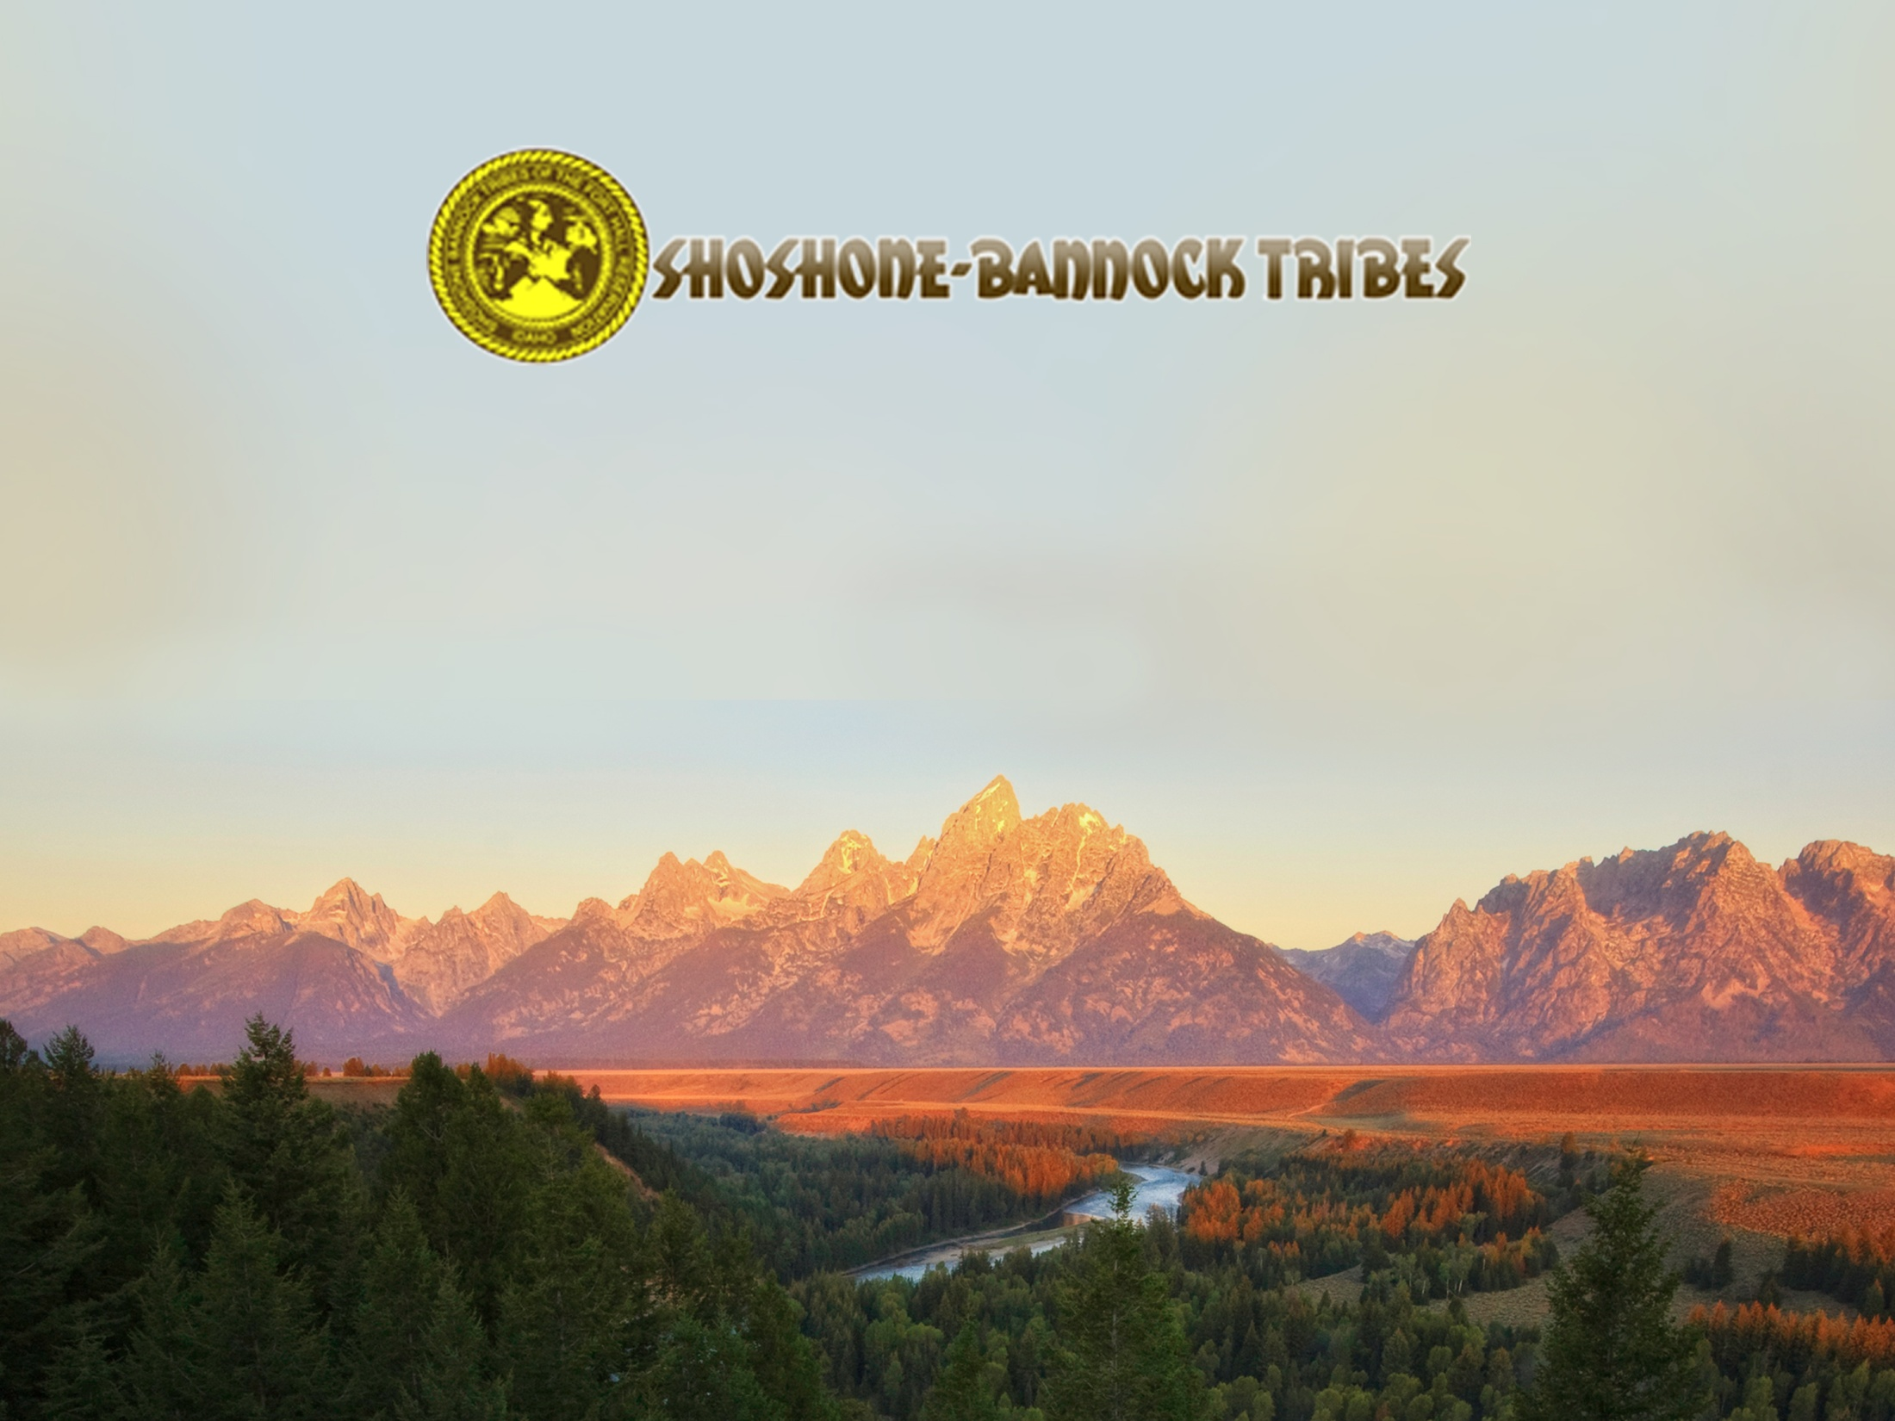
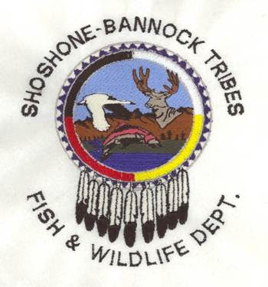
GOVERNOR’S SALMON WORKGROUP
SALMON RIVER SUBBASIN
HABITAT ACTIONS
JULY 31, 2019
Notes:
THE TRIBES PERSPECTIVES IS BASED UPON OUR RELIANCE ON THE NATURAL RIVERINE ECOSYSTEM OF THE COLUMBIA RIVER BASIN FOR SUBSISTENCE SINCE TIME IMMEMORIAL.
THE POLICY RECOMMENDATIONS GIVEN BY THIS WORKING GROUP WILL HAVE A SIGNIFICANT IMPACT ON THE MANY DIFFERENT CULTURES AND ECONOMIES OF IDAHOANS.
WE MUST ENSURE FUTURE GENERATIONS WILL HAVE THE SAME UNIQUE OPPORTUNITIES TO ENJOY THE LANDSCAPE, GATHER RESOURCES AND CONTINUE TRADITIONAL CULTURAL PRACTICES.

Slide 2
THE TRIBES’ DESIRED FUTURE CONDITION
Tribal members will have the opportunity to harvest salmon using both traditional and contemporary methods on populations that are sustainable, resilient, and abundant.
Snake River Management – Policy Statement:
The Shoshone Bannock Tribes (Tribes) will pursue, promote, and where necessary, initiate efforts to restore the Snake River systems and affected unoccupied lands to a natural condition. This includes the restoration of component resources to conditions which most closely represents the ecological features associated with a natural riverine ecosystem. In addition, the Tribes will work to ensure the protection, preservation, and where appropriate-the enhancement of Rights reserved by the Tribes under the Fort Bridger Treaty of 1868 (Treaty) and any inherent aboriginal rights.
Notes:
THE TRIBES ARE AN ACTIVE CO-MANAGER OF SALMON, WITH POLICY THAT GUIDES FUTURE TRIBAL ACTIONS.
THE TRIBES OFFER A POLICY STATEMENT THAT STRESSES THE IMPORTANCE OF INITIATING EFFORTS TO RESTORE THE SNAKE RIVER AND AFFECTED UNOCCUPIED LANDS TO A NATURAL CONDITION.
THIS POLICY PROVIDES THE DIRECTION AND GUIDANCE FOR THE IMPLEMENTATION OF HABITAT ACTIONS WE BELIEVE WILL PROVIDE FOR SUSTAINABLE, RESILIENT, AND ABUNDANT SALMON POPULATIONS.

Slide 3
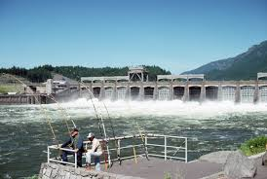
FISH ACCORD & EXTENTION 2008 - 2022
In 2008 the Tribes entered into a 10 year $61 million fish and wildlife mitigation funding agreement “Fish Accord” w/ Bonneville Power Administration, Bureau of Reclamation and Corps of Engineers; and, signed an Extension to the original agreement for 2019 -2022.
Extensions provided:
Additional Funding Commitment –
  ~$20 million over 4 years (2019-2022)
  Carryforward $12.5 million Hatchery
Integrated Fish & Wildlife Mitigation –
  Federal Columbia River Power System
    ESA - biological opinion; and,
    NPCC’S Fish and Wildlife Program
Flexibility for project implementation and budgeting.
Bonneville Dam – Columbia River
Notes:
THE PRIMARY PURPOSE IN DEVELOPING THIS AGREEMENT WAS TO ALLOW THE TRIBES FUNDING TO IMPLEMENT SOUND CONSERVATION PROJECTS FOR ANADROMOUS AND RESIDENT FISH/WILDLIFE WHILE THE FEDERAL AGENCIES DEVELOPED AN ENVIRONMENTAL IMPACT STATEMENT FOR THE COLUMBIA RIVER SYSTEM OPERATIONS OVER THE NEXT FOUR YEARS.
WITHOUT AN EXTENSION TO THE ACCORD, OUR PROJECTS WOULD HAVE ULTIMATELY BEEN DEEMED ‘COMPLETE’ AND EACH PROJECT WOULD THEN HAVE TO GO THROUGH A STATE (OREGON, IDAHO, WASHINGTON, MONTANA) APPOINTED FUNDING BOARD KNOWN AS THE NORTHWEST POWER CONSERVATION COUNCIL FOR APPROVAL ON A THREE-YEAR CYCLE.
THIS EXTENSION PUTS THE TRIBES IN A POSITION TO DETERMINE THE MOST APPROPRIATE USE OF OUR FUNDS AND OUR PRIORITY FOR PROJECTS.

Slide 4
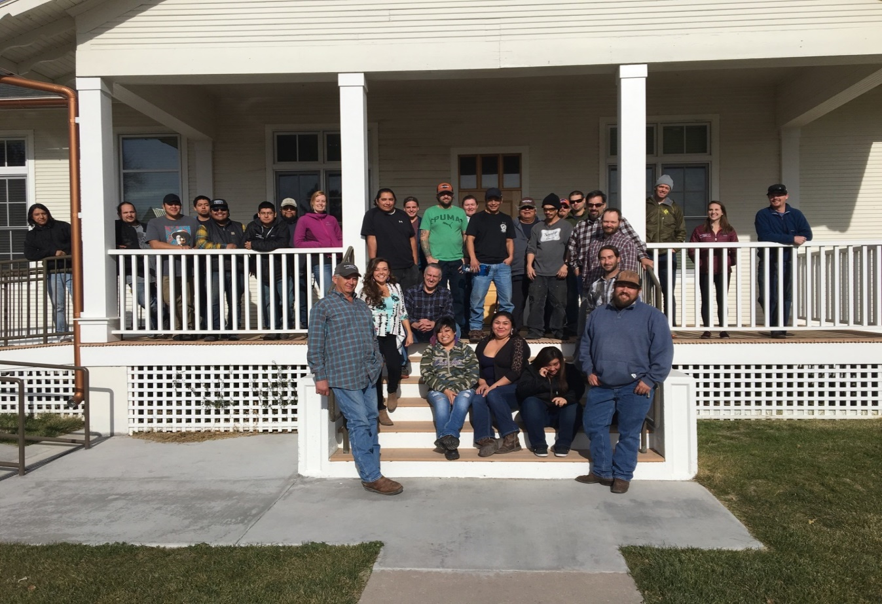
THE FISH AND WILDLIFE DEPARTMENT
Employment: ~ 60 permanent and seasonal employees
Annual Budget: $5 million Contracts / Grants: 30
PROGRAMS:
Southern Idaho Wildlife Mitigation
Snake River Sockeye Research
Crystal Springs Hatchery
Fort Hall Stream Restoration
Idaho Supplementation Studies
Administration Program
Tribal Supplementation
Salmon River Habitat Enhancement
Yankee Fork Floodplain Restoration
Nutrient Enhancement
ESA Habitat
Lower Snake River Compensation
Resident Fish & Wildlife
Columbia River Fish Management
Environmental
Forestry / Woodlands
Greenhouse / Nursery
Pacific Coastal Salmon Recovery
Native American Interpretive Rivers
Non-Member Permit Fishing / Hunting Programs
FUNDING SOURCES: Bonneville Power Administration, U.S. Fish & Wildlife Service, NOAA Fisheries, Bureau of Indian Affairs, Tribal General Fund, Bureau of Land Management, Bureau of Reclamation, Forest Service, Natural Resource Conservation Service, and the Department of Energy.
Notes:
TO IMPLEMENT THE ORIGINAL FISH ACCORD REQUIIRED THE DEPARTMENT TO INCREASE OUR CAPACITY.
PRE 2008 AT 40 EMPLOYEES 20 ; 20; PEAK DURING ACCORD 70 W/ 40 : 30; AND NOW AT ~ 60 W/ 40 : 20 SPLIT

Slide 5
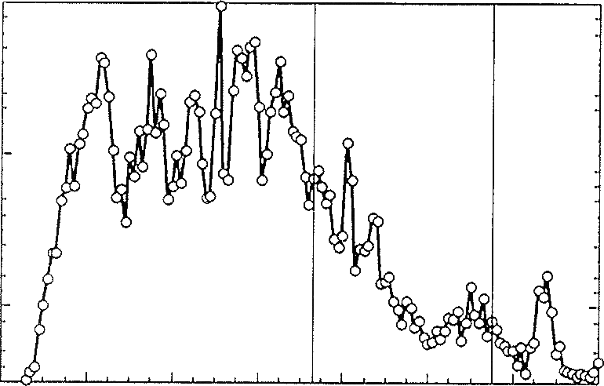
Past land-use practices, fish harvesting strategies, and hydroelectric development led to a severe reduction of nutrients reaching natal streams
COLUMBIA RIVER - HISTORIC SALMON CATCH
50
40
30
20
10
0
Columbia River Dam Construction
Millions of pounds
1860 1880 1900 1920 1940 1960 1980 2000
Graph depicting annual salmon catches on the Columbia River, 1860 to 2000.
Notes:
IN THE BASIN AN ESTIMATED 5-9 MILLION ANADROMOUS FISHES RETURNED ANNUALLY (ALLDREDGE ET AL., NORTHWEST POWER AND CONSERVATION COUNCIL ISAB REPORT 2015).
EXCESSIVE HARVEST, POOR LAND-USE AND HATCHERY PRACTICES, AND HYDROELECTRIC DEVELOPMENT IN THE COLUMBIA RIVER BASIN HAS LED TO A PRECIPITOUS DECLINE OF ADULT SPAWNERS REACHING THEIR NATAL STREAMS.
THE TRIBES ARE SEEING A GROWING ACCEPTANCE OF THE NEW LEVELS OF ABUNDANCE.
THE MAJOR SOURCE OF DECLINE CAME AFTER THE CONSTRUCTION OF THE COLUMBIA AND SNAKE RIVER DAMS.

Slide 6
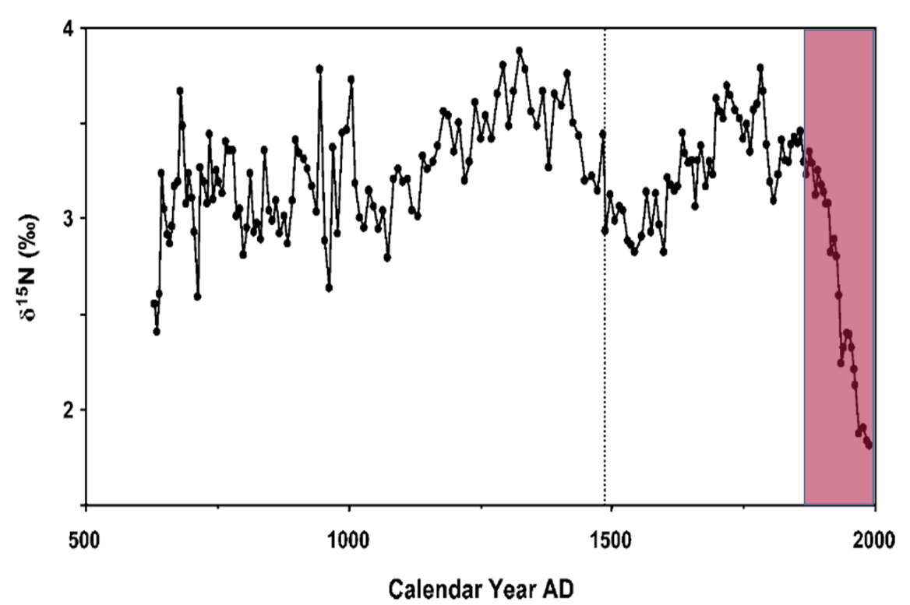
MARINE DERIVED NUTRIENTS
Population decline reflected in estimates from lake sediment cores examining marine derived nutrients in Redfish Lake. Highlighted area represents dam installation in the Columbia River Basin.
Notes:
ABUNDANT POPULATIONS OF ANADROMOUS SALMONIDS (ONCORHYNCHUS SPP.) HISTORICALLY CONTRIBUTED LARGE AMOUNTS OF MARINE-DERIVED NUTRIENTS (MDN) TO AQUATIC AND TERRESTRIAL ECOSYSTEMS IN THE PACIFIC NORTHWEST (PNW) OF THE UNITED STATES OF AMERICA (CALIFORNIA, OREGON, WASHINGTON, AND IDAHO) (KLINE ET AL. 1990; LARKIN & SLANEY 1997; CEDERHOLM ET AL. 1999; GRESH ET AL. 2000; BILBY ET AL. 2003).
ENERGY AND NUTRIENTS DELIVERED TO FRESHWATER ECOSYSTEMS ALSO BENEFIT A MYRIAD OF AQUATIC AND TERRESTRIAL WILDLIFE SPECIES AND ACTS TO SUSTAIN THE ECOLOGICAL INTEGRITY AND PROPER FUNCTIONING CONDITION OF WHOLE ECOSYSTEMS.
THE PRESENCE AND AVAILABILITY OF MARINE-DERIVED NUTRIENTS HAS BEEN SHOWN TO INCREASE THE GROWTH RATE, LIPID LEVEL, AND CONDITION FACTOR OF JUVENILE FISHES (BILBY ET AL. 1996; WIPFLI ET AL. 2004); AND HIGHER GROWTH RATES APPEAR TO INCREASE FRESHWATER AND MARINE SURVIVAL (BECKMAN ET AL. 1999; BILTON ET AL. 1982; WARD AND SLANEY 1988).
EFFECTIVELY, THE LOSS OF ECOLOGICAL FUNCTIONS ASSOCIATED WITH ABUNDANT SALMON RETURNS WILL CONSTRAIN EFFORTS TO RECOVER SALMON AND STEELHEAD POPULATIONS.

Slide 7
SOCKEY NUTRIENT ENHANCEMENT
Phosphorus nutrient flux in Pettit Lake with no management influence and with inorganic nutrient additions.
Take home is that lakes would be in negative nutrient flux (that is juveniles would be exporting more nutrients than adults importing) without the influence of fertilization (habitat actions) or captive adult releases (production).
Notes:
THE SIMPLE TRUTH FOR IDAHO SALMON IS THAT WE NEED RETURNING ADULTS TO FEED THE NEXT GENERATION OF ANADROMOUS FISH AND TO SUPPORT THE ECOLOGICAL FUNCTIONS NECESSARY FOR THEIR SURVIVAL.
WITHOUT SALMON TO SUPORT THE NEXT GENERATION WE CAN COME CLOSE TO PROPER FUNCTIONING CONDITION BUT IT WILL NEVER BE FULLY ATTAINED.

Slide 8
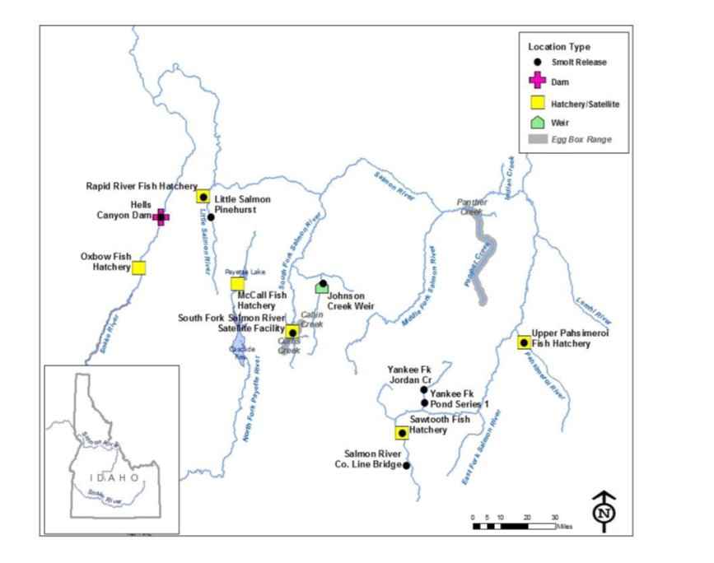
SALMON RIVER SUBBASIN
Notes:
THE TRIBES BEGAN ASSITING THE NORTHWEST POWER AND PLANNING COUNCIL IMPLMENT THEIR FISH AND WILDLIFE MITIGATION PROGRAM’
THE MAJORITY OF OUR HABITAT WORK HAS BEEN COMPLETED IN THE UPPER SALMON RIVER.
IT IS BASED UPON OUR OWN TRADITIONAL ECOLOGICAL KNOWLEDGE, LIMITING FACTORS IDENTIFIED IN DOCUMENTS SUCH AS THE SALMON RIVER SUBBASIN PLAN; AND,
THE PREMIS OF “IF YOU BUILD IT THEY WILL COME”

Slide 9
SUBBASIN LEVEL PROBLEM STATEMENTS, OBJECTIVES, AND STRATEGIES
The underlying goal of the objectives and strategies is to improve freshwater survival-productivity of focal species so as to enable species recovery. The habitat component of a species’ biological requirements must be in Proper Functioning Condition.
primary issues that are limiting in-basin survival-productivity, abundance, distribution, and life history diversity.
  Lack of functional riparian areas, disconnected tributary habitats, excessive sediment, and structural barriers impeding migration are among the primary limiting factors inhibiting species recovery.
  The problems alone are, for the most part, insignificant; however, they can act cumulatively to decrease population persistence.
Notes:
PROPERLY FUNCTIONING CONDITION IS THE SUSTAINED PRESENCE OF NATURAL, HABITAT
FORMING PROCESSES IN A WATERSHED (E.G., RIPARIAN COMMUNITY SUCCESSION, BEDLOAD TRANSPORT,
PRECIPITATION RUNOFF PATTERN, CHANNEL MIGRATION) THAT ARE NECESSARY FOR THE LONG-TERM SURVIVAL OF
THE SPECIES THROUGH THE FULL RANGE OF ENVIRONMENTAL VARIATION. PFC,
THEN, CONSTITUTES THE HABITAT COMPONENT OF A SPECIES’ BIOLOGICAL REQUIREMENTS.
The NPCC is responsible for developing and periodically revising the Columbia River Basin
Fish and Wildlife Program. In the 2000 revision, the NPCC proposed that 62 locally developed
subbasin plans, as well as plans for the mainstem Columbia and Snake rivers, be developed and
adopted into its Fish and Wildlife Program. The NPCC has administered subbasin planning
contracts pursuant to requirements in its Master Contract with the BPA (NPCC 2002). The
NPCC is responsible for reviewing and adopting each subbasin plan, including ensuring that it is
consistent with the vision, biological objectives, and strategies adopted at the Columbia Basin
and province levels.

Slide 10
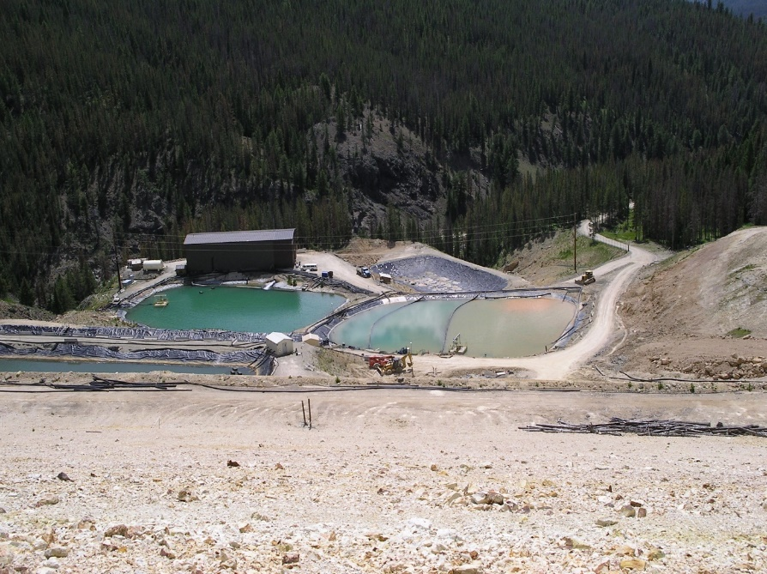
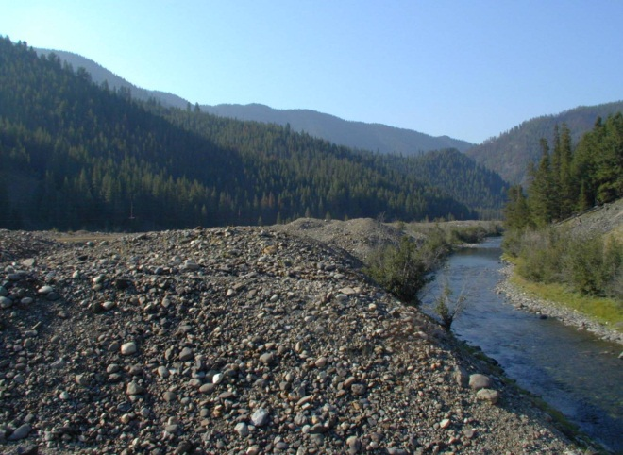
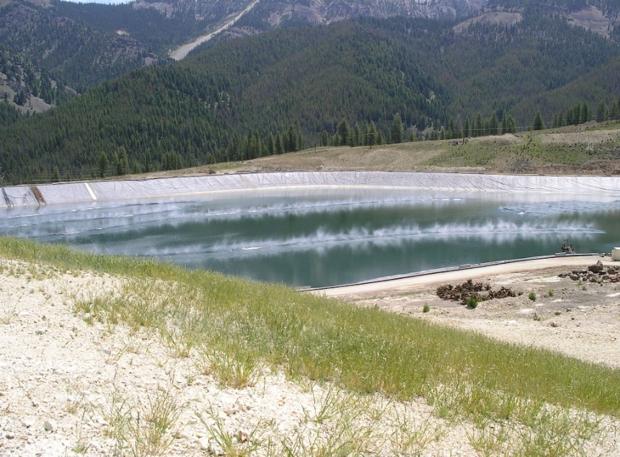
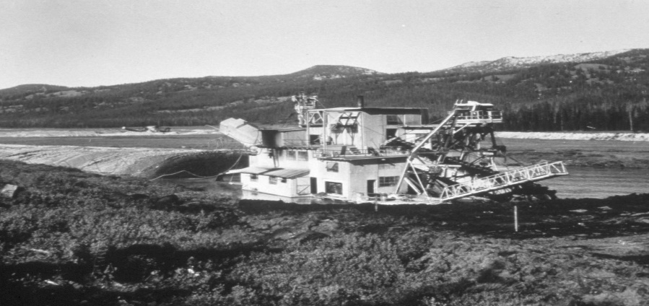
LEGACY OF MINING
The legacy of mining in the Salmon River sub-basin impacted the largest available spawning area for anadromous fish in the entire Columbia River basin. Since the discovery of gold at Loon Creek, in 1869, numerous rivers and streams have lost the ability to function as a natural riverine ecosystem.

Slide 11
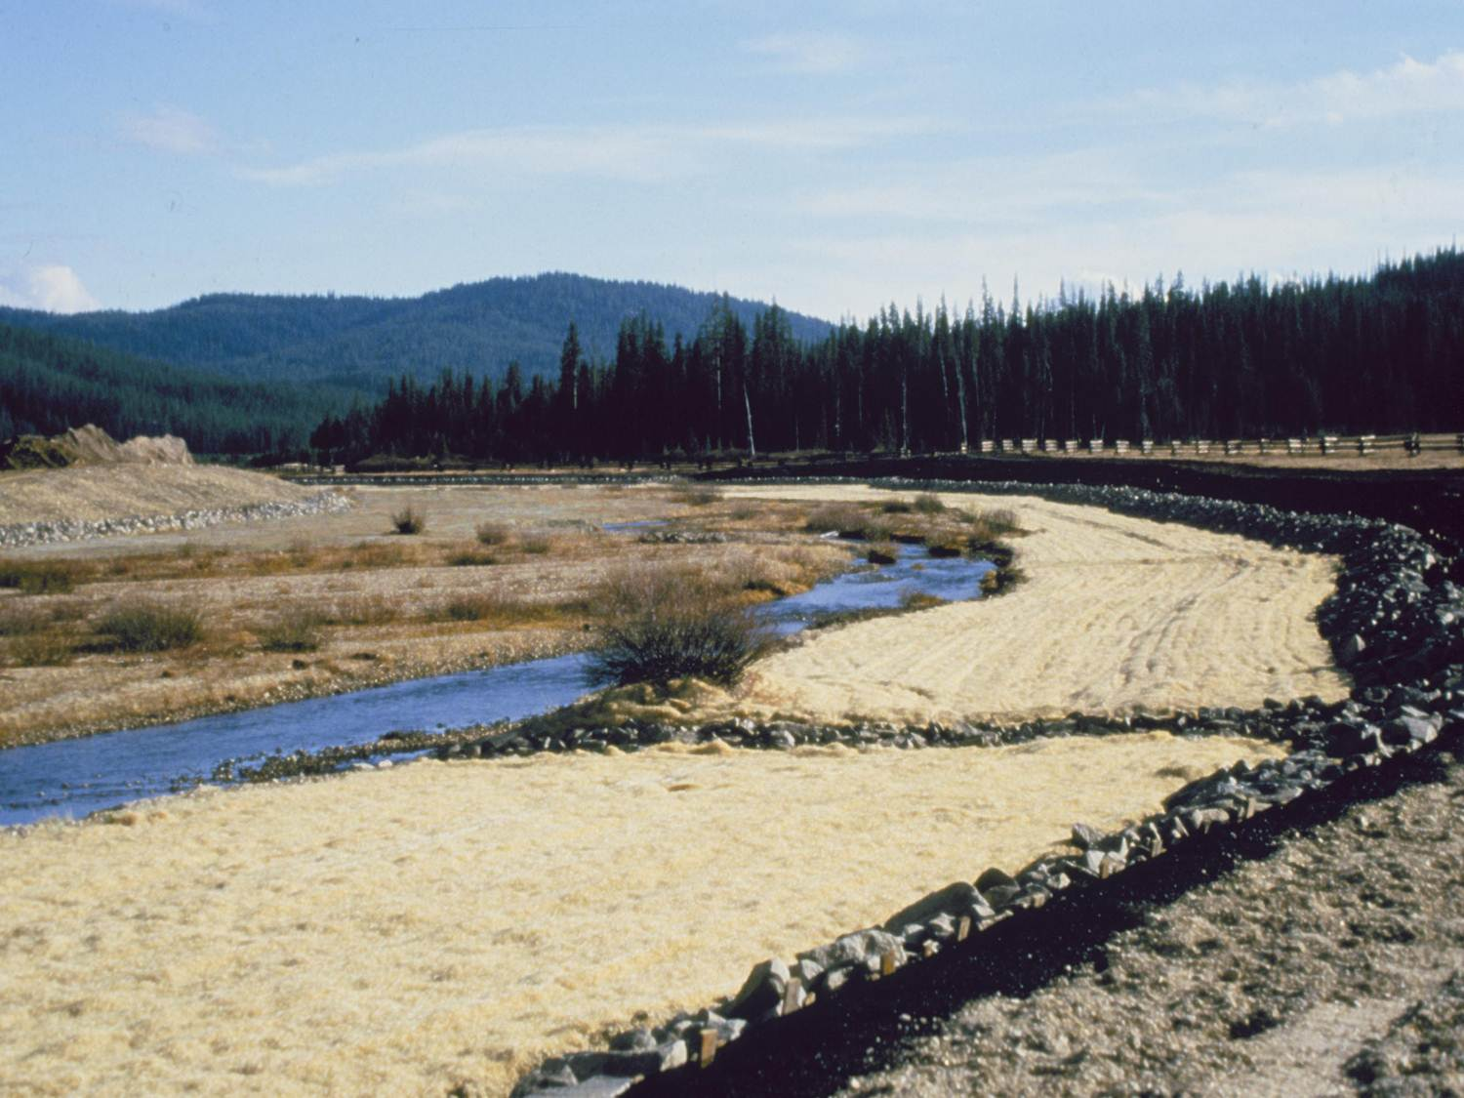
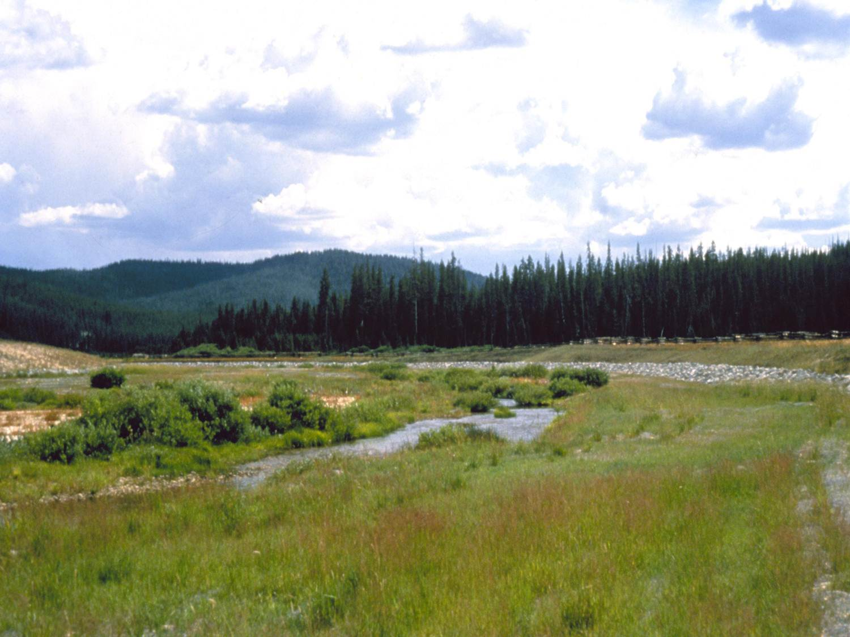
MIDDLE FORK SALMON RIVER– BEAR VALLEY
Notes:
WE RECLAIMED LEGACY MINING IMPACTS IN BEAR VALLEY

Slide 12
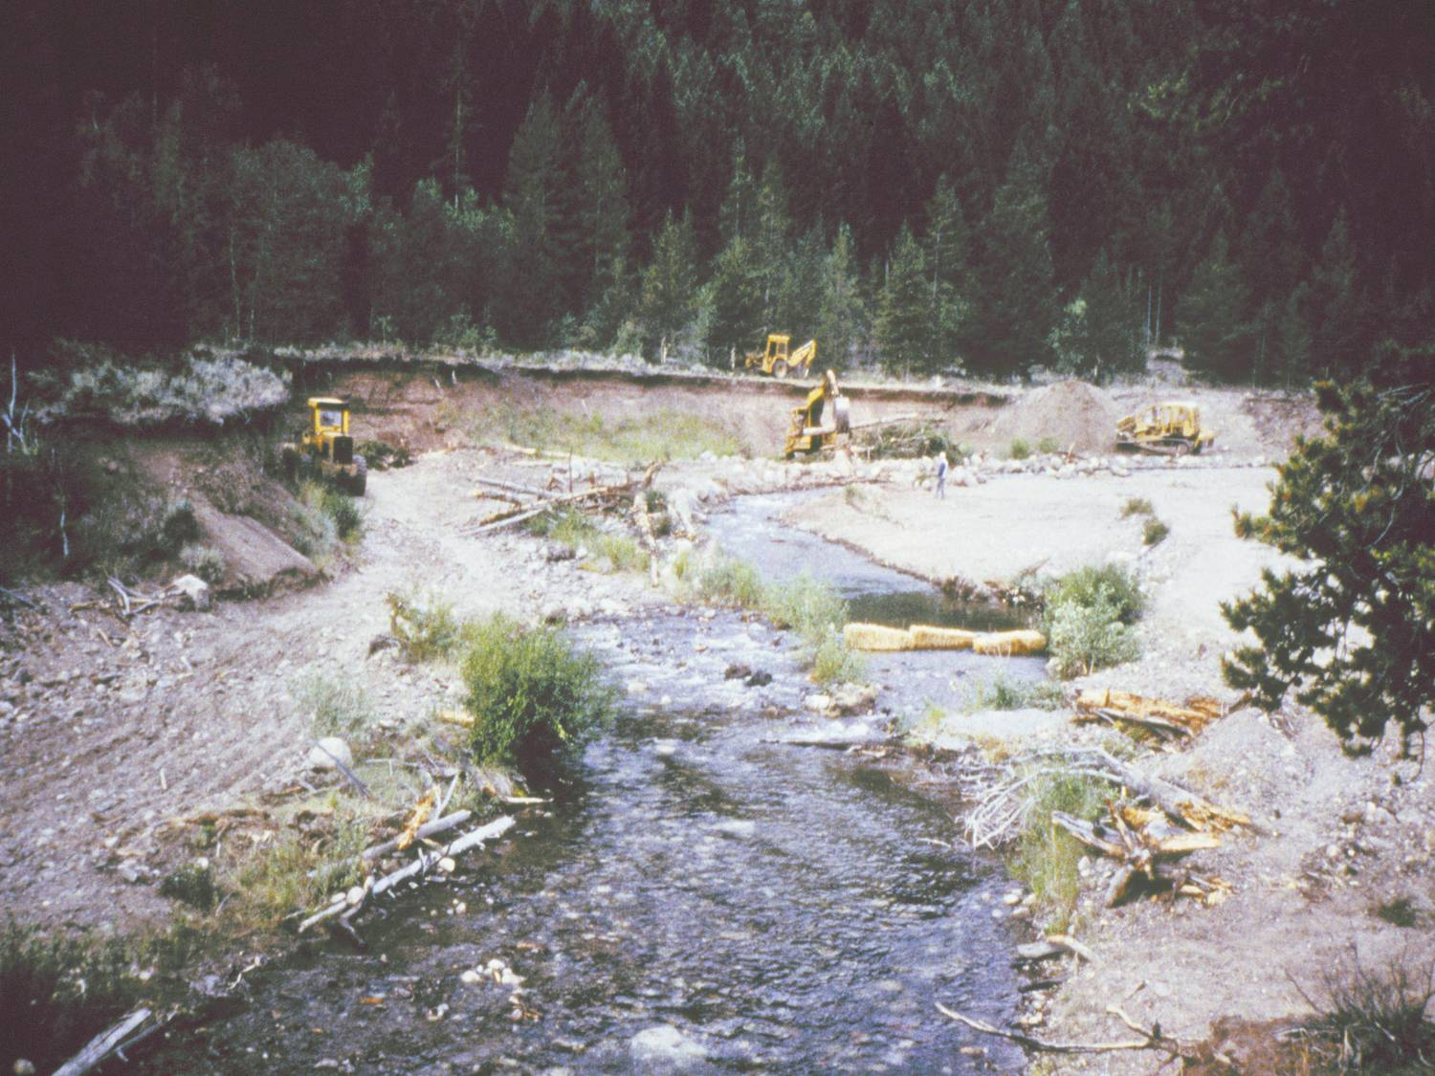
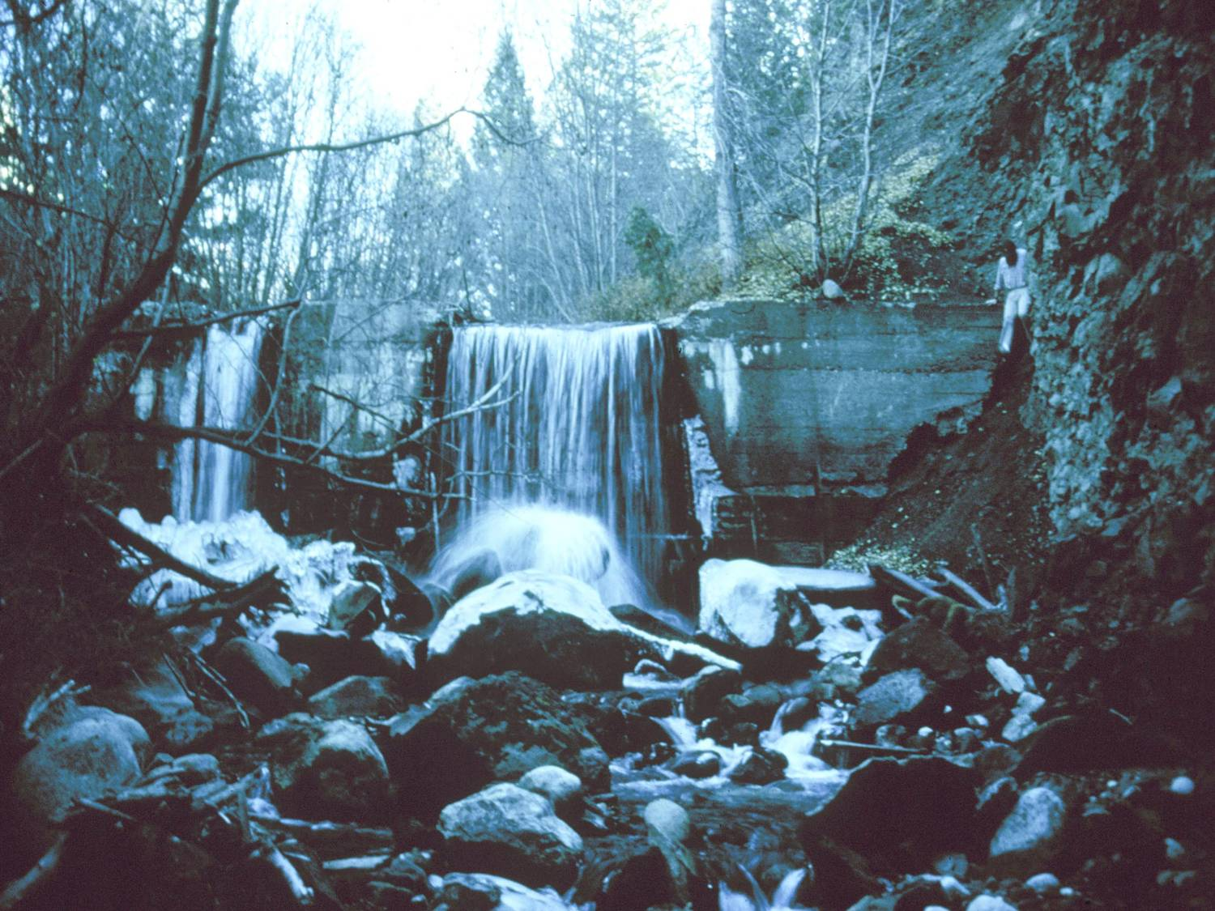
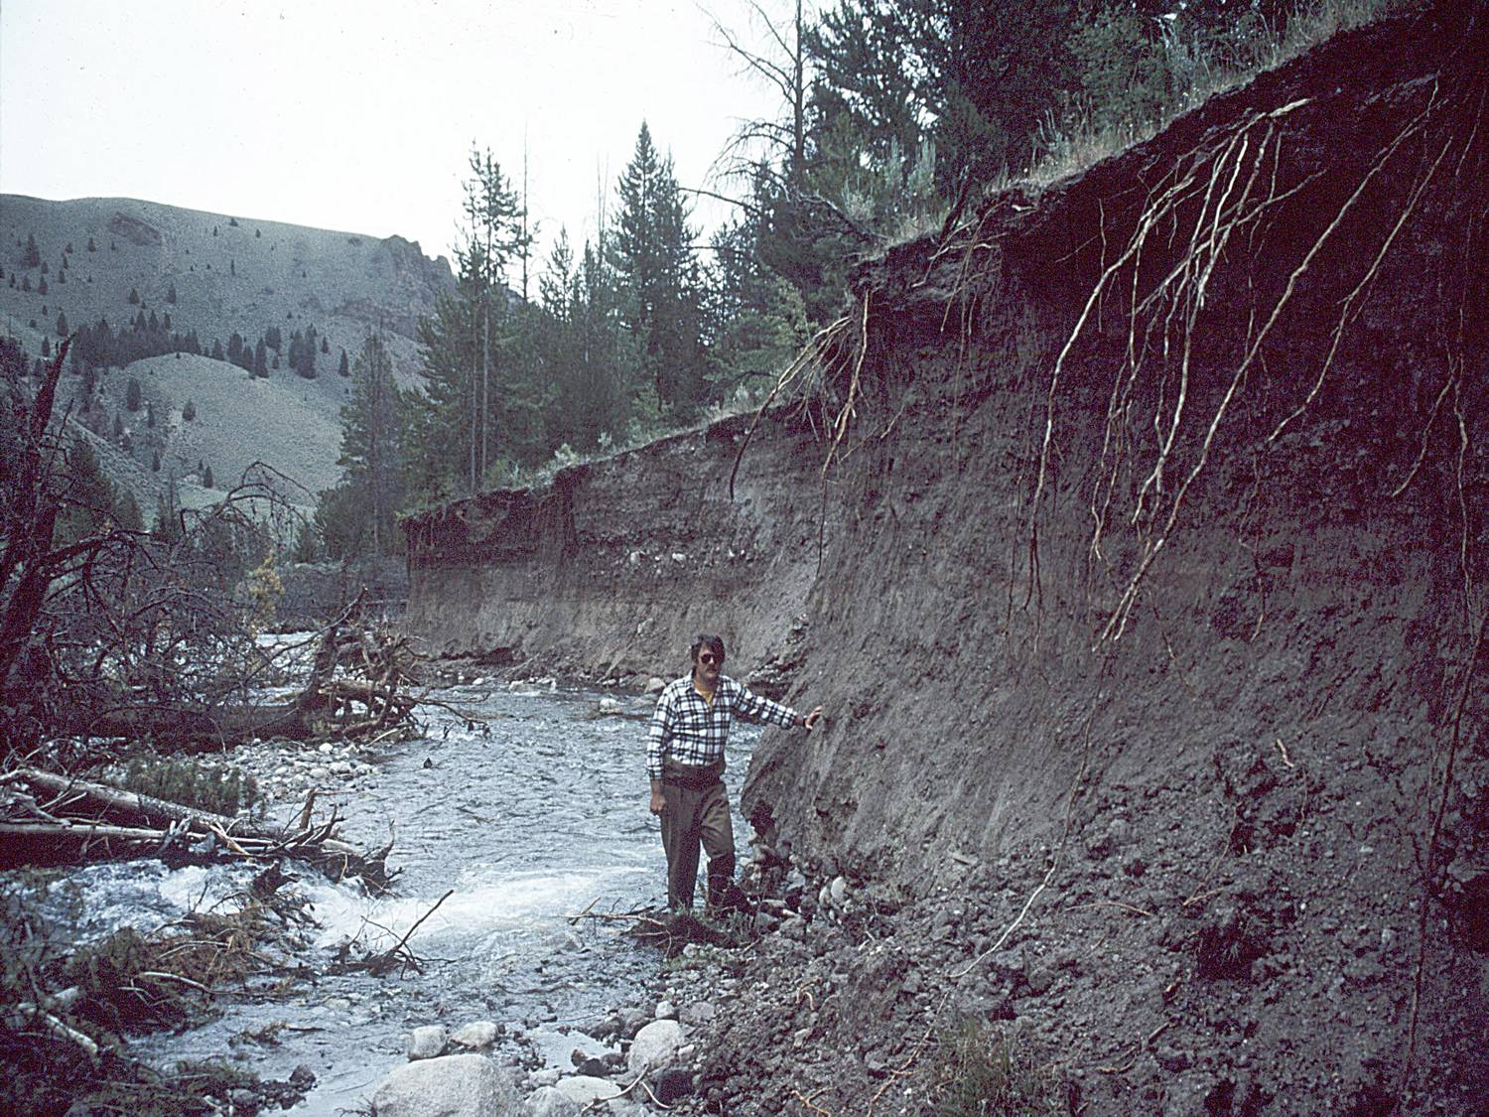
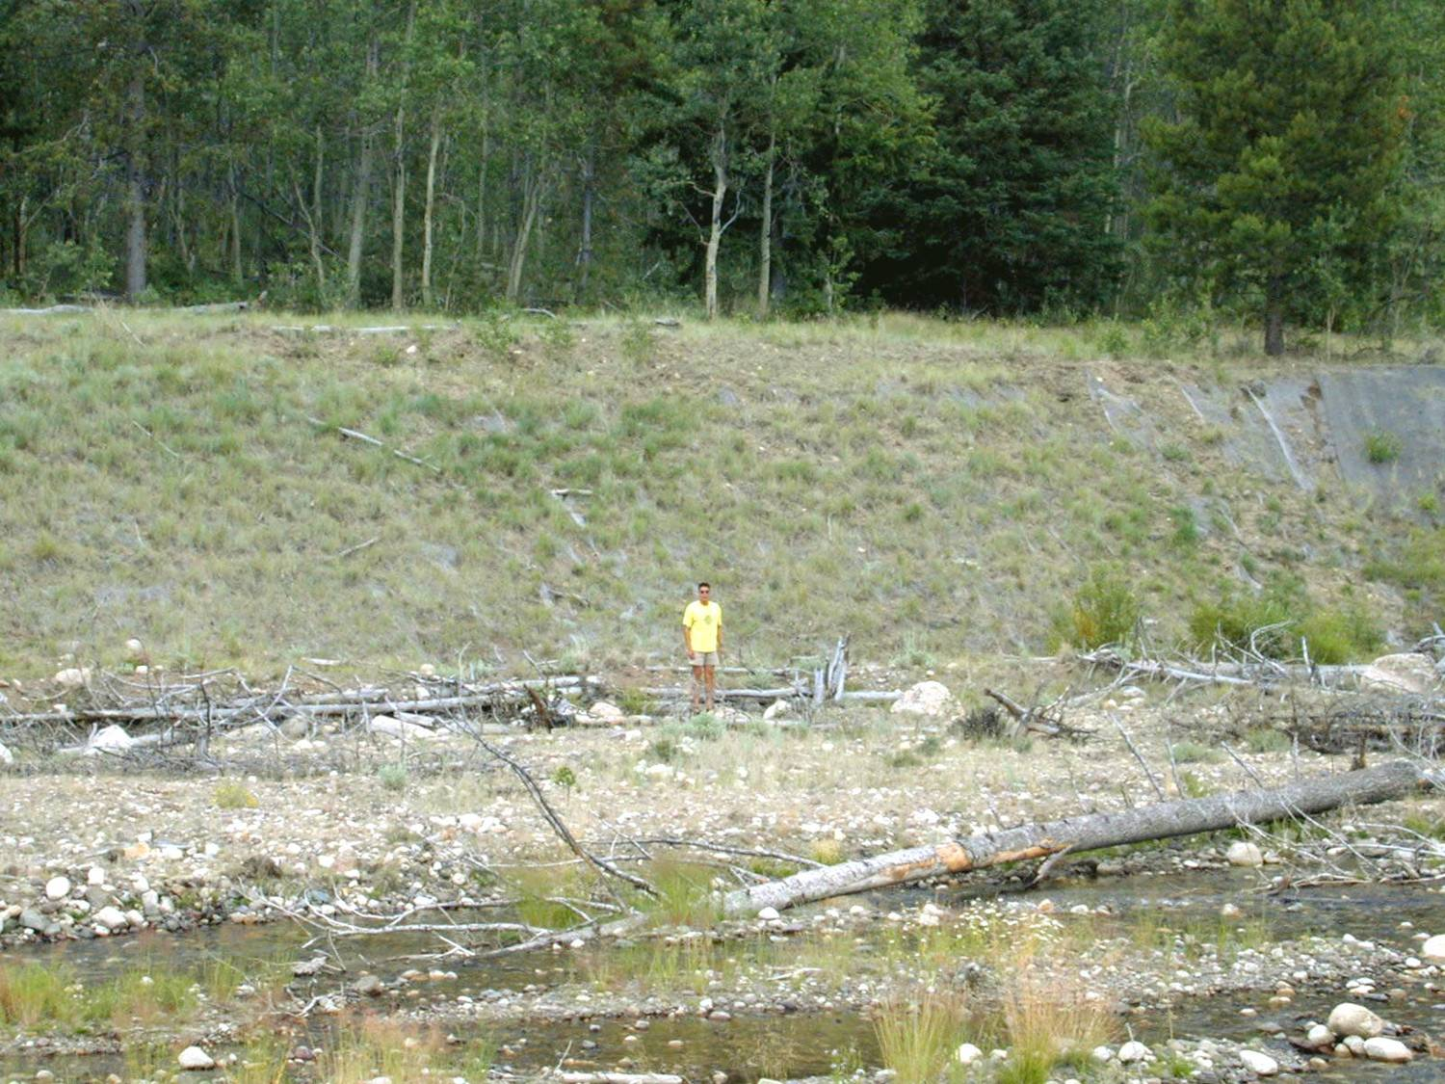
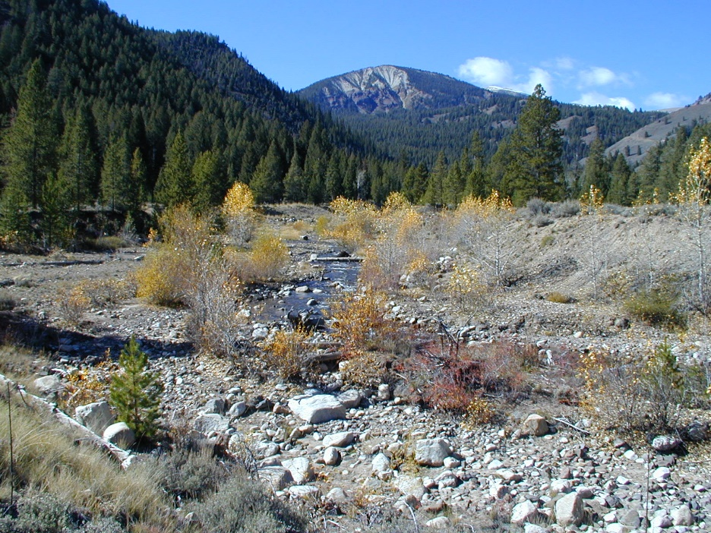
EAST FORK
Big Boulder Creek, a tributary to the East Fork, was also mined causing significant sediment loads and blocked passage.
Notes:
ON THE EAST FORK

Slide 13
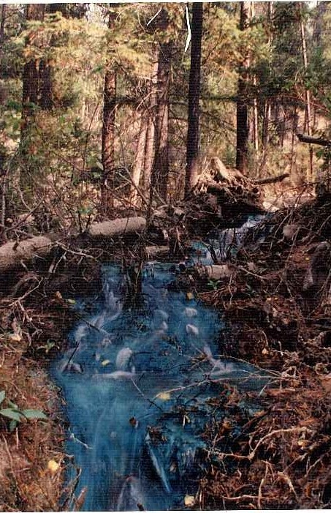
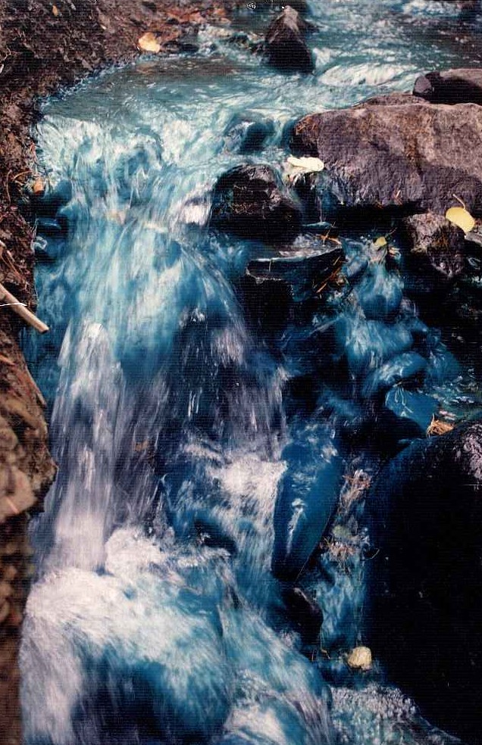
PANTHER CREEK
Panther Creek was determined by NOAA Fisheries to be functionally extirpated because of the impacts of mining. Copper lined the stream bottoms of numerous streams
Notes:
AND NOW AT PANTHER CREEK

Slide 14
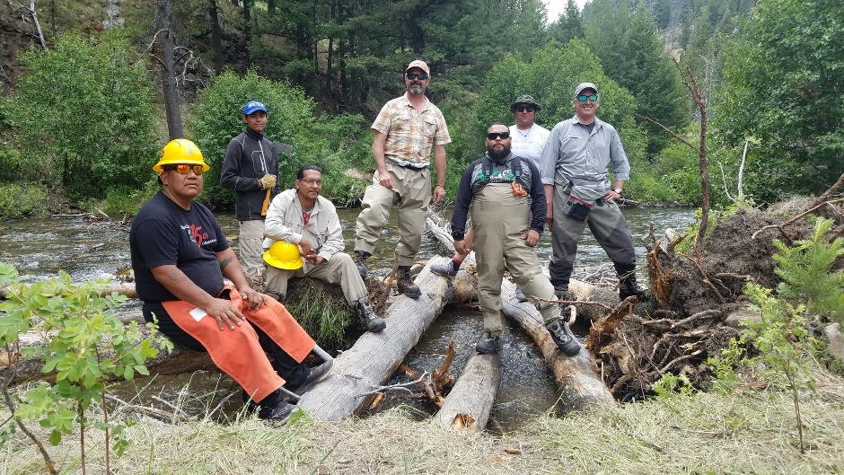
PANTHER CREEK
The goals of the assessment and restoration plan include: assess the reach types, reach condition, recommend restoration strategies, and prioritize locations (reaches) and restoration actions that will benefit spring Chinook, steelhead, and bull trout productivity in the short-term (i.e., next 5-10 years).

Slide 15
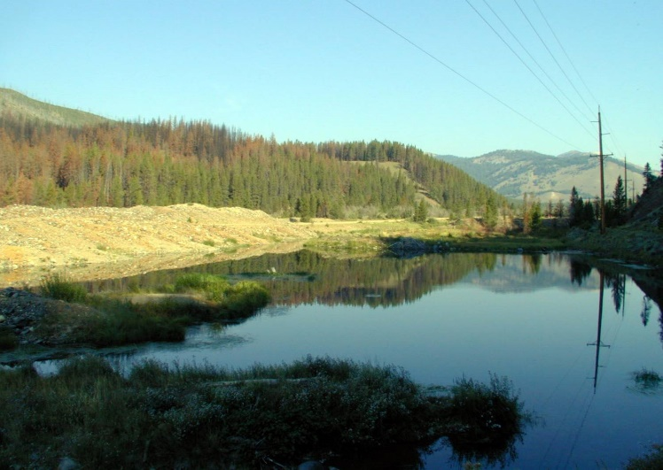
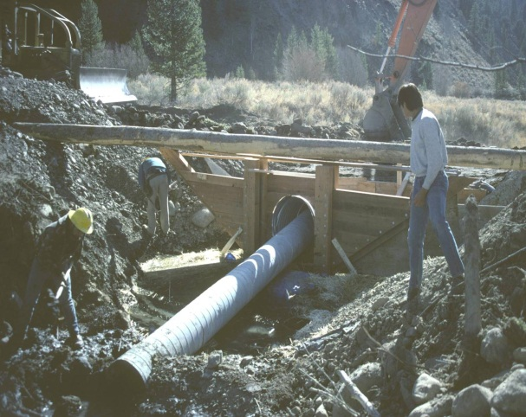
YANKEE FORK
The Tribes have been working on Yankee Fork restoration since the late 1980’s with the completion of acclimation ponds constructed with inflow and outflow controls on existing dredge ponds.
Notes:
BUT OUR LARGEST INVESTMENT OF TIME AND RESOURCES HAS BEEN ON THE YANKEE FORK

Slide 16
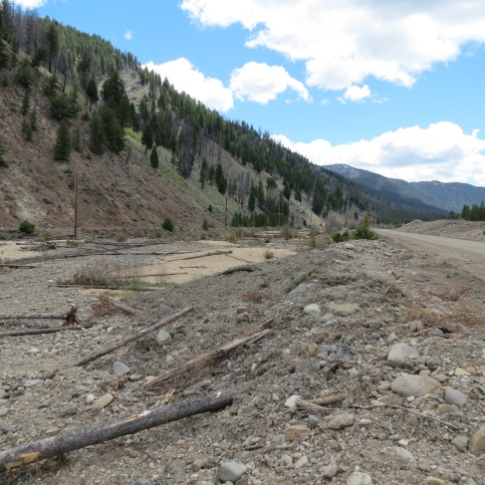
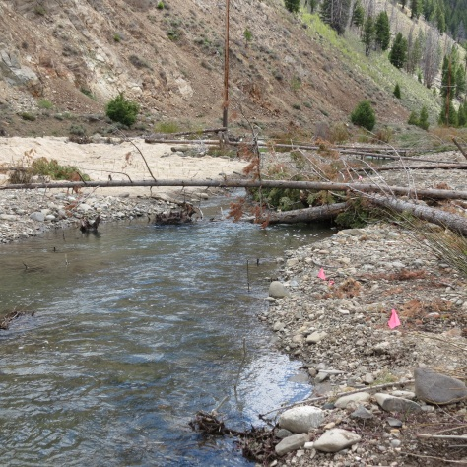
YANKEE FORK
RESTORATION GOAL: restore physical process and function by emphasizing channel / floodplain interaction.
Notes:
IN 2012, THE YANKEE FORK OF THE SALMON RIVER TRIBUTARY ASSESSMENT, UPPER SALMON SUBBASIN, CUSTER COUNTY, IDAHO (TRIBUTARY ASSESSMENT) WAS COMPLETED BY THE YANKEE FORK INTERDISCIPLINARY TEAM WAS CREATED COMPRISED OF TECHNICAL SPECIALISTS FROM THE SHOSHONE-BANNOCK TRIBES, U.S. BUREAU OF RECLAMATION (RECLAMATION), BPA, U.S. FOREST SERVICE (USFS), TROUT UNLIMITED, U.S. FISH AND WILDLIFE SERVICE (USFWS), NOAA FISHERIES, IDAHO DEPARTMENT OF FISH AND GAME (IDFG), AND OTHER STAKEHOLDERS THAT HAVE LOCAL KNOWLEDGE OF THE WATERSHED AND THE FISHERIES RESOURCES.
THE TEAM COMPLETED THE IMPLEMENTATION OF 6 OUT OF THE 7 IDENTIFIED PROJECTS WHICH PROVIDED FOR ADAPTIVE MANAGEMENT, FLOODPLAIN INTERACTIONS AND ENHANCEMENT, INSTREAM COMPLEXITY, RECONNECTION OF HISTORIC CHANNELS AND TRIBUTARIES.

Slide 17
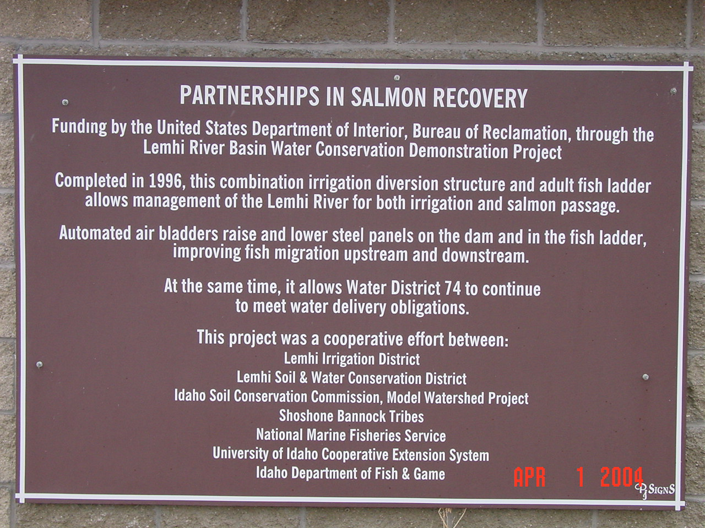
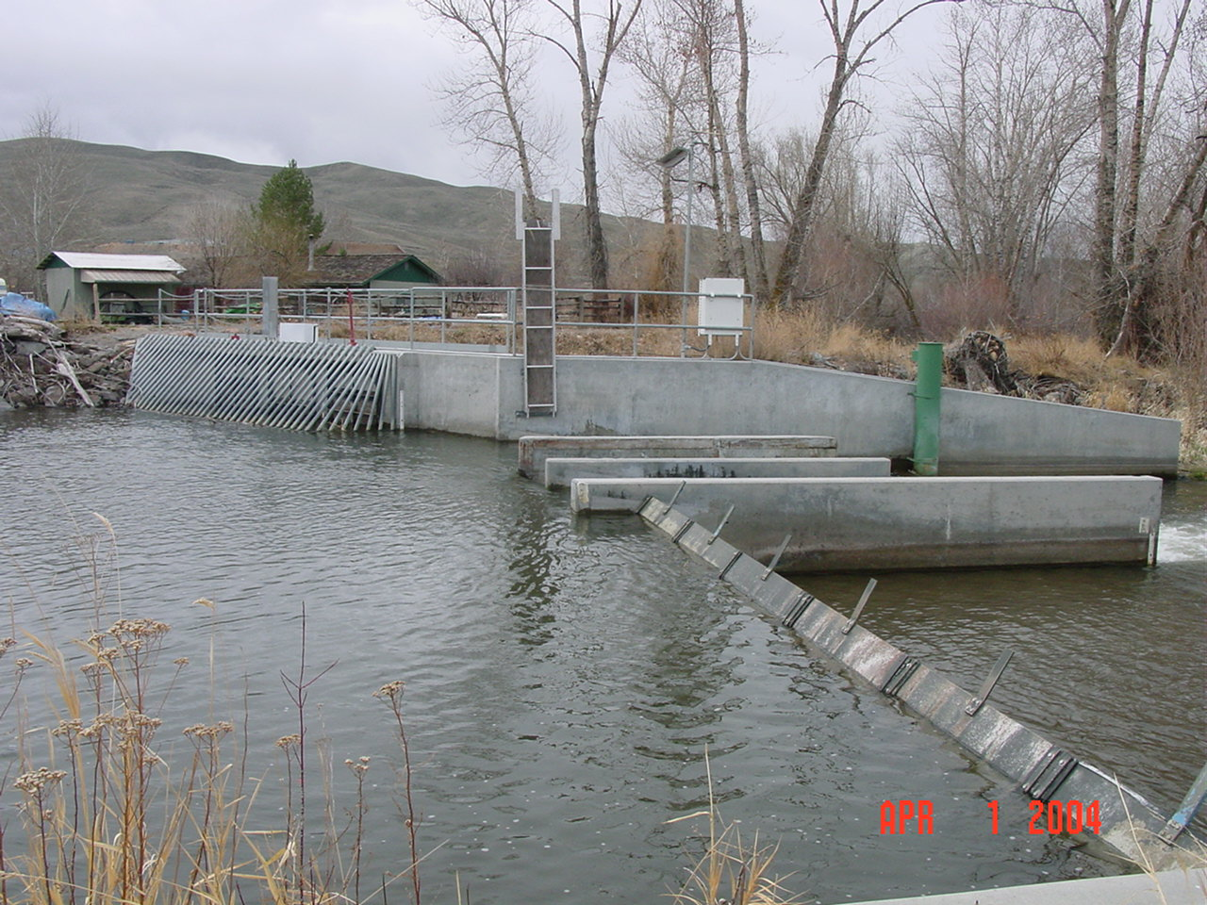
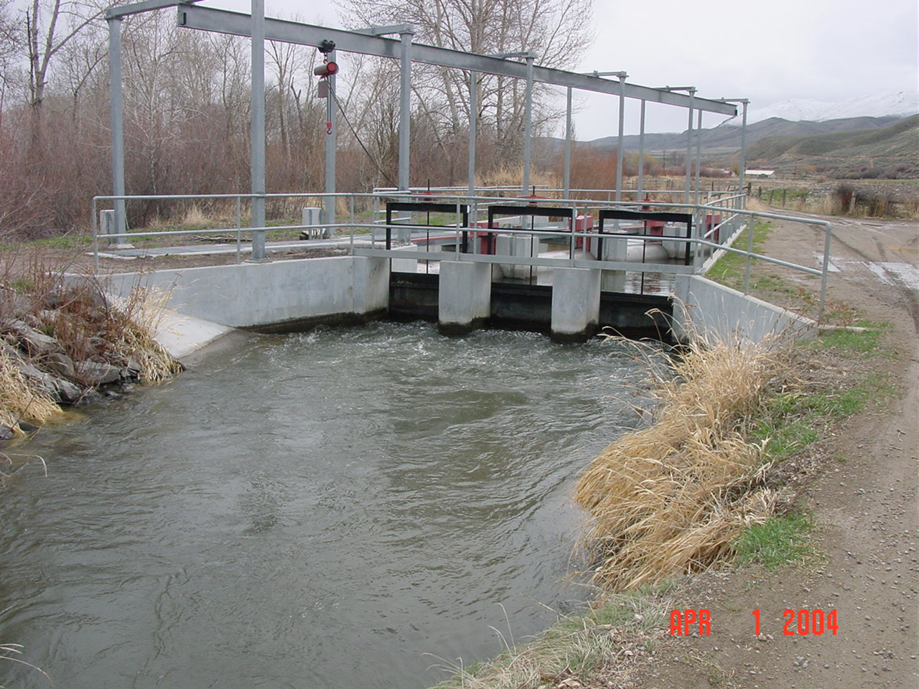
LEMHI - AGRICULTURAL IMPACTS
As the agricultural community began to feel the impacts of having listed species in their backyard, trust was difficult to obtain. Local partnerships were developed to achieve our goals and objectives.
Notes:
WE HAVE WORKED THROUGH PARTNERSHIPS TO CONSOLIDATE DIVERSIONS WHICH PUT WATER BACK INTO STREAMS AND IMPROVED FISH PASSAGE.

Slide 18
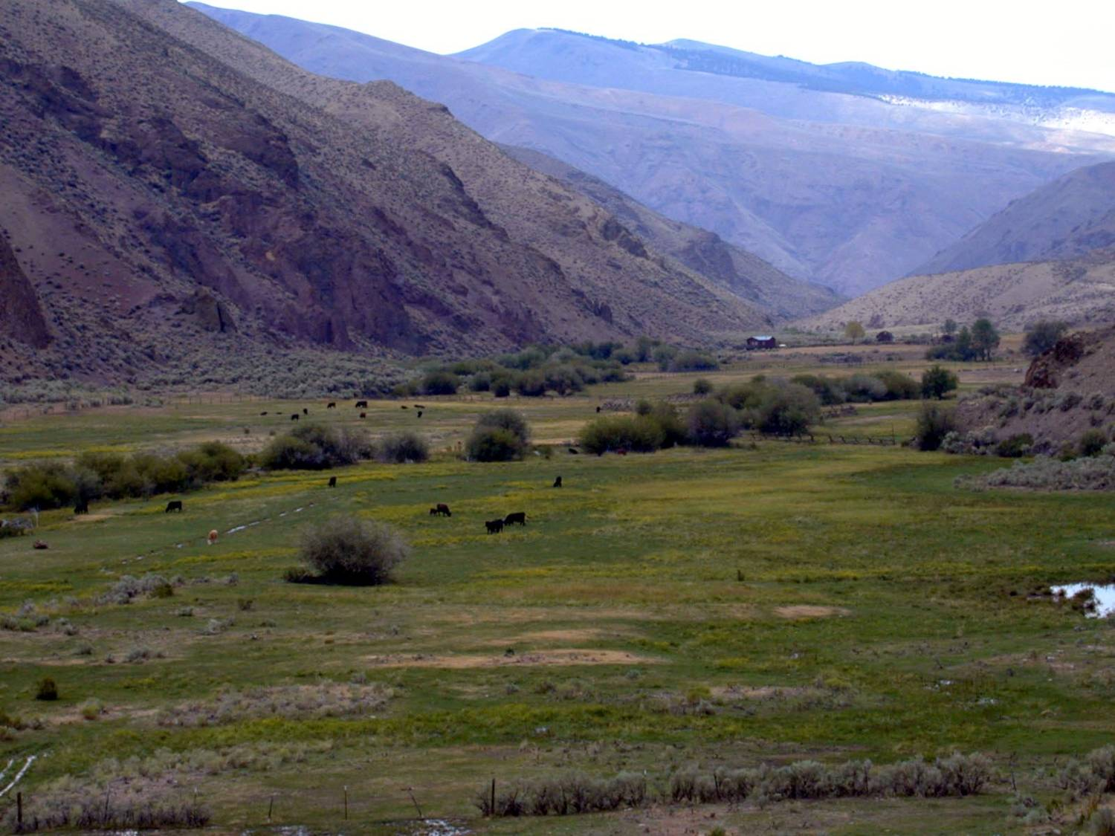
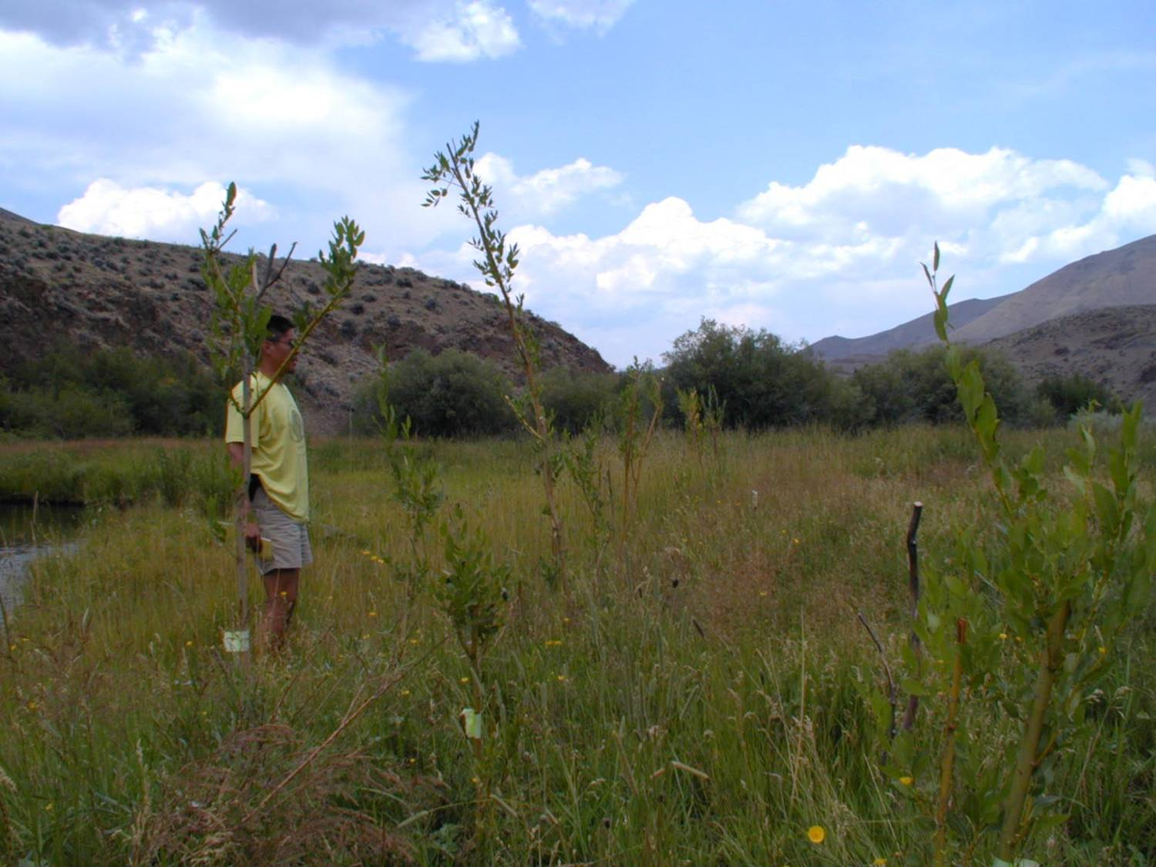
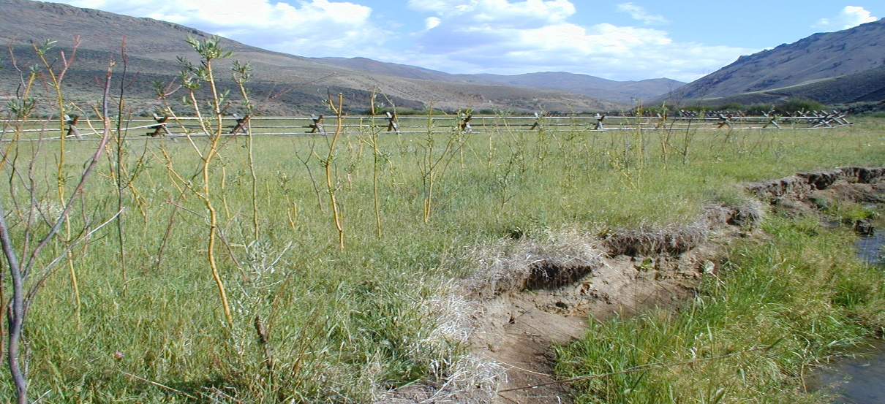
EAST FORK – AGRICULTUAL IMPACTS
As time went on more private land owners became willing to work with the tribes to address limiting factors such as sedimentation. We constructing miles of riparian enclosure fence and replanted riparian vegetation.

Slide 19
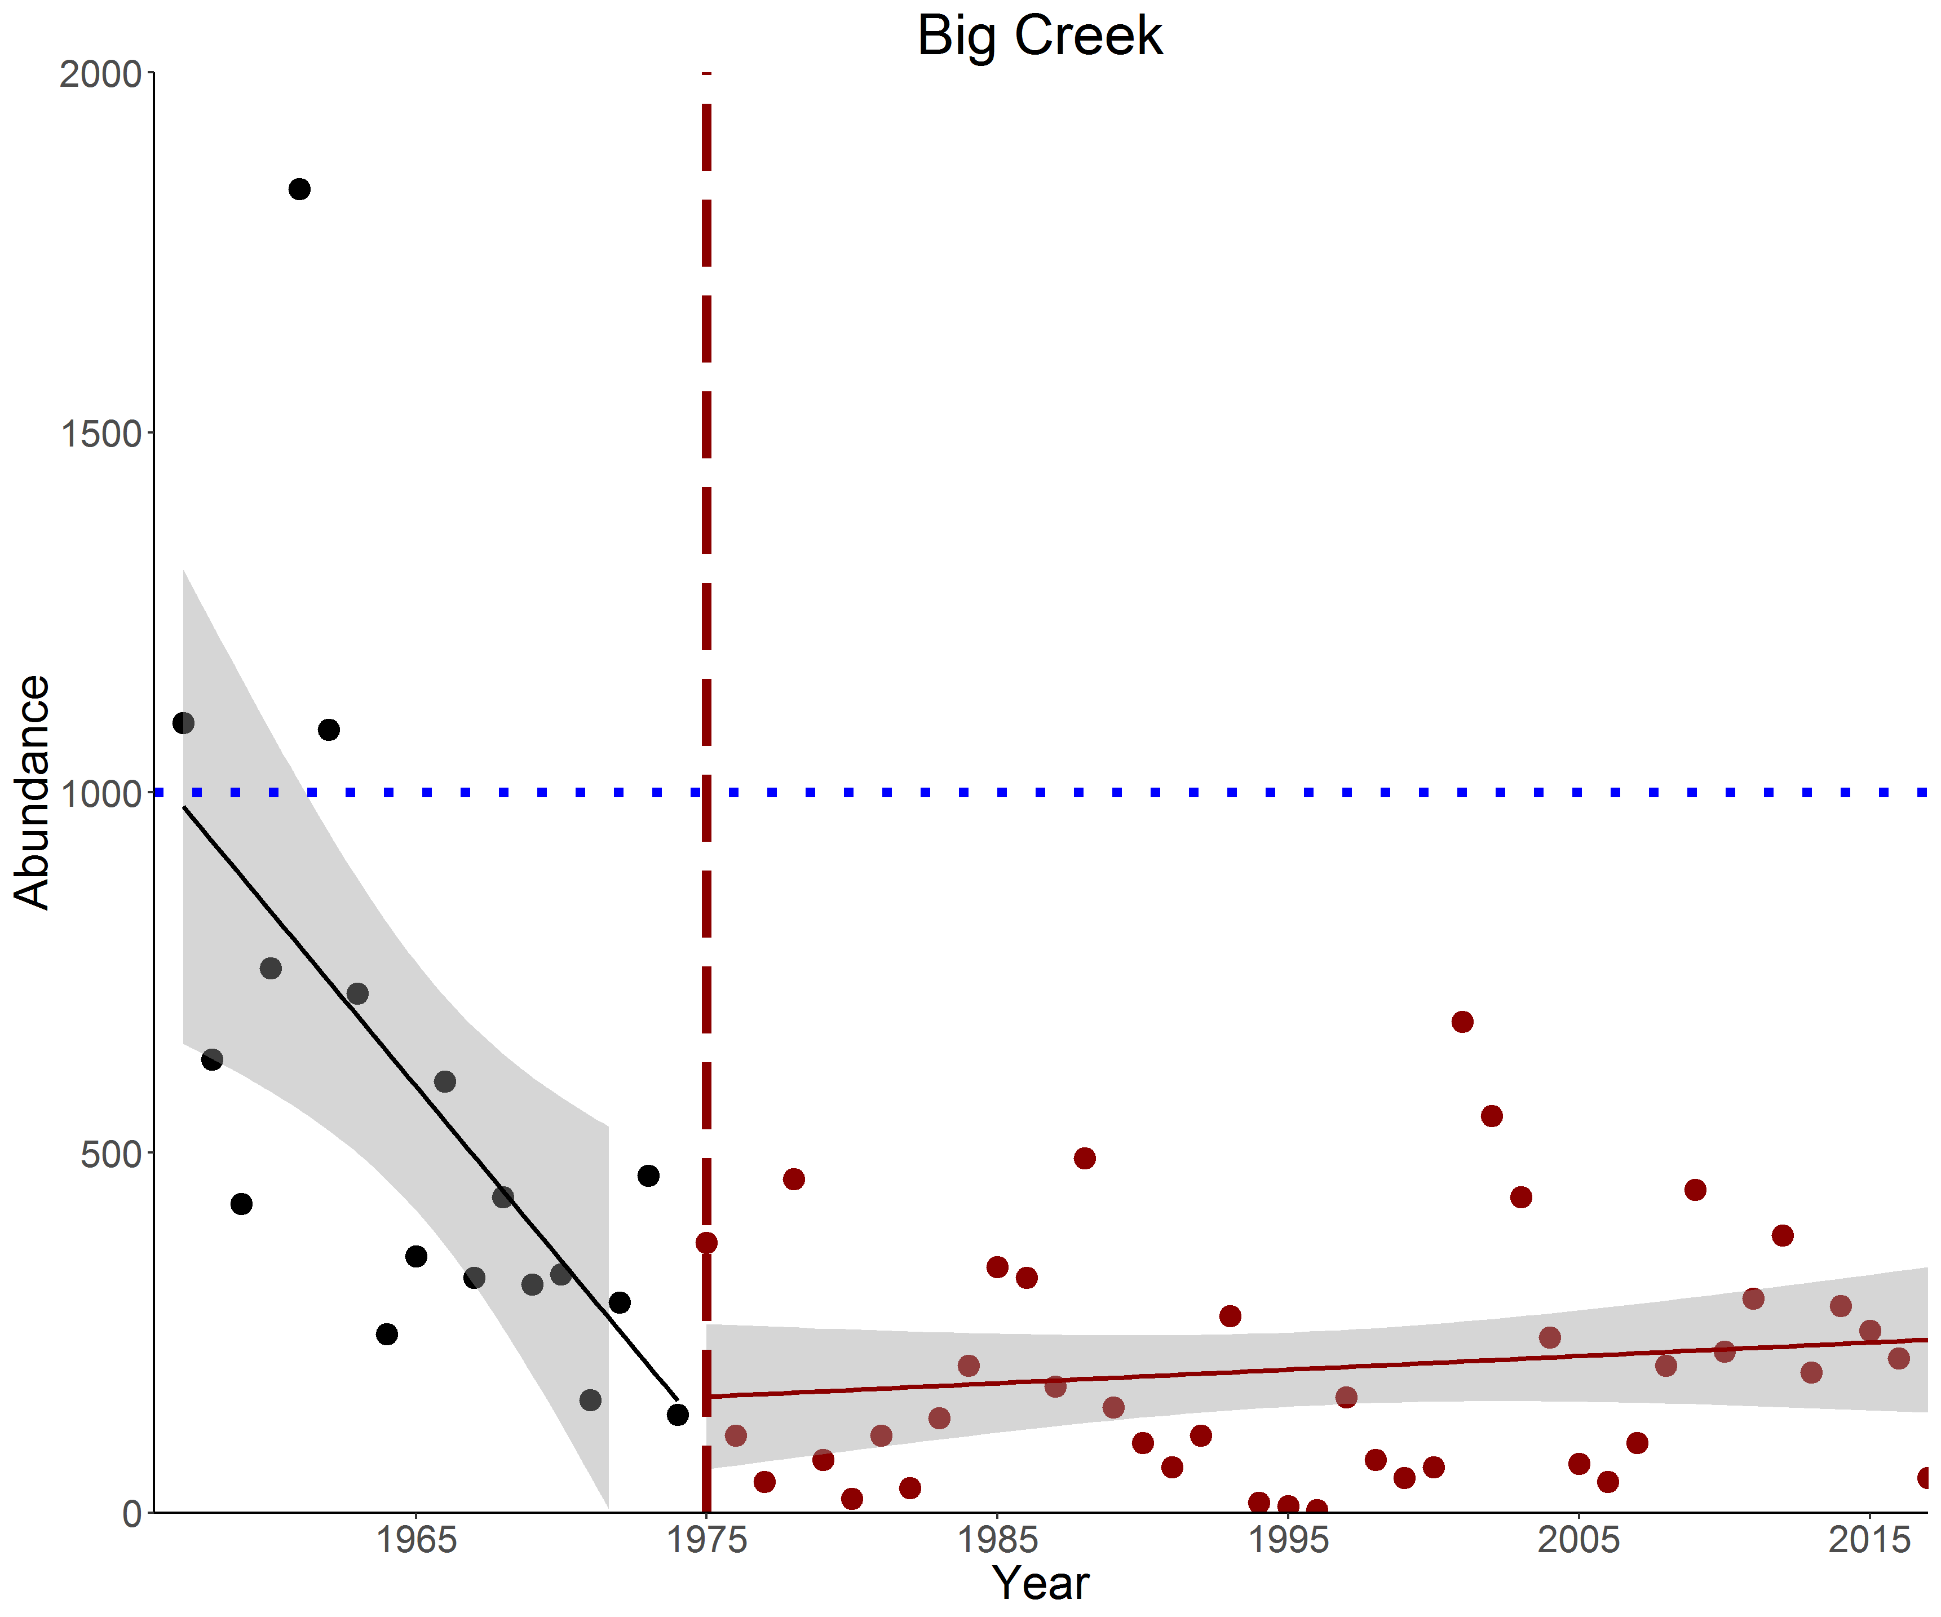
MIDDLE FORK ABUNDANCE TRENDS

Slide 20
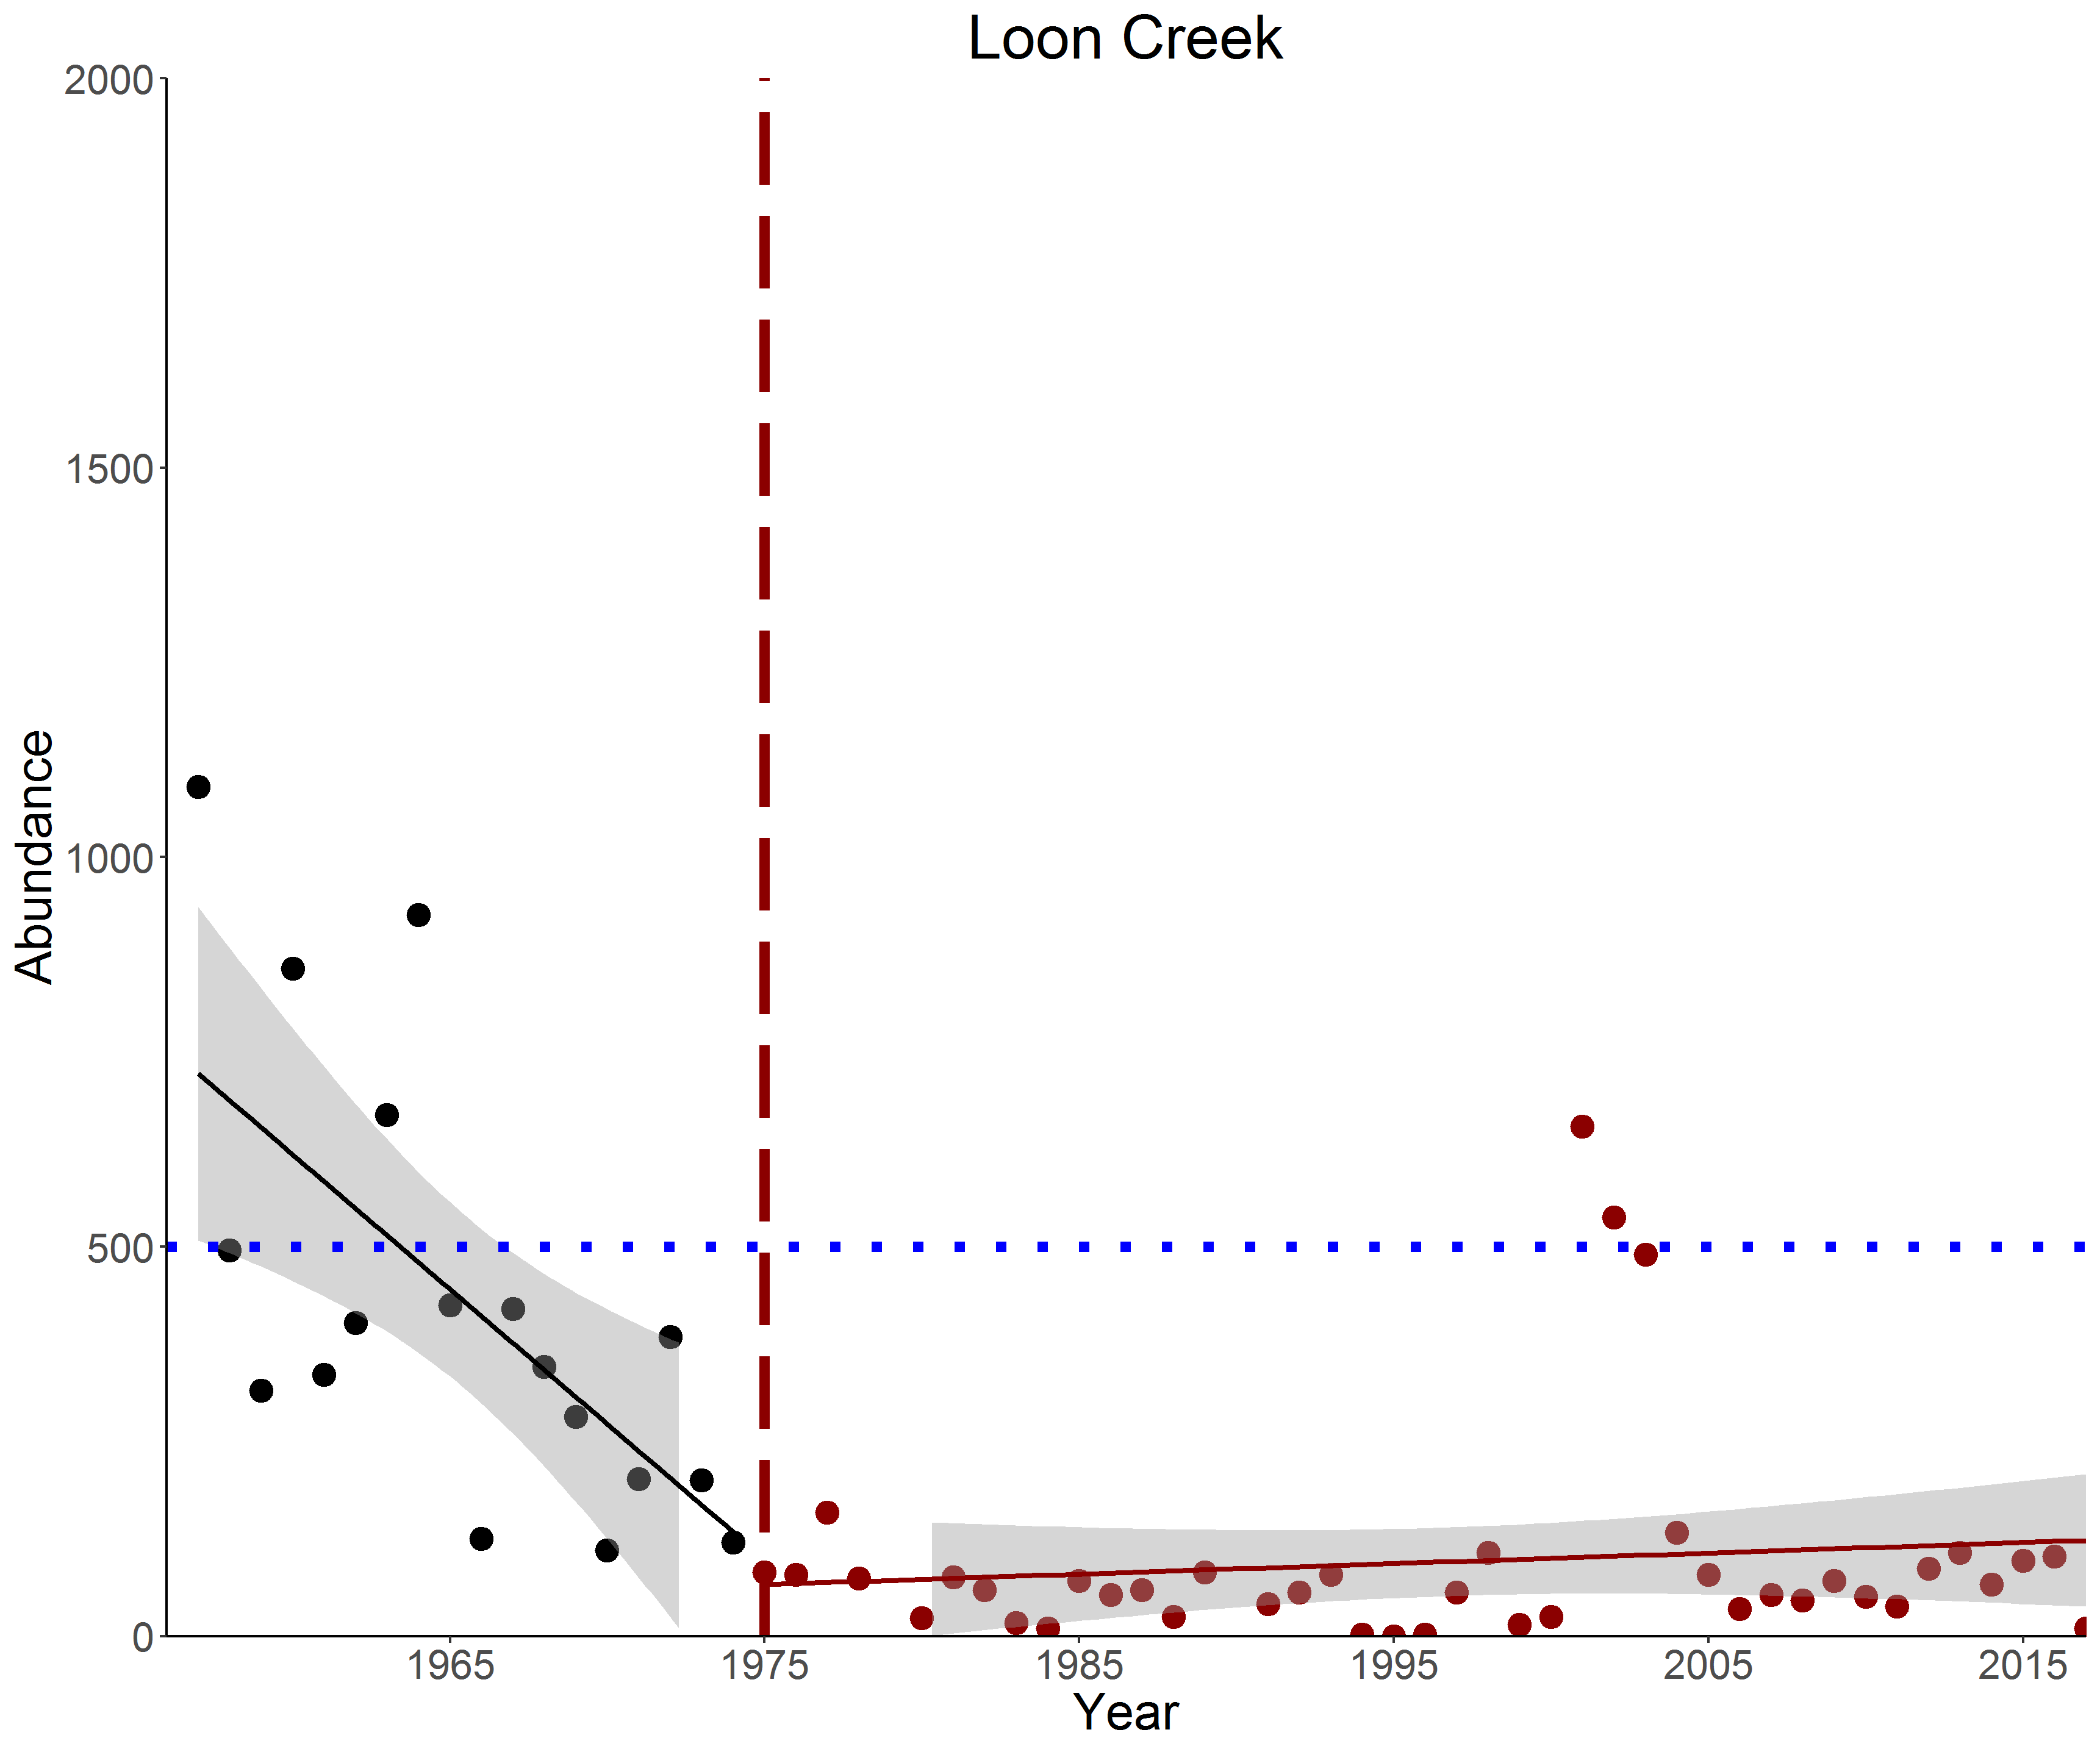
MIDDLE FORK ABUNDANCE TRENDS

Slide 21
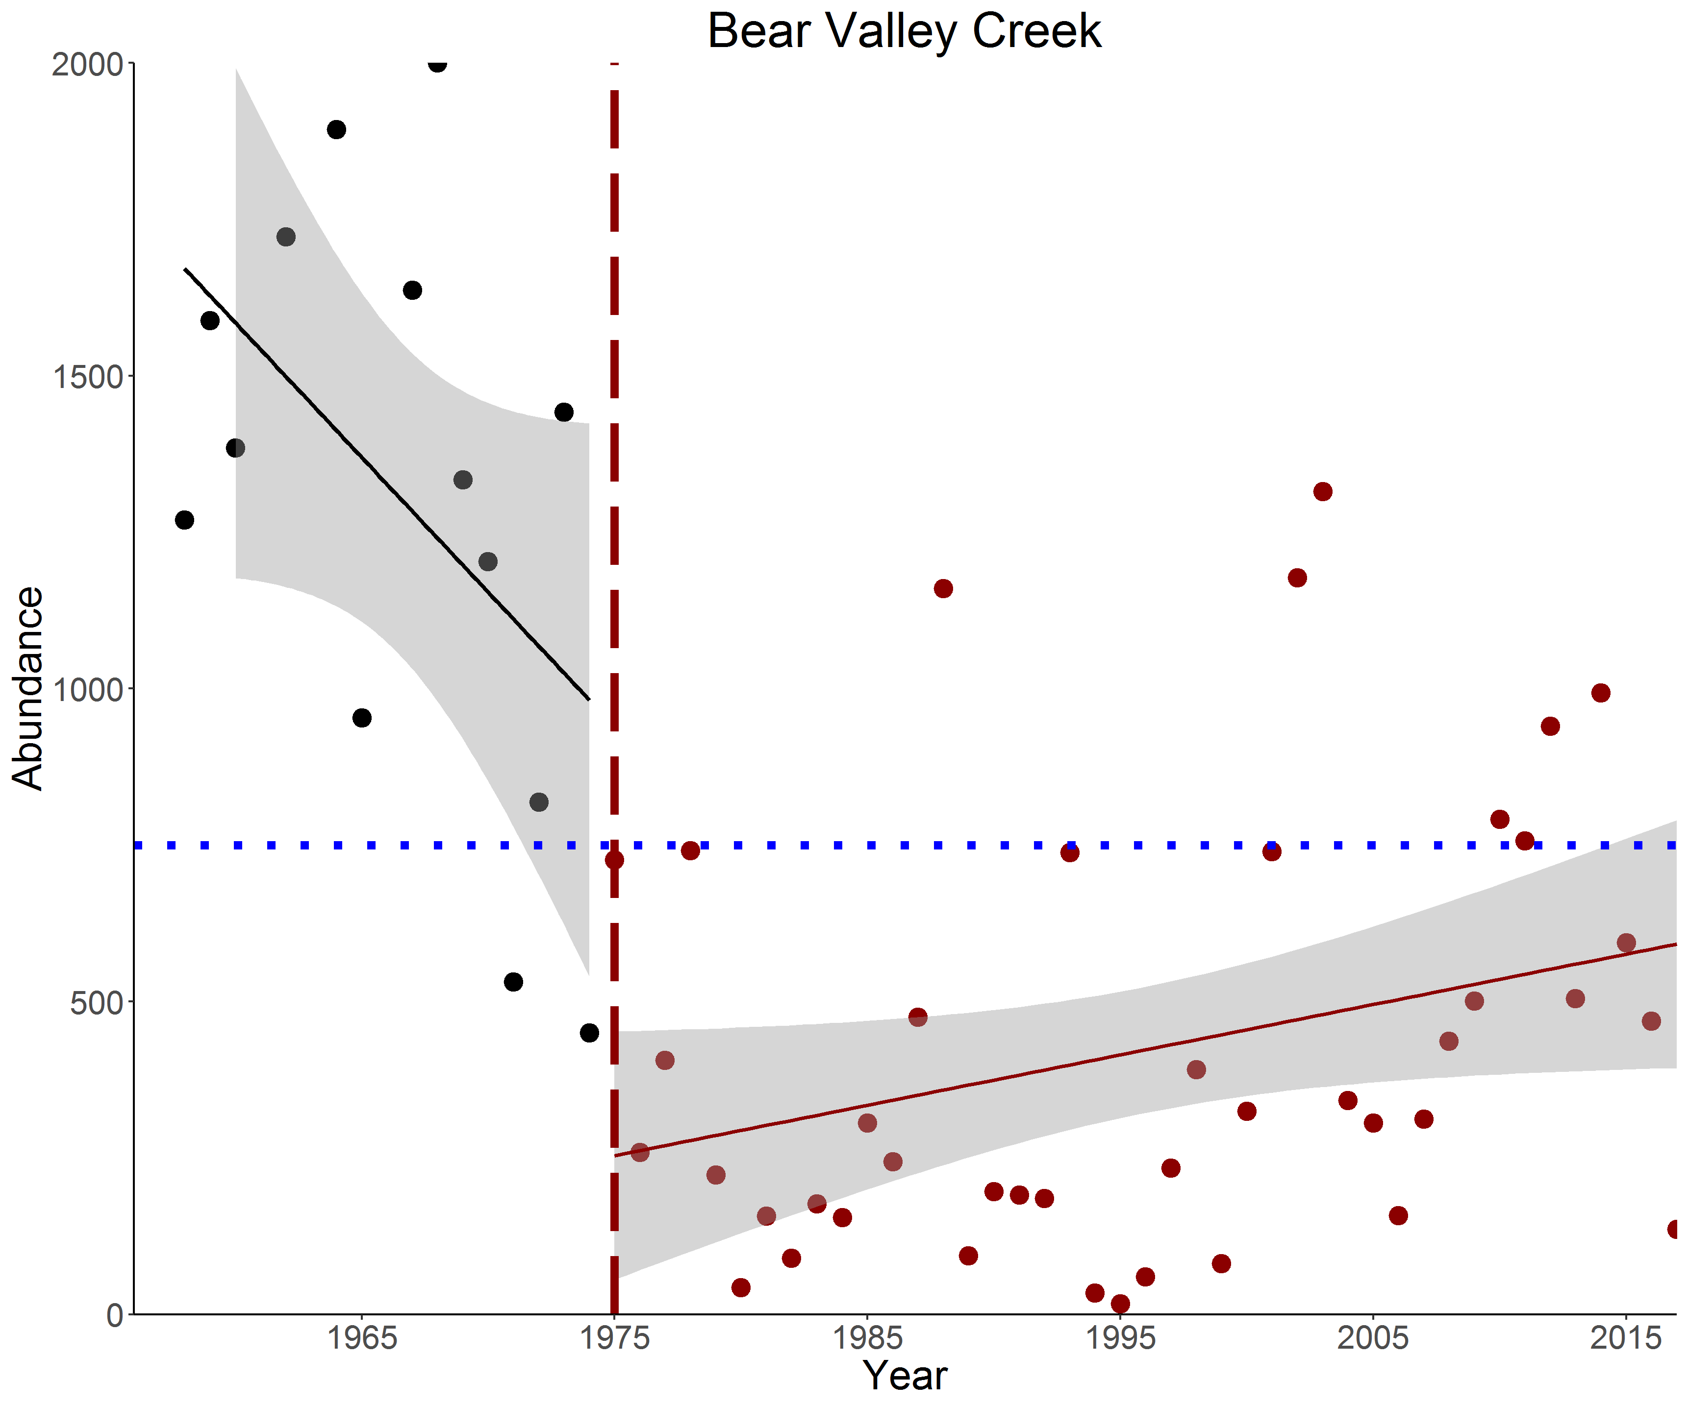
MIDDLE FORK ABUNDANCE TRENDS

Slide 22
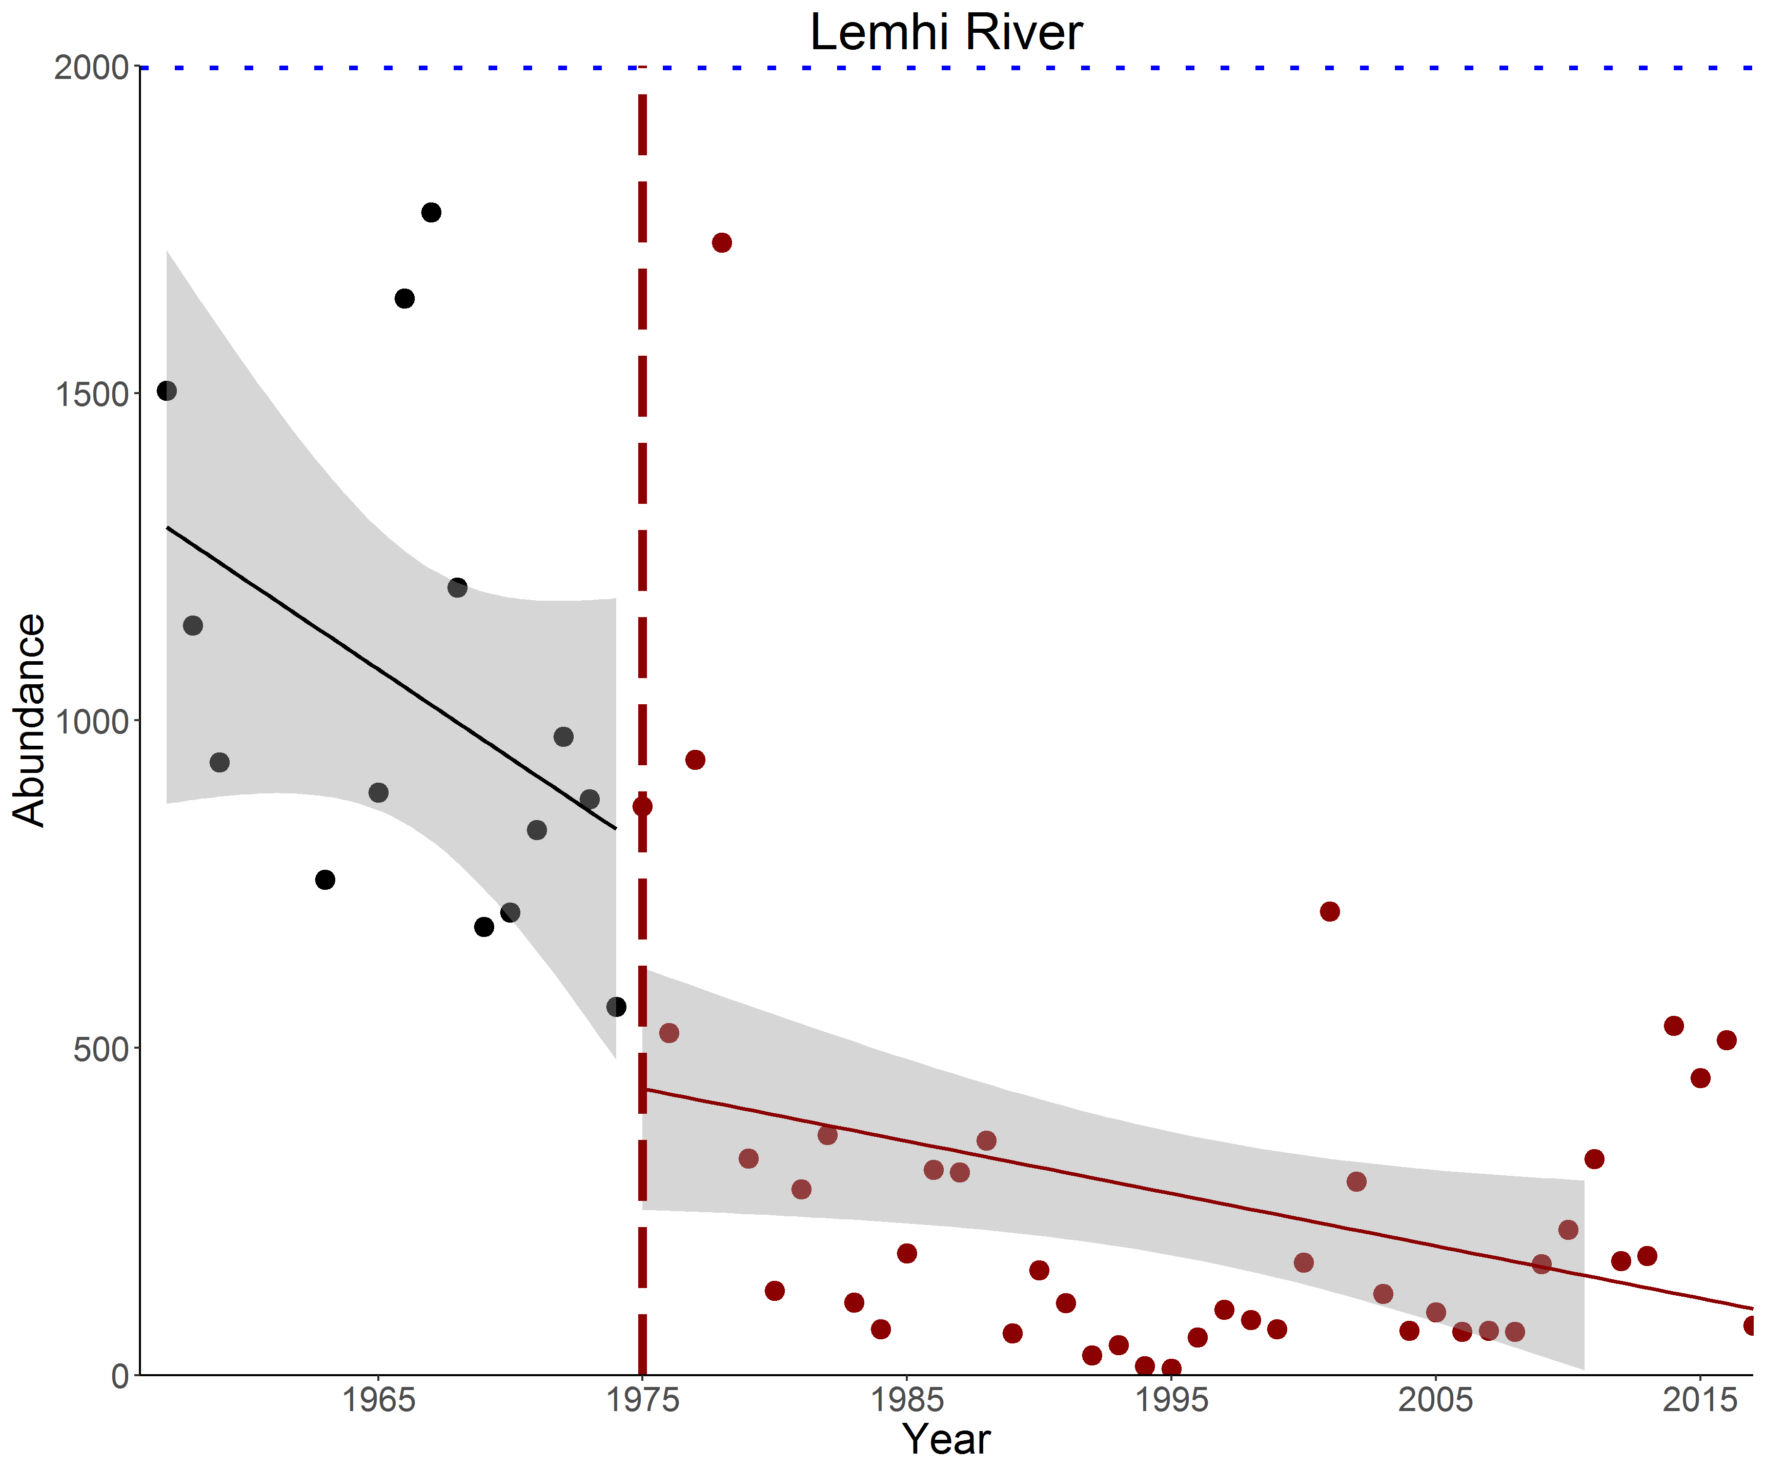
LEMHI ABUNDANCE TRENDS

Slide 23
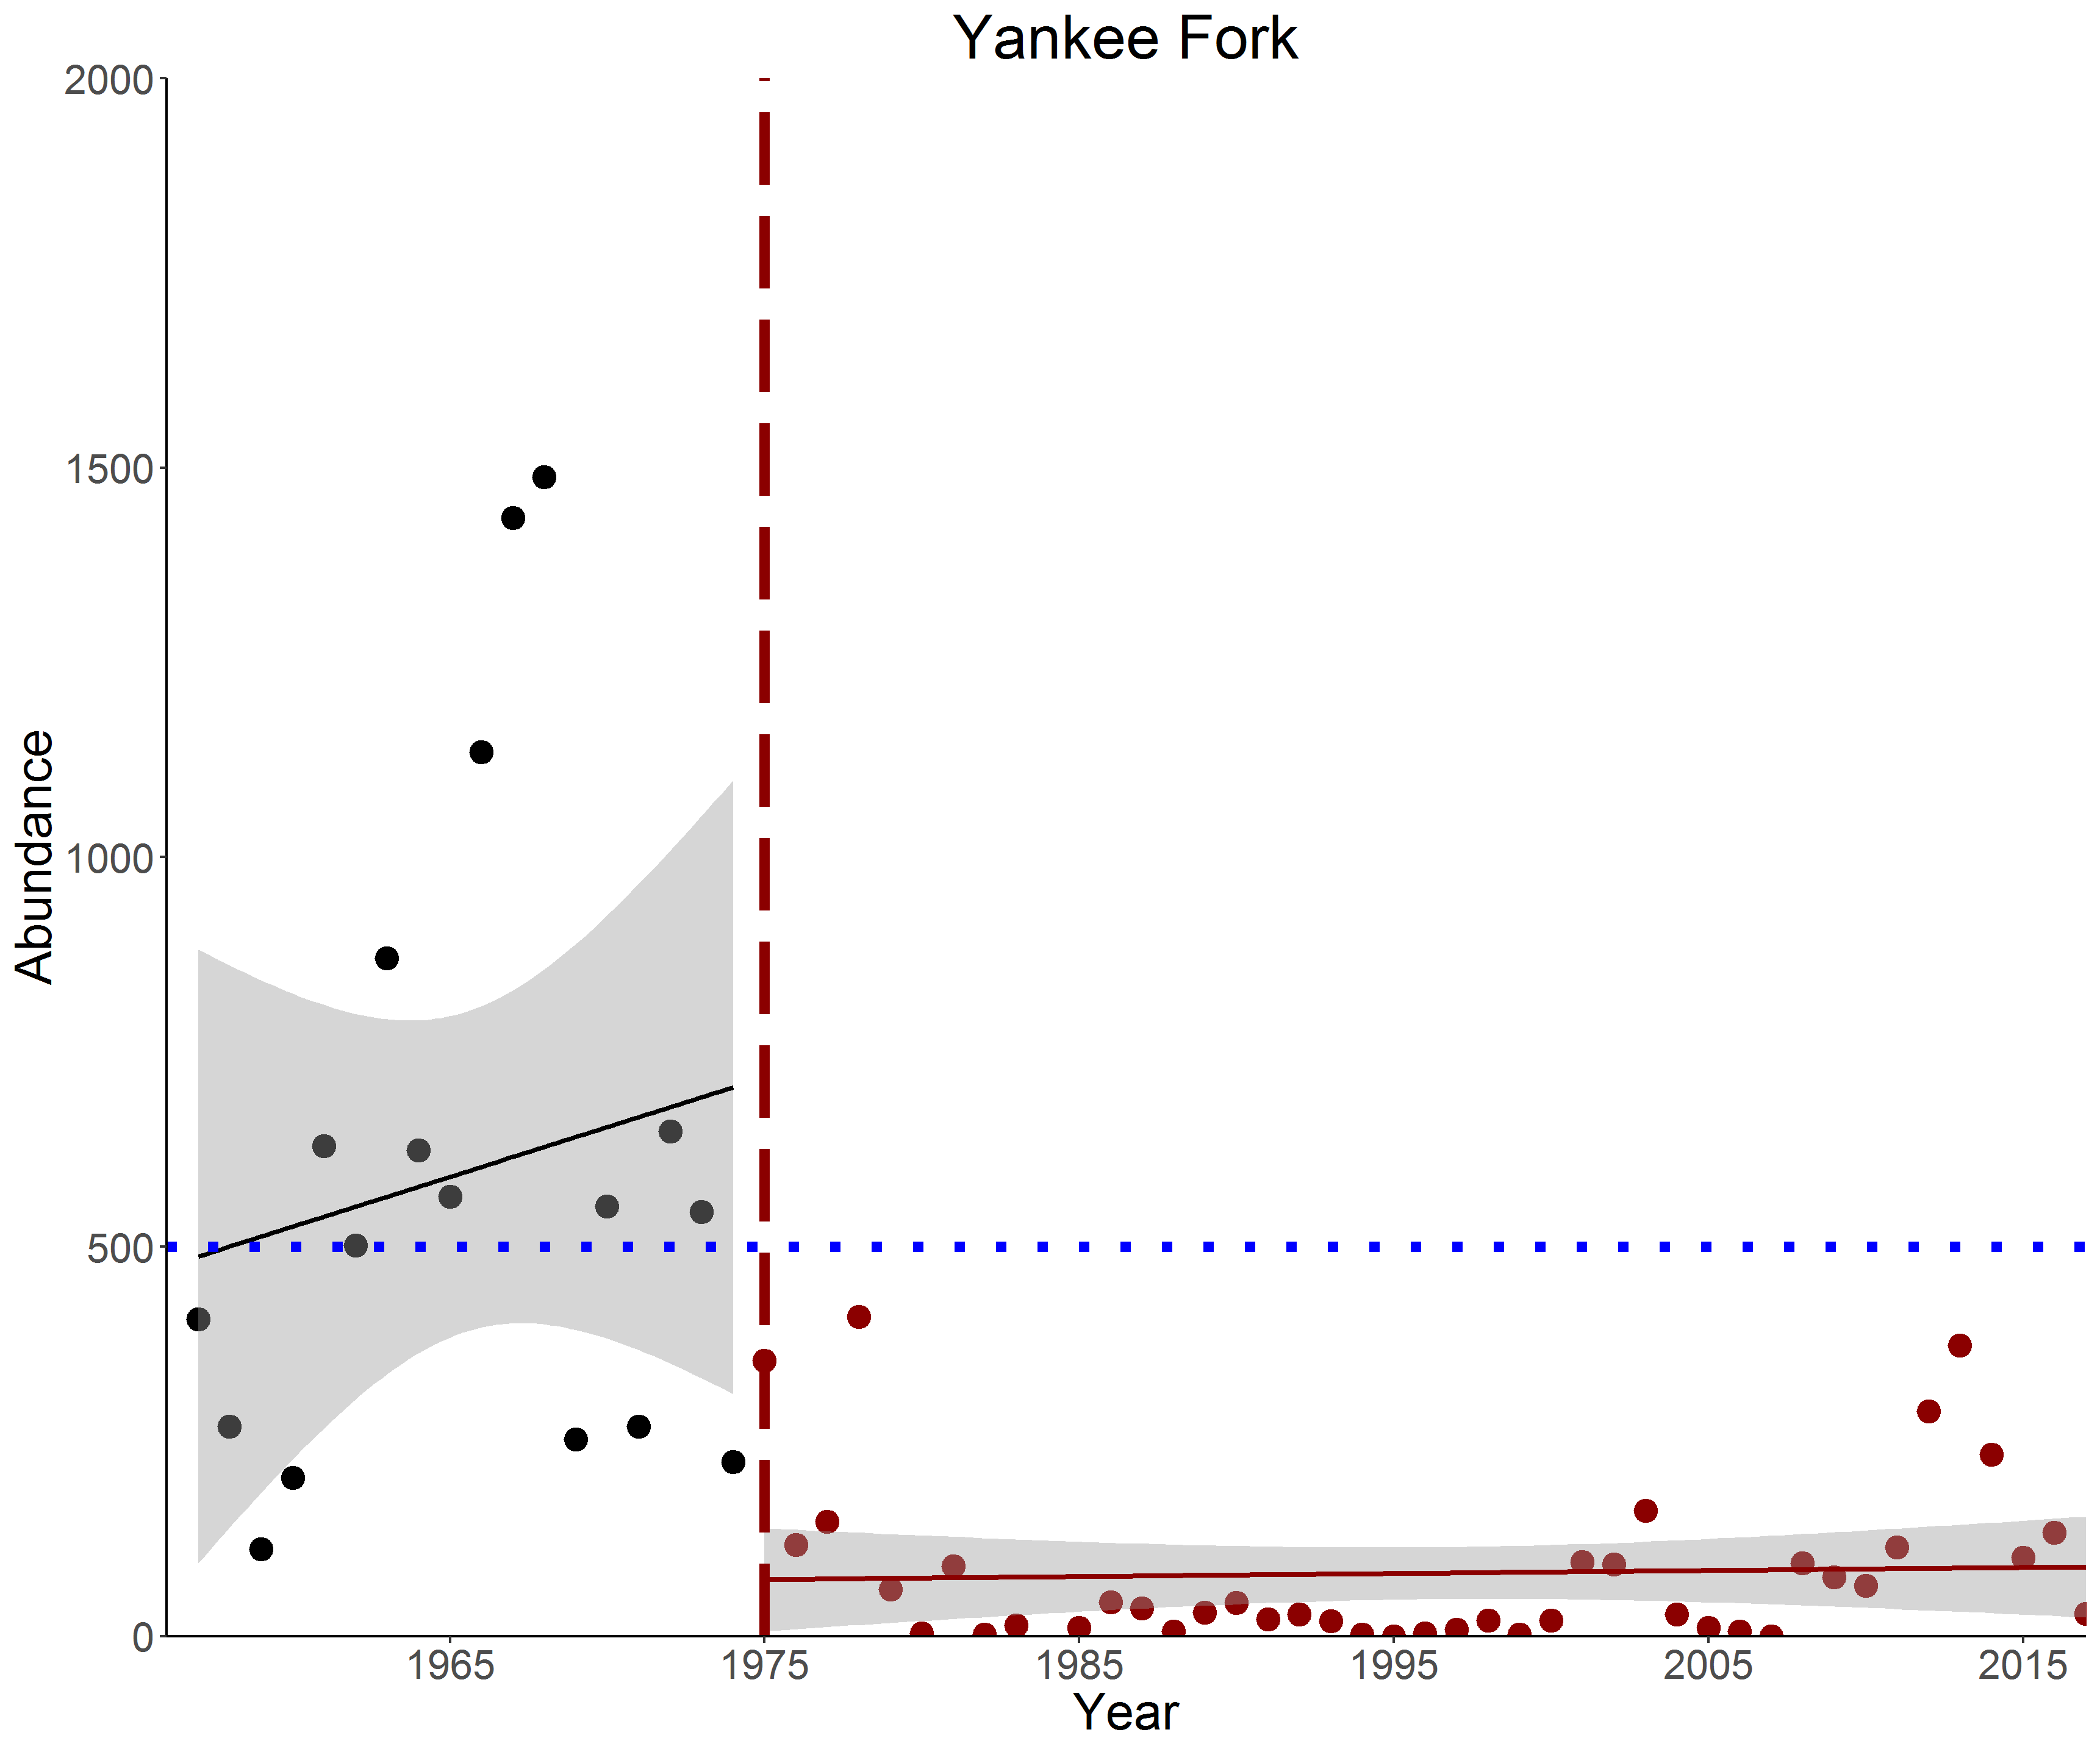
YANKEE FORK ABUNDANCE TRENDS

Slide 24
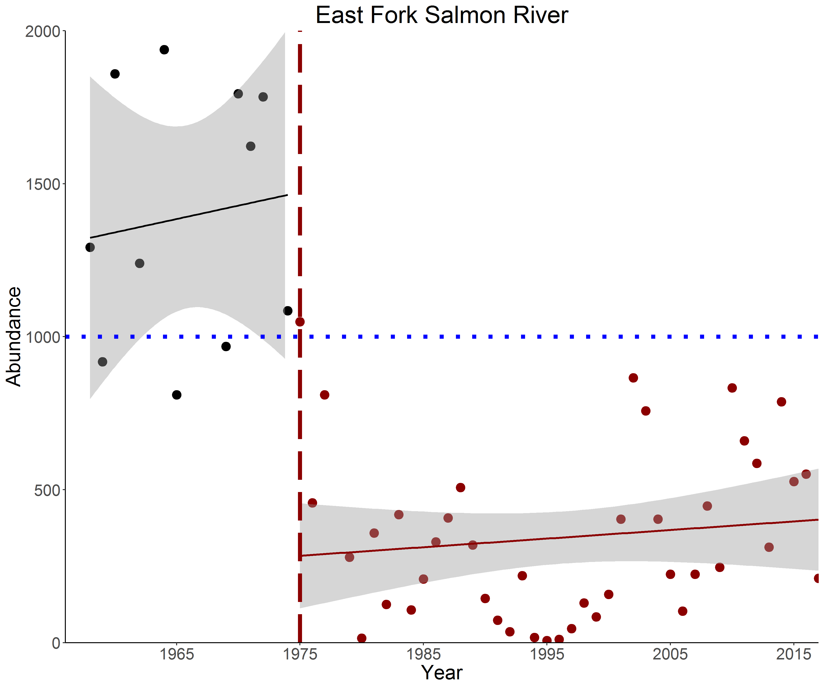
EAST FORK ABUNDANCE TRENDS

Slide 25
VIABLE POPULATION THRESHOLD
Comparison of natural-origin adult escapement values to the Viable Population Threshold (VPT) set for each Fishery Management Area. Red values indicate escapement was under VPT and green values indicate escapement was over VPT.

Slide 26
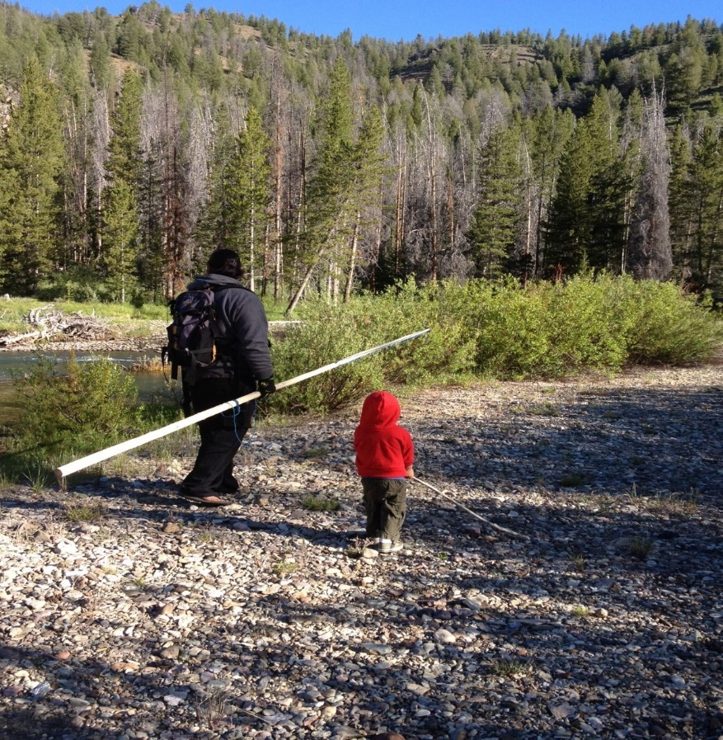
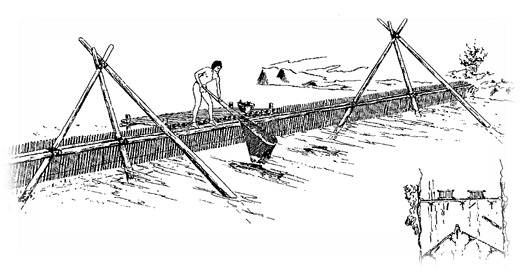
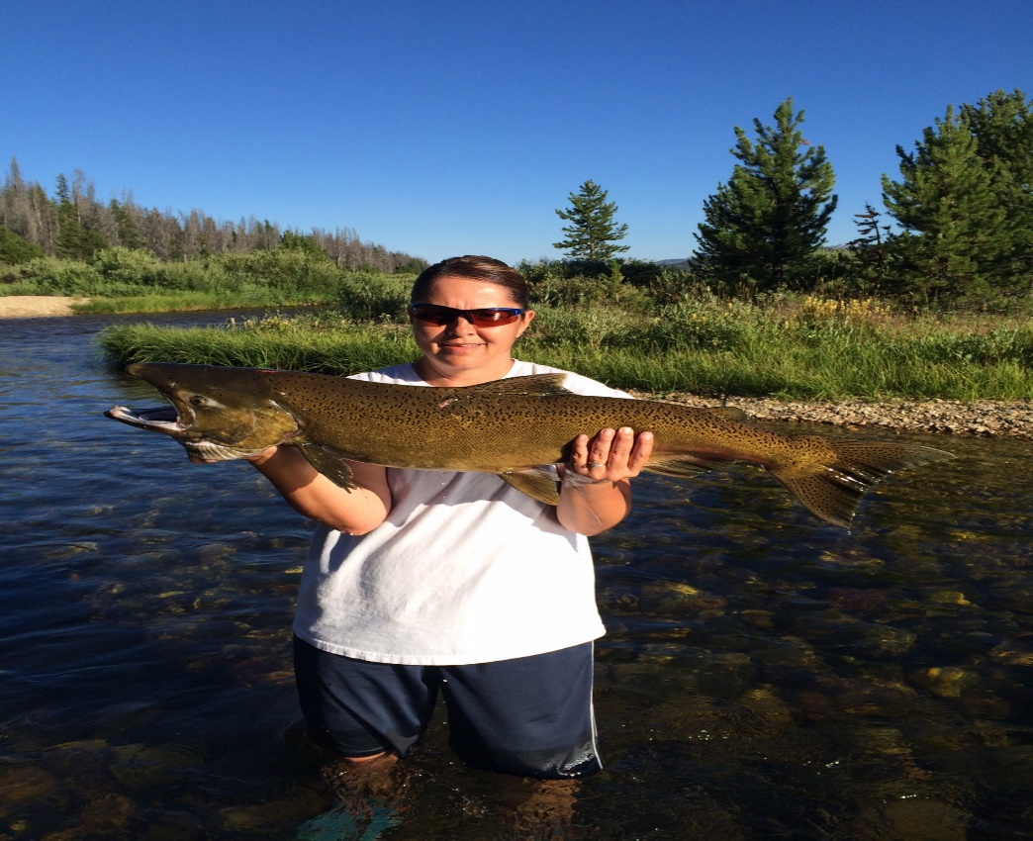
SUBSISTANCE CULTURE – A FISHING PEOPLE
Annual historic consumptions of salmon was estimated to be about 700 pounds per Tribal member, today’s annual consumption is about 1.2 pounds of salmon per person. The loss of salmon threatens traditional cultural practices that are a vital part of our Tribal identity.
Notes:
AS A PEOPLE, WE HAVE GONE FROM RELYING ON ANADROMOUS FISH RUNS THAT PROVIDED YEAR-LONG SUBSISTENCE RESOURCES FOR OUR COMMUNITIES TO INGESTING MERELY CEREMONIAL AMOUNTS OF SALMON DURING A SHORT WINDOW EACH FISHING SEASON.
FOR THE TRIBES…, THE CONTINUED EXISTENCE OF OUR CULTURE AND TRADITIONAL CULTURAL PRACTICES ARE AT RISK OF EXTINCTION BECAUSE OF THE LOSS OF SALMON.

Slide 27
HARVEST – SHOULDERING THE BURDEN OF CONSERVATION
Prior to listing there was no regulatory mechanism in the ESA to authorize the take of a listed species. The 4 (d) rule was created to authorize the take of threatened species with an approved conservation based resource management plan. The Shoshone-Bannock Tribes have approved Tribal Resource Management Plans for the take of listed chinook salmon which is based on a sliding scale harvest framework.
Notes:
THE EQUITABLE DISTRIBUTION OF ENVIRONMENTAL RISK AND BENEFITS HAS NOT BEEN AFFORDED TO THE SHOSHONE AND BANNOCK PEOPLES.
OUR CULTURE AND ECONOMIES, LIKE MANY OF YOUR OWN, ARE FORCED TO SHOULDER THE BURDENS OF CONSERVATION.
SINCE THE LISTING OF SALMON UNDER THE ENDANGERED SPECIES ACT THE TRIBES HAVE BEEN RESTRICTED AND PRECLUDED FROM HARVESTING FISH IN ANY MEANINGFUL MANNER.
WE ASSUMED THAT THE LISTING OF SALMON WOULD INCREASE ABUNDANCE OVER THE NEXT FEW DECADES TO PROVIIDE FOR SUSTAINABLE, HARVESTABLE, AND RECOVERED POPULATIONS.
WE PARTICIPATED IN THE DEVELOPMENT OF RECOVERY GOALS, PROVIDED A CONSERVATION BASED HARVERST FRAMEWORK, AND IMPLMENTED HABITAT IMPROVEMENTS PROJECTS AND SET THE LISTING OF SALMON WOULD
UNFORTUNATELY, AFTER ALMOST 30 YEARS SINCE THE DECISIONS TO LIST WAS MADE SALMON ABUNDANCE REMAINS ROUGHLY AT THE SAME LEVELS.

Slide 28
SBT HARVEST
Total Chinook harvested by SBT over the last 30 years reflects a less than meaningful annual fishery for the Tribes 6,000 members.

Slide 29
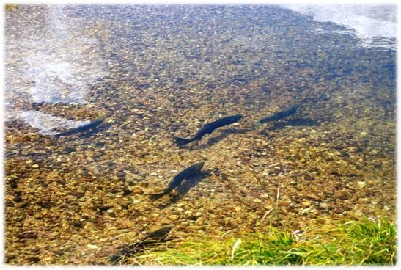
TRIBES PERSPECTIVE ON THE SALMON PROBLEM
The lack of abundant salmon populations in Idaho is causing conflict for all of us in this room. We need salmon to have salmon and to get there we need SAR’s in the 2 - 6% range; preferably at the at the higher end to support meaningful harvest. We need to restore the Snake River’s natural riverine ecosystem.
Salmon occupy 40% of their historic habitat in the Basin.
Abundance in the Salmon River is estimated at 0.5% of its historical runs size.
25-50% of Idaho streams are nutrient-limited – suggesting limiting factor.
Snake River salmon smolt to adult returns are generally less than 1%
  — far below what is necessary for Recovery or to meet the Northwest Power and Conservation Council goals of 2-6%.
Notes:
EVERYONE OF US HERE WHETHER WE ARE FROM A TRIBAL CULTURE OF AGRICULTURE CULTURE HAS FELT THE IMPACTS OF THE LACK OF SALMON ABUNDANCE .
WE HAVE ALL FELT THE STRAIN ON OUR BACKS FROM SHOULDERING THE BURDEN OF CONSERVATION.
THE HAND CUFFS PLACED ON OUR ABILITY TO UTILIZE IDAHO RESOUCES BECAUSE OF ABUNDANCE HAS IMPACTED OUR ECONOMIES AND OUR CULTURES.
WE ALL KNOW THAT THE OPPORTUNIITIES WE HAVE ARE FAR LESS THAN THOSE OF OUR PARENTS; AND,
WE ALL WONDER IF OUR CHILDREN WILL HAVE THE SAME OPPORTUNITIES AS WE HAVE HAD.
WILL OUR CHILDREN CONTINUE IN OUR FOOTSTEPS OR WILL THEY BE FORCED TO LOOK ELSEWHERE FOR OPPORTUNITIES BECAUSE THE ECONOMIES WE RELIED UPON ARE NO LONGER SUSTAINABLE.
THERE IS A COMMON THREAD THAT BRIINGS US ALL TOGETHER TODAY IN THIS ROOM…
THE NEED FOR ABUNDANCE.

