Slide 1
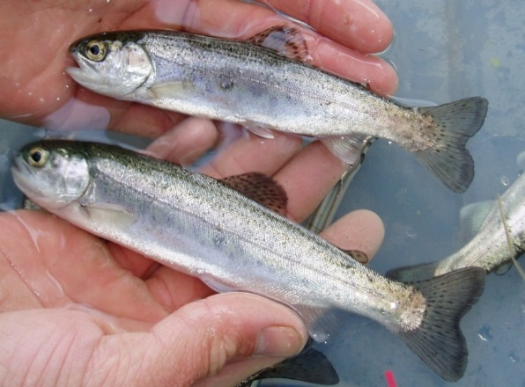
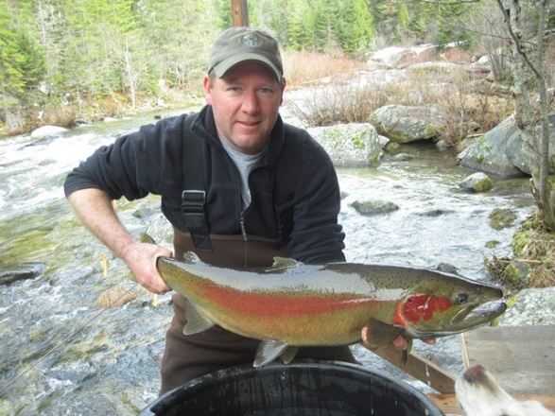

Comparative Survival Study
SARs and Productivity
Timothy Copeland, Idaho Dept of Fish & Game
Governor’s Salmon Workgroup Meeting
October 30, 2019
1
Notes:
Intro me & CSS involvement
Acknowledge this work largely done by Petrosky & Schaller (now retired)

Slide 2
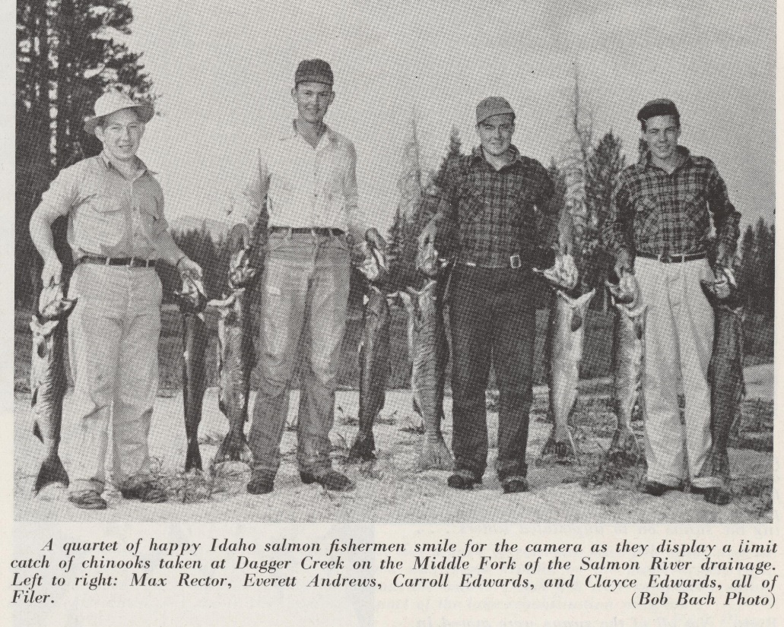
Today’s Menu
What are SARs? (A Refresher)
Why are SARs important to salmon?
What are the historical and recent SAR trends?

Slide 3
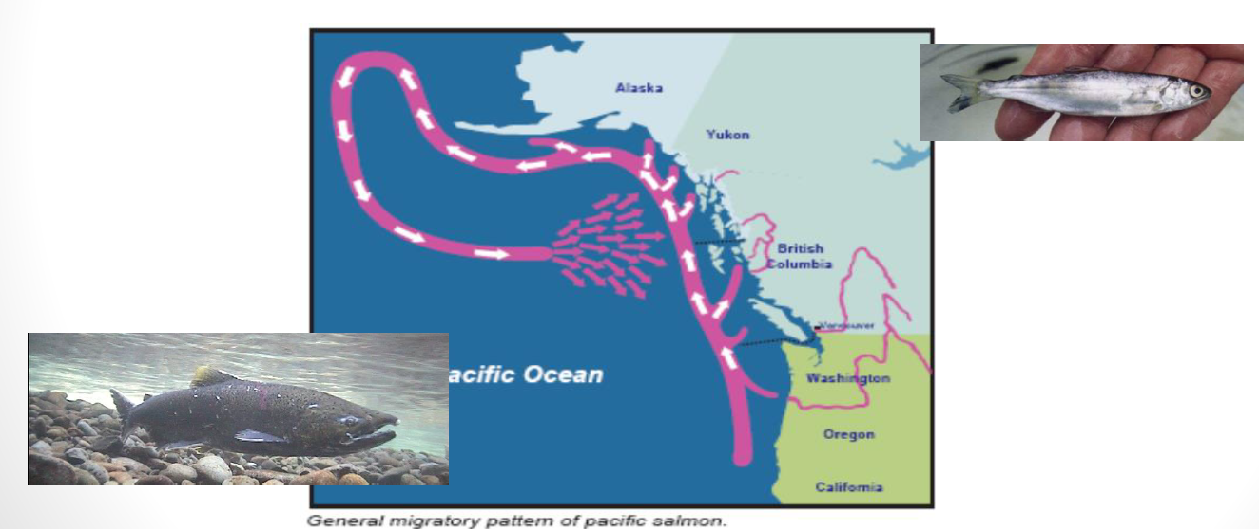
1. What are SARs?
Smolt to Adult Return rates
Survival from beginning point as a smolt to ending point as an adult
Notes:
FACH have very different starting point & life history

Slide 4
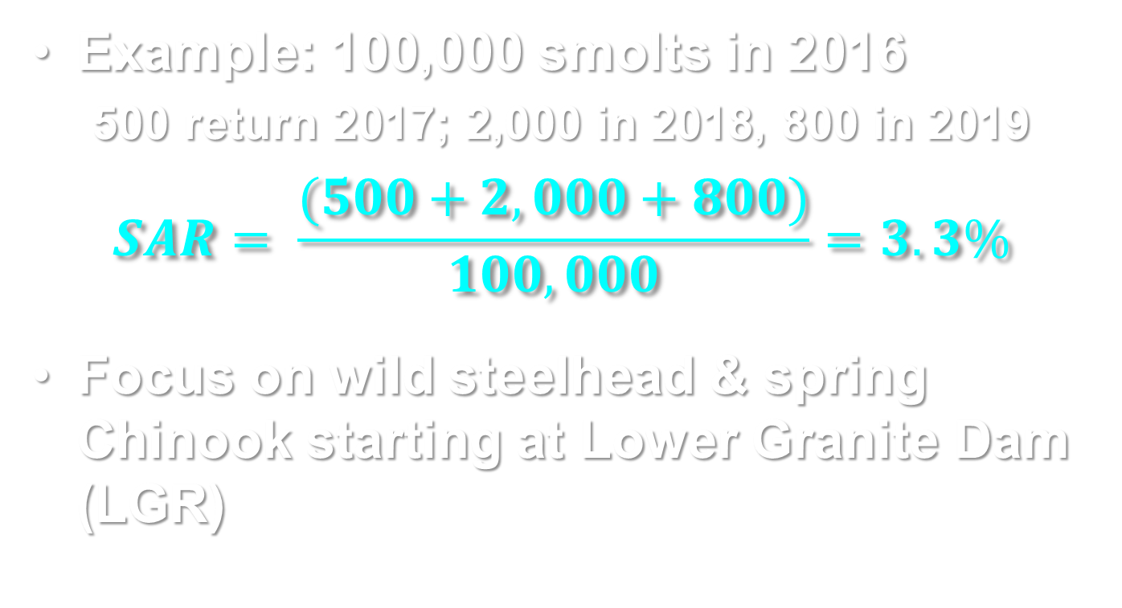
1. What are SARs?
Example: 100,000 smolts in 2016
  500 return 2017; 2,000 in 2018, 800 in 2019
$$SAR= \frac{(500+2,000+800)}{100,000}=3.3\%$$
Focus on wild steelhead & spring Chinook starting at Lower Granite Dam (LGR)
Notes:
FACH have very different starting point & life history

Slide 5
Smolt Emigration
Lower
Granite
Dam
WASHINGTON
Columbia River
Salmon River
Bonneville
Dam
OREGON
Snake River
IDAHO
Notes:
Smolts originate in Idaho tribs and first accounting is at LGR
Steelhead & spring/summer Chinook; no evidence of rearing below LGR

Slide 6
Passage Through Hydrosystem
Lower
Granite
Dam
WASHINGTON
Columbia River
Salmon River
Bonneville
Dam
OREGON
Snake River
IDAHO
Notes:
Juvenile emigration thru the hydrosystem, dam passage stresses & predation (Birds & fish)

Slide 7
Estuary & Near Shore
Lower
Granite
Dam
WASHINGTON
Columbia River
Salmon River
Bonneville
Dam
OREGON
Snake River
IDAHO
Notes:
Transition to ocean is stressful, most ‘ocean mortality’ thought to occur at this stage
Potential for carry-over from hydro experiences

Slide 8
Return from the Ocean
Lower
Granite
Dam
WASHINGTON
Columbia River
Salmon River
Bonneville
Dam
OREGON
Snake River
IDAHO
Notes:
Ocean mortality not well-known, generally thought to be low
Idaho’s steelhead & spring CH migrate far out at sea & not subject to coastal fisheries

Slide 9
Return to Idaho
Lower
Granite
Dam
WASHINGTON
Columbia River
Salmon River
Bonneville
Dam
OREGON
Snake River
IDAHO
Notes:
Subject to fisheries, sea lion predation, dam passage less of an issue for adults
Warming waters burn irreplaceable energy, disease, straying

Slide 10
Part 1 Summary
SARs encompass several years
Incorporate many different hazards
Account for events outside spawning & rearing habitats
  SARs for potential productivity at Columbia River mouth
  SARs for population dynamics at Lower Granite Dam

Slide 11
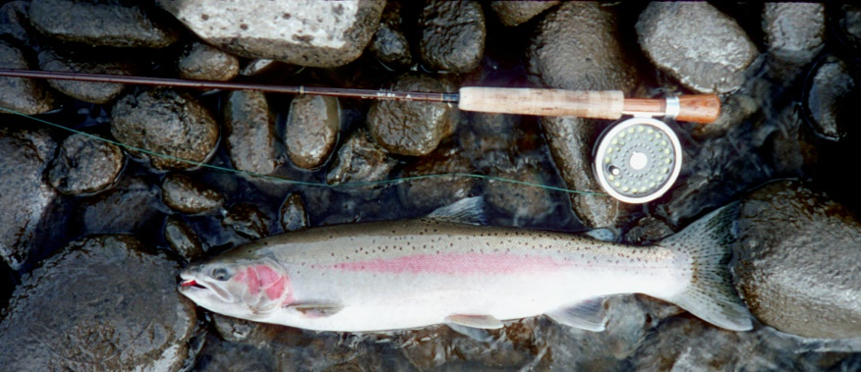
2. Why are SARs Important?
Gain >98% weight in the ocean
Determine adult numbers in Idaho
Directly related to population resilience
  Informative performance metric
  Ability to sustain harvest
  Viability at low abundance

Slide 12
SAR Goals
Set for NPCC Fish & Wildlife Program
  4% average, range 2%-6%
Derived by a model for Snake River spring/summer Chinook
  >4% for 48-yr recovery standard
  >2% for 100-yr survival standard
  >6% for 24-yr survival standard
How do these relate to population productivity?
  Adult-to-adult replacement
5
Notes:
Model probability of populations avoiding extinction vs rebuilding
Goals applied to steelhead; compare expectations to actual performance

Slide 13
First Analysis
1992-present
Adults from spawning monitoring
  Spawners = parents
  Recruits = adult progeny spawning
Productivity: recruits/spawner
  Log R/S < 0 means population declining
  Log R/S = 0 means population stable
  Log R/S > 0 means population increasing
Plot R/S at SARs <1%, 1%-2%, >2%
7
Notes:
Current period (since 1992) focuses on viability, ie on the spawning grounds
These are populations at low abundance

Slide 14
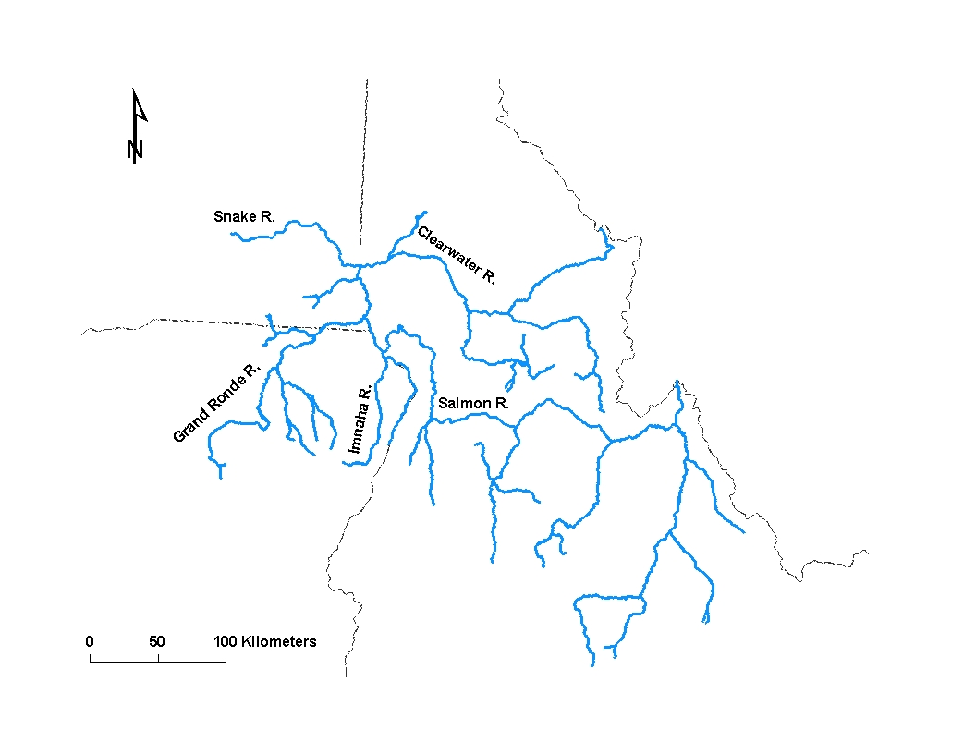
Study Populations
Chinook (n = 17)
Steelhead (n = 6)
WA
OR
MT
ID
Notes:
Examine Chinook populations in 4 groups

Slide 15
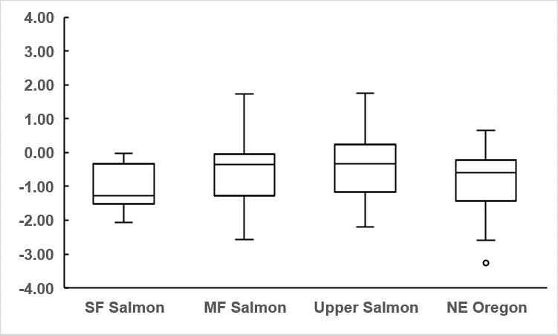
Chinook Productivity
SAR <1%
Population increases
Population Productivity
Population declines
Notes:
Explain: box is middle half of obs, line is median
Whiskers are range of data out to 1.5 times IQR. Points farther than that are defined as outliers.
High risk for declines

Slide 16
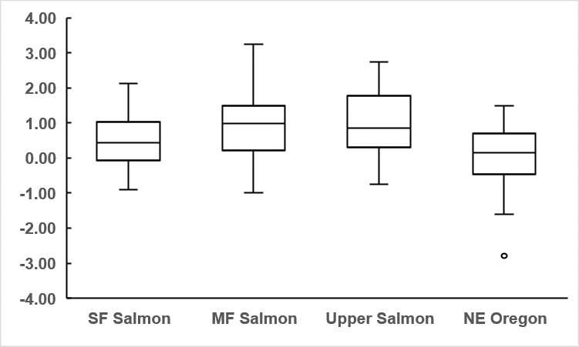
Chinook Productivity
SAR 1-2%
Population increases
Population Productivity
Population declines
Notes:
Populations hovering around stability but not recovering & at substantial risk of decline

Slide 17
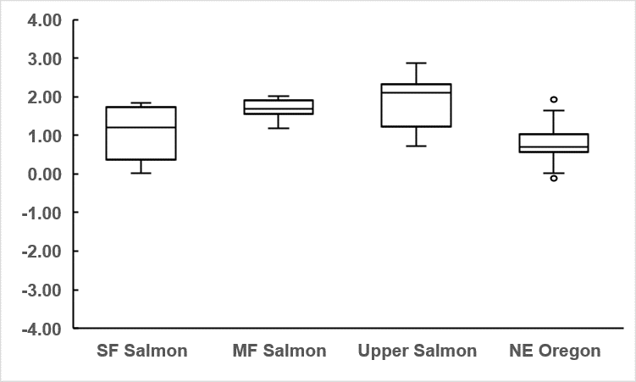
Chinook Productivity
SAR >2%
Population increases
Population Productivity
Population declines
Notes:
At SAR>2%, populations increasing & low risk of decline

Slide 18
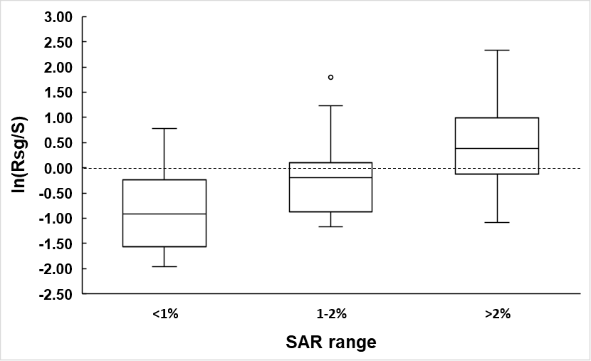
Steelhead Productivity
Population increases
Population Productivity
Population declines
9
Notes:
Similar picture for steelhead

Slide 19
Second Analysis
Current vs Historic Productivity
Define 1960s as ‘healthy & harvestable’
  Total downriver & Idaho harvest ~60%
Scale productivity to 1960s
  Deviation from predictions from stock-recruit model
  What would a healthy population produce at a given number of spawners?
Compare to SAR at Columbia mouth
Notes:
Need to account for periods with very different harvest mgt

Slide 20
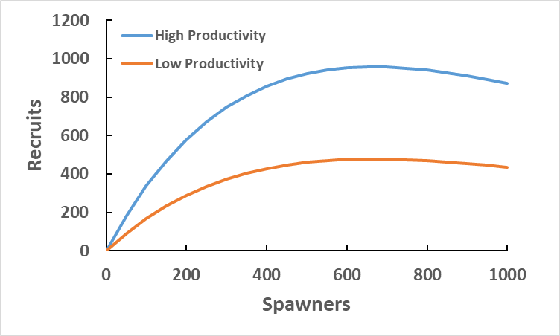
Example: Scaling Productivity
Notes:
Imagine a population with high & low periods of productivity

Slide 21
Example: Scaling Productivity
951 recruits, 100% of prediction
Natural log = 0
476 recruits, 50% of prediction
Natural log = -0.63
Notes:
Imagine a population with high & low periods of productivity

Slide 22
Scaled Productivity
Notes:
Base period is pre-1970

Slide 23
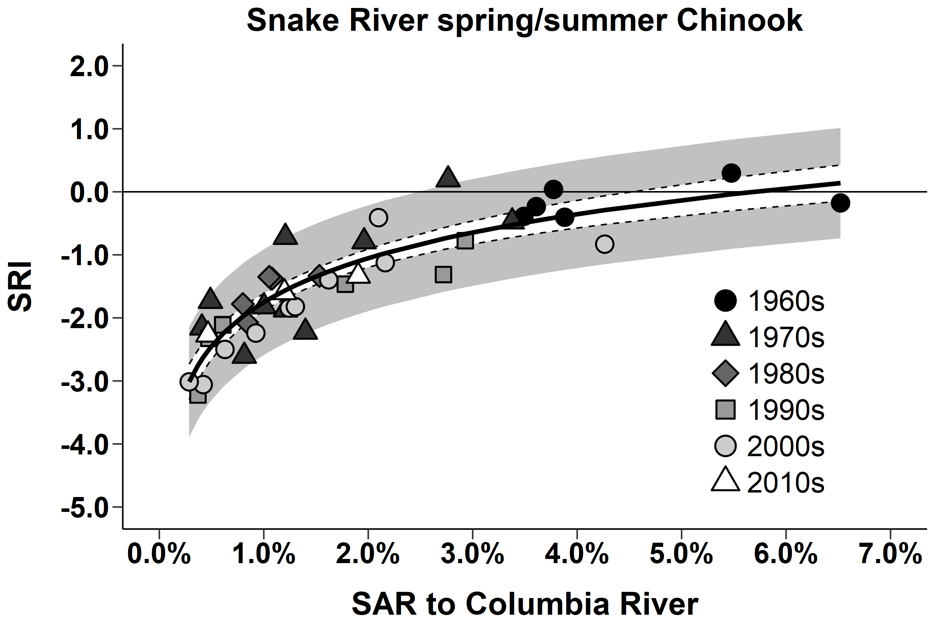
Productivity & SAR Trend
Less than 1960s
Scaled Productivity
Notes:
SARs explain much of productivity, as SARs drop, so does productivity
Need SARs >4% to get 1960s productivity

Slide 24
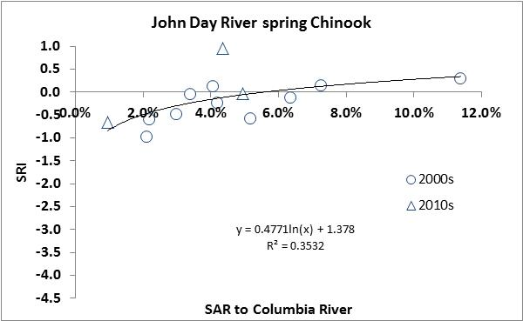
Mid-Columbia Productivity & SARs
Traverse 3 dams
Higher SARs
Productivity similar to 1960s
Fisheries on wild Chinook in 2012, 2014, 2015 & 2016
Scaled Productivity
Notes:
Same analysis as previous slide to compare; JD not listed

Slide 25
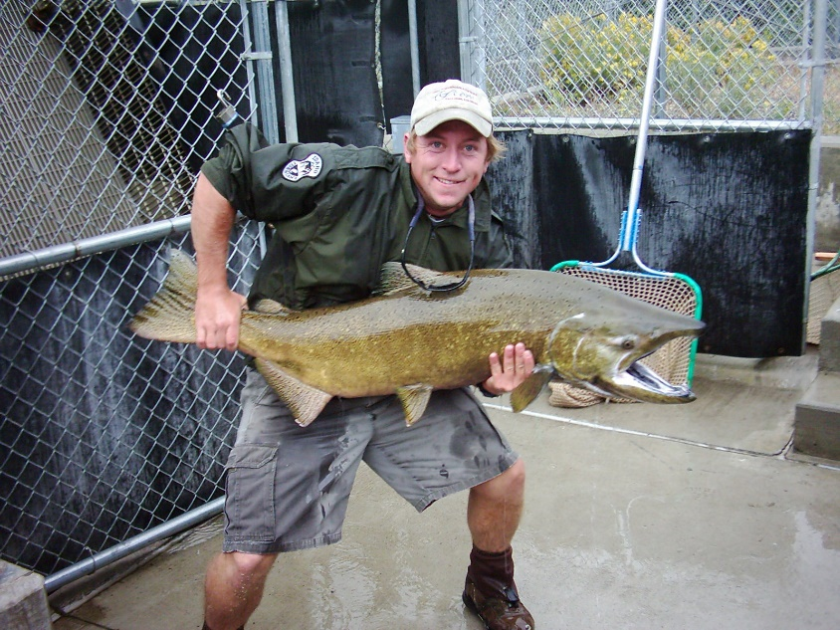
Part 2 Summary
SARs account for most of variation in salmon population dynamics
Observations support NPCC SAR goals
  SAR is a good performance metric
  SARs >4% necessary for ‘healthy & harvestable’ (not 2%)
20

Slide 26
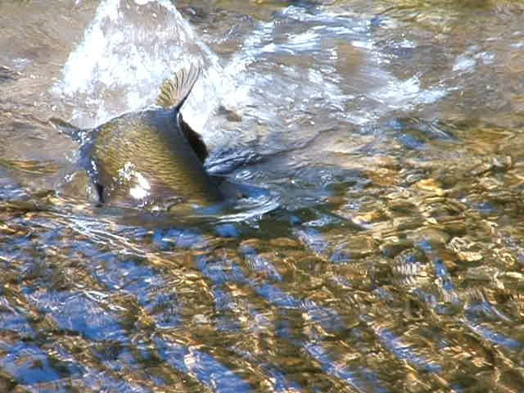
3. SAR Trends
Trends from draft 2019 CSS report
Plot with 2%-6% range shown
SARs to Bonneville & LGR
Hatchery Chinook trends
Notes:
1 slide with hatchery CH trends

Slide 27
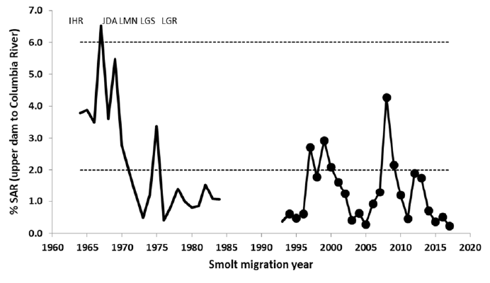
Chinook into Columbia
Notes:
SARs declined in 1970s into same range as recent
Same years saw precipitous population declines & curtailment of fisheries

Slide 28
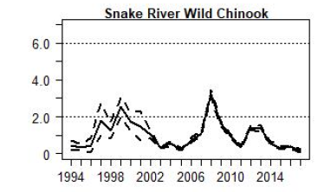
Chinook at LGR
% SAR
Notes:
Recent years have had poor productivity & populations have not recovered

Slide 29
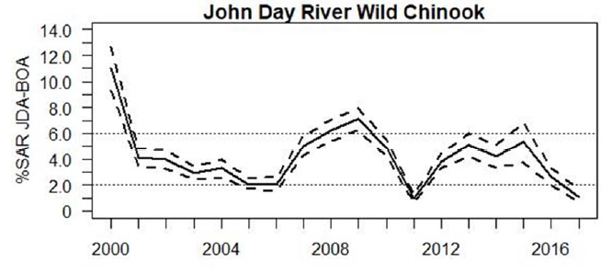
Mid-Columbia SARs
Notes:
ODFW still runs harvest fisheries on John Day Chinook when returns are high

Slide 30
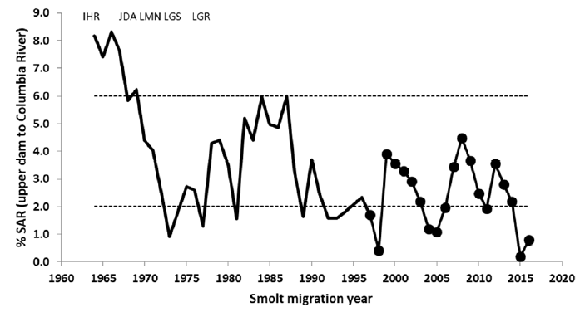
Steelhead into Columbia
Notes:
Steelhead more resilient but picture similar

Slide 31
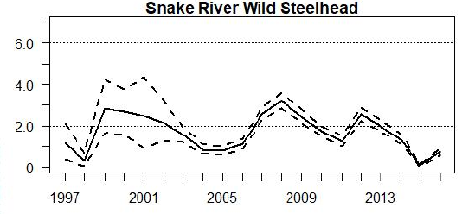
Steelhead at LGR
% SAR
Notes:
Considerable losses of wild steelhead between Columbia mouth & LGR
Very recent yrs particularly bad

Slide 32
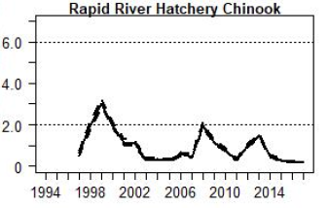
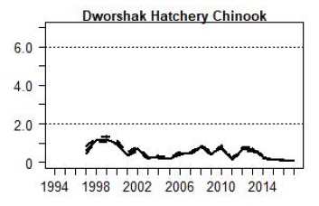
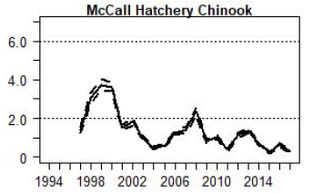
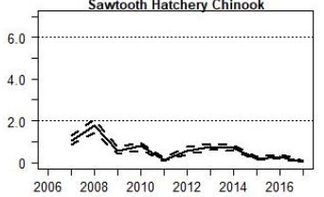
Hatchery Chinook
Hatcheries need 0.87% SAR to meet mitigation goals
Hatchery success depends on SARs!
Notes:
4 of our larger hatchery stocks

Slide 33
Summary
SARs and productivity at current low abundances
  SARs < 1% population declines
  SARs > 2% population increases
  SARs >4% necessary for ‘healthy & harvestable’ (not 2%)
Recent SARs are below goals
SARs affect hatchery mitigation success

Slide 34
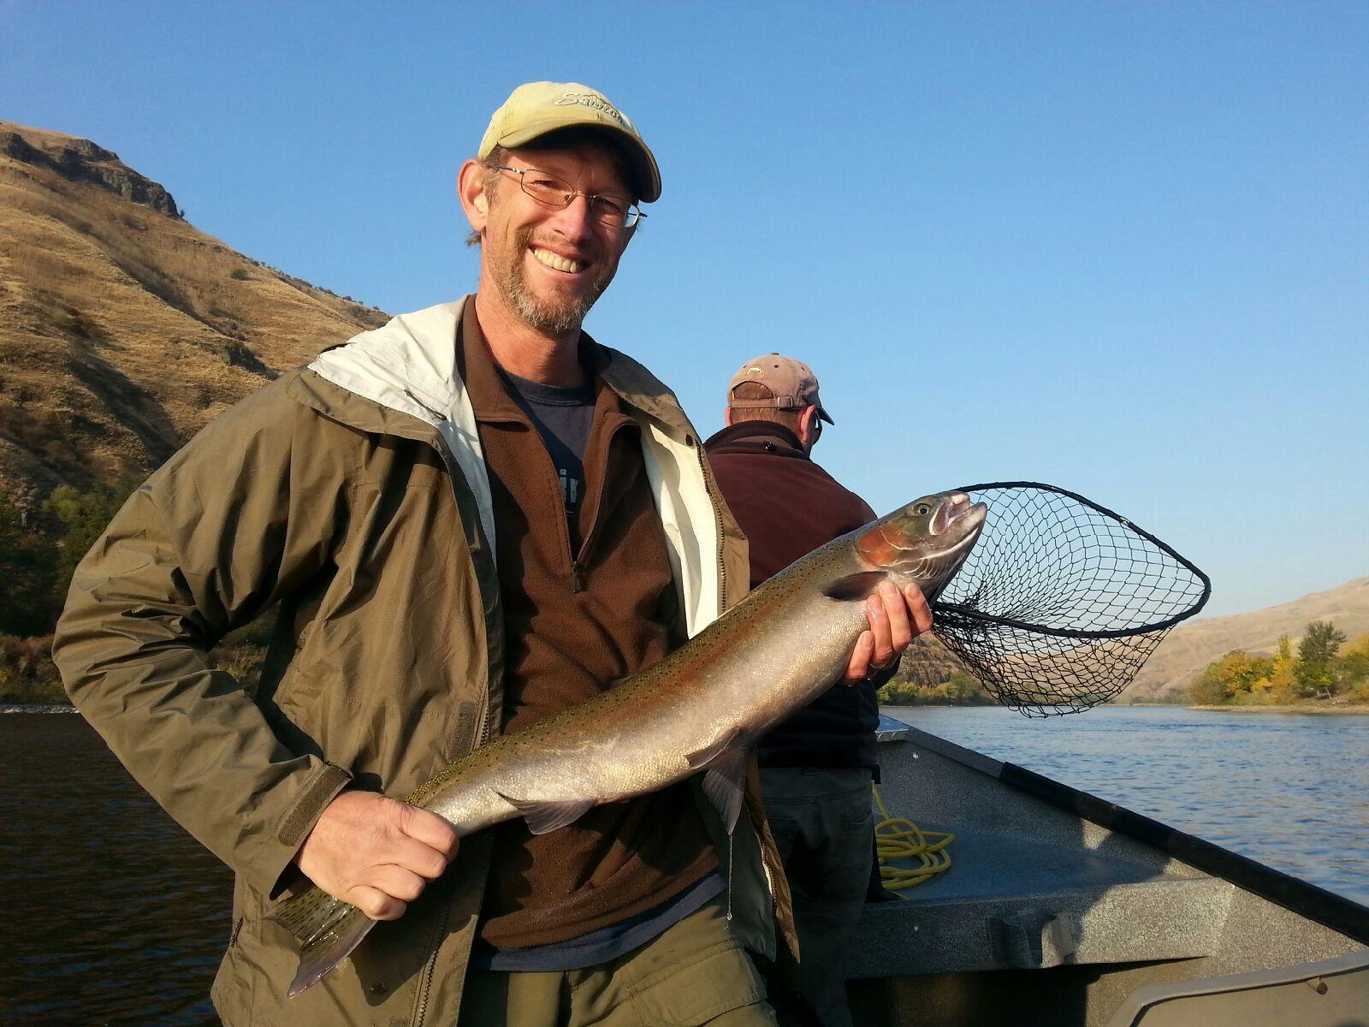
The End of the Rainbow

