Slide 1

Overview of the Northwest Fisheries Science Center’s
Life Cycle and COMPASS Models
West Coast Region
Ritchie Graves
Chief, Columbia Hydropower Branch
Interior Columbia Basin Office
Idaho Governor’s Salmon Workgroup Meeting
Twin Falls, Idaho
October 30, 2019

Slide 2

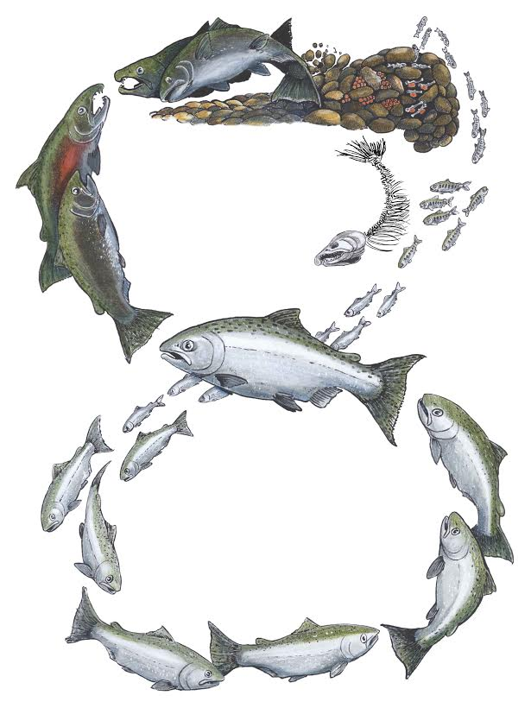

Salmon and Steelhead Life Cycle Model
COMPASS Model
Recruits Per Spawner
Smolt to Adult Return (SAR)

Slide 3
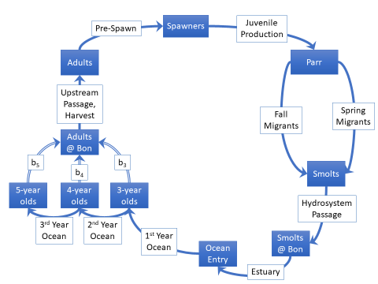
Life Cycle Model
Population Models
ESU / DPS Model
COMPASS Model

Slide 4
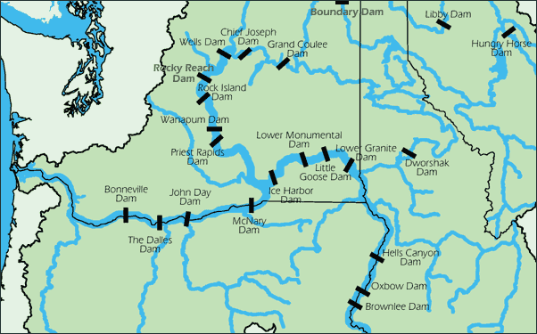
Mainstem Columbia and Snake River Dams

Slide 5
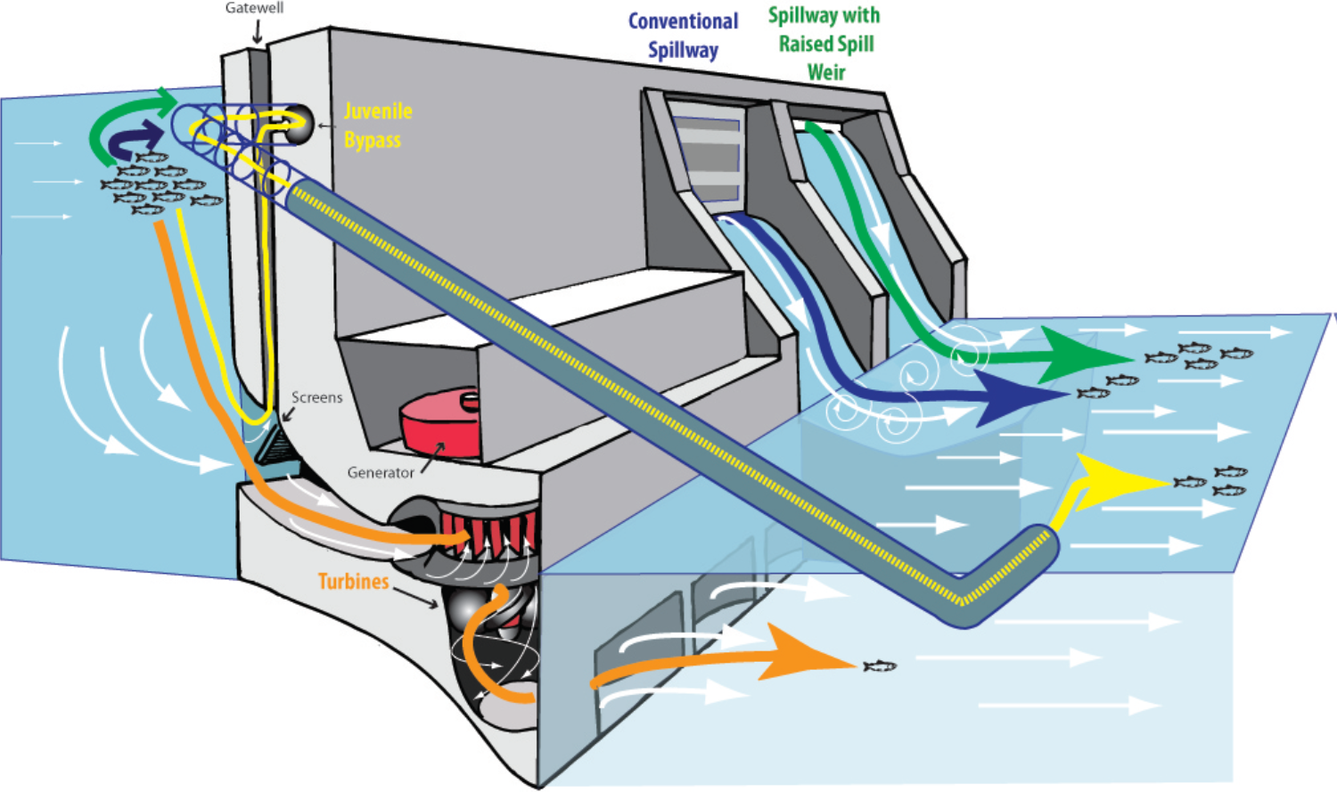
Dam Passage Routes

Slide 6
COMPASS Model Inputs (Daily to Hourly time steps)
Migration Timing and Distribution
Reservoir Elevations, River Flows, and Spill Levels
River Temperatures
Route-Specific Passage and Survival Rates
Spill Efficiency
  Proportion of smolts passing via the spillway for a given percentage of spill
Fish Guidance Efficiency
  Proportion of smolts entering a turbine intake screened into the juvenile bypass system
Calibrated using PIT tag, Acoustic Tag, and Radio Tag data
Notes:
Peer Reviewed literature and 3 Reviews by the ISAB

Slide 7
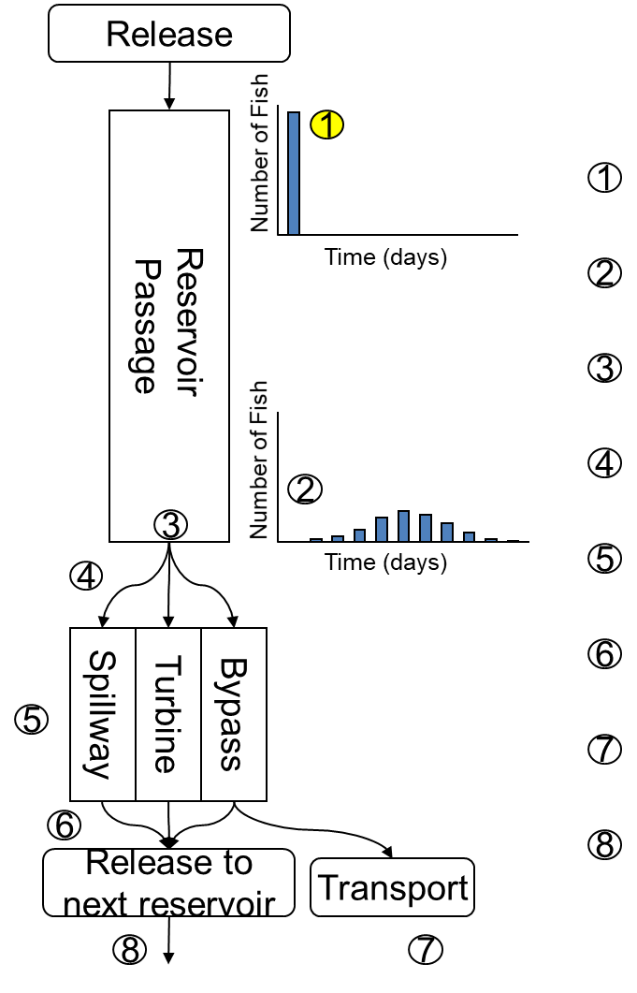
Fish released at top of reservoir
Fish migrate downstream
Reservoir mortality applied
Fish distributed among passage routes
Rout-specific dam mortality applied
Fish recombined
Fish removed for transportation (Bypass only)
Fish released into next reservoir

Slide 8
COMPASS Model Outputs
Smolt Survival
  Inriver smolts
  Transported smolts
Smolt Travel Times
Powerhouse Passage
  Proportion of inriver fish passing powerhouses 0, 1, 2 etc. times
  Average number of powerhouses a smolt is likely to pass
SAR estimates (Ocean Module)
  Based on arrival at Bonneville Dam tailrace
  Average SAR of inriver migrating smolts
  Average SAR of transported smolts
Notes:
Peer Reviewed literature and 3 Reviews by the ISAB

Slide 9
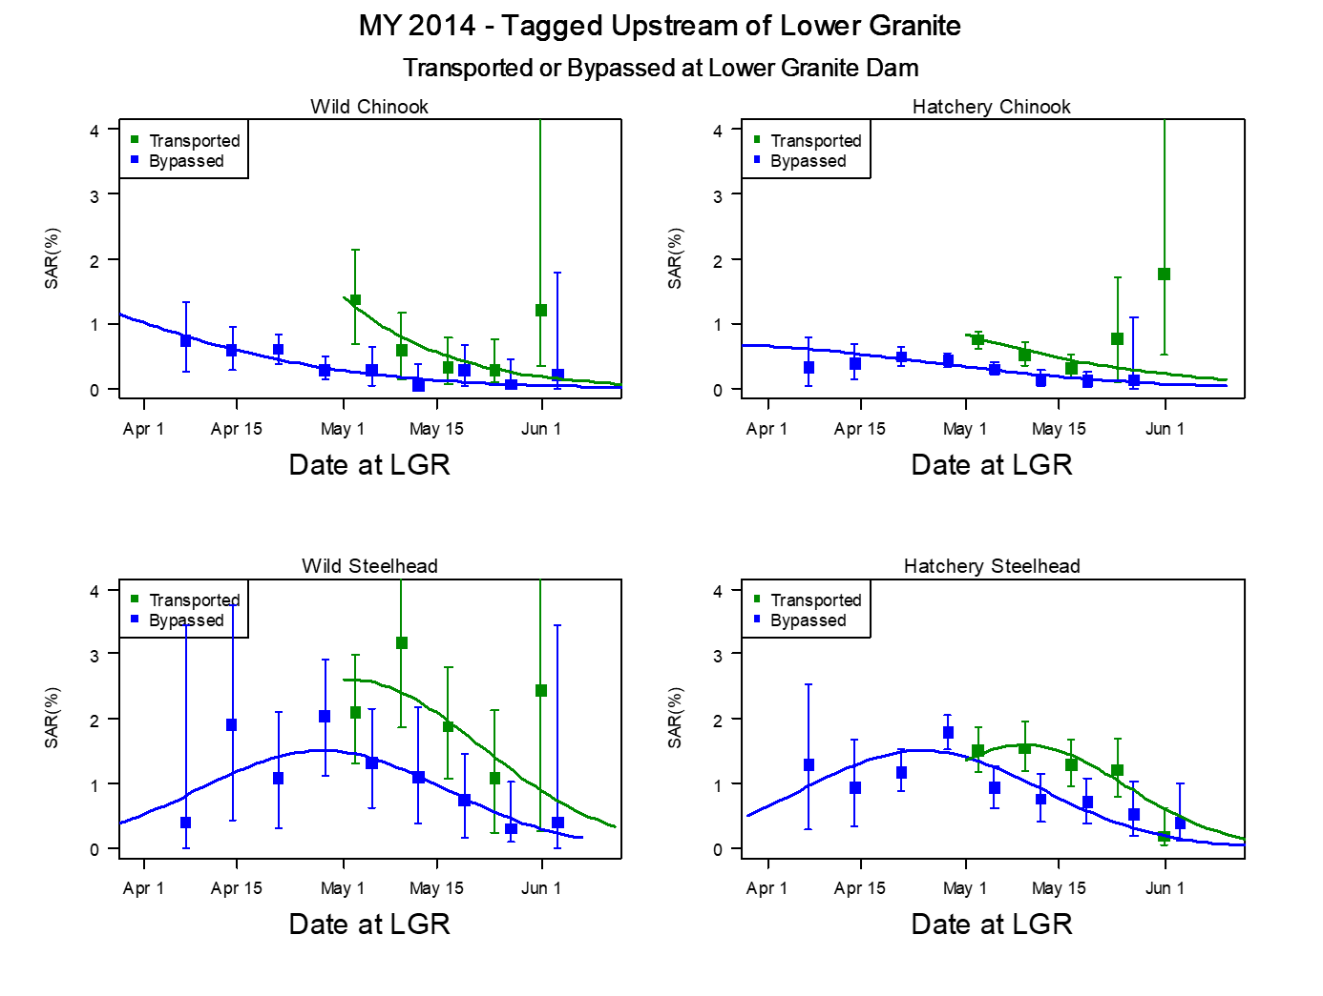
Example:

Slide 10
Life Cycle Model

Slide 11
Life Cycle Modeling: 2019 Columbia River System BiOp
Snake River spring/summer Chinook salmon
  4 MPGs; 20 populations
  Mean Abundance (24 years)
  Quasi-Extinction Risk (<30 and 50 adults for 4 consecutive years)
Environmental Baseline (pg. 785-791)
  Past Tributary Habitat Actions
  Hatchery Supplementation (where applicable)
  Pinniped Predation
Proposed Action (pg. 816-837)
  Hydro Action (120% Flex Spill and 125% Flex Spill)
  Tributary Enhancement Actions
  Latent Mortality (10%, 25%, 50% improvements in productivity)

Slide 12
Example:
Past Tributary Habitat Actions, Hatchery Supplementation (where applicable), and Pinniped Predation

Slide 13
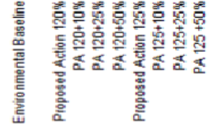
Example:
Proposed Hydro Action and assessment of potential productivity increases (from reduced latent mortality)

Slide 14
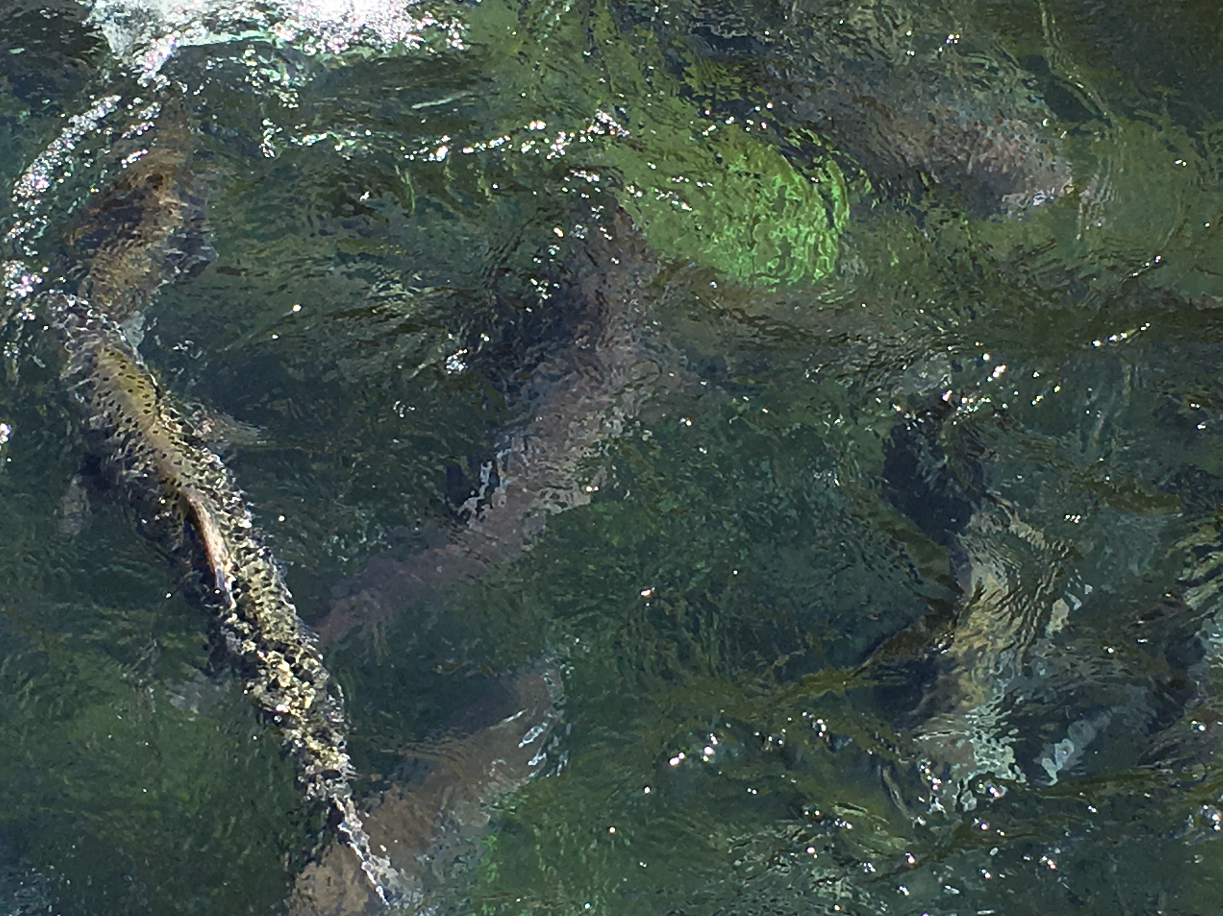
QUESTIONS?
https://www.salmonrecovery.gov/BiologicalOpinions/FCRPSBiOp.aspx

