Slide 1
The Columbia Basin Partnership Task Force
A NOAA-led effort to establish shared, quantitative
objectives for salmon and steelhead in the
Columbia Basin
Governor’s Salmon Workgroup Meeting
October 29-30, 2019
Twin Falls, Idaho

Slide 2
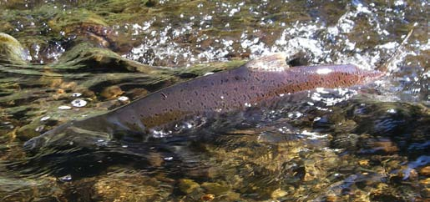
Outline
Build on Katherine’s presentation – focus on how quantitative objectives for salmon and steelhead were developed for Snake River Basin.

Slide 3
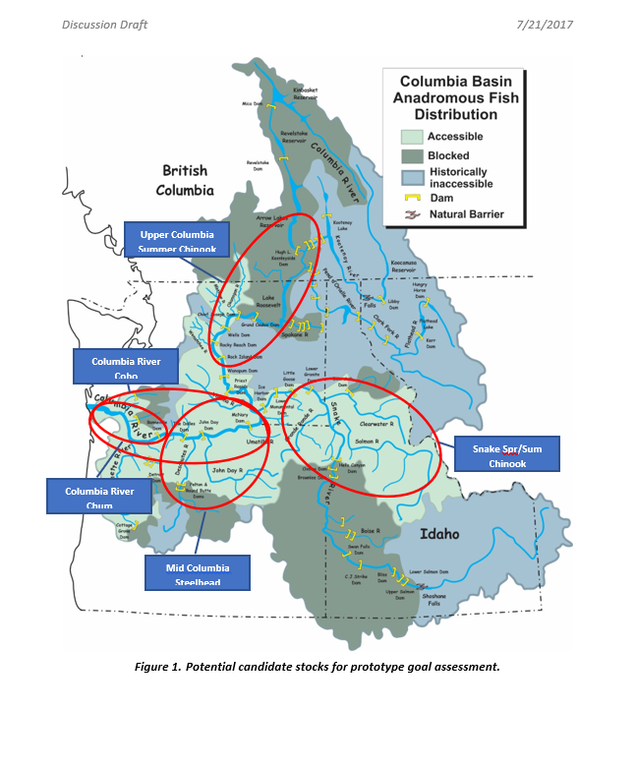
Quantitative Objectives Work Teams
Five Prototype areas (and work teams) were created to “test drive” the process of setting quantitative objectives for salmon and steelhead.
Upper Columbia Su. Chinook
C.R. Coho
C.R. Chum
Mid C.R. Steelhead
S.R. Sp/Su Chinook
Other stocks came later

Slide 4
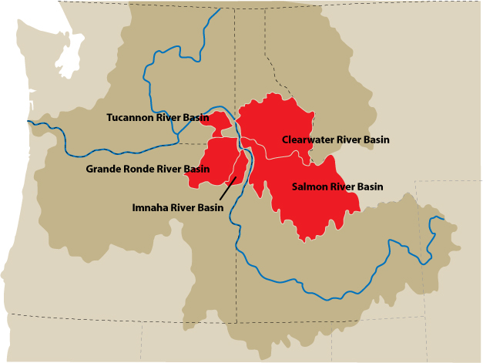
Quantitative Objectives Work Teams
Idaho identified its interest in leading objective development for the Snake River Sp/Su Chinook Prototype Team.

Slide 5
Snake River Work Team Participation
Mike Edmondson, Jim Yost – Idaho Governor’s Office
Paul Kline – Idaho Department of Fish and Game
Dan Rawding – Washington Department of Fish and Wildlife
Tucker Jones – Oregon Department of Fish and Wildlife
Rob Masonis – Trout Unlimited
Kurt Fesenmyer – Trout Unlimited
John McMillan – Trout Unlimited
Burt Bowler – Idaho Salmon Group
Bob Lessard – Columbia River Inter-tribal Fish Commission
Zach Penney – Columbia River Inter-tribal Fish Commission
Bob Austin – Upper Snake River Tribes Foundation
Scott Hauser – Upper Snake River Tribes Foundation
John Foltz – Snake River Salmon Recovery Board
Steve Martin – Washington Governor’s Salmon Recovery Office
Paul Arrington – Idaho Water Users Association
Jay Hesse - Nez Perce Tribe
Dave Johnson – Nez Perce Tribe
Bill Bradbury – Oregon Governor’s Office
John Simpson – Barker Rosholt & Simpson LLP
Liz Hamilton – Northwest Sportfishing Industry Association
Rod Sando – Northwest Sportfishing Industry Association
Russ Thurow – USFS, Rocky Mountain Research Station
NOAA Fisheries
Snake River Working Group

Slide 6
Quantitative Objectives Work Teams
Quantitative Objectives Framework
Sustainability (conservation)
How many natural-origin fish do we want spawning in the habitat?
Fishery (harvest)
How many natural- and hatchery origin fish do we want to harvest?
Mitigation
Are hatchery mitigation goals being met?

Slide 7
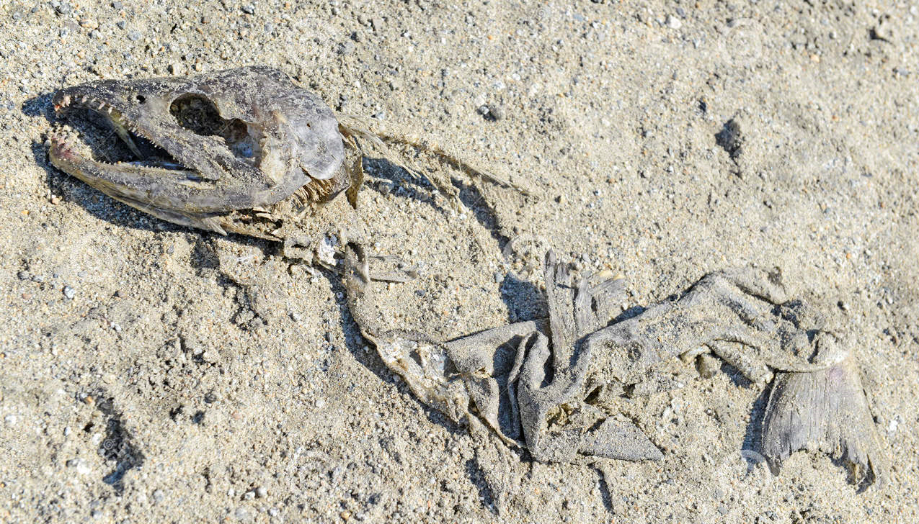
Quantitative Objectives Work Teams
Guidance provided by NOAA -
  Objective, defendable and time bound.
  Don’t need to answer “how do we get there.”

Slide 8
Quantitative Objectives Work Teams
Healthy and
Harvestable
Now
Delist (MAT)
Historical
2017
25yrs?
50+yrs?
> 100 yrs
First priority
Assignment
objective
defendable
Avoid

Slide 9
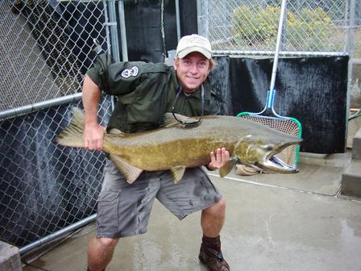
Snake River Work Team
The Work Team focused first on Spring/Summer Chinook Salmon

Slide 10
Snake River Work Team
Did any objectives or goals already exist?
NOAA delisting goals for natural-origin fish
  Snake River Sp/Su Chinook (ESU)
  Includes 5 major population groups (MPG)
  32 populations
  Minimum Abundance Threshold (MAT) = 31,750
  What is healthy and harvestable goal = ???
Hatchery mitigation goals for Sp/Su Chinook
  LSRCP = 58,700
  IPC ~ 31,000
  Is hatchery goal being met??, Is it adequate ??
~ 90,000

Slide 11
References Used
Natural-origin fish
Idaho toolbox –
  Historical accounts of abundance
    Pre-western development, 1950’s on
  Long time-series of spawner info (redd counts) from 1957 forward
  Snake River dam counts (1962 forward)
  Planning assumptions for LSRCP hatchery mitigation program

Slide 12
References Used
Natural-origin fish
Historical accounts (spring Chinook):
  1890 – 1895
  ~ 600,000 returns to the Snake
  Late 1950s to early 1960s
  120,000+ wild fish to the Snake
  Recent Lower Granite Dam counts:
  ~25,000 wild fish (10 yr avg)
  45,381 wild fish in 2001

Slide 13
References Used
Natural-origin fish
Regional planning goals:
  NPCC document
    ~80,000 natural-origin fish (CLW + SAL)
  LSRCP hatchery mitigation planning
    Used 122,000 as the starting number

Slide 14
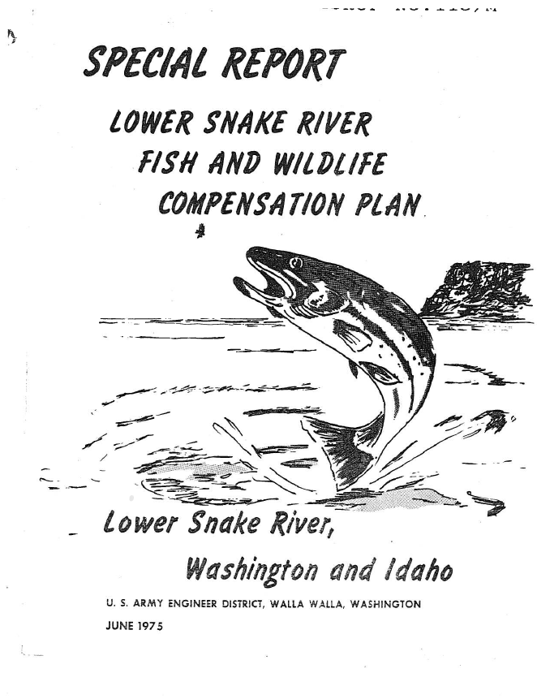
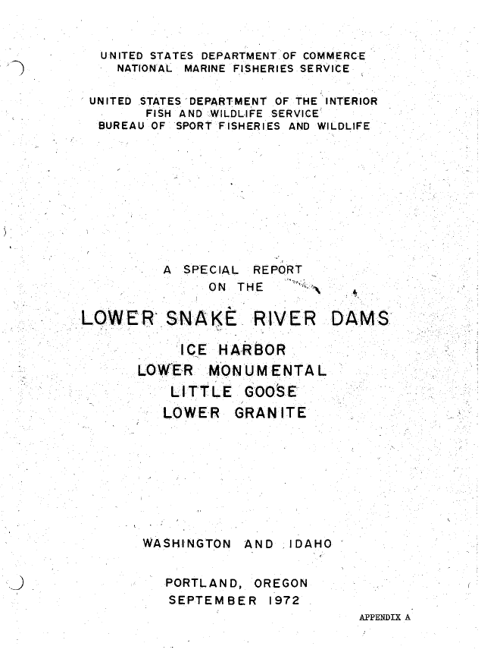
References Used

Slide 15
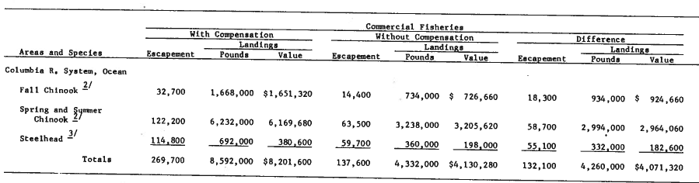
References Used
1950’s Pre-Snake Dams
Fall Chinook = 32,700
Sp/Su Chinook = 122,200
Steelhead = 114,800
Hatchery Mitigation
Fall Chinook = 18,300
Sp/Su Chinook = 58,700
Steelhead = 55,100

Slide 16
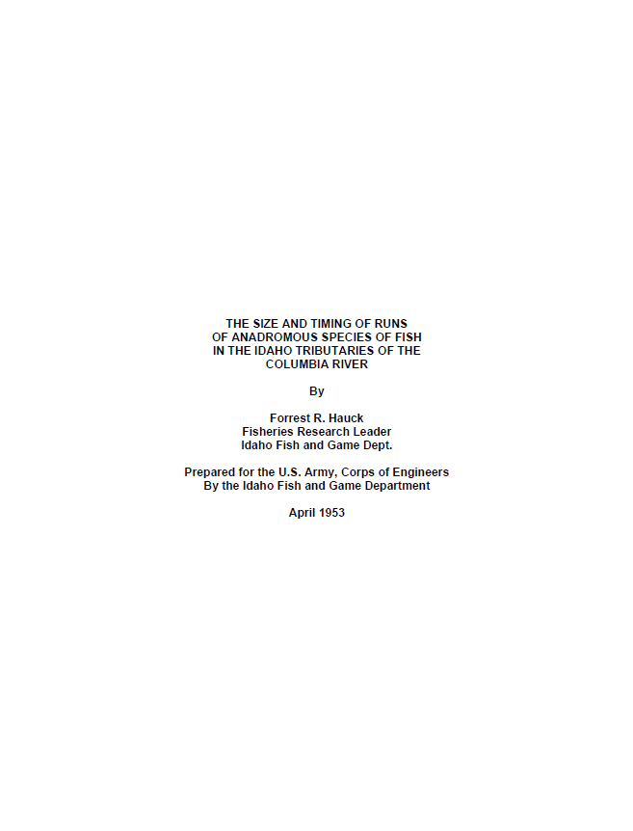
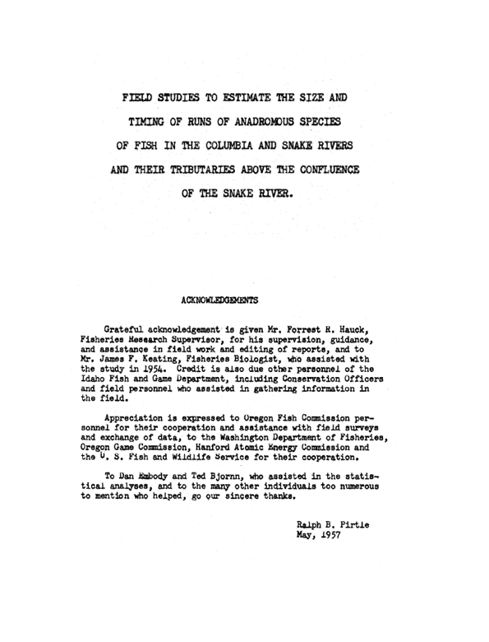
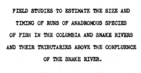
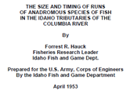
References Used
103,000 sp/su CH 143,000 Sthd
Wild/Natural

Slide 17
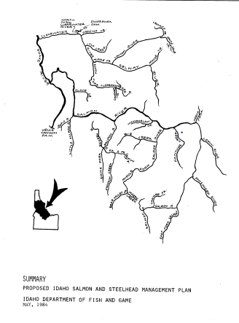
References Used
Proposed Escapement Goals
(Wild/Natural)
Sp/Su Chinook = 134,000
Steelhead = 92,000
Sockeye = 6,000

Slide 18
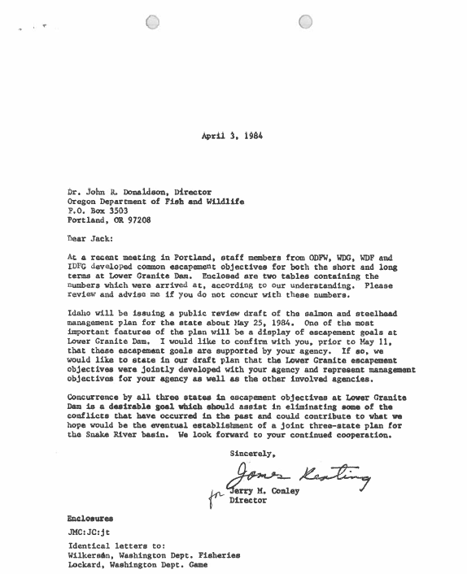
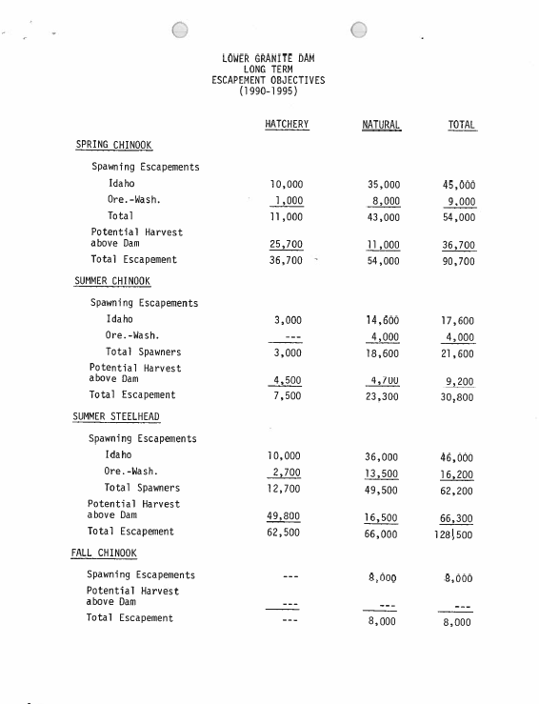
References Used
77,300 sp/su CH 66,000 Sthd
Wild/Natural

Slide 19
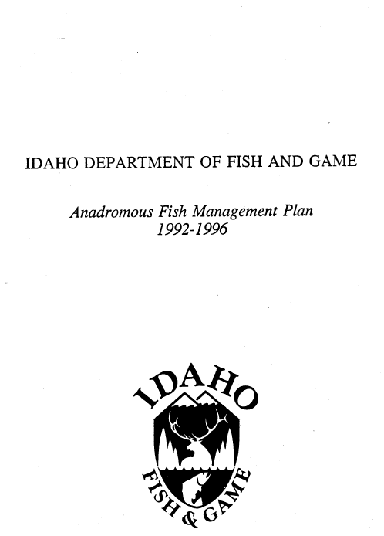
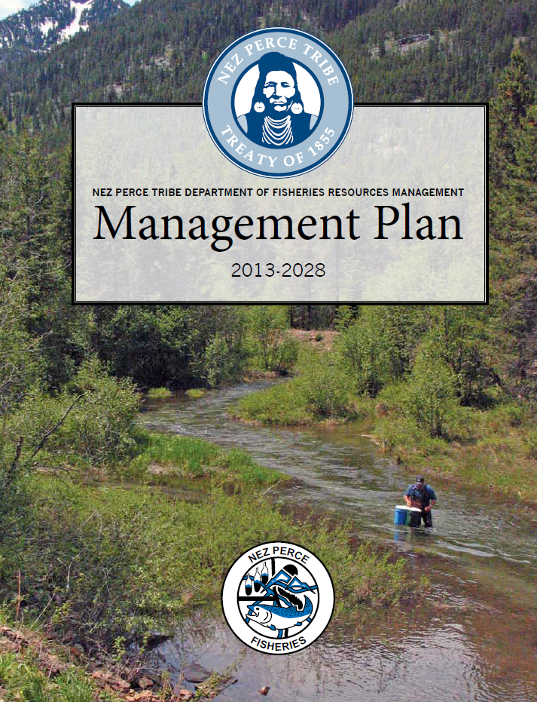
References Used

Slide 20
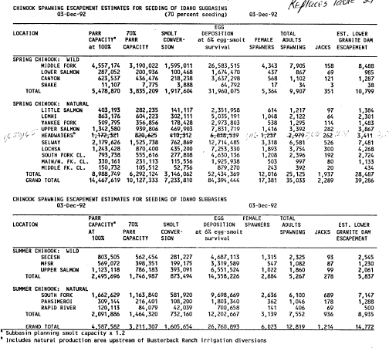
References Used
92-96 IDFG
Management Plan
Wild/Natural Sp/Su Chinook
Salmon, Clearwater, Snake
54,048 at Lower Granite
/.70 = 77,225

Slide 21
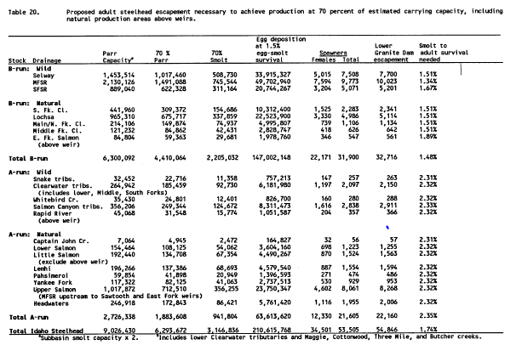
References Used
92-96 IDFG
Management Plan
Wild/Natural Steelhead
Salmon, Clearwater, Snake
54,846 at Lower Granite
/.70 = 78,351

Slide 22
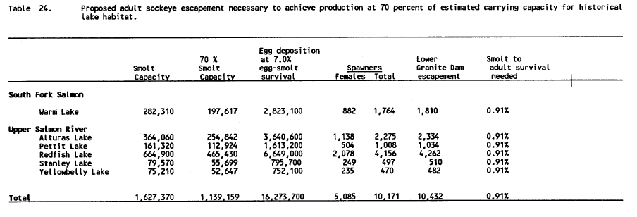
References Used
92-96 IDFG
Management Plan
Wild/Natural Sockeye
Snake Basin Lakes
10,432 at Lower Granite
/.70 = 14,902

Slide 23
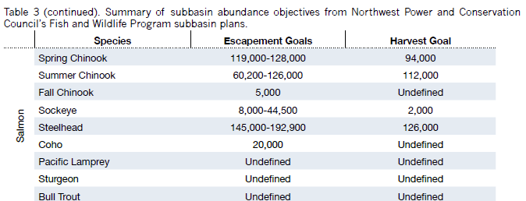
References Used
2013-28 NPT
Management Plan

Slide 24
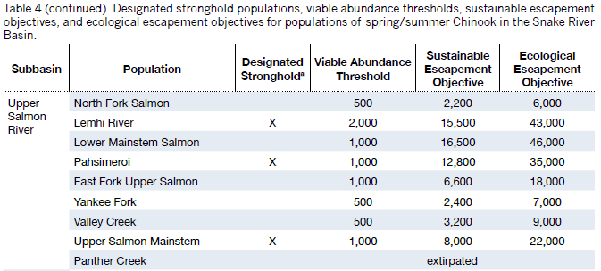
References Used
2013-28 NPT
Management Plan

Slide 25
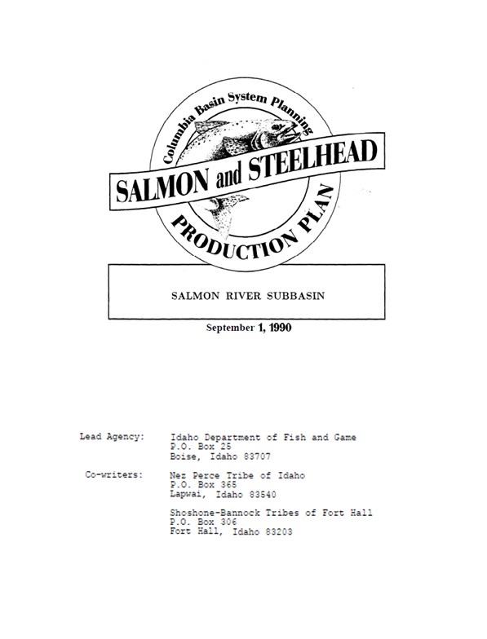
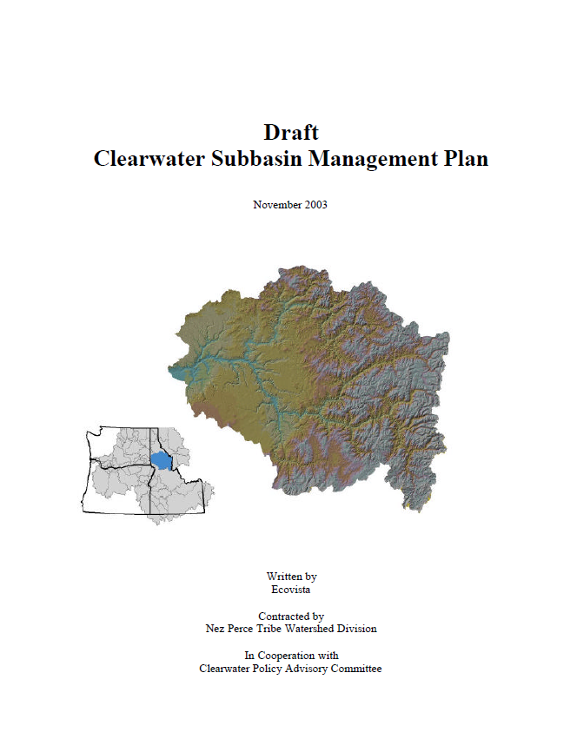
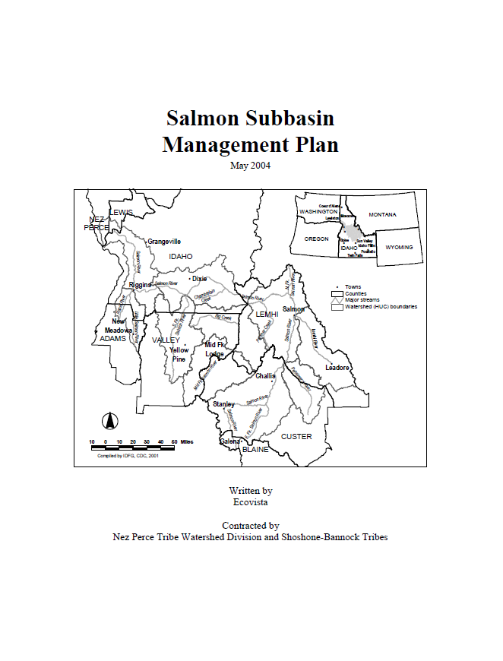
References Used
93,500 sp/su CH 140,000 Sthd
Wild/Natural
210,200 sp/su CH
314,200 Sthd
Wild/Natural + Hatchery
Asotin, Grand Ronde, Imnaha, Lower Snake Mainstem, Tucannon, Snake Hells Canyon

Slide 26
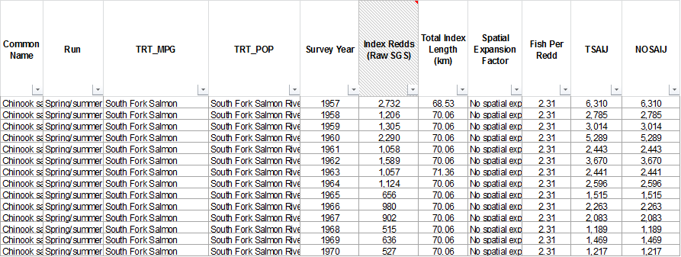
References Used
IDFG Redd Count Database
MAT = 1,000

Slide 27
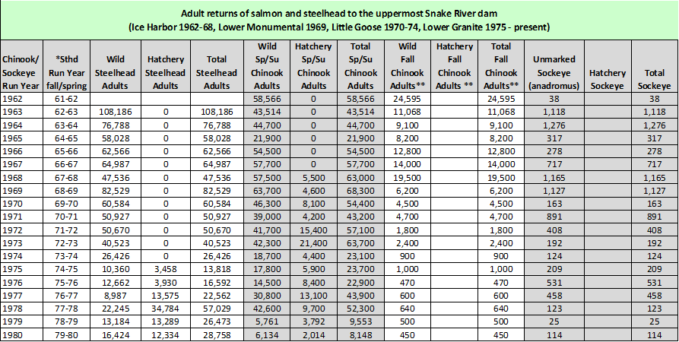
References Used
Snake River Dam Counts

Slide 28
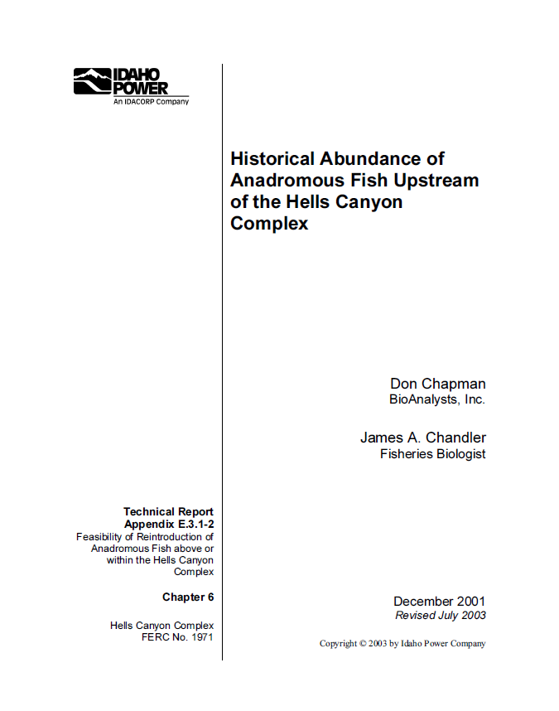
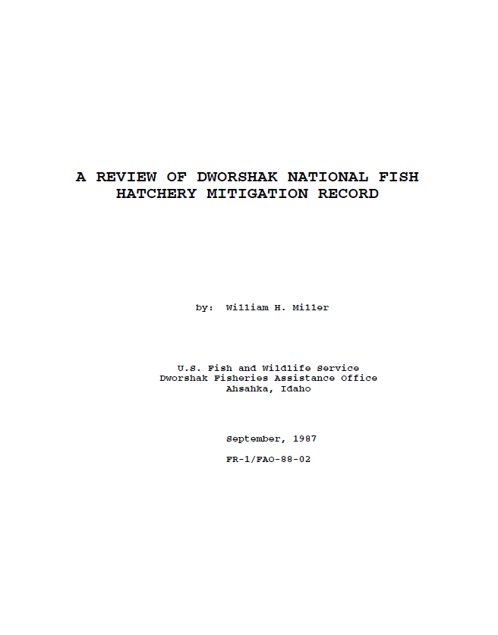
References Used

Slide 29
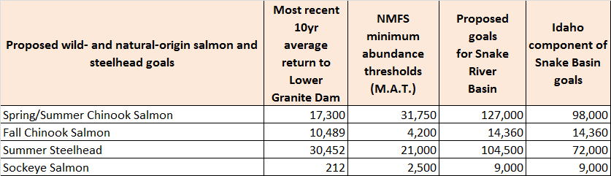
Proposed Snake River Objectives
Crosswalk with NOAA Minimum Abundance Thresholds
Spring/Summer Chinook Salmon: 127,000 = 4.0 x MAT
Fall Chinook Salmon: 14,360 = 3.4 x MAT
Summer Steelhead: 104,500 = 5.0 x MAT
Sockeye Salmon: 9,000 = 3.6 x MAT

Slide 30
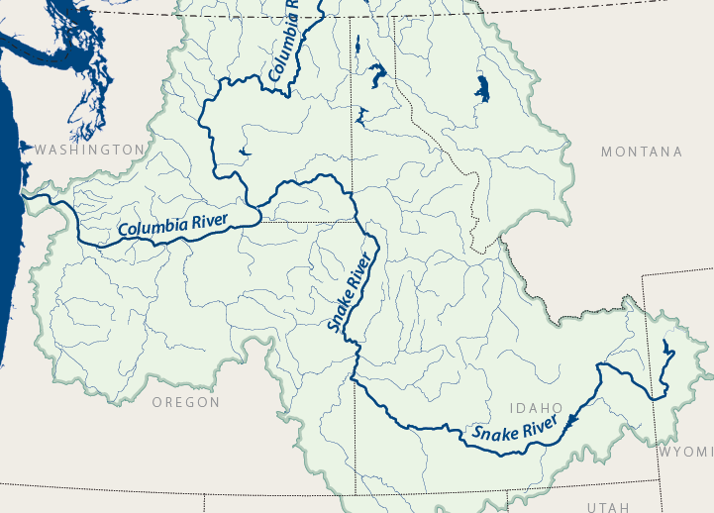
Deciding on a Common Place to Count
Natural-origin fish
127,000

Slide 31
Deciding on a Common Place to Count
Natural-origin fish
127,000
Factor terminal number back
to the mouth of the Columbia River
31

Slide 32
Deciding on a Common Place to Count
Natural-origin fish
4,000
20%
10%
5,556
Identify terminal population goal: ______
Identify terminal harvest rate: ______
Identify natural loss upstream of LGR: ______
Calculate adjusted passage at LGR: ______
Upper Salmon Population

Slide 33
Deciding on a Common Place to Count
Natural-origin fish
5,556
8%
5%
6,356
Identify LGR passage number: ______
Identify MCN to LGR harvest rate: ______
Identify natural loss MCN to LGR: ______
Calculate adjusted passage at MCN: ______
Upper Salmon Population

Slide 34
Deciding on a Common Place to Count
Natural-origin fish
6,356
30%
10%
10,090
Identify MCN passage number: ______
Identify BON to MCN harvest rate: ______
Identify natural loss BON to MCN: ______
Calculate adjusted passage at BON: ______
Upper Salmon Population

Slide 35
Deciding on a Common Place to Count
Natural-origin fish
10,090
10%
20%
14,013
Identify BON passage number: ______
Identify CR mouth to BON harvest rate: ______
Identify natural loss CR mouth to BON: ______
Calculate adjusted passage at CR mouth: ______
Upper Salmon Population

Slide 36
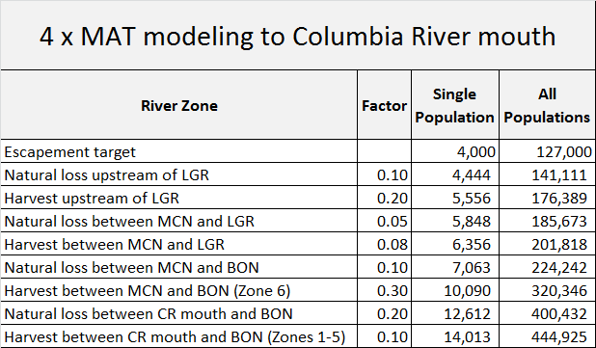
Deciding on a Common Place to Count
Natural-origin fish

Slide 37

Establishing Hatchery Objectives
Hatchery-origin fish
Why Hatcheries?
Fulfill mitigation promises
Treaty Tribe rights – 50%

Slide 38
Establishing Hatchery Objectives
Hatchery-origin fish
LSRCP
IPC

Slide 39
Establishing Hatchery Objectives
Hatchery-origin fish
LSRCP adult goals
  58,700 adult fish upstream of LGR (includes broodstock need).
  4:1 mitigation ratio downstream of LGR.
    4 x 58,700 = 234,800.
  Total LSRCP mitigation =
    58,700 + 234,800 = 293,500.

Slide 40
Establishing Hatchery Objectives
Hatchery-origin fish
IPC goals
  Lbs. or #s of smolts released.
  Converted to LSRCP equivalents = 31,300 adult fish.
  4:1 mitigation downstream of LGR.
    4 x 31,300 = 125,200.
  Total mitigation =
    31,300 + 125,200 = 156,500.

Slide 41
Establishing Hatchery Objectives
Hatchery-origin fish
Hatchery Mitigation = 450,000
LSRCP = 58,700
IPC = 31,300
Total = 90,000
LSRCP = 234,800
IPC = 125,200
Total = 360,000

Slide 42
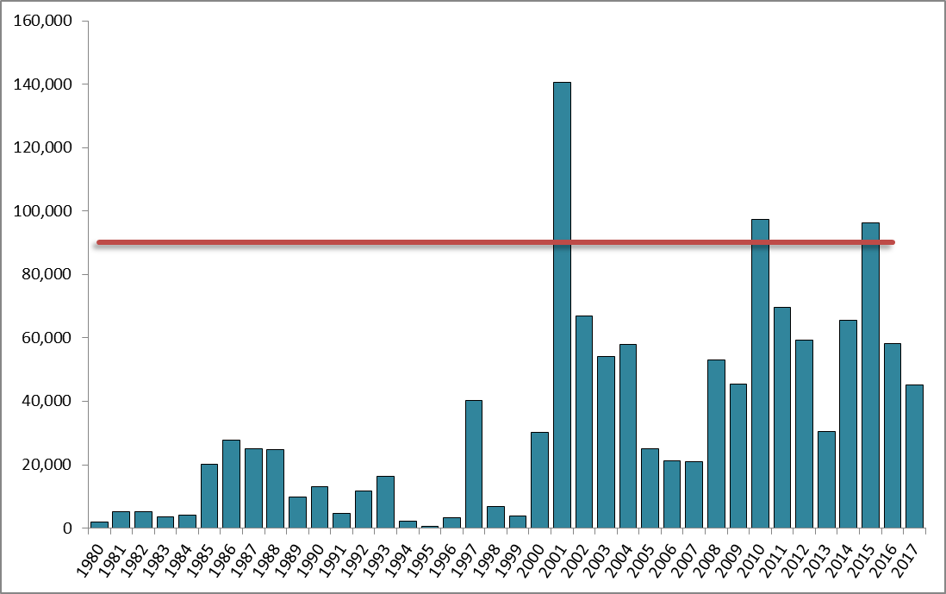
Establishing Hatchery Objectives
Hatchery-origin fish
Hatchery-origin sp/su Chinook returns to LGR
Are we meeting
mitigation objectives?
Aggregate mitigation goal
upstream of LGR (90,000)

Slide 43

Establishing Hatchery Objectives
Natural- & Hatchery-origin fish
Terminal goals (MAT = delisting).
  31,750 natural-origin sp/su Chinook.
Terminal goals (healthy and harvestable)
  127,000 natural-origin sp/su Chinook.
  90,000 hatchery-origin sp/su Chinook.
C.R. mouth goals (healthy and harvestable).
  444,925 natural-origin sp/su Chinook.
  450,000 hatchery sp/su Chinook.

Slide 44
Establishing Hatchery Objectives
Natural- & Hatchery-origin fish
Upstream of LGR
Natural = 127,000
Hatchery = 90,000
Total = 217,000
At C.R. mouth
Natural = 444,925
Hatchery = 450,000
Total = 894,925

Slide 45
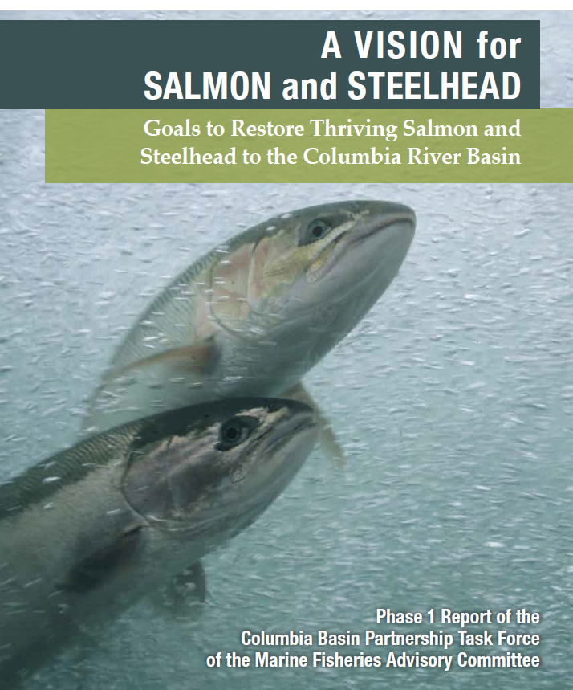
Marine Fisheries Federal Advisory Committee (MAFAC)
Phase 1 Report accepted by Chris Oliver, Assistant Administrator for NOAA Fisheries on July 10, 2019

Slide 46
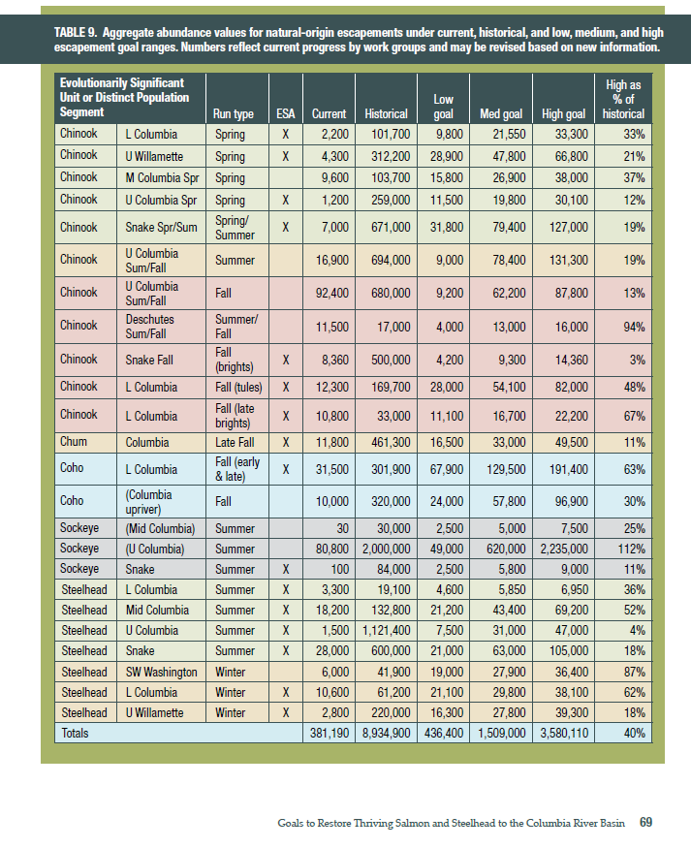
Total
wild-natural escapement goal identified for Columbia River Basin salmon and steelhead
= 3,580,110

Slide 47
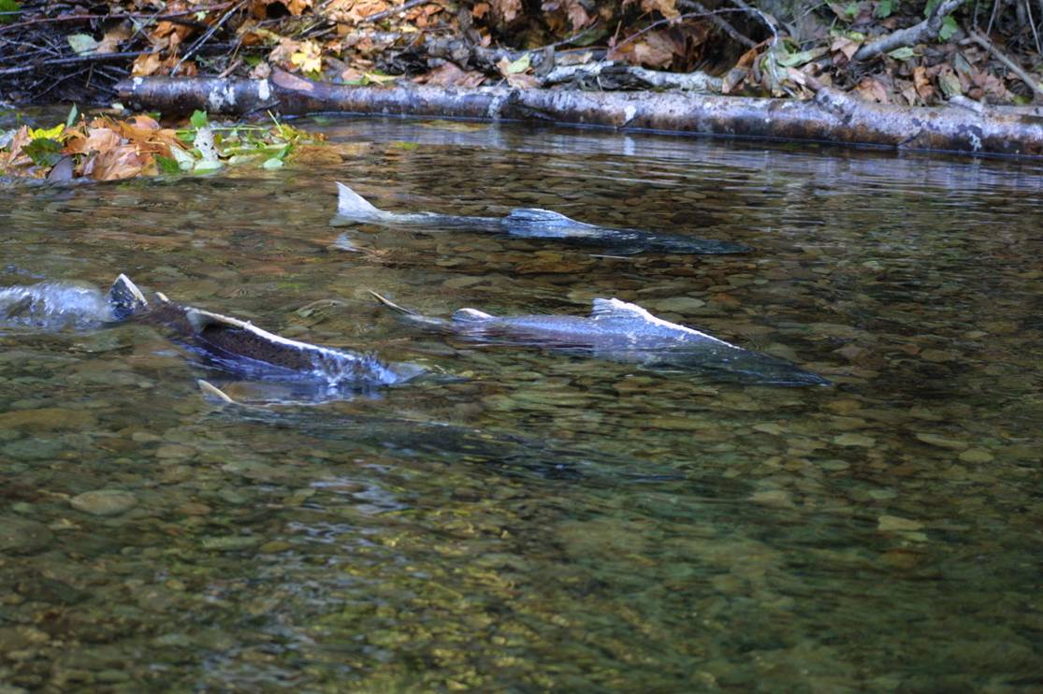
Questions ?

