Slide 1






Survival, travel time and the in-river environment
Presenter: Steve Haeseker

Slide 2
Juvenile migration
Two simultaneous processes: migration and mortality
Migration (Fish Travel Time)
Mortality
How does the in-river environment affect fish travel time and survival?

Slide 3

Question: Do smolts generally face upstream or downstream as they migrate to sea?
Current
Ocean

Slide 4
Question: Do smolts generally face upstream or downstream as they migrate to sea?
Current
Ocean

Slide 5
Question: Do smolts generally face upstream or downstream as they migrate to sea?
Answer: upstream
Current
Ocean

Slide 6
How do reservoirs affect the currents that fish rely on?
Un-impounded velocity = 7 miles/hour

Slide 7
How do reservoirs affect the currents that fish rely on?
Impounded velocity = 0.7 miles/hour

Slide 8
How do reservoirs affect the currents that fish rely on?
Impounded velocity = 0.7 miles/hour

Slide 9
Water Transit Time (WTT)
Estimate of the number of days required for average water particle to transit a reservoir (volume/flow)
3 days
2 days
2 days
7 days

Slide 10
Long-term changes in Lewiston-BON WTT
WTT
~2 days
Migration Year

Slide 11
Long-term changes in Lewiston-BON WTT
dam construction
WTT
~2 days
Migration Year

Slide 12
Long-term changes in Lewiston-BON WTT
~20 days
dam construction
WTT
~2 days
Migration Year

Slide 13
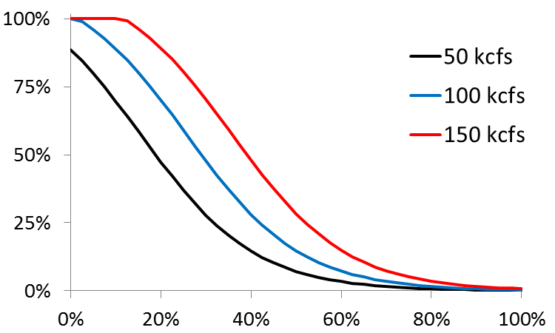
Characterizing fish passage through dams
PowerHouse passage experiences (PITPH)
Incorporates spill proportion, flow, and spillway surface passage
Powerhouse = Turbines + collection/bypass system
Spillway = 1 - Powerhouse
Percent
powerhouse
Percent spill

Slide 14
Powerhouse passages for Snake River migrants
PITPH

Slide 15
Objectives:
Measure and monitor yearling Chinook and steelhead travel time and survival through the hydrosystem
Examine associations between environmental factors and fish travel time and survival
Develop models that explain variation in travel time and mortality rates through the hydrosystem

Slide 16
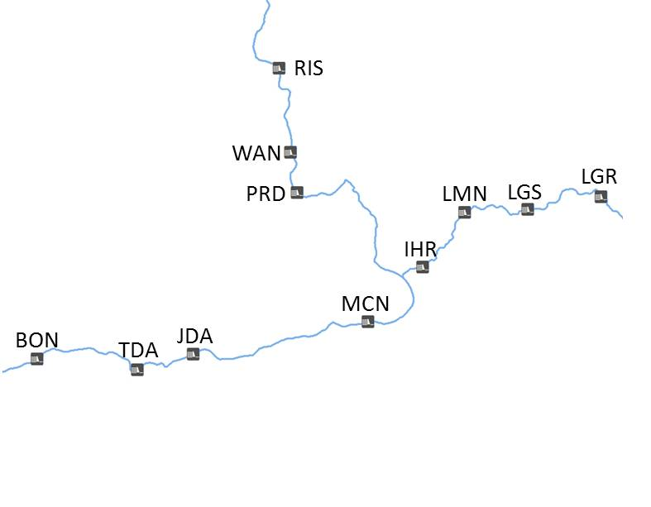
Monitoring methods:
Yearling Chinook salmon and steelhead

Slide 17
Fish Travel Time (LGR-BON)
Steelhead
Yearling Chinook

Slide 18
Juvenile Survival (LGR-BON)
Steelhead
Yearling Chinook

Slide 19
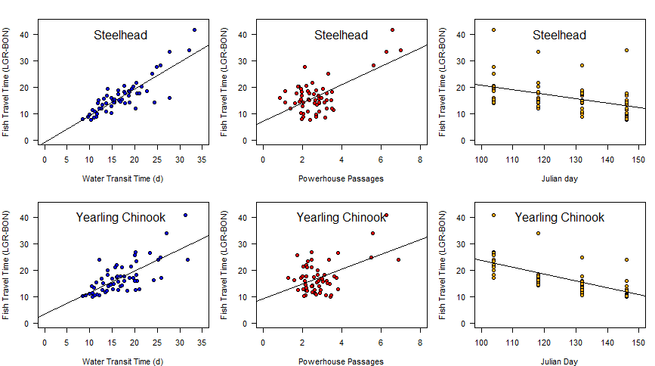
Fish Travel Time

Slide 20
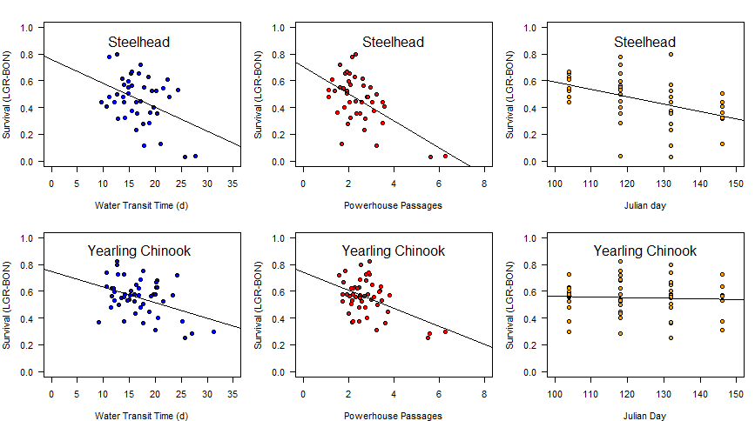
Survival

Slide 21
Fish Travel Time (LGR-BON)
Steelhead
R² = 0.96
Yearling Chinook
R² = 0.92

Slide 22
Juvenile Survival (LGR-BON)
Steelhead
R² = 0.69
Yearling Chinook
R² = 0.26

Slide 23
What are the spatial and temporal patterns in survival for Snake River stocks compared to other stocks in the Columbia River Basin?
Species:
Wild spring/summer (yearling) Chinook salmon
Wild steelhead
Timeframe:
Juvenile outmigration years 2000-2012
Tools:
Mark-recapture methods using PIT tags
330K steelhead, 1.1 million Chinook salmon tags

Slide 24
Study Area
1-3 years
Snake
Yakima
John Day

Slide 25
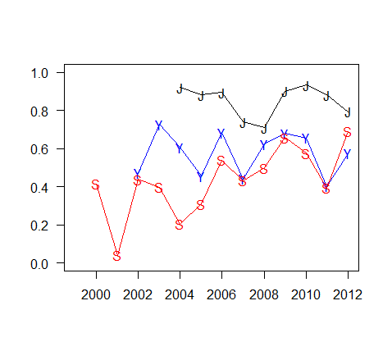
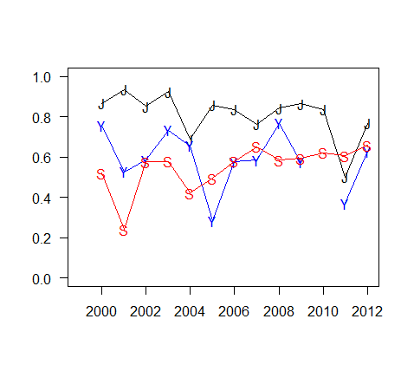
Freshwater survival
steelhead
Chinook salmon
Mean: 85% >> 57% > 48%
Mean: 81% >> 60% > 54%

Slide 26
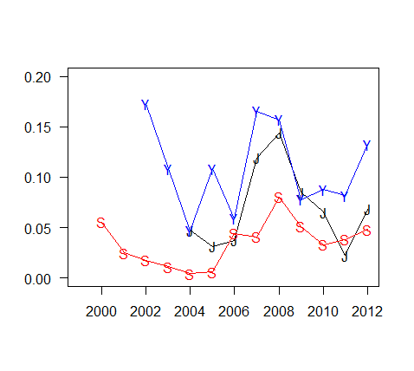
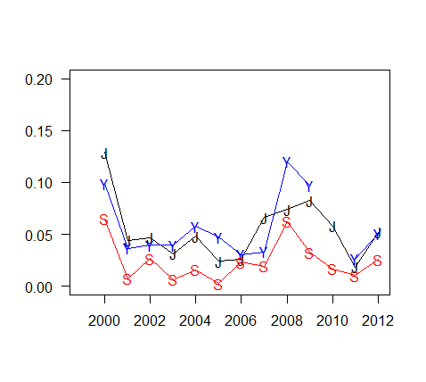
Ocean survival
steelhead
Chinook salmon
Mean: 10.2% > 7.0% >> 3.8%
Mean: 6.0% ≈ 5.4% >> 2.5%

Slide 27
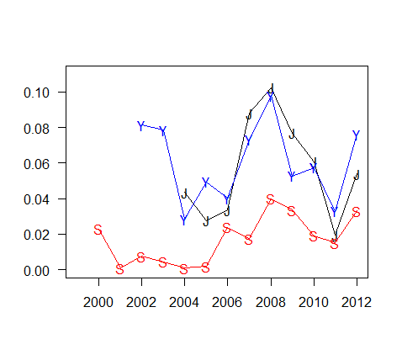
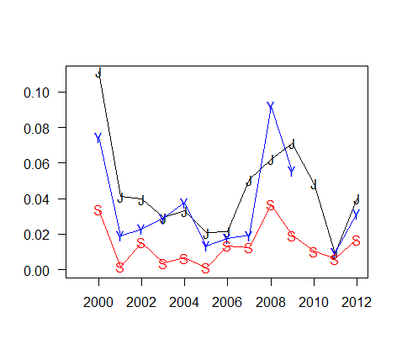
Smolt-to-Adult survival
steelhead
Chinook salmon
Mean: 5.6% ≈ 5.6% >> 2.1%
Mean: 4.4% ≈ 3.7% >> 1.4%

Slide 28
Study Area
Snake
Yakima
John Day

Slide 29
Variable environmental conditions

Slide 30
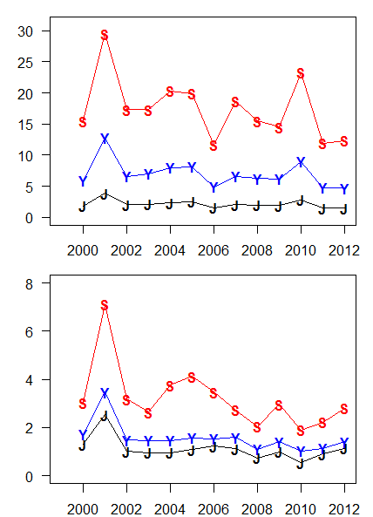
Variable environmental conditions
Freshwater
Water Transit Time
Powerhouse Passages

Slide 31
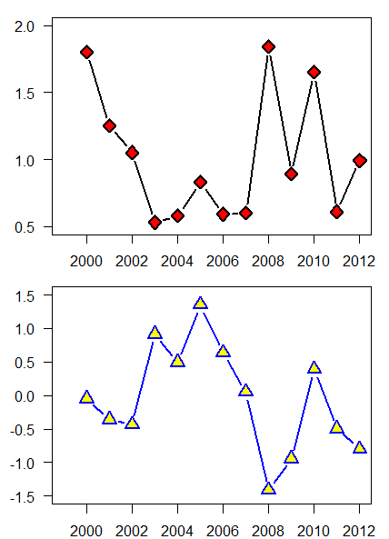
Variable environmental conditions
Marine
Winter Icthyoplankton
Pacific Decadal Oscillation

Slide 32
Variable environmental conditions
Freshwater
Marine
Water Transit Time
Winter Icthyoplankton
Powerhouse Passages
Pacific Decadal Oscillation

Slide 33
Variable environmental conditions
Log (SAR) )
Powerhouses
Water Transit Time

Slide 34

What factors are associated with the patterns in survival?
Multiple regression with multi-model inference
Smolt-to-Adult survival
Freshwater survival
Ocean survival
Variables
Water Transit Time
Powerhouse passages
Average dissolved gas
Stock
Winter Ichthyoplankton
Pacific Decadal Oscillation

Slide 35
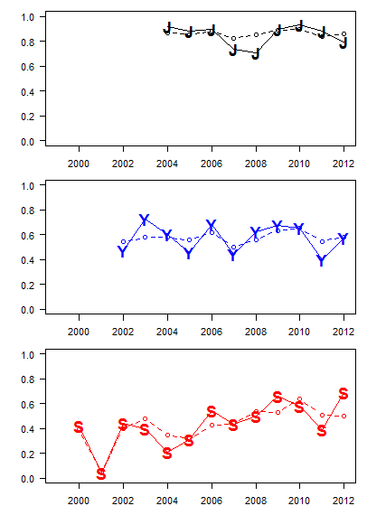
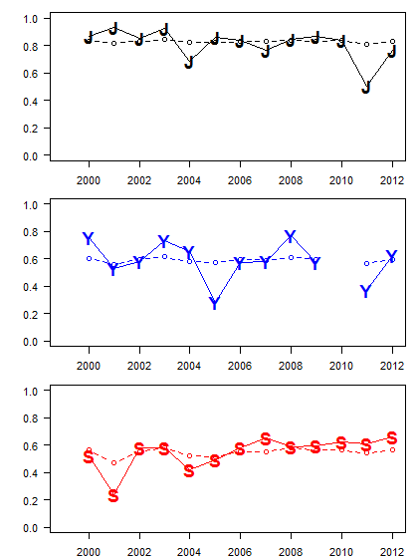
Fitted freshwater survival
steelhead
R² = 0.85
Chinook salmon
R² = 0.60

Slide 36
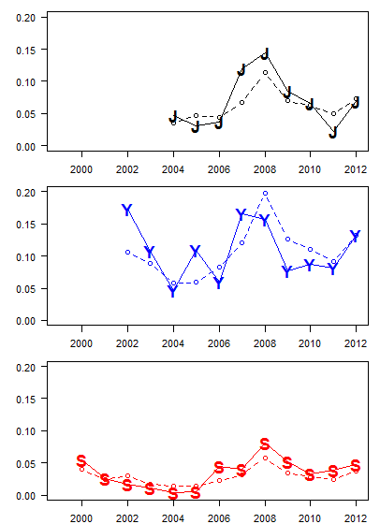
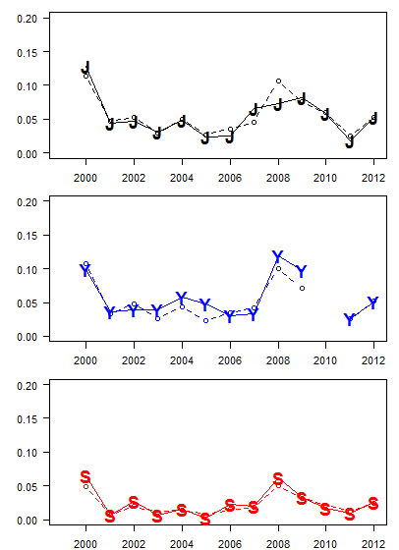
Fitted ocean survival
steelhead
R² = 0.70
Chinook salmon
R² = 0.87

Slide 37
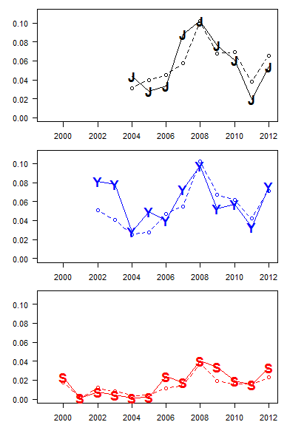
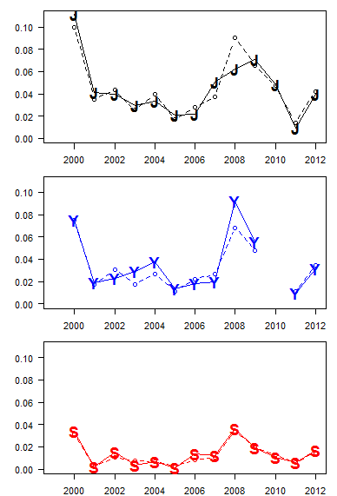
Fitted Smolt-to-Adult survival
steelhead
R² = 0.79
Chinook salmon
R² = 0.90

Slide 38
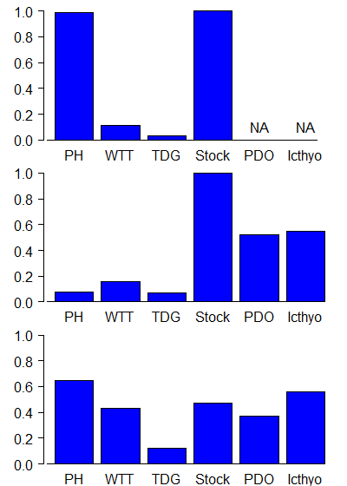
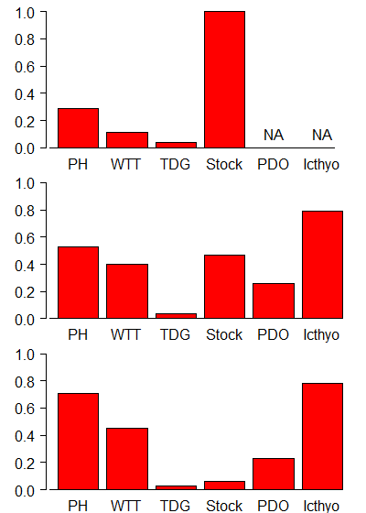
Relative Variable Importance
steelhead
Chinook salmon
Freshwater
survival
Ocean
survival
Smolt-to-Adult
survival

Slide 39
Can management efforts help achieve regional survival goals?
Use model-averaged coefficients to forecast Smolt-to-Adult survival rates
Considered two management scenarios:
Current Biological Opinion spill levels
Spill to 125% dissolved gas limits
Account for variable freshwater and ocean conditions:
High, average, low flow years
Winter Ichthyoplankton, Pacific Decadal Oscillation

Slide 40
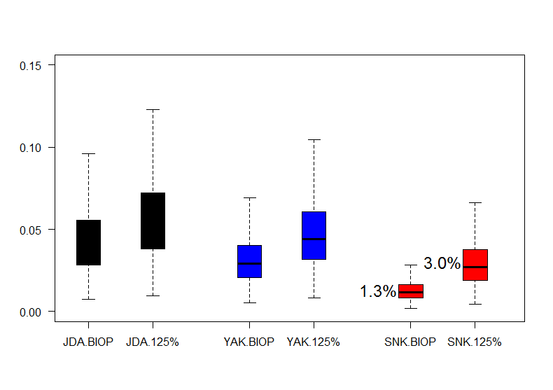
Predicted Smolt-to-Adult survival rates: Chinook salmon
Prob. (< 1% SAR):
38% 5%

Slide 41
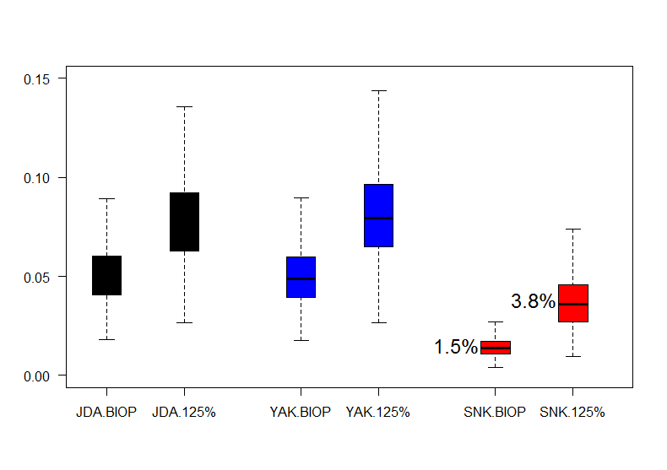
Predicted Smolt-to-Adult survival rates: steelhead
Prob. (< 1% SAR):
26% 0%

Slide 42
Conclusions
Models captured high degree of spatial and temporal patterns in variation
Freshwater: Powerhouses + Water Transit Time
Ocean: Powerhouses + Water Transit Time + Ichthyoplankton + PDO
Smolt-to-Adult: Powerhouses + Water Transit Time + Ichthyoplankton + PDO
Snake: 230% - 250% improvement in Smolt-to-Adult survival with increased spill
Yakima: 50% - 60% improvement “
John Day: 30% - 50% improvement “
Adaptive Management Experiment:
Ongoing tagging efforts provides framework for monitoring

