Slide 1




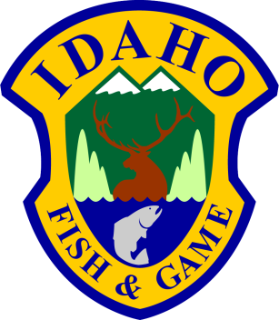
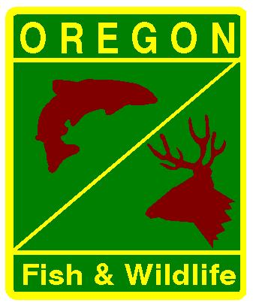
SARs and Juvenile Survival of Upper Columbia Stocks
Dan Rawding (WDFW)

Slide 2
Presentation Outline
Objectives Juvenile Metrics & Reach Survivals
Smolt-to-Adult Returns (SARs)
Conclusions

Slide 3
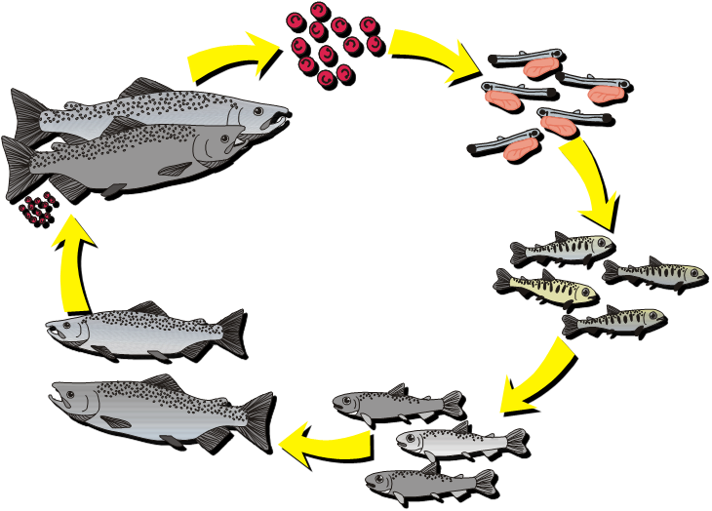
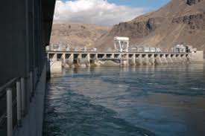
CSS Objectives for the Upper Columbia
Establish long term survival estimates over the full life-cycle of upper Columbia stocks
Develop Smolt to Adult Return rates (SARs) from the upper most dam encountered
Photo: Chelan PUD
Notes:
One of the CSS objectives for the Upper Columbia is to build a long-term data set similar to that of the Snake River.
Improve the precision of the SARs by reporting data from the 1st dam encountered
Today we are discussing progress towards our overall goals for the upper Columbia.

Slide 4
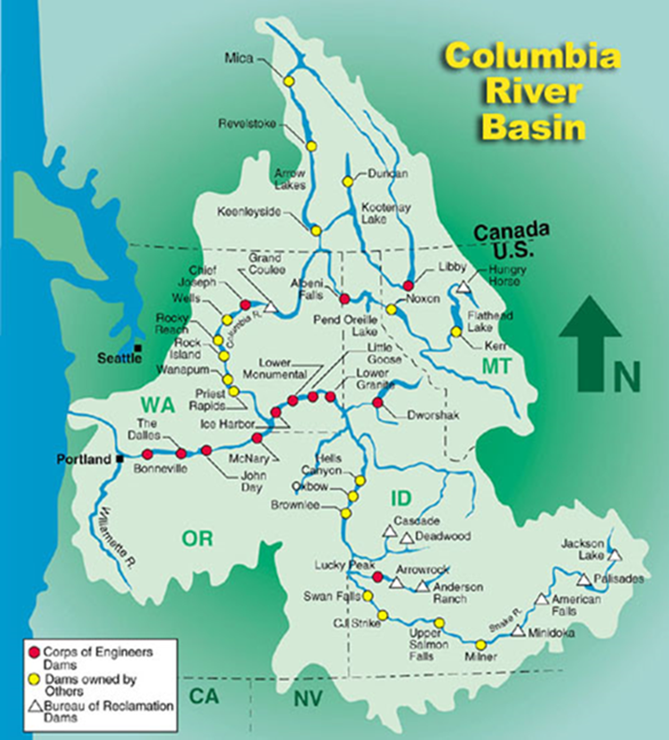
Columbia River Hydro Projects

Slide 5
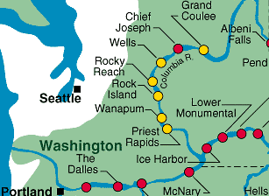
Rock Island-McNary Juvenile Metrics:
  RIS – MCN Reach
    150 miles with 2 dams in between
  Juvenile passage
    Travel time
    Survival
    Instantaneous mortality
  Passage metrics relative to environmental variables
Notes:
We can report on some of the juvenile metrics we observed in the 150 mile reach from Rock Island Dam downstream to McNary Dam
For 5 years we’ve included updated analyses of UPC mark groups

Slide 6
Rock Island to McNary Juvenile Survival
Typically species’ survival is ~ 60%
Notes:
Descriptive stuff if needed
These are averages of survivals from the years 2004-2014 for Chinook and Steelhead marked at RIS for the Smolt Monitoring Project.
Survival was measured from RIS to MCN for each species.
Hatchery and Wild are combined for each species
This is a river reach of approx. 308 miles which is a little farther than LGR to MCN (286 miles).
Main Points
These two estimates indicate the typical survival rates for spring outmigranting juvenile Chinook and Steelhead through this reach.
Additional detection downstream and larger mark groups would strengthen the data
Additional detection upstream allows for a larger component of the life cycle to be included in CSS SARs (e.g. new Rocky Reach detector).

Slide 7
Rock Island to McNary:
Juvenile Metrics/Environmental Variables
Fish Travel Time:
  Decreased with higher flow and with later Julian date
Instantaneous Mortality:
  Decreased for Chinook as spill levels increased at Wanapum and Priest Rapids
  Increased for steelhead with increase in Julian date
Reach Survival:
  Increased with higher flow and spill
Notes:
Data is for both Chinook and steelhead and only addresses the RIS to McN river reach
We found that the responses of Upper Columbia stocks to environmental variables were similar to the responses of the Snake River stocks
Again our objective is to continue to improve and refine the upper Columbia data and analyses

Slide 8

Reach Survival Comparison of Juvenile Salmon:
Snake River to Upper Columbia Stocks
Yearling Chinook
Steelhead
Notes:
Another comparison we can look at is Juvenile survival of juvenile Chinook and steelhead from the Snake R and those from the upper Columbia. Survival is measured from Lower Granite to McNary for Snake R stocks, and Rock Island to McNary for upper Col stocks
The distance between the two measuring points is about the same but one less dam for UC stocks
For the Chinook – in the early portion of the time series, both stocks appeared to be similar in survival, with upper Col stocks having even greater survival in some years, but since 2004 up until a few years ago, the survival rates for the upper Col stocks have consistently less than the Snake River Chinook.
For Steelhead, the same analogy is generally true, with a change becoming apparent a little later, perhaps since 2008 or so, with some improvement in the recent few years.

Slide 9
Upper Columbia CSS Challenges
Mainstem juvenile detection sites are few compared to the Snake River
    SARs and survival estimates may not account for full life history
Low abundance of smolts makes it difficult to tag enough fish for a specific population
  Result is often aggregate tag groups
Notes:
It is difficult to collect enough smolts for tagging from each tributary in order to develop stock specific data.
Because there are limited juvenile detection sites in the Upper Columbia Reach, it presents a challenge in developing SAR and survival estimates to the upper- most dam.

Slide 10
Upper Columbia Mark Groups
Eight groups – basin and rear-type specific
  Wenatchee hatchery spring Chinook (Leavenworth)
  Wenatchee wild Chinook
  Wenatchee hatchery Steelhead
  Wenatchee wild Sockeye (new in 2017)
  Entiat-Methow aggregate wild Chinook
  Wenatchee-Entiat-Methow aggregate wild Steelhead
  Okanogan/Columbia River above Wells Dam wild summer Chinook
  Okanogan wild Sockeye (new in 2016)
Notes:
There are 7 basin specific mark groups – 3 come out of the Wenatchee and the other two are an aggregate for wild Chinook and wild Steelhead. These area fish that are marked in the area they have originated from, and it is also known if they are hatchery or wild fish
The two new groups for this year’s presentation are from above Wells. All the wild Sockeye are from the Okanogan. The wild Chinook are largely from the Okanogan but there are at least some that are not from the Okanogan but are from above Wells Dam.
The limited juvenile detection sites in the Upper Columbia Reach presents a challenge in developing SAR estimates to the upper- most dam.

Slide 11
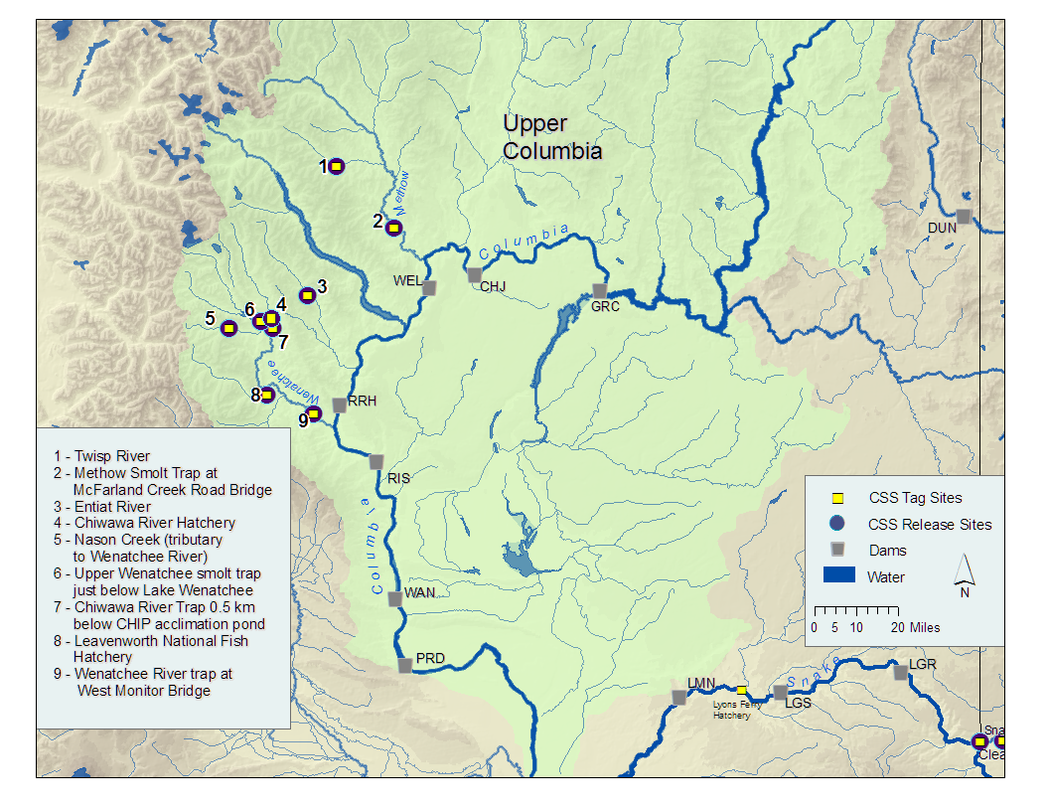
Wild Chinook & Sockeye
- Okanogan/Wells
Wild Chinook & Steelhead
Methow/Entiat
Wenatchee Basin
Hatchery Chinook (Leavenworth)
Wild Chinook
Steelhead (Hatchery)
Wild Sockeye
Detection at McNary
Notes:
Wenatchee fish enter the mainstem downstream of Rocky Reach- first JV detection opportunity is MCN

Slide 12
McNary to Bonneville SARs
Lack of juvenile detection sites and small tag groups often preclude us from calculating SARs from the uppermost dam
When we report on BON-MCN SARs juvenile mortality occurring upstream of McNary Dam is not included
Notes:
Lack of juvenile detection sites further upstream precludes us from developing SARs from the uppermost Dam
SARS are calculated only for fish that survived to McNary and does not include juvenile mortality that occurs upstream of McNary
This makes the McN-BON SARs reported higher than the full ‘life cycle’ SARs that would start at RIS

Slide 13
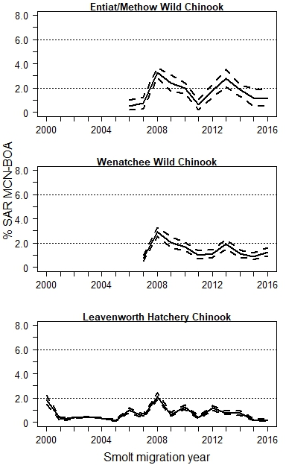
MCN to BON SARs Chinook
Entiat/Methow Wild Chinook
SARs averaged 1.7% (0.5%-3.2%)
exceeded 2% in 2008, 2009, and 2013
Wenatchee Wild Chinook
SARs averaged 1.4% (0.2%-2.9%)
exceeded 2% in 2008 and 2009
Leavenworth Hatchery Chinook
SARs averaged 0.7 (0.1% - 2.1%)
exceeded 2% in 2008
All Groups
Upper reaches not included in SARs
2016 data does not include 3-salt fish
13
Notes:
These 3 graphs show the SARs for the upper Columbia Chinook.
Again the MCN to BON SARs do not account for juvenile mortality through the upper reaches, so this is accounting only for the juveniles that survived to McNary.
Your will notice that the graphs are bound by the 2% and 6% marks. The NWPC set the goal of SARS being within 2-6%.
1st Graph – Currently Entiat and Methow wild Chinook are an aggregate because there are few marks. Short time series, data since 2006.
2nd Graph – Wenatchee wild Chinook . Tracks similar to the Entiat/Methow wild Chinook
3rd Graph - Leavenworth Hatchery fish return to Icicle Creek in the lower reaches of the Wenatchee R. We have a longer time series, and overall pattern is somewhat the same as other two groups, but average SAR is significantly less.
With all three study groups, MCN to BOA SARs are underestimating the whole life cycle SAR
13

Slide 14
MCN to BON SARs Chinook
Entiat/Methow Wild Chinook
SARs averaged 1.7% (0.5%-3.2%)
exceeded 2% in 2008, 2009, and 2013
SARs also available for Rocky Reach to Bonneville
14
Notes:
These 3 graphs show the SARs for the upper Columbia Chinook.
Again the MCN to BON SARs do not account for juvenile mortality through the upper reaches, so this is accounting only for the juveniles that survived to McNary.
Your will notice that the graphs are bound by the 2% and 6% marks. The NWPC set the goal of SARS being within 2-6%.
1st Graph – Currently Entiat and Methow wild Chinook are an aggregate because there are few marks. Short time series, data since 2006.
2nd Graph – Wenatchee wild Chinook . Tracks similar to the Entiat/Methow wild Chinook
3rd Graph - Leavenworth Hatchery fish return to Icicle Creek in the lower reaches of the Wenatchee R. We have a longer time series, and overall pattern is somewhat the same as other two groups, but average SAR is significantly less.
With all three study groups, MCN to BOA SARs are underestimating the whole life cycle SAR
14

Slide 15
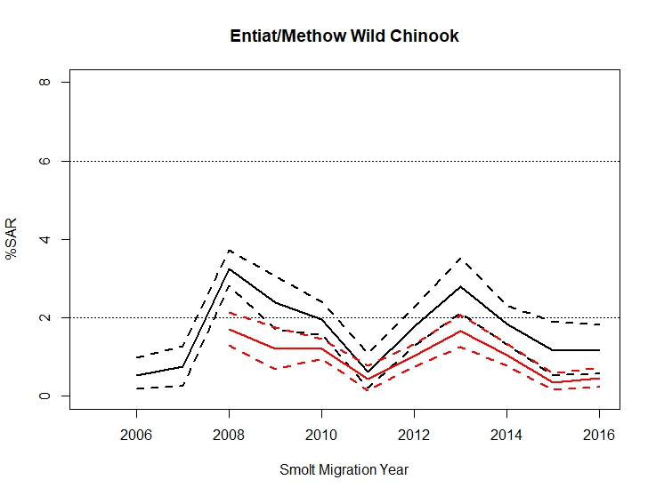
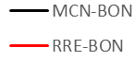
SARs for RRE to BON are much lower than those calculated for MCN to BON
Notes:
When we compare SARs from MCN to BON to the SARs from RRE to BON, we can see that both track generally the same; however, the SARs that include the upper reach of RRE to MCN are less
With all three study groups, MCN to BOA SARs are underestimating the whole life cycle SAR

Slide 16
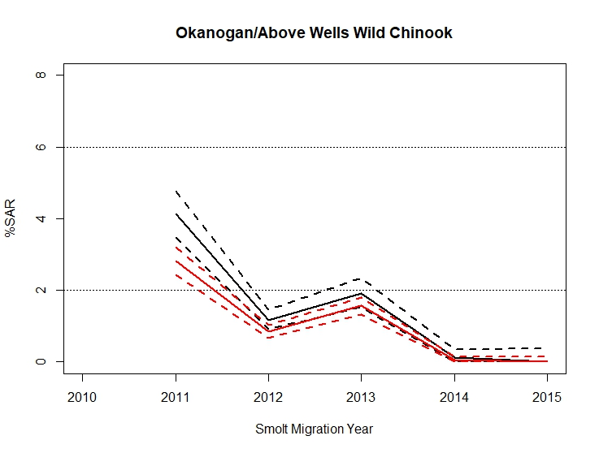
SARs for RRE to BON are lower than those calculated for MCN to BON
Notes:
This group is new to the CSS in 2016. With three years of data there aren’t a lot of conclusions to draw, but so far the RRE to BON SARs are consistently lower than the MCN-BON SARs.

Slide 17
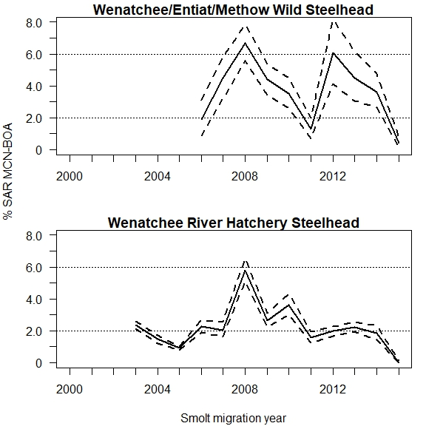
MCN to BON SARs
Steelhead
Wild Steelhead
Aggregate
SARs averaged 3.7%
Hatchery Steelhead
Wenatchee River
SARs averaged 2.2%
17
Notes:
These 2 graphs show the SARs for wild and hatchery steelhead from McNary back to BON
The data for the wild fish is an aggregate of the Wenatchee, Entiat and Methow populations, again combined due to small individual numbers.
We have a longer dataset for The Hatchery steelhead
These are a wild hatchery cross released in the Wenatchee River Basin.
Data shows a favorable SAR in 2003, then dipping below the 2% mark to a low of 0.9% in 2005
then generally increasing to nearly 6% in 2008.
The average is just over the 2% mark for these hatchery steelhead
17

Slide 18
MCN to BON SARs
Steelhead
Wild Steelhead
Aggregate
SARs averaged 3.7%
SARs also available for Rocky Reach to Bonneville
Hatchery Steelhead
Wenatchee River
SARs averaged 2.2%
18
Notes:
Similar to what we did with the wild Chinook, we can compare the SARs of wild steelhead from two different starting points.
We can omit the Wenatchee group and develop a SAR for just the Entiat and Methow groups which originate upstream of Rocky Reach Dam
18

Slide 19
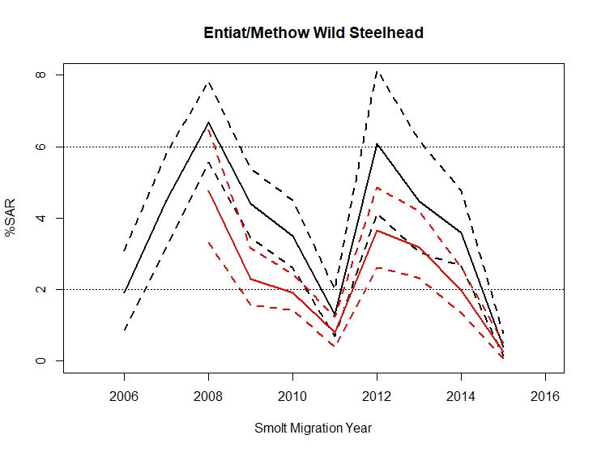
SARs for RRE to BON are lower than those for MCN to BON
Notes:
The story is the same for these wild steelhead as it was for wild Chinook; when the uppermost Dam of Rocky Reach is included the SARs decrease, indicating MCN to BON SARs are underestimating the whole life cycle SAR

Slide 20
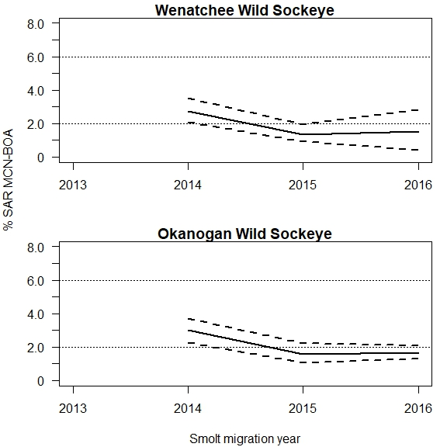
MCN to BON SARs
Wild Sockeye
Wenatchee Sockeye
SARs averaged 1.8%
Okanogan Sockeye
SARs averaged 2.1%
20
Notes:
These 2 graphs show the SARs for wild and hatchery steelhead from McNary back to BON
The data for the wild fish is an aggregate of the Wenatchee, Entiat and Methow populations, again combined due to small individual numbers.
We have a longer dataset for The Hatchery steelhead
These are a wild hatchery cross released in the Wenatchee River Basin.
Data shows a favorable SAR in 2003, then dipping below the 2% mark to a low of 0.9% in 2005
then generally increasing to nearly 6% in 2008.
The average is just over the 2% mark for these hatchery steelhead
20

Slide 21
MCN to BON SARs
Wild Sockeye
Okanogan Sockeye
Short time series
SARs averaged 2.1%
SARs also available for Rocky Reach to Bonneville
21
Notes:
These 2 graphs show the SARs for wild and hatchery steelhead from McNary back to BON
The data for the wild fish is an aggregate of the Wenatchee, Entiat and Methow populations, again combined due to small individual numbers.
We have a longer dataset for The Hatchery steelhead
These are a wild hatchery cross released in the Wenatchee River Basin.
Data shows a favorable SAR in 2003, then dipping below the 2% mark to a low of 0.9% in 2005
then generally increasing to nearly 6% in 2008.
The average is just over the 2% mark for these hatchery steelhead
21

Slide 22
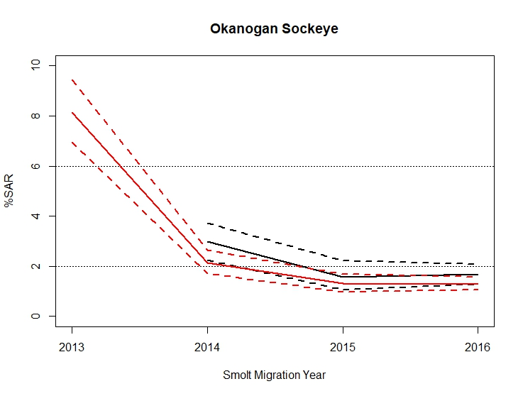
Notes:
Not a lot of conclusions to draw from this graph, just showing since it’s a new group we’ll be following in the future

Slide 23
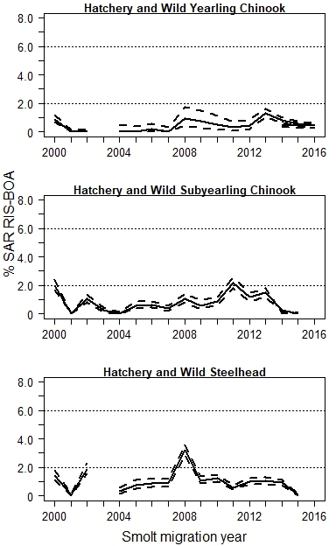
RIS to BON SARs
Chinook and Steelhead
Yearling Chinook
Hatchery and wild aggregate
SARs averaged 0.5%
Subyearling Chinook
Hatchery and wild aggregate
SARs averaged 0.8%
Steelhead
Hatchery and wild aggregate
SARs averaged 1.1%
*Bypass inoperable during spring of 2003 – no data
Notes:
We’ve talked about SARs from MCN to BON, and RRE to BON, and now we will focus on SARs from RIS to BON. These are juvenile fish that are collected, tagged and released at RIS. Obviously all the fish originated upstream of RIS, but we do not always know what tributary they are from or if they are hatchery or wild.
You’ll remember that there are four aggregate groups, that are not basin or rear-type specific. Obviously all the fish originated upstream of RIS, but we do not always know what tributary they are from or if they are hatchery or wild.
Collecting information since MY 2000. SARs for Chinook and steelhead fall below the 2% mark in most years. Although still low, the average SAR for Steelhead is higher than Chinook

Slide 24
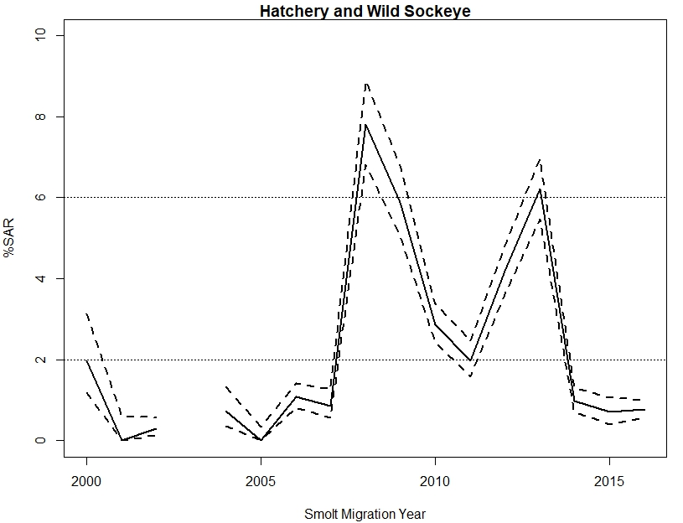
RIS to BON SARs
Sockeye
Sockeye
Hatchery and Wild combined
SARs averaged 2.4%
Data part of CSS Report since 2014
*Bypass inoperable during spring of 2003 – no data
Notes:
4th group we look at wit hat RIS to BON SAR is sockeye,
the average sockeye SAR is greater than those for Chinook (< 1%) and steelhead (1.1%).

Slide 25
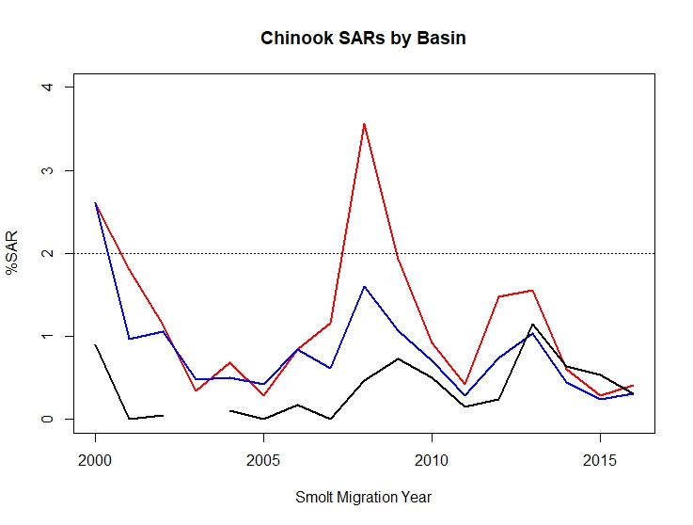
SR Wild Chinook [LGR – BON]
SR Hatchery Chinook [LGR – BON]*
CR Yearling Chinook (H+W)
[RIS – BON]
LGR to BON is approximately 286 miles [7 dams]
RIS to BON is approximately 308 miles [6 dams]
*Snake River Hatchery Chinook is a weighted average of annual hatchery specific estimates
Notes:
Another thing we can look is a comparison of the SARs of Snake River and Upper Columbia fish.
The juvenile fish from these two basins travel similar distances and traverse a similar # of dams in their downstream migration
This graph illustrates the pattern of SARs for Snake River Chinook compared to yearling Upper Col Chinook .
The adults from both basins are detected at Bonneville.
Take Home
All groups follow the same general pattern, indicating these stock have similar responses to the lower hydro system (MCN to BON), estuary, and Ocean conditions.
The Upper Columbia SARs shown here are consistently lower than Snake River SARs

Slide 26
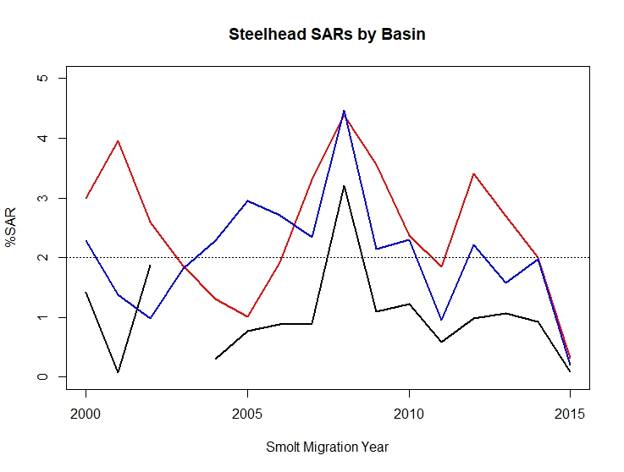
SR Wild Steelhead [LGR – BON]
SR Hatchery Steelhead [LGR – BON]*
CR Steelhead (H+W) [RIS – BON]
LGR to BON is approximately 286 miles [7 dams]
RIS to BON is approximately 308 miles [6 dams]
*Snake River Hatchery Steelhead are weighted averages of annual hatchery specific estimates
Notes:
Same story for steelhead: Hatchery and wild steelhead from Snake River compared to H/W steelhead from upper Columbia basin.
Take Home message the same as Chinook
All groups follow the same general pattern, indicating these stock have similar responses to the lower hydro system (MCN-BON), estuary, and ocean conditions.
The Upper Columbia SARs are consistently lower than Snake River SARs

Slide 27
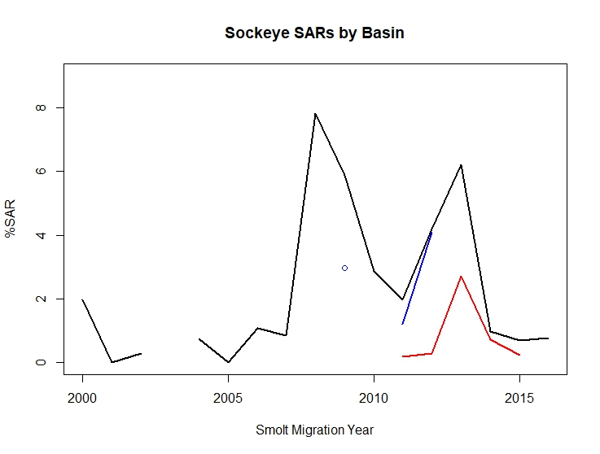
CR Sockeye (H + W) [RIS – BON]
SR Oxbow Hatchery Sockeye
[LGR – BON]*
SR Sawtooth Hatchery Sockeye
[LGR – BON]
LGR to BON is approximately 286 miles [7 dams]
RIS to BON is approximately 308 miles [6 dams]
*No SARs calculated for Oxbow Hatchery for migration year 2010
Notes:
This graph shows the two CSS Sockeye groups for the Snake River, and the hatchery+wild aggregate for the Upper Columbia.
UC is higher, but hard to see patterns with so little data for the Snake.

Slide 28
Conclusions
Marking efforts allow us to monitor the effect of hydro system passage on Upper Columbia groups, which is cost-effective and provides a region-wide benefit
UC juvenile response to environmental variables (travel time, instantaneous mortality, & reach survivals) is similar to the response of Snake and Middle Columbia stocks
The Upper Columbia (RIS-BON) and Snake River (LWG-BON) SARs for Chinook and steelhead trends are similar, but SARs are lower for the Upper Columbia for steelhead & higher for sockeye

Slide 29
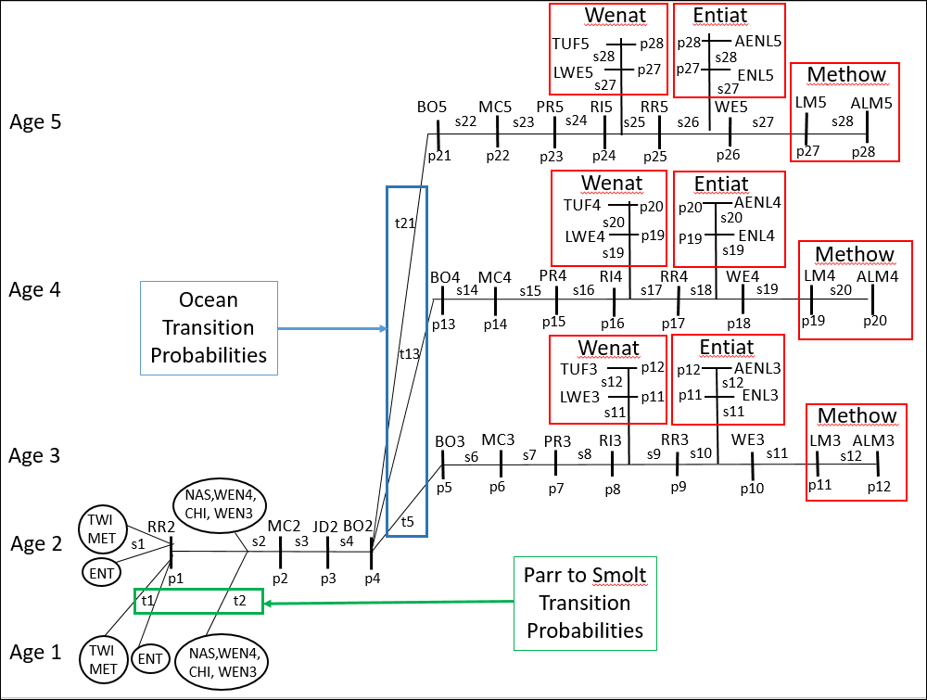
Tagging Life Cycle Model

