Slide 1







Snake River Fall Chinook
Dan Rawding (WDFW)
Notes:
Today I’m going to present some analyses and results from the PIT-tag monitoring of fall Chinook. I’ll start out with a look at what we’ve learned from monitoring juvenile out-migrants and then switch to a summary of adult return data.

Slide 2
Presentation Outline
Brief History
Hydro Impacts
Acknowledgements:
Jay Hesse (NPT)
Jerry McCann (FPC)

Slide 3
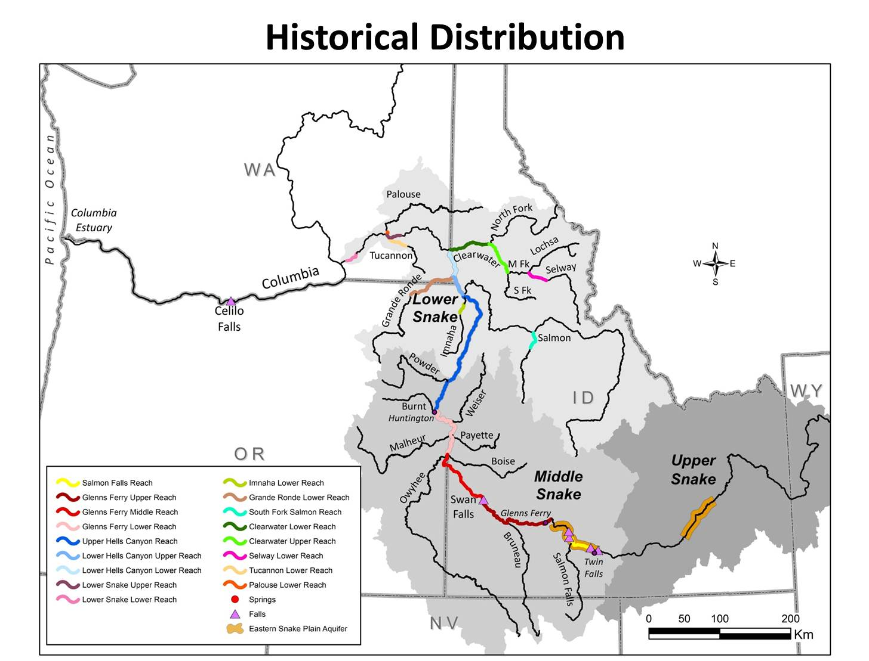
Notes:
Historical Distribution of Fall Chinook in the Snake River Basin. The distribution is believed to have occurred from the mouth of the Snake River up to Twin Falls, with areas occupied in the Clearwater, Grande Ronde, Imnaha and Salmon river basins as well.

Slide 4
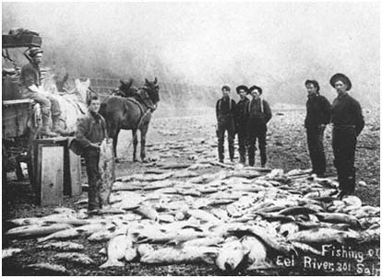
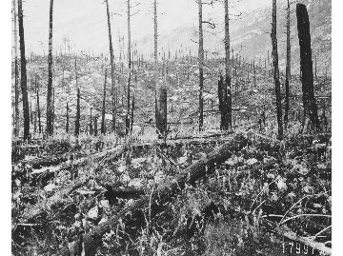
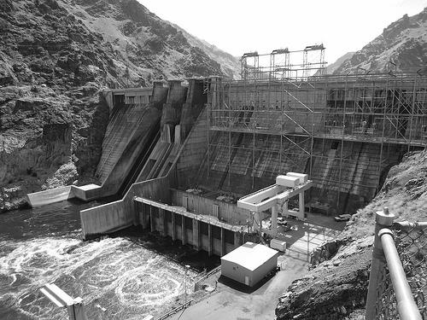
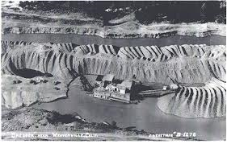

Factors of Decline
Anthropogenic
  Over harvest
  Habitat loss
    Irrigated Agriculture
    Logging
    Gold Dredging
    Dam construction
  Failed Hatchery Efforts
Natural
  Drought
  Ocean Productivity
Notes:
Multiple actions can be attributed to the overall decline of Snake River Fall Chinook salmon.

Slide 5
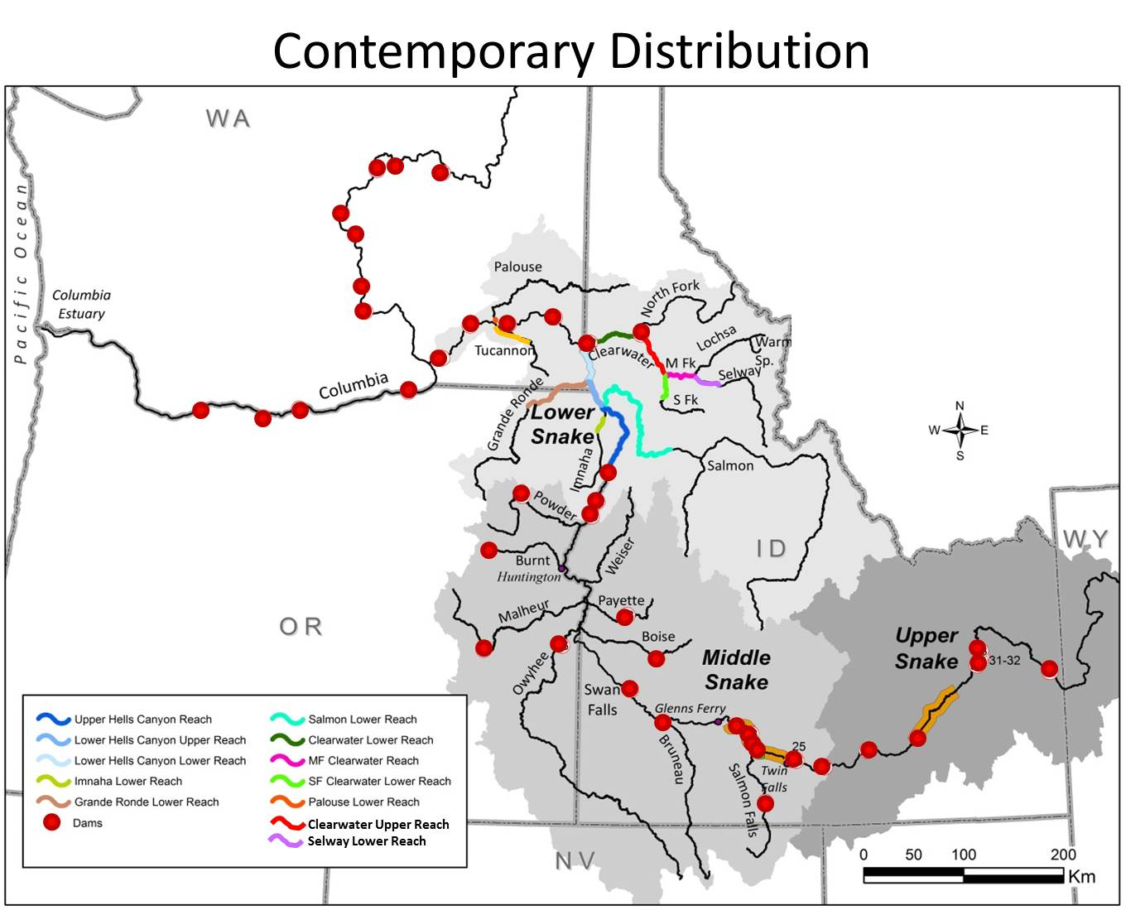
Contemporary Distribution
~80% Loss
NMFS (2015c)
Notes:
Taken in all, these actions have reduced the distribution in the Snake River to about 80% of what it once was, and is limited to the Lower Snake Region.

Slide 6
Historical Abundance
= Hatchery Origin
= Wild/Natural Origin
= Mixed Origin
Notes:
Historical abundance was thought to be as higher as 0.5 million prior to the 1940’s. While there has been a slight rebound in recent year due to the success of the hatchery program seeding the available area left with fish, the overall returns are still of fraction of historical abundance.

Slide 7
Snake River Fall Chinook Salmon
Production Goals by Program
Funding Source | Production Facility | Production Capacity
 |  | 1+ | 0+
Lower Snake River Compensation Plan | Lyons Ferry Hatchery | 900,000 | 2,200,000
Idaho Power Company | Irrigon Hatchery |  | 1,000,000
Columbia Basin Fish and Wildlife Program | Nez Perce Tribal Hatchery |  | 1,400,000
Totals |  | 900,000 | 4,600,000
5.5 Million
Notes:
Production by programs is a follows, with all yearlings coming from Lyons Ferry hatchery, with subyearling produced at all three facilities.

Slide 8
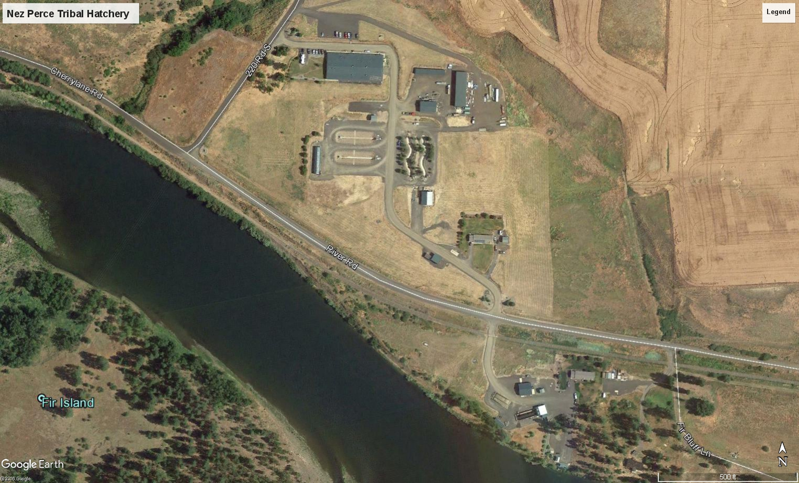
Nez Perce Tribal Hatchery
Clearwater River
RKM 38 (784)
Notes:
Nez Perce Tribal Hatchery on the Clearwater.

Slide 9
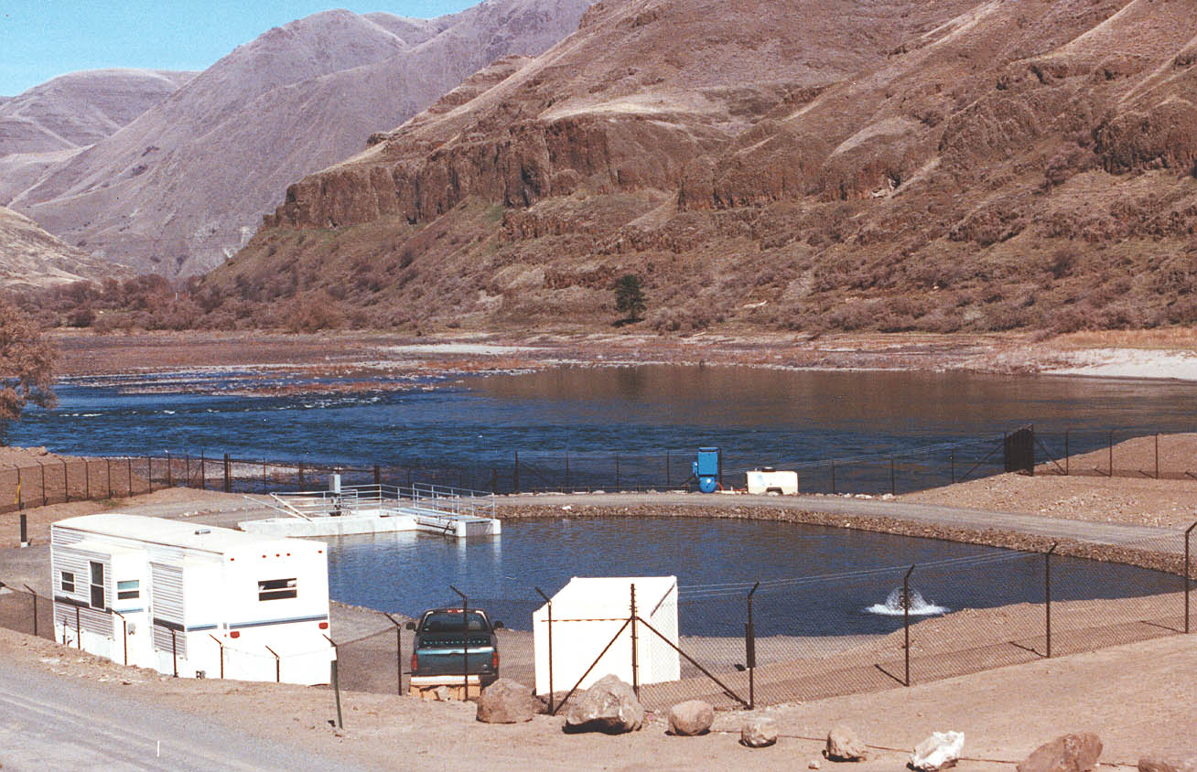
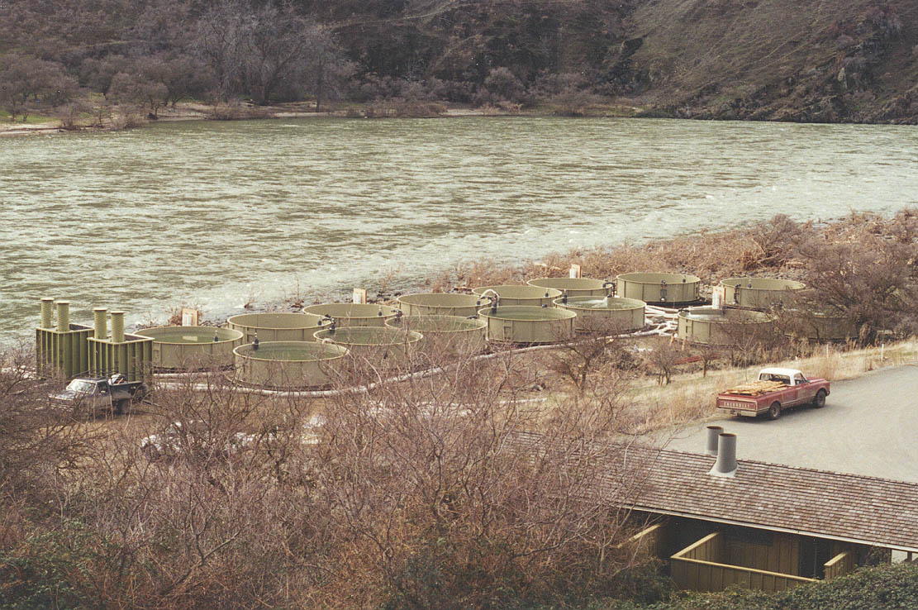
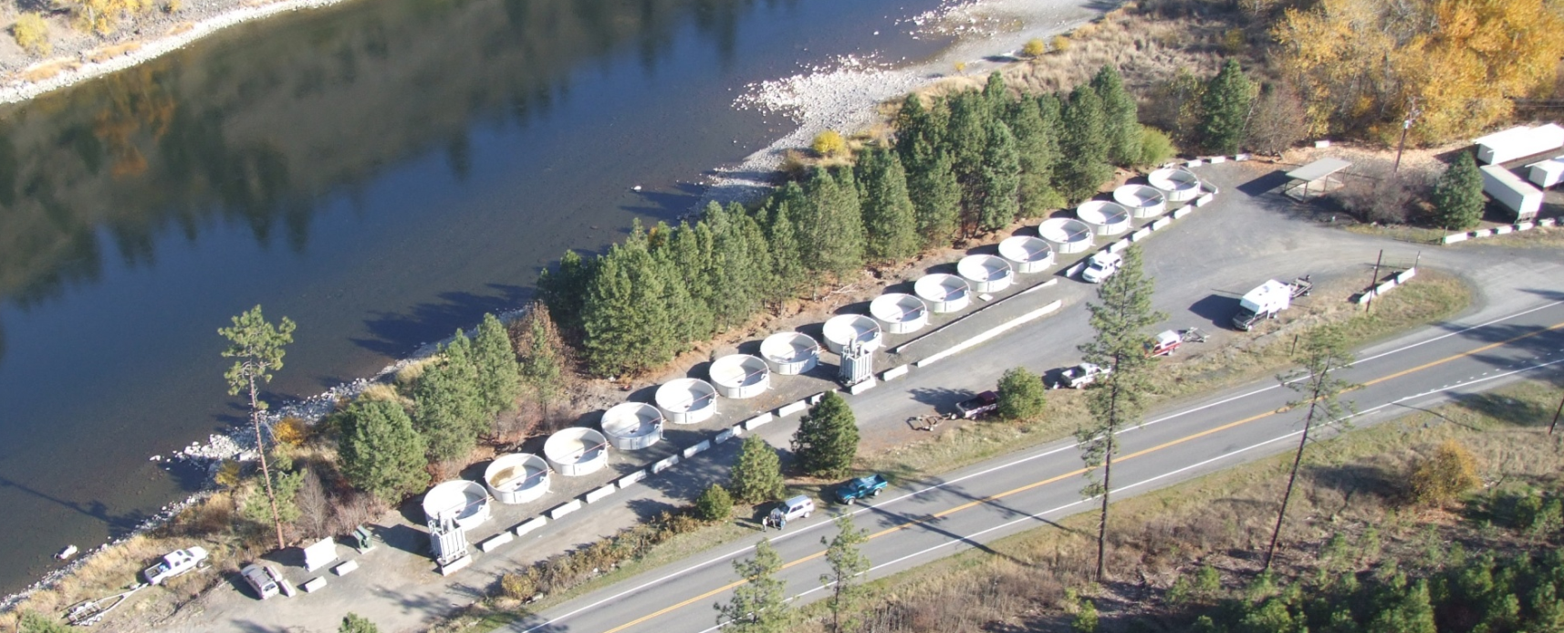
Fall Chinook Acclimation Project (FCAP)
Captain John Rapids,
Snake River
Pittsburg Landing, Snake River
Big Canyon, Clearwater River
Notes:
There are three FCAP facilities, Cap John on the Snake, Pittsburg Landing on the Snake, and Big Canyon on the Clearwater

Slide 10
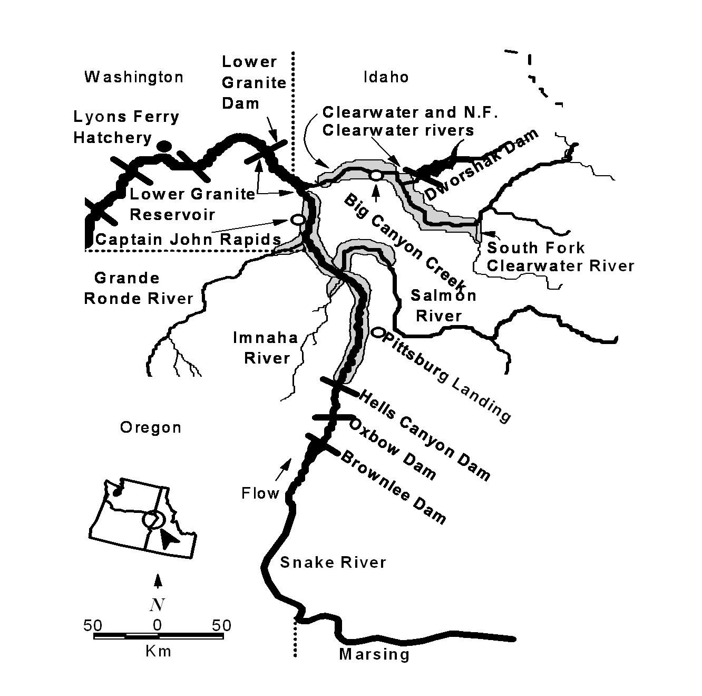
Hatchery Facilities and Release Locations
Nez Perce Tribal Hatchery
Irrigon Hatchery
Oxbow Hatchery
Notes:
Map showing all hatchery facilities currently used and release locations. Rearing facilities, as mentioned previously, are Lyons Ferry, Nez Perce Tribal and Irrigon Hatcheries. Release sites are also shown. Green are acclimated releases, pink are direct stream released. Releases also occur at Lyons Ferry and Nez Perce Tribal Hatcheries directly to the Snake and Clearwater rivers.

Slide 11
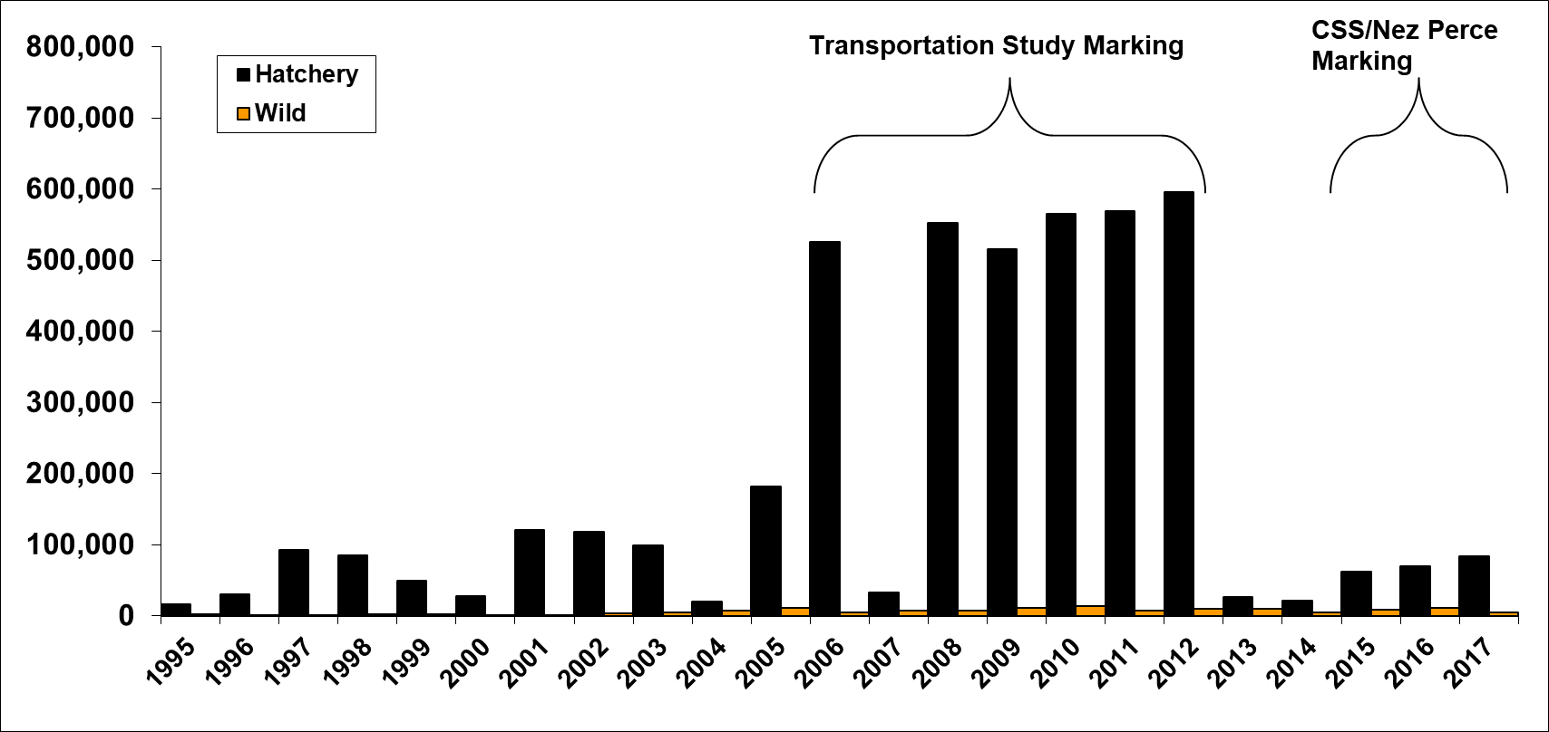
Subyearling fall Chinook PIT-tag marking above Lower Granite Dam

Slide 12
Overall SARs for Fall Chinook
LGR to LGR (jacks excluded)
1.2
1.0
0.8
SAR LGR to LGR
0.6
0.4
0.2
0.0
2006
2008
2010
2012
2014
Migration Year
PIT-tag groups generally outmigrated between mid-May and early July with very few yearling (holdovers).
SARs ranged between 0% and 1% for the juvenile migration years 2006 to 2012
Similar pattern as seen in spring migrants
12
Notes:
Here are the SARs from those 2006 to 2012 outmigration years.
Explain graph.
SARs for fall Chinook ranged from 0 to 1%. Lower than spring migrants.
Some similarities. 2006 low returns, 2008 high returns.
Note that for 2015 I’m showing the 2 salt returns only. But suggests relatively low return rates for that year as well.

Slide 13
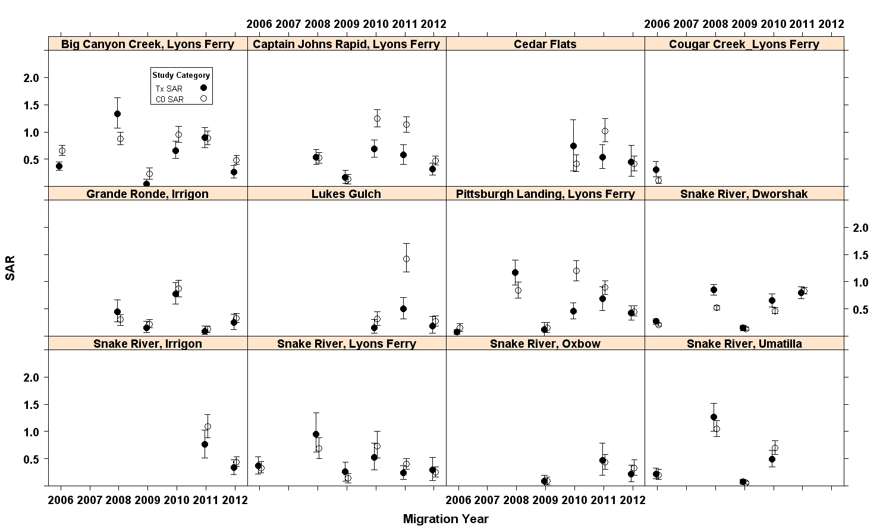
SARs by category LGR to LGR

Slide 14
Summary of Transport in-River Ratios
Tx/C₀ = TIR
51 TIR comparisons
22 TIRs significant
  17 higher In-river SARs
  5 higher Transport SARs
Notes:
Taking the transport and in-river SARs we calculate the TIR or transport in-river SAR ratios.
Overall we had 51 TIRs we could estimate from the SAR analyses.
22 showed significant TIRs…meaning non-overlapping 95% CI’s. Of those 17 showed higher in-river SARs, only 5 showed higher transport SARs
This result for fall Chinook groups we analyzed, suggests that transportation is not compensating for the effects of the hydrosystem.

Slide 15
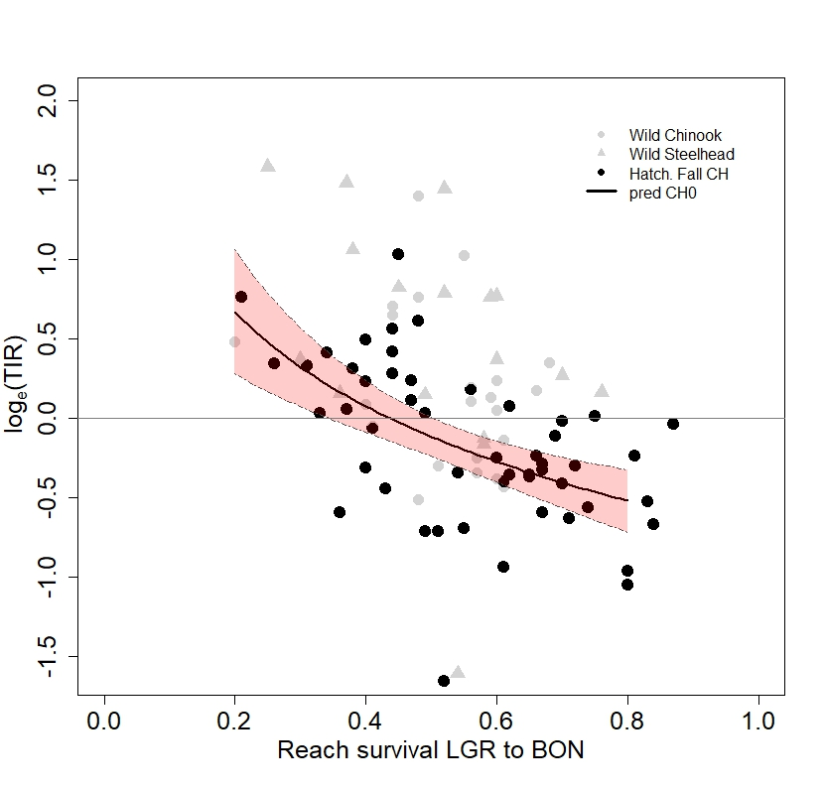
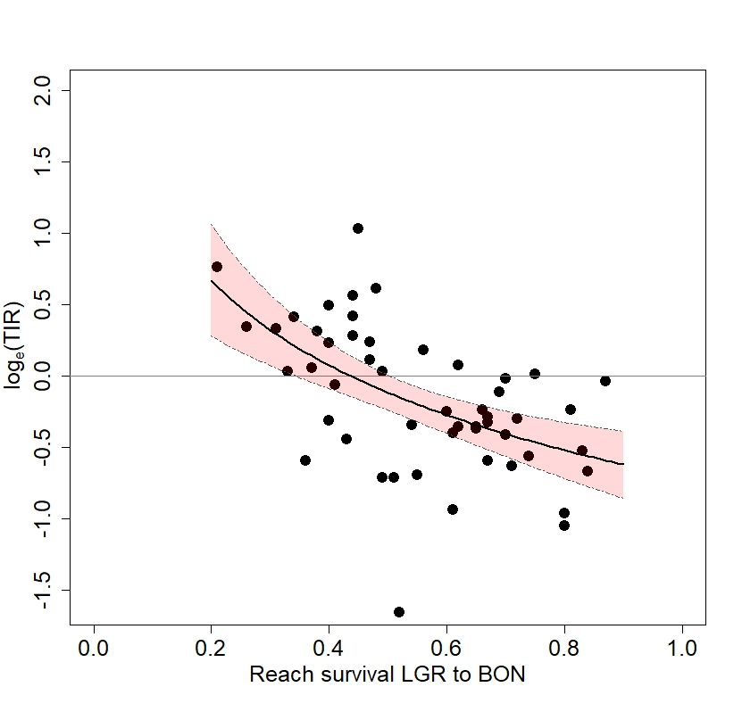
TIR vs Reach Survival
0.44 (0.34-0.51)
Notes:
An interesting pattern has been observed between the Reach Survival and TIR ratio.
As in-river survival increases (as shown on the x-axis) the transport benefit decreases.
Here I’ve plotted the TIR on the log scale, so that when values are below 0, that indicates that the in-river SAR was higher than the transport SAR.

Slide 16
TIR survival threshold
Species | Survival Threshold
Hatchery Fall Chinook | 0.44 (0.34-0.51)
Wild Spr/Su Chinook | 0.65 (0.53-0.86)
Wild Steelhead | 0.70 (0.56-0.96)

Slide 17
Conclusions
SARs ranged from 0% to just over 1% (LGR to LGR without jacks).
Only 5 groups of 51 showed significant transport benefit, while 17 groups showed significant in-river benefit.
Transport benefit appeared to decrease with increasing in-river survival similar to pattern seen with spring migrants. Possibly lower in-river survival threshold for fall Chinook.
17

