Slide 1
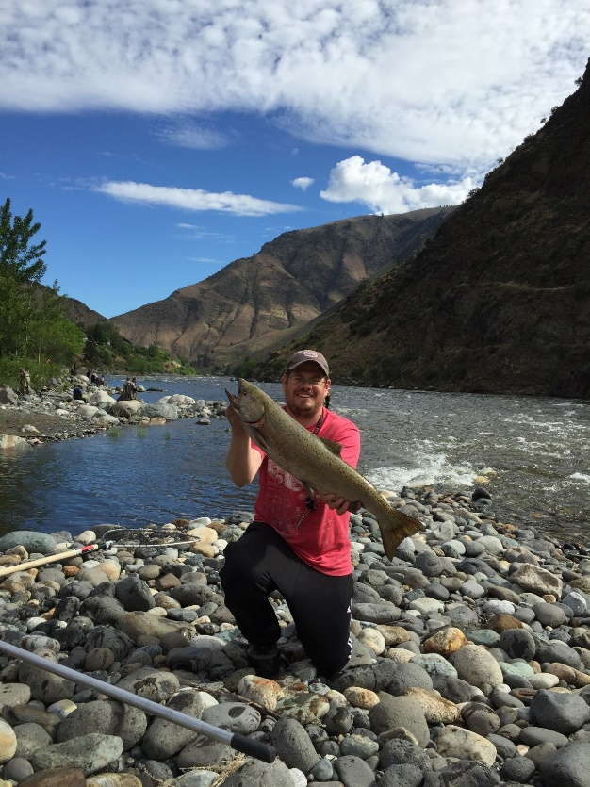

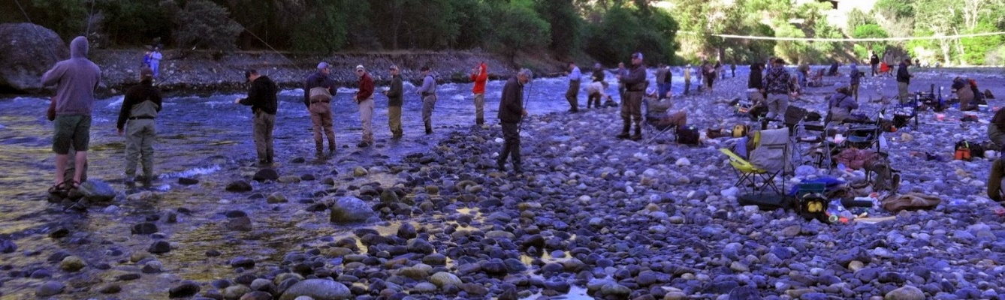
Salmon and Steelhead
Run Forecasts for 2020
Chris Sullivan
Anadromous Fisheries Program Coordinator
Idaho Department of Fish and Game

Slide 2
Today’s Forecast Presentation
Introduction
Methodology
2020 Forecasts and recent trends
  Spring/Summer Chinook
  Fall Chinook
  Steelhead
  Sockeye
Factors that effect forecast accuracy

Slide 3





Acknowledgements
US v OR Technical Advisory Committee (TAC)
Nez Perce Tribe
USFWS
ODFW
WDFW

Slide 4
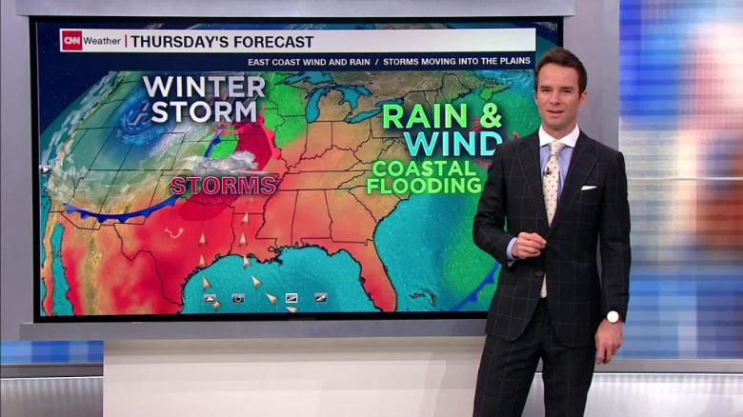
Why do we make forecasts?
Photo credit: cnn.com

Slide 5

Why do we make fish forecasts?

Slide 6
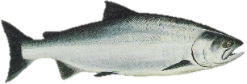
Why do we make fish forecasts?

Slide 7
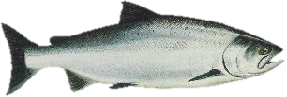

Why do we make fish forecasts?
or

Slide 8
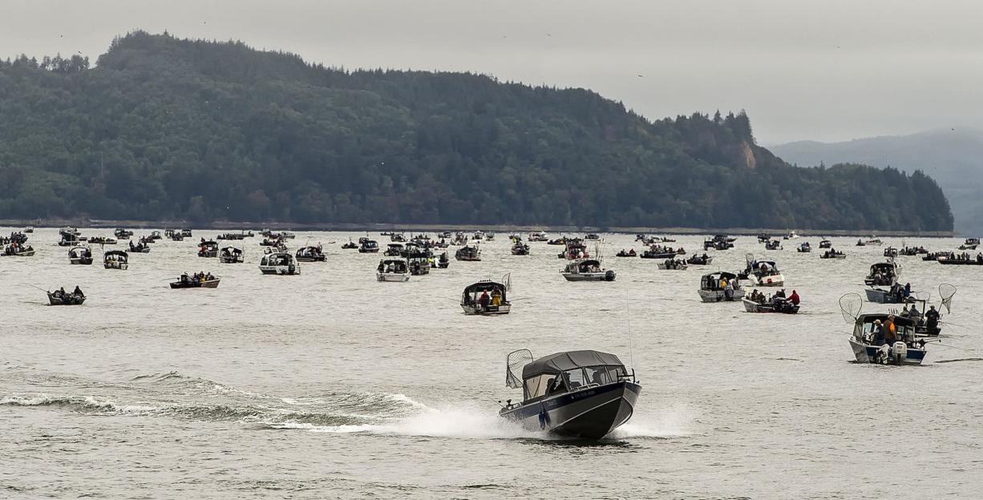
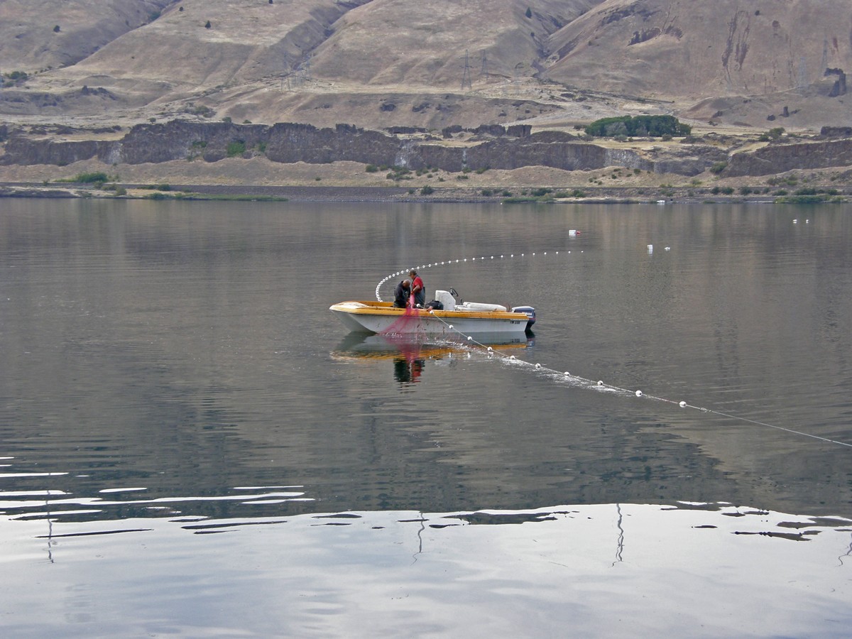
Why do we make fish forecasts?
Photo credit: thecolumbian.com
Photo credit: critfc.org

Slide 9
Why do we make forecasts?
Forecasts set the stage for fishery planning
-Good, average, poor
Photo credit: thecolumbian.com
Photo credit: critfc.org

Slide 10
Why do we make forecasts?
Forecasts set the stage for fishery planning
Photo credit: thecolumbian.com
US v. OR Management Agreement
-Harvest rates in Columbia River
-Allowable impacts to listed species
-Informs on-the-ground management
Photo credit: critfc.org

Slide 11
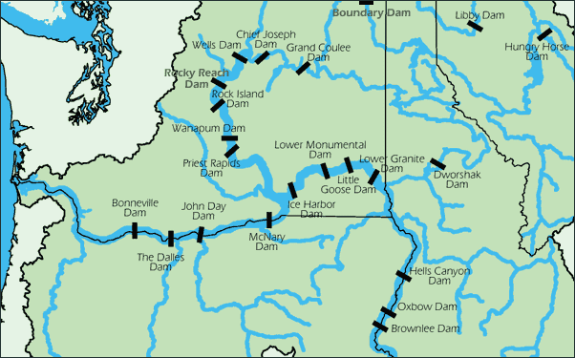
Columbia River
Non-treaty Fisheries
(146 river miles)

Slide 12
Columbia River
Non-treaty Fisheries
(146 river miles)

Slide 13
Columbia River
Non-treaty Fisheries
(146 river miles)
Tribal ceremonial, subsistence, and commercial fishery

Slide 14
Snake River Fisheries
Columbia River
Non-treaty Fisheries
(146 river miles)
Tribal ceremonial, subsistence, and commercial fishery

Slide 15
Snake River Fisheries
Columbia River
Non-treaty Fisheries
(146 river miles)
Tribal ceremonial, subsistence, and commercial fishery

Slide 16
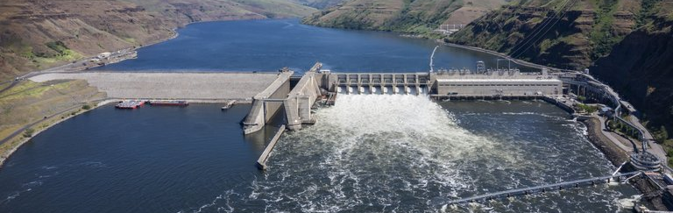
How are forecasts generated?
Run reconstruction is the first step
Abundance estimated at Lower Granite Dam

Slide 17
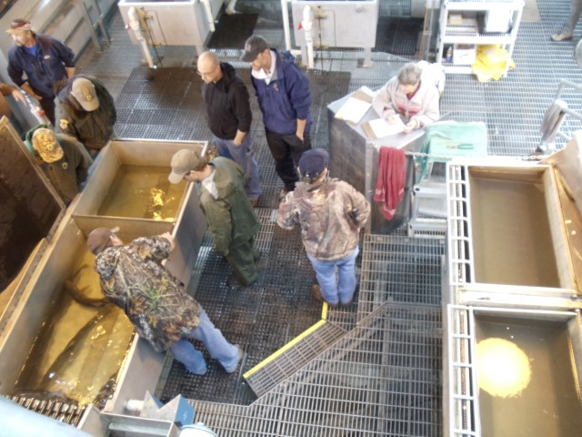
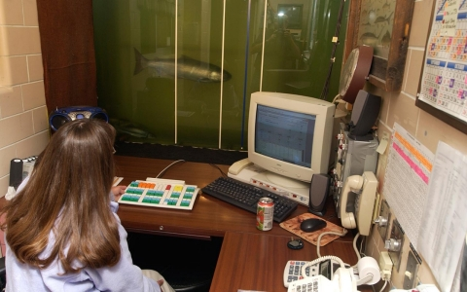

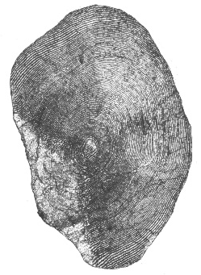
How are forecasts generated?
Run reconstruction is the first step
Abundance estimated at Lower Granite Dam

Slide 18

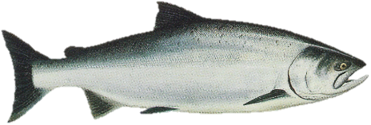
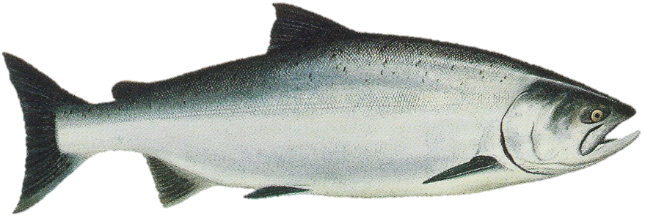
Chinook Salmon Lifecycle
Freshwater 1-2 years
Ocean 1-3 years

Slide 19
Chinook Salmon Lifecycle
Freshwater 1-2 years
Ocean 1-3 years
Jacks
Adults

Slide 20
Chinook Salmon Lifecycle
Ocean 1-3 years
Jacks
Adults

Slide 21
Steelhead forecasting
Ocean 1-3 years
Jacks
Adults

Slide 22
Steelhead forecasting
Ocean 1-3 years
Jacks
Adults

Slide 23
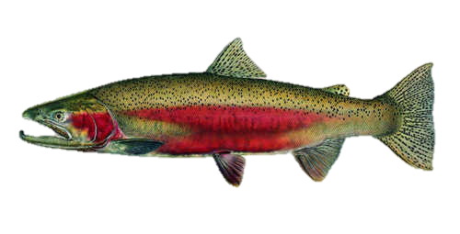
Steelhead forecasting
Freshwater 1-3+ years
Ocean 1-3 years

Slide 24
Steelhead forecasting
Freshwater 1-3+ years
Ocean 1-3 years
Adults

Slide 25
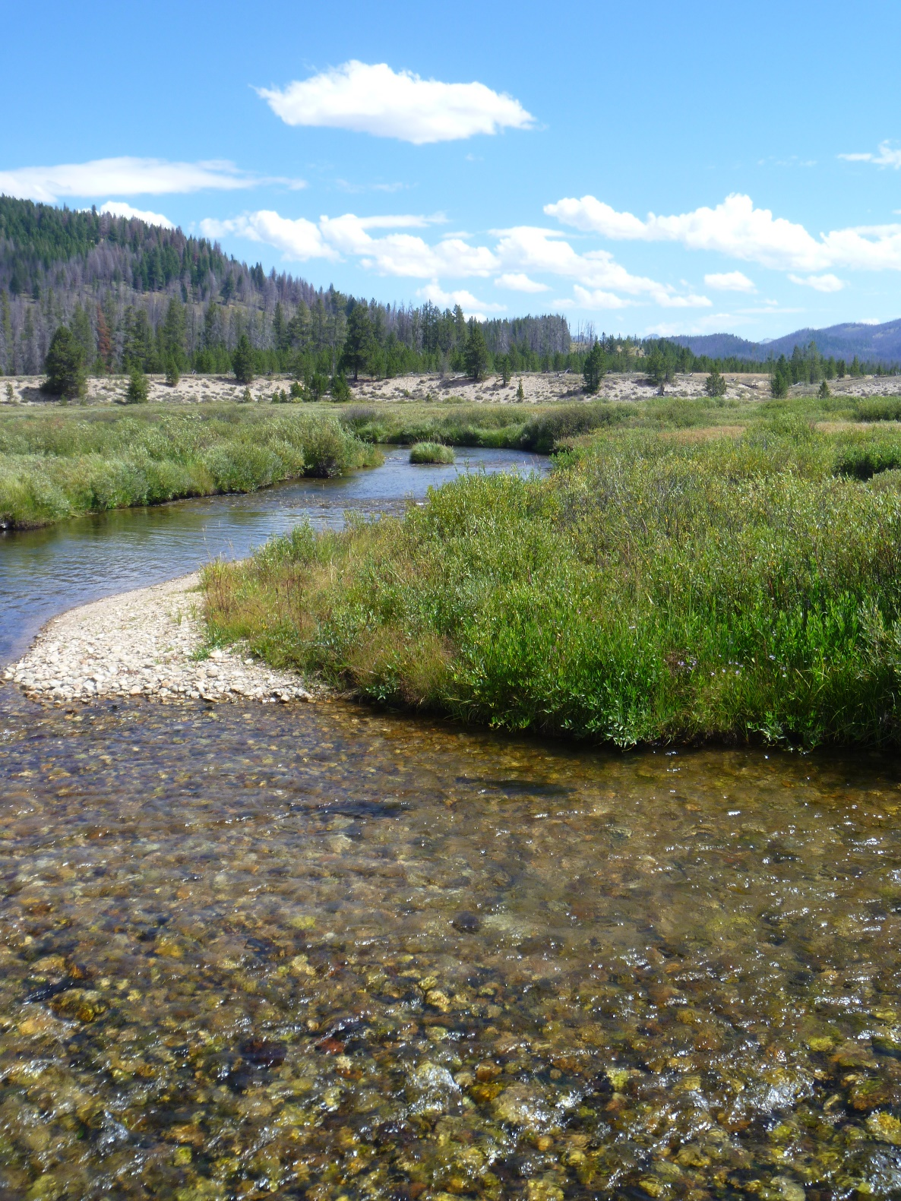
2020 Forecasts

Slide 26
Wild Spring/Summer Chinook Adults at Lower Granite Dam
2019 Forecast: 6,130
2019 Actual: 4,152
10 Yr. Avg.: 16,031
2020 Forecast: 7,065
ESA Listing

Slide 27
Hatchery Spring/Summer Chinook Adults at Lower Granite Dam
2019 Forecast: 25,701
2019 Actual: 19,529
10 Yr. Avg.: 55,798
2020 Forecast: 30,069

Slide 28
Wild Fall Chinook Adults at Lower Granite Dam
2019 Forecast: 5,435
2019 Actual: 6,558
10 Yr. Avg.: 10,893
2020 Forecast: 6,590
ESA Listing

Slide 29
Hatchery Fall Chinook Adults at Lower Granite Dam
2019 Forecast: 10,016
2019 Actual: 9,950
10 Yr. Avg.: 27,277
2020 Forecast: 11,560

Slide 30
Wild Steelhead at Lower Granite Dam
2019-20 Forecast: 17,615
2019-20 Actual: 9,014
10 Yr. Avg.: 25,539
2020-21 Forecast: 17,630
ESA Listing

Slide 31
Hatchery Steelhead at Lower Granite Dam
2019-20 Forecast: 43,085
2019-20 Actual: 23,182
10 Yr. Avg.: 91,225
2020-21 Forecast: 32,040

Slide 32
Wild Sockeye at Lower Granite Dam
2019 Forecast: 43
2019 Actual: 41
10 Yr. Avg.: 186
2020 Forecast: 114
ESA Listing

Slide 33
Hatchery Sockeye at Lower Granite Dam
2019 Forecast: 162
2019 Actual: 240
10 Yr. Avg.: 764
2020 Forecast: 1,327

Slide 34
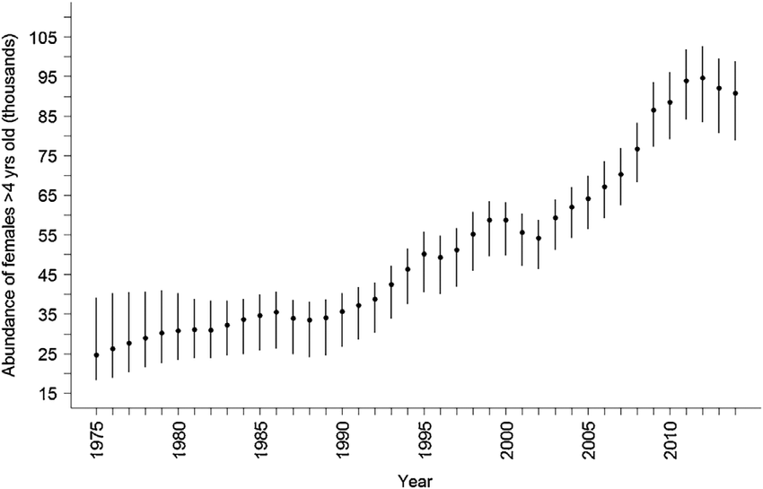
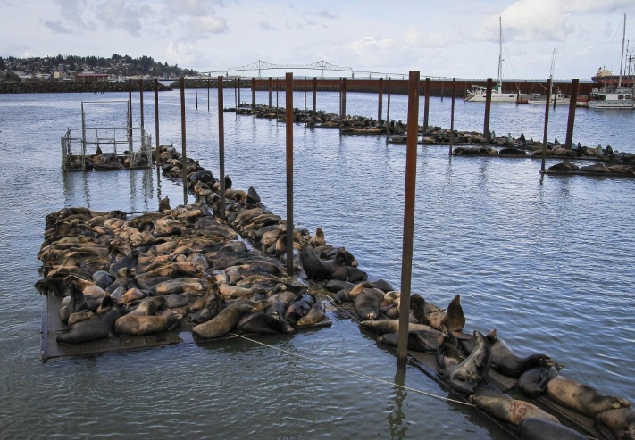
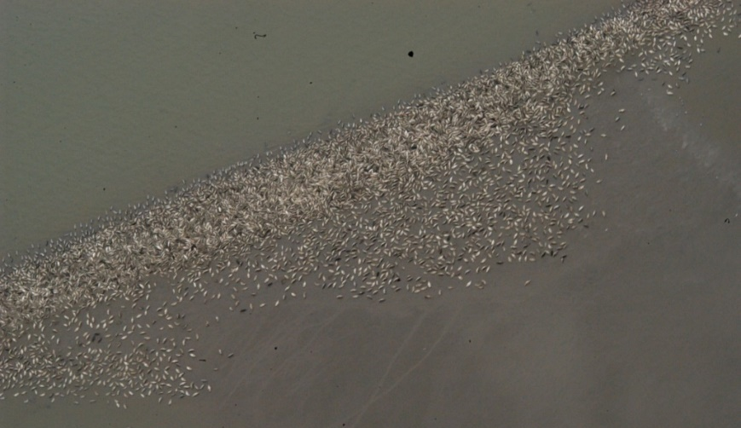
Things that can lead to forecasting error
http://www.columbian.com/news/2015/mar/25/pinnipeds-find-food-along-columbia-river-seals/
https://www.researchgate.net/
Photo credit: Washington Department of Fish and Wildlife

Slide 35
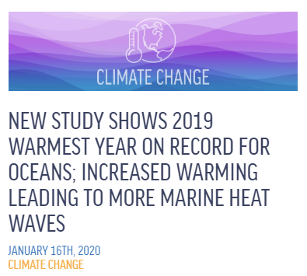


Things that can lead to forecasting error

Slide 36
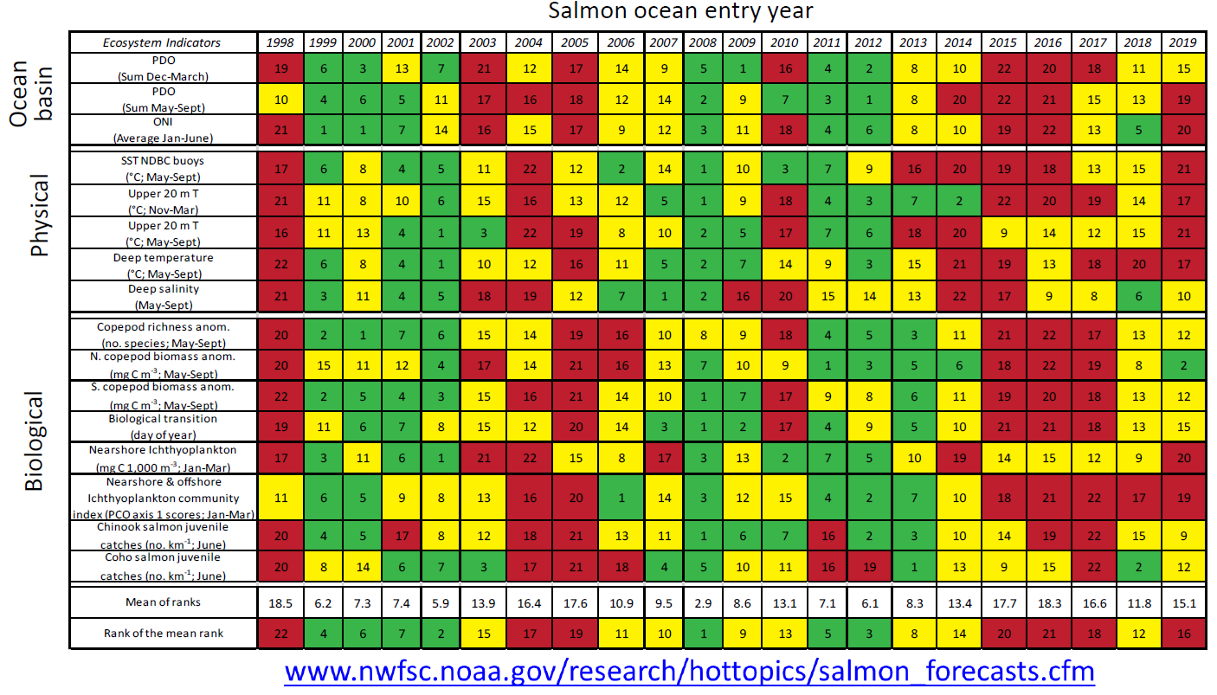
More on ocean conditions….
  NOAA ocean indicators stoplight chart

Slide 37
Forecast Summary
Species | 2020 Forecast | 10-Year Average | Run Strength

Slide 38
Forecast Summary
Species | 2020 Forecast | 10-Year Average | Run Strength
Spring/Summer Chinook | 37,134 | 78,129 | Poor

Slide 39
Forecast Summary
Species | 2020 Forecast | 10-Year Average | Run Strength
Spring/Summer Chinook | 37,134 | 78,129 | Poor
Fall Chinook | 18,150 | 38,170 | Poor

Slide 40
Forecast Summary
Species | 2020 Forecast | 10-Year Average | Run Strength
Spring/Summer Chinook | 37,134 | 78,129 | Poor
Fall Chinook | 18,150 | 38,170 | Poor
Steelhead | 49,670 | 116,763 | Poor

Slide 41
Forecast Summary
Species | 2020 Forecast | 10-Year Average | Run Strength
Spring/Summer Chinook | 37,134 | 78,129 | Poor
Fall Chinook | 18,150 | 38,170 | Poor
Steelhead | 49,670 | 116,763 | Poor
Sockeye | 1,441 | 953 | Average

Slide 42
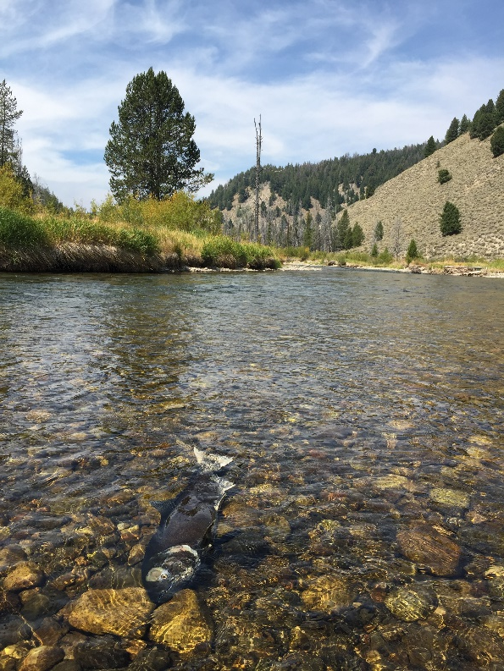
Questions?

