Slide 1


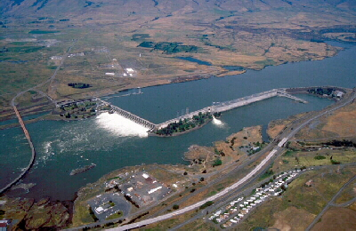
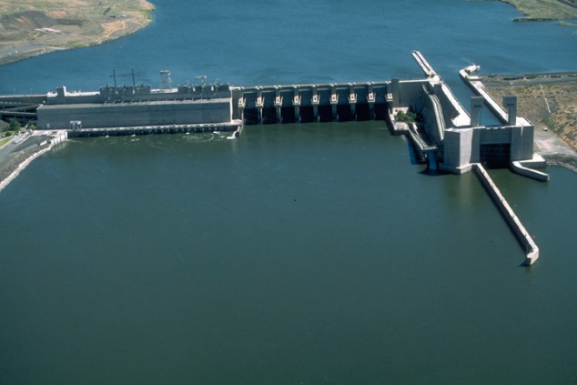
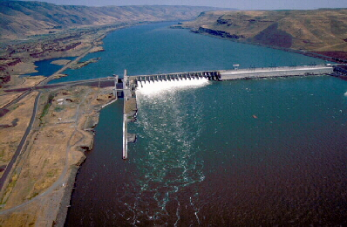
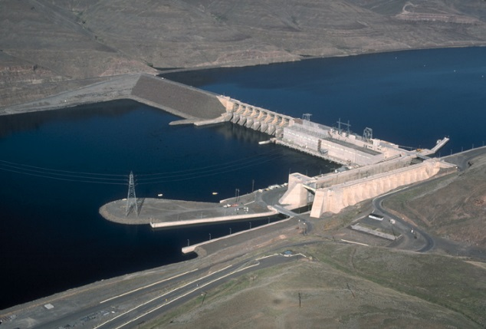
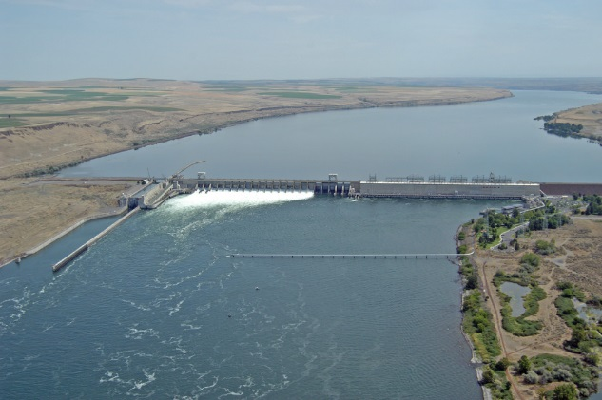
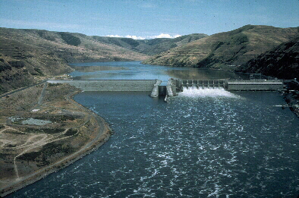
2019-2021 Flex Spill Agreement
2020 Implementation Update
Jay Hesse
Nez Perce Tribe

Slide 2
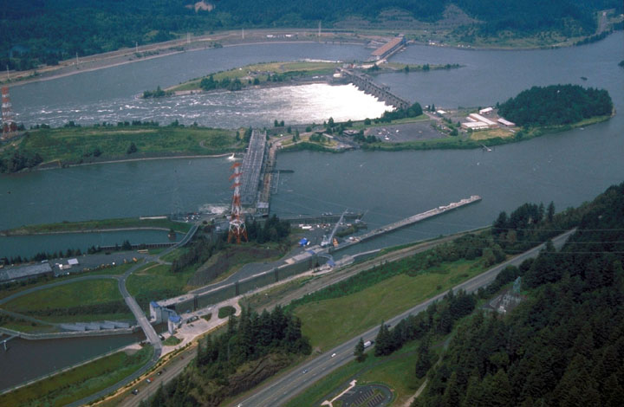
Implementation Acknowledgements
COE on-site staff
FPC GBT sampling crews
BPA power groups
Dan Turner, Corps of Engineers
Shane Mosier, Bonneville Power Administration
Chad Brown, WA Ecology
Brandon Chockley, Fish Passage Center
Alexis Mills, Corps of Engineers
https://pweb.crohms.org/tmt/
http://www.fpc.org/river_home.html
http://www.cbr.washington.edu/dart/query/pitadult_reachdist

Slide 3
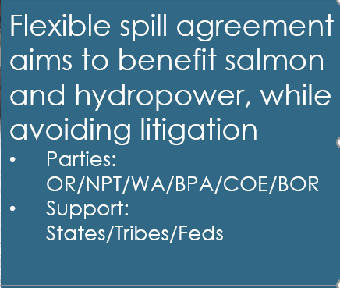
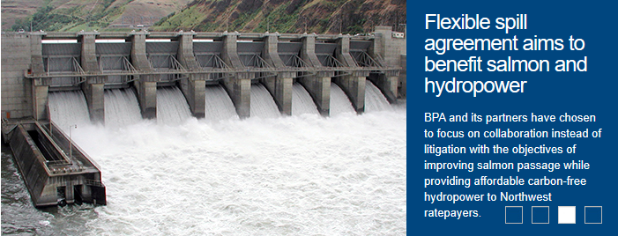
2019 - 2021 Spill Operations Agreement
Limited Duration - 3 year agreement to avoid litigation on the 2019 CRS BIOP
Diverse Interests - Three objectives (pillars) specific to term of the agreement
Presumptive Path (NPT and OR) – Improvement for fish, but more needed in CRSO EIS

Slide 4
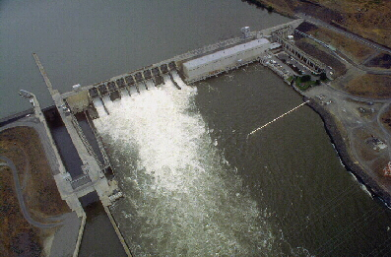
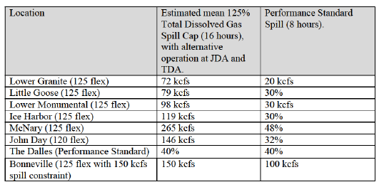
2020 Spring Operation
“125 Flex”
16 hours high spill
8 hours performance standard spill
125% TDG Flex – 5 Projects
120% TDG Flex – 1 Project
40% Perf. Std. – 1 Project
150kcfs Flex – 1 Project
MOP + 1.5’ pool elevation range
No perf. std. spill 10PM to 3AM
Abund. trigger for LGO 8hr block
Transportation start April 24

Slide 5
In-season Observations
2020 operation generally implemented as envisioned
Low flows
  Limited ability to reach 125% TDG
  Additional decrement (DEC) reserves
  Spill caps adjustments
  Pool elevation increases for transportation
Low PITPH under min gen spill the rest conditions
Lack of Market demand resulting in PS spill reduction
No to low Gas Bubble Trauma (GBT)
Possible slower adult travel time at Little Goose Dam
Assessment of fish survival and revenue not possible in-season
2020 125 flex operation does not achieve SAR goal

Slide 6
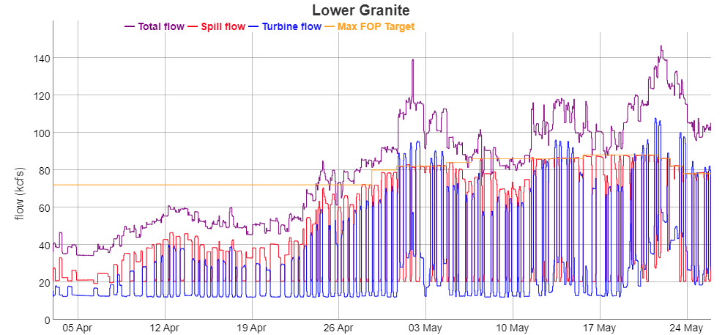
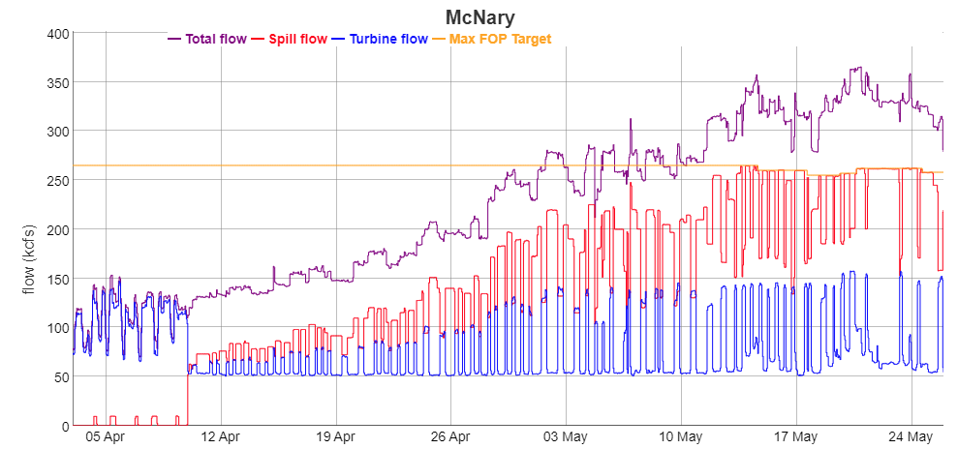
Flow Detail
https://www.nwd-wc.usace.army.mil/ftppub/water_quality/flexspill/flex_spill_implementation_lag.html

Slide 7
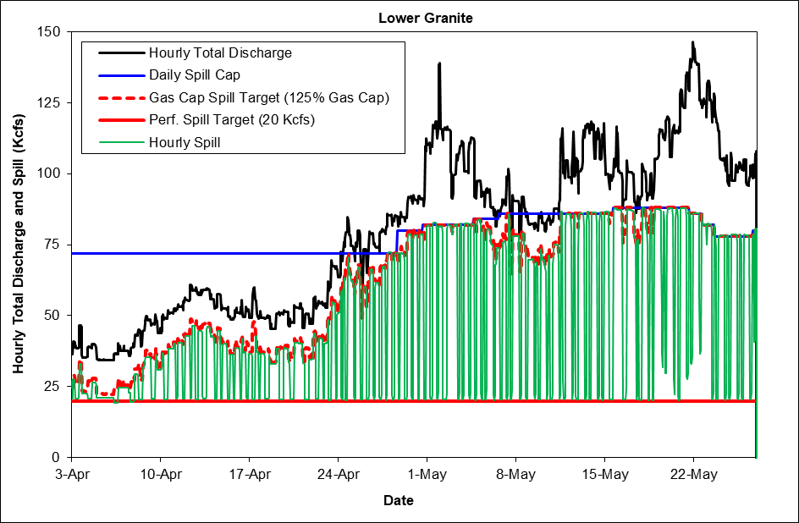
Min gen spill the rest ~ 50%
Revised spill caps (increased and lowered)
Notes:
Min gen spill the rest ~ 50%
Revised spill caps (raised and lowered)

Slide 8
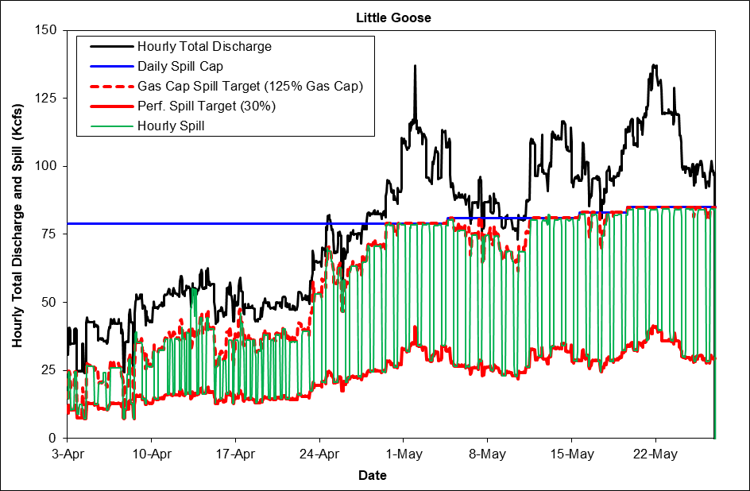
Min gen spill the rest >50%
Revised spill caps (increased)
Single 8 hour AM PS block ~ April 20th
Notes:
Min gen spill the rest >50%
Revised spill caps (increased)
Single PS block ~ April 20th

Slide 9
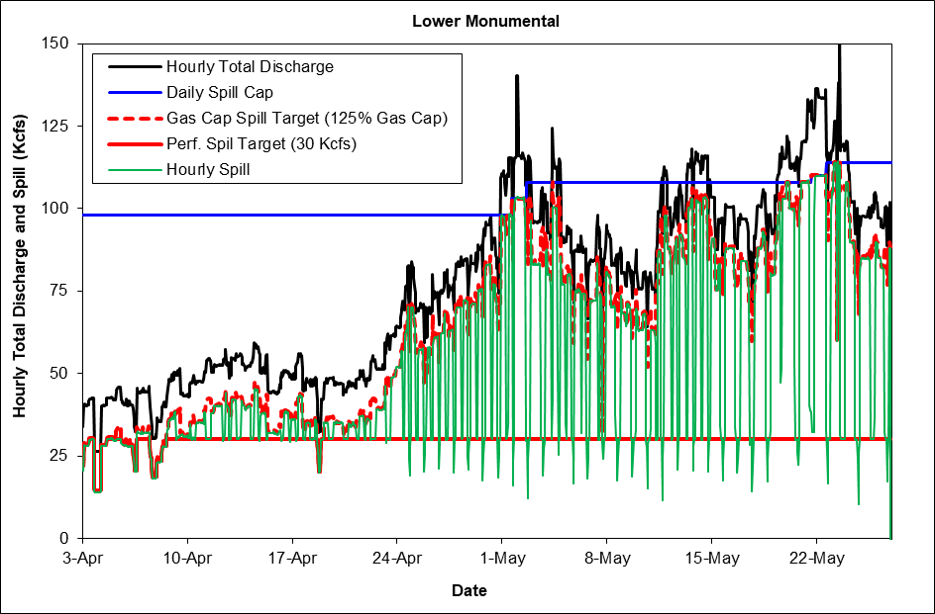
Min gen spill the rest > 90%
Revised spill caps (increased)
Routine spill reduction below PS spill for fish barge docking.
Notes:
Min gen spill the rest > 90%
Revised spill caps (increased)
Routine spill reduction below PS spill for fish barge docking.

Slide 10
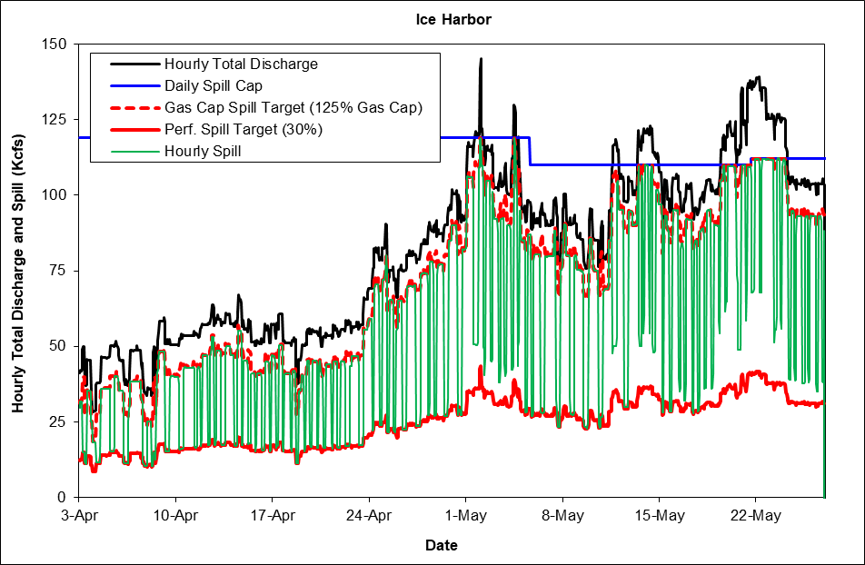
Min gen spill the rest > 95%
Revised spill caps (decreased)
Perf. stand. spill not fully implemented on multiple occasions due to Lack of Market demand.
Notes:
Min gen spill the rest > 90%
Revised spill caps (increased)
Spill above PS levels LOM or limited PH capacity.

Slide 11
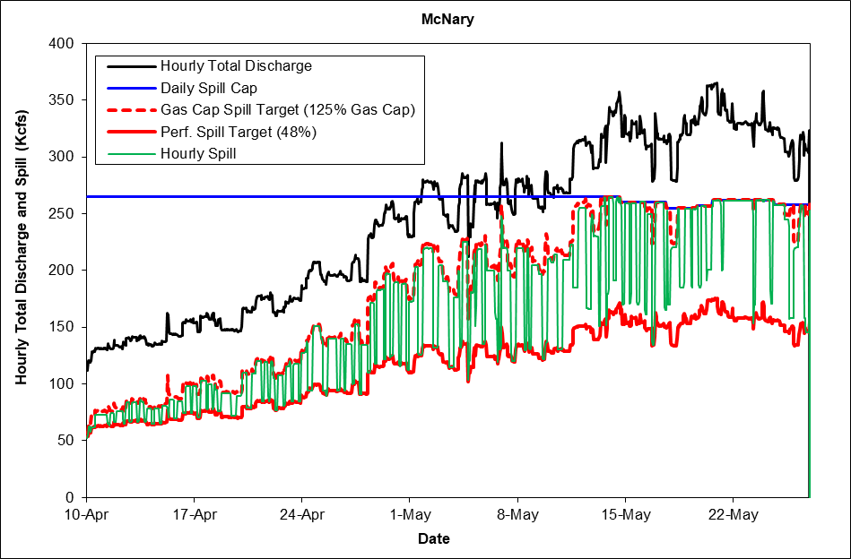
Min gen spill the rest >75%
Revised spill caps (decreased)
Perf. stand. spill not fully implemented on multiple occasions due to Lack of Market demand.

Slide 12
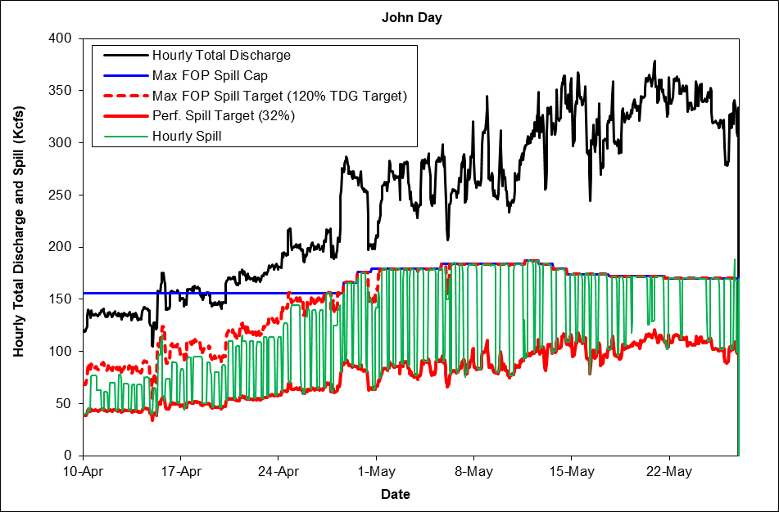
Min gen spill the rest ~30%
Revised spill caps (increased)
Perf. stand. spill not fully implemented on multiple occasions due to Lack of Market demand
Decrement Reserves added to min gen requirement

Slide 13
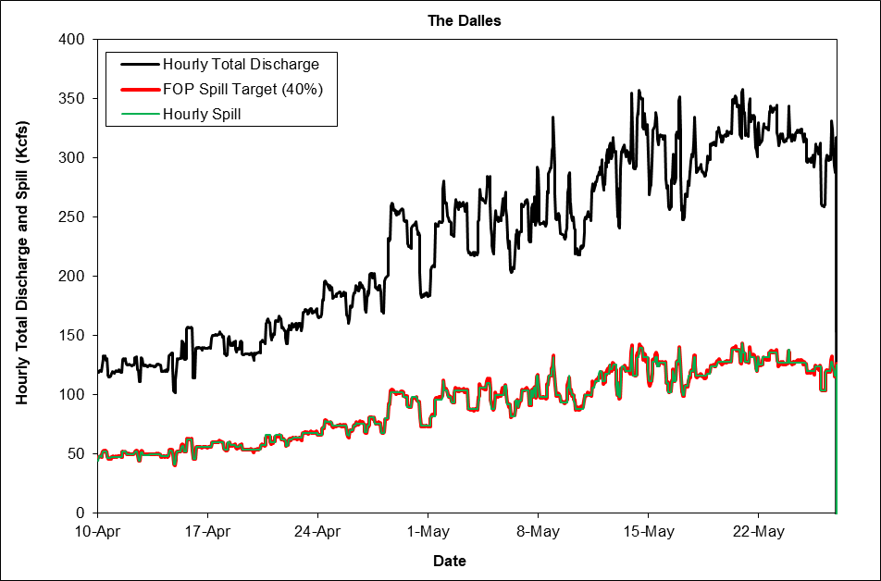
Notes:
.5

Slide 14
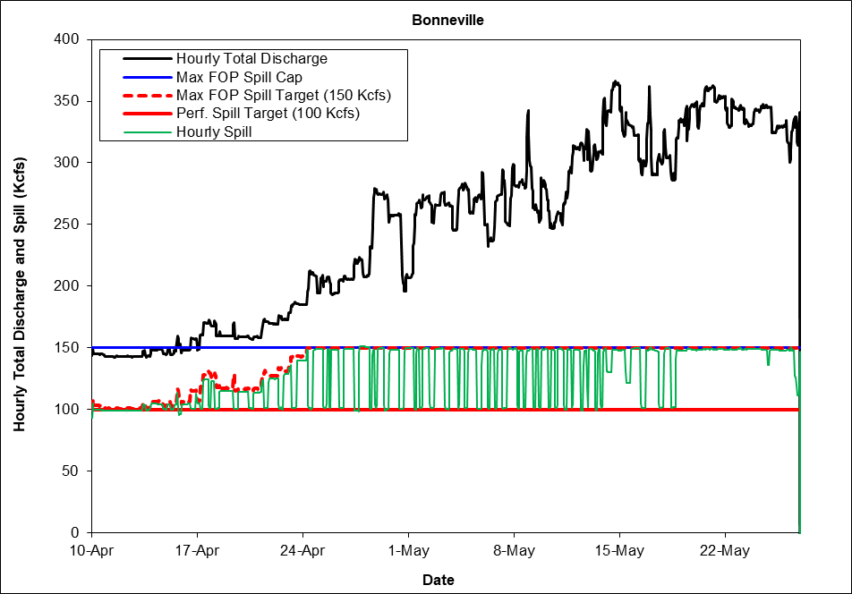
Min gen spill the rest ~25%
Perf. stand. spill not fully implemented on multiple occasions due to Lack of Market demand

Slide 15
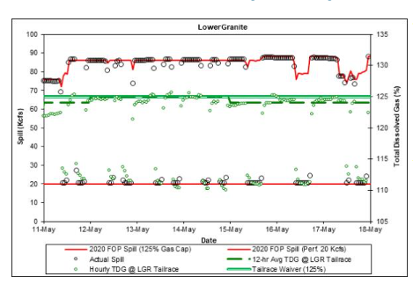
Total Dissolved Gas Detail
www.fpc.org/WebForm2013/MAINCHART.ASPX

Slide 16
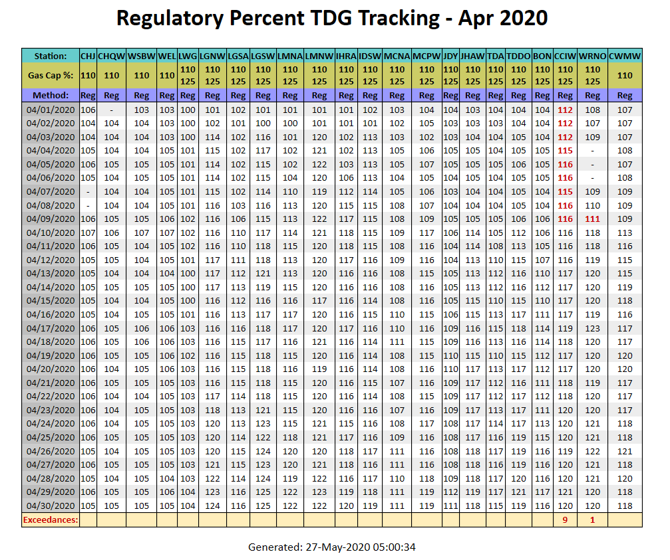
Total Dissolved Gas Detail
https://pweb.crohms.org/ftppub/water_quality/12hr/

Slide 17
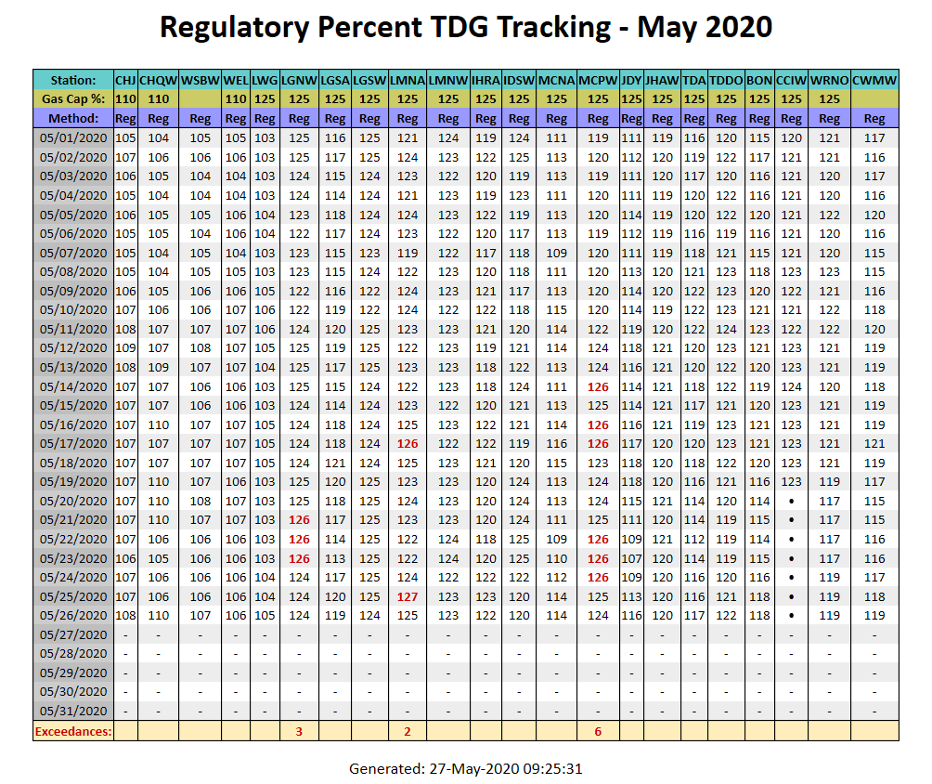
Total Dissolved Gas Detail
https://pweb.crohms.org/ftppub/water_quality/12hr/

Slide 18
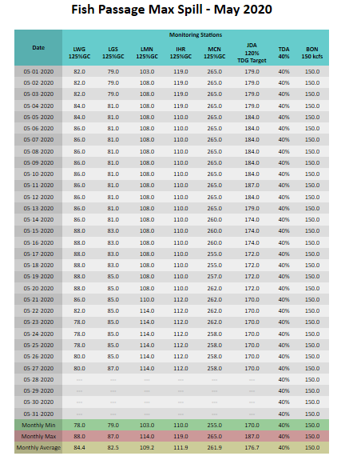
Spill Cap Detail
https://pweb.crohms.org/tmt/documents/ops/spill/caps/202005-Max+FOP.html

Slide 19
Spill Cap Detail
https://pweb.crohms.org/tmt/documents/ops/spill/caps/202005-Max+FOP.html

Slide 20
Spill Cap Detail

Slide 21
PITPH Detail

Slide 22
Gas Bubble Trauma Detail
http://www.fpc.org/smolt/gbtqueries/GBTwebsum_currentyear_query.html
Project | # Examined | GBT | Severe GBT
Bonneville | 1,000 | 10 | 0
McNary | 1,400 | 10 | 0
Lower Monumental | 1,098 | 10 | 0
Little Goose | 574 | 10 | 0
Lower Granite | 638 | 0 | 0
Total | 4,710 | 40 | 0
Less than 1% exhibiting GBT symptoms
No fish exhibiting severe GBT symptoms

Slide 23
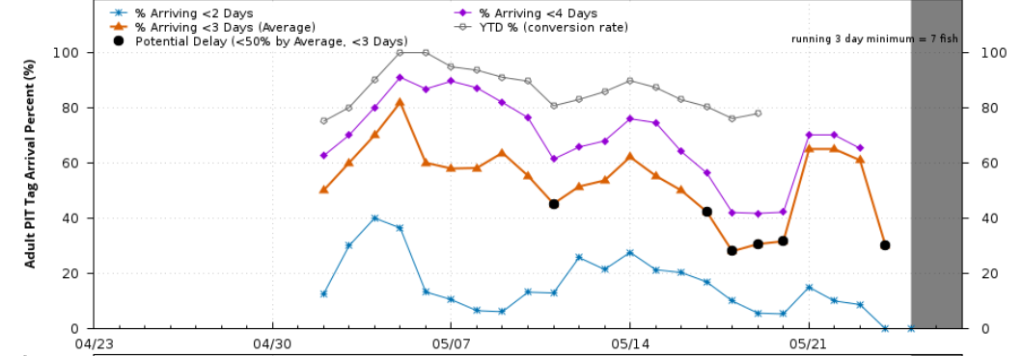
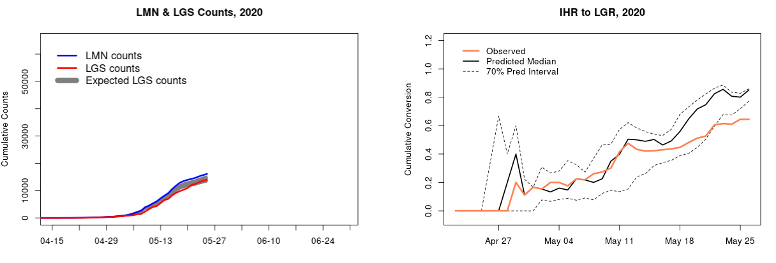
Adult Passage Detail
http://www.cbr.washington.edu/dart/query/pitadult_reachdist
http://216.206.157.83/da_indicator/

Slide 24
CRSO DEIS Alternatives
Natural Origin Spring/Summer Chinook
CSS and COMPASS-Based Effects

Slide 25
In-season Summary
2020 operation generally implemented as envisioned
Low flows
  Limited ability to reach 125% TDG
  Additional decrement (DEC) reserves
  Spill caps adjustments
  Pool elevation increases for transportation
Low PITPH under min gen spill the rest conditions
Lack of Market demand resulting in PS spill reduction
No to low Gas Bubble Trauma (GBT)
Possible slower adult travel times at Little Goose Dam
Assessment of fish survival and revenue not possible in-season
2020 125 flex operation does not achieve SAR goal

Slide 26
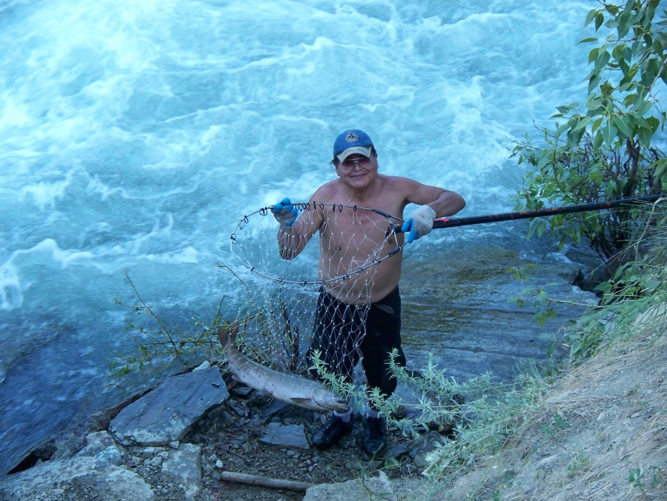
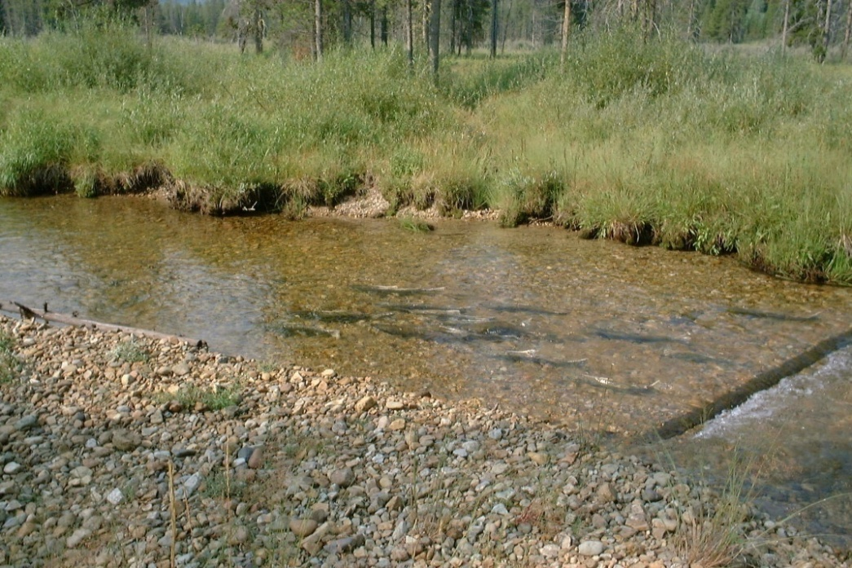
Questions?
“Our fate and the fate of the fish are linked.”
Dan Landeen and Allen Pinkham, Salmon and His People

