Slide 1
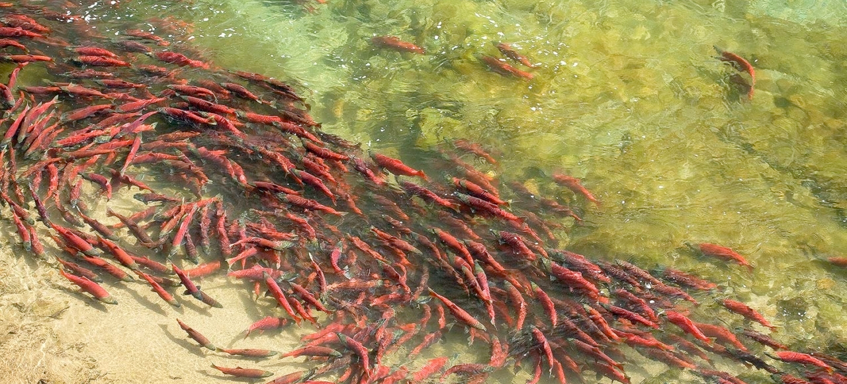


Why are Marine-Derived Nutrients (MDN) important?
Forms of MDN…….are they all the same?
That was then……this is now
Nutrient flux evaluations in Alaska and Idaho
MDN mitigation tools used by managers
Cultural oligotrophication and why it matters

Slide 2
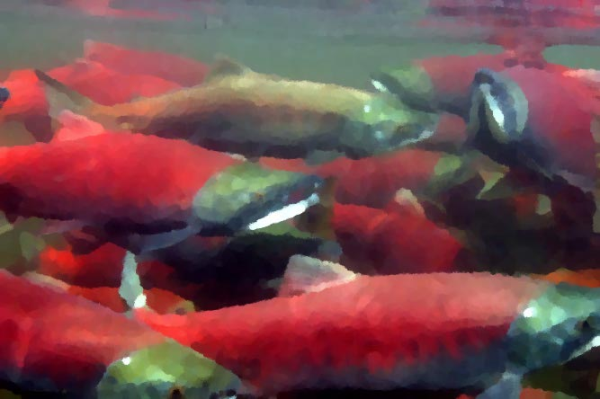
Pacific salmon and steelhead once contributed large amounts of marine-derived carbon,
nitrogen, and phosphorus to freshwater ecosystems across the Pacific Northwest
Notes:
Abundant populations of Pacific salmon, steelhead trout, and Pacific lamprey historically contributed large amounts of marine-derived Carbon, Nitrogen, and Phosphorus to aquatic and terrestrial ecosystems throughout the Pacific Northwest.
And in the Columbia River Basin, the world’s largest returns of anadromous fishes numbered in the 10 of millions on an annual basis and represented a massive influx of biomass from the Pacific Ocean to inland watersheds.
This ecological process has been characterized as a pulsed resource subsidy that fuels both freshwater and terrestrial ecosystem productivity.
Sadly, this ecosystem service has been severed or no longer functions to scale across much of the landscape following declines that coincide with intense harvest, hatchery production, habitat degradation, and the development of the Federal Columbia and Snake River Hydrosystem.

Slide 3

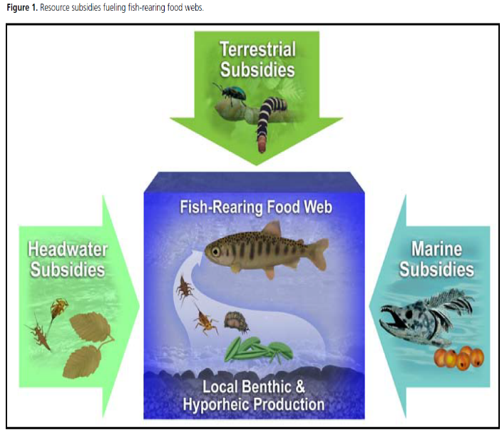
Wipfli and Baxter 2010
Notes:
So I’d like to talk briefly about freshwater productivity and fish-rearing food webs, specifically the aquatic environments where salmon and steelhead spawn and rear. These habitats are supported by what ecologists call resource subsidies. And these subsidies represent significant energy sources for aquatic systems from:
Headwater subsidies that contribute organic leaf litter and invertebrates, terrestrial subsidies that contribute fish food mainly from riparian habitats, local benthic and hyporheic production, and marine subsidies that contribute inorganic and organic forms of nutrients and energy that indirectly stimulate biofilm production as well as providing direct forms of energy such as salmon eggs and carcass flesh.

Slide 4
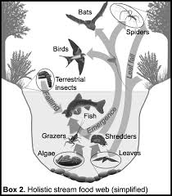
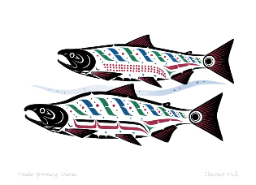



Many animals, including humans, depend upon annual returns of abundant anadromous fishes such as Pacific Lamprey, Pacific Salmon, and Steelhead Trout.
Cederholm et al. (1999) documented 137 species as dependent on salmon including: 41 mammals such as orcas, bears, and river otters; 89 birds including water ouzels and bald eagles.

Slide 5
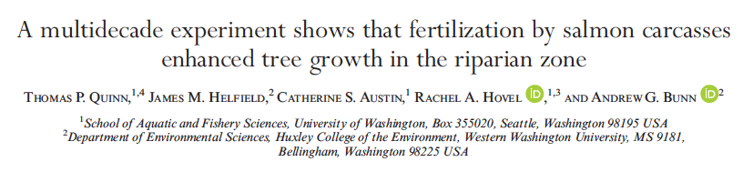


Slide 6
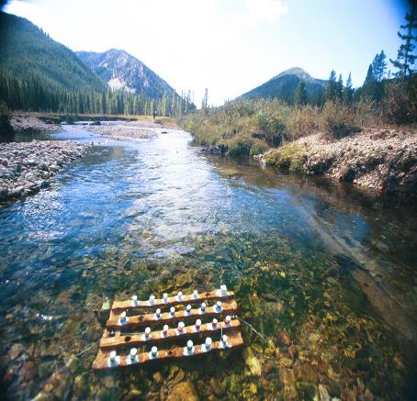
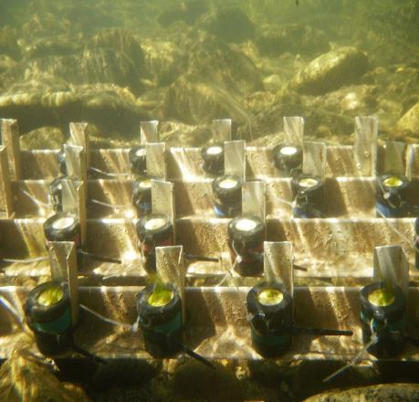
Are central Idaho streams limited by available nutrients?
Fig. 2. Pictures of a nutrient diffusing substrata (NDS) bioassay experiments in action.
Notes:
We started by asking some basic ecological questions??
Are Salmon River streams limited by available nutrients?
For example, is the base of the aquatic food web, what we call benthic biofilm production, limited by available nutrients…...............specifically Nitrogen, Phosphorus, or a combination of the two?
And the answer to this question, at least in our study streams, is yes….they are.
We tested this question with in situ assays called nutrient diffusing substrata experiments, shown here in the pictures above.

Slide 7
Yankee Fork Salmon River
Chlorophyll a (mg m⁻²)
Fig. 3. Nutrient diffusing substrata (NDS) bioassay experiments used to assess biofilm nutrient limitation in the
Yankee Fork Salmon River in 2010. ANOVA (F = 10.952; P = 0.012) results indicate primary nitrogen limitation.
Error bars are +1 SD.
Notes:
And here is a graphical representation of the results from our experiments.
The vertical axis is the mean Chlorophyll a content of replicate samples from nutrient treatments after being incubated in the stream for 30 days.
As you can clearly see, only groups with Nitrogen responded significantly, clear evidence that biofilm production was limited by available Nitrogen.

Slide 8

The Dr. Seuss Study
Live Fish
Dead Fish
Fake Fish
No Fish
Notes:
We are also trying to better understand how the different forms of various nutrient mitigation strategies affects the expected response.
So I’d like to share some results from an experiment we conducted that we’re calling the Dr. Seuss Study: Live Fish, Dead Fish, Fake Fish, No Fish.

Slide 9
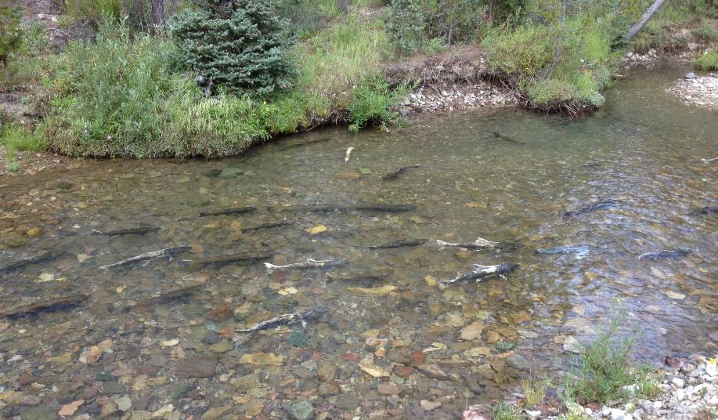
171 live Chinook salmon released into a 500m reach in Eight-Mile Creek
Notes:
We released 171 adult Chinook salmon into a closed, 500m reach in our ‘Live Salmon’ stream.

Slide 10
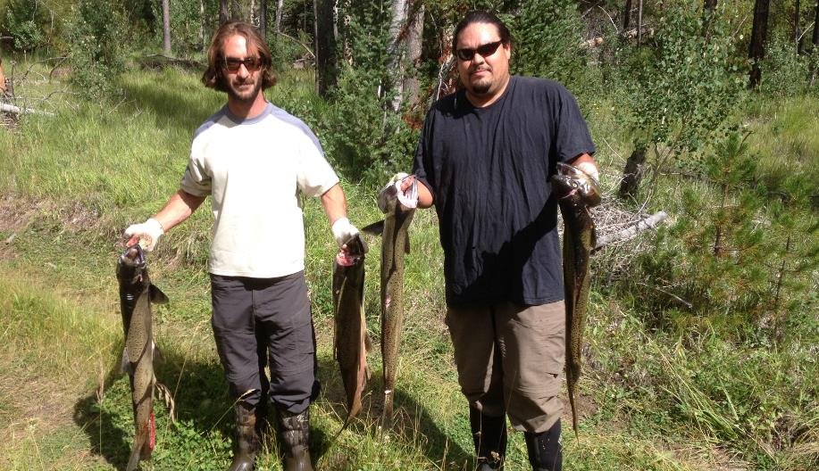
66 Chinook salmon carcasses added to a 500m reach in Ramey Creek
Notes:
We added 66 Chinook salmon carcasses to a 500m reach in our ‘Dead fish’ stream.

Slide 11
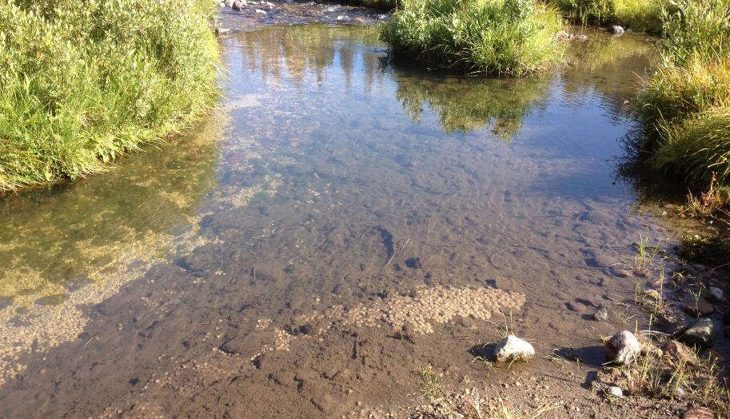
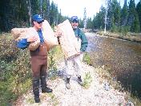
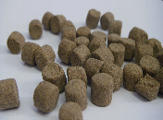
94 Kilograms of SCA added to a 500m reach in Mckay Creek
Notes:
We added 94 kilograms of Salmon Carcass Analog to a 500m reach in our ‘Fake fish’ stream.
Salmon carcass analog is a manufactured, pasteurized product designed to mimic the nutrient contribution and breakdown rates of salmon carcasses.

Slide 12
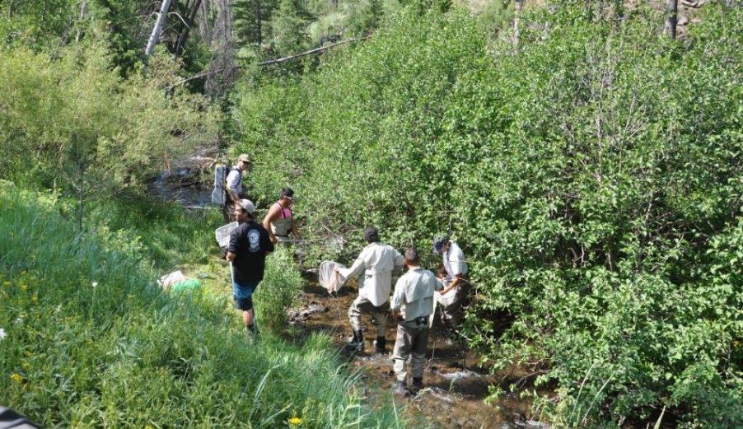
A 500m reach in Five-Mile Creek served as a Control
Notes:
And we added no subsidies to our ‘No fish’ stream.
Loading rates in our treatment streams were standardized to the equivalent of salmon-derived N contributed per unit area in our ‘Live fish’ stream.

Slide 13
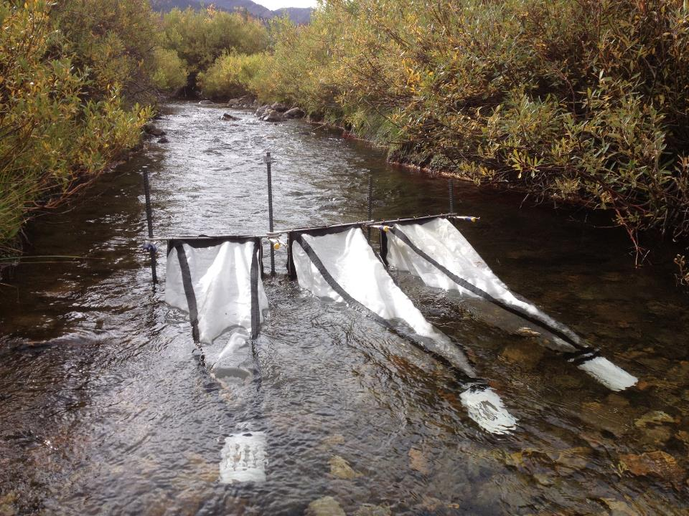
Notes:
In addition to functional metabolism measures that give insight into basal food resources, we wanted to characterize fish food availability for stream dwelling salmonids. To do this we sampled drifting invertebrates that represent a direct food resource available to sight-feeding predators such as salmonid fishes.

Slide 14
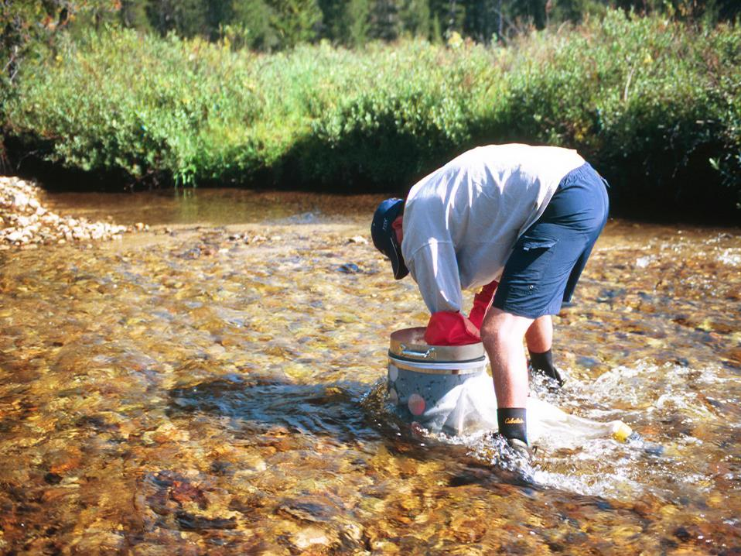
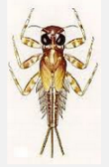

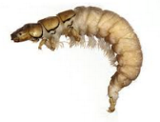
Notes:
We also measured benthic macroinvertebrate abundance, biomass, and community assemblage metrics before and after treatment additions.
July and October

Slide 15
Control
Salmon
Carcass
Analog
Notes:
Here’s a graphic that summarizes large effect size responses representing the change in benthic invertebrate communities from July to October in our Control, Live Salmon, Carcass, and Analog streams. We note that while abundance and biomass increased seasonally in all our study streams, the streams receiving marine-derived subsidies show more and larger effect size responses.

Slide 16




Total abundance (No. per m²)

Slide 17



Total biomass (g per m²)
Notes:
Similarly, benthic macroinvertebrate biomass for small to mid-size class invertebrates was higher in treatment streams relative to our control.

Slide 18
3.4 fold increase
2.2 fold increase
Notes:
But to give you an idea for the scale of these effects, we estimated the reach level response in total abundance across stream types. The grey portions of the bars represent the measured change in abundance from July to October derived from our Control stream while the green portions are speculated to be a response to our treatments. The greatest effect was seen in our Live salmon stream. Please note that treatment responses seem to suggest that even small resource subsidies have a large invertebrate response when expanded to the scale of our 500 meter study reaches. In this case we estimate effect sizes of 4 to 8 million invertebrates. And these estimates should be considered conservative, as they are expansions that were only applied to riffle habitat areas.

Slide 19
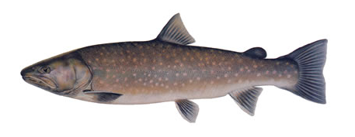


Bull Char Growth Rates
Growth Rate (g per day)
Control
Salmon
Analog
Stream
Notes:
Shown here are growth rate comparisons for Bull Char from our Control, Live Salmon, and Analog streams. Interestingly, the Live Salmon stream exhibited the highest growth rates among stream types.
We hypothesize that this finding is due to the presence of lipid rich Chinook salmon eggs available to Bull Char in our Live Salmon stream.
In fact, the direct consumption of salmon eggs may be one of the most profitable forage resources for stream dwelling consumers at a time when putting on weight is critical to overwinter survival.

Slide 20
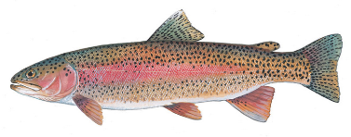

Rainbow Trout Growth Rates
Growth Rate (g per day)
Control
Carcass
Stream
Notes:
And we documented a similar response when using change in mass per unit time as a measure of growth.

Slide 21
Salmonid Nitrogen (δ¹⁵N) and Carbon (δ¹³C) Stable Isotope Biplots
Nitrogen
Carbon
Notes:
We also measured Carbon and Nitrogen stable isotope ratios before and after additions of marine-derived subsidies.
Isotope ratios can be used to track nutrients of marine-origin into specific consumer groups, in this case Bull Char and Rainbow Trout.
In this graph, the size of the bubbles represents an effect size of Carbon and Nitrogen isotopes in salmonid fishes following resource subsidy additions and compared to a Control stream.
As you can see, we only measured large effects in our treatment streams, with the largest response coming from the Live Salmon stream. Again, we think this may be due to the availability of salmon eggs as well as carcass materials and enriched macroinvertebrates.

Slide 22
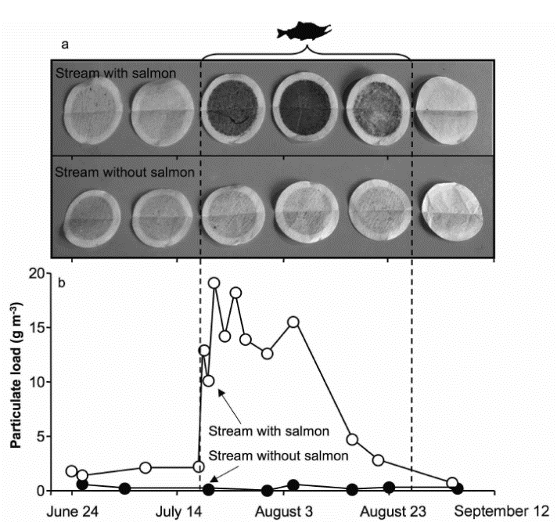

Animal Ecosystem
Engineers in Streams
Notes:
And shown here are more results from Alaska streams that show the presence of spawning salmon having a profound influence on the physical stream environment.
Salmon are known as Ecosystem Engineers because they modify physical habitat features as well as having a functional role.
The top row of filters, pictured above the graph, show a bioturbation response where spawning activities have entrained sediment, organic matter, and invertebrates in the drift during spawning activities.

Slide 23

Notes:
Shown here is a measured bioturbation response that very significantly distinguishes our live Chinook salmon effects from those of our inanimate Carcass and Analog subsidies
Salmon are known as Ecosystem Engineers because they modify physical habitat features as well as playing a functional role.

Slide 24
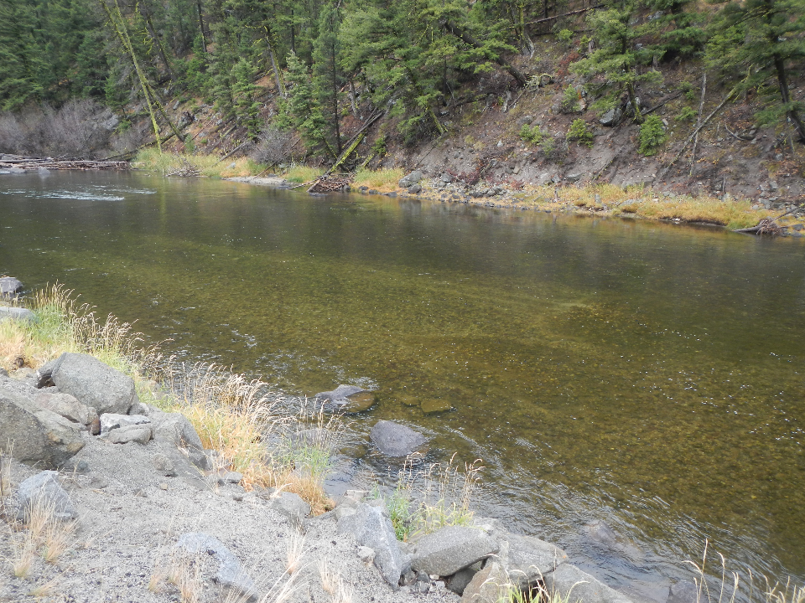
Notes:
And to further drive home this concept of bioturbation, I’d like to share a picture I took a few weeks ago in the Salmon River. Shown here are two Chinook salmon redds with long tailout plumes of fine sediment trailing at least 30 meters downstream of the nests. So salmon are grooming and cleaning the gravel and cobble substrates of fine sediment to promote the exchange of oxygenated water and the removal of metabolic waste products for their incubating eggs that are buried in the stream substrate. And over generations, salmon are maintaining the quantity and quality of spawning gravels, and making the habitat more profitable for future generations of fish.

Slide 25
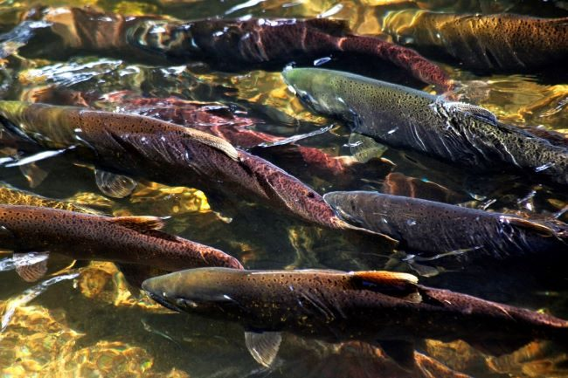

Slide 26
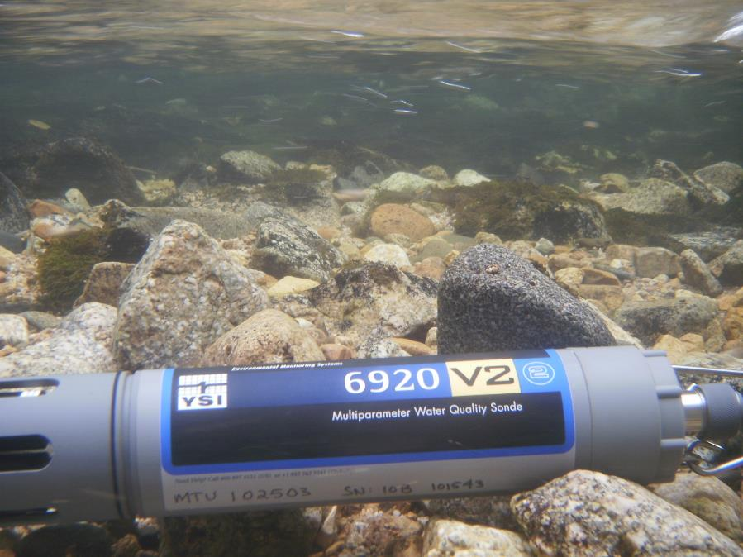
Open-Channel Stream Metabolism
Gross Primary Productivity (g 0₂ m⁻² d⁻¹)
and
Ecosystem Respiration (g 0₂ m⁻² d⁻¹)
Notes:
We measured open-channel stream metabolism to better understand the functional response to our Dr. Seuss Study stream treatments.
Stream ecosystem metabolism is a measure of how much organic carbon is produced and consumed in river ecosystems. And stream metabolic rates have been shown to be dramatically affected by the presence of spawning salmon, both here in Alaska and in other PNW streams.

Slide 27
Control
Salmon
Spawning period
P/R
Carcass
Analog
Notes:
We measured stream metabolic rates before, during, and after the addition of live Chinook salmon and other inanimate resource subsidy treatments. Vertical lines show when Live Salmon were released and inanimate treatment forms were applied. The shower lines indicate the period of active spawning. Productivity to Respiration ratios that express the balance of metabolic processes in relative terms are shown on the y-axis. P/R ratios less than one indicate a heterotrophic stream condition with a net loss of energy from the system. This functional condition is very common in oligotrophic headwater streams and was generally expected among our study streams. What appears unique is the pattern in P/R ratios through time in our live Chinook salmon stream compared to the other stream types. The presence of live salmon appears to influence functional stream attributes like the balance between Gross Primary Production and Ecosystem Respiration. In short, live Chinook salmon are directly influencing stream ecosystem metabolic rates.

Slide 28
Click here to watch video: http://species.idaho.gov/wp-content/uploads/sites/82/2020/07/SRBNE-Video_Copy.mp4
Notes:
And now that I’ve shown empirical data that illustrates the suspended sediment response of physical bioturbation, I’m excited to play a small clip from our ‘Live Salmon’ stream that illustrates this concept perfectly. Please notice the juvenile bull char, precocial Chinook salmon parr, and resident cutthroat trout that are actively keying in on the female spawner to gain access to eggs and invertebrates made available during spawning activities.

Slide 29
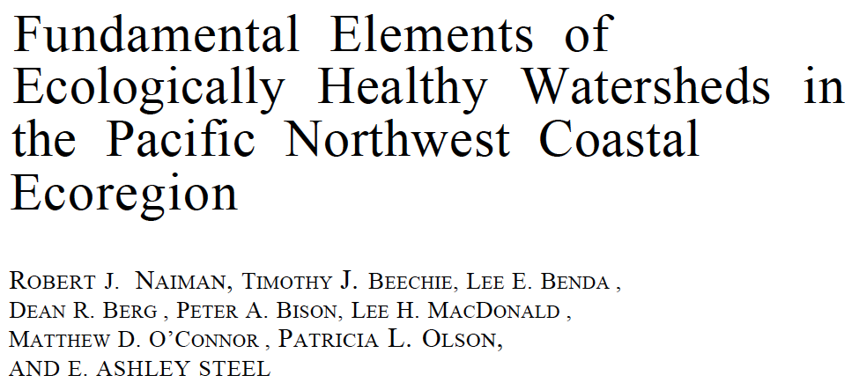

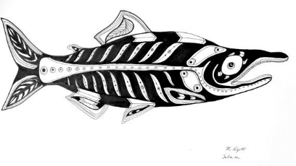

Slide 30
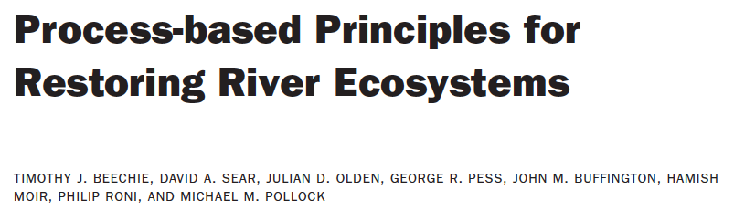
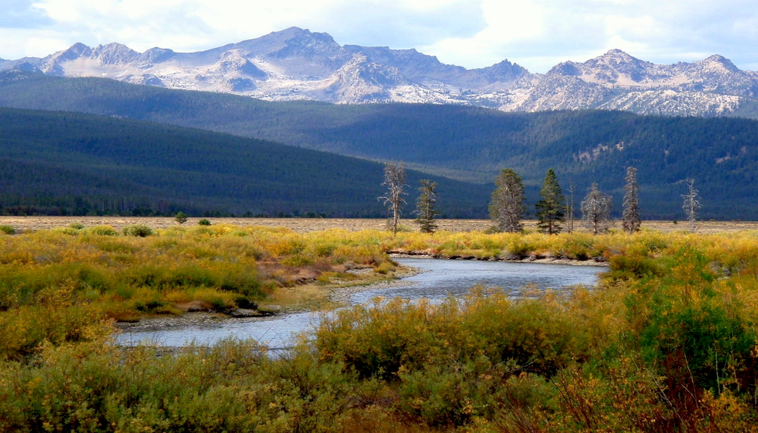

Slide 31
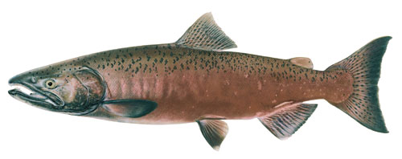



Nutrient Import
from adults
+
4 kilogram adult Chinook Salmon
(3.04% N and 0.38% P)
Upstream
Nutrient Import - Nutrient Export = Nutrient Flux
Nutrient Export
from smolts
−
10 gram juvenile Chinook Salmon
(2.49% N and 0.43% P)
Downstream
Notes:
So let’s take a look at some data. These box and whisker plots show the adult import across study streams and years and the corresponding juvenile export by brood year.
The top graph is Nitrogen data and ranges from 0 to 379 kilograms for adult import and from 0 to 67 kilograms for juvenile export.
The bottom graph is Phosphorus data and ranges from 0 to 47 kilograms for adult import and from 0 to12 kilograms for juvenile export.

Slide 32
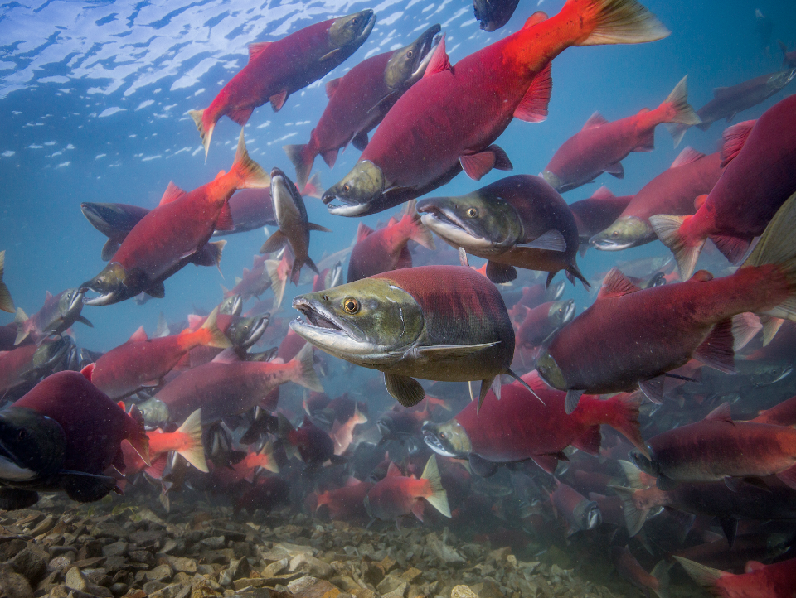
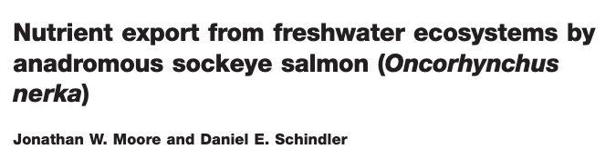

Slide 33
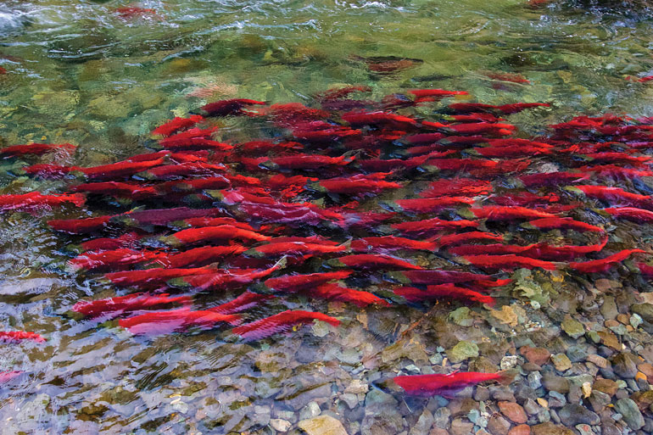
In 67 lake/year evaluations Moore et al.
never documented a single case of negative
nutrient flux, where juvenile smolt exported
more nutrients than their parents imported,
despite harvest rates of up to 67%.

Slide 34
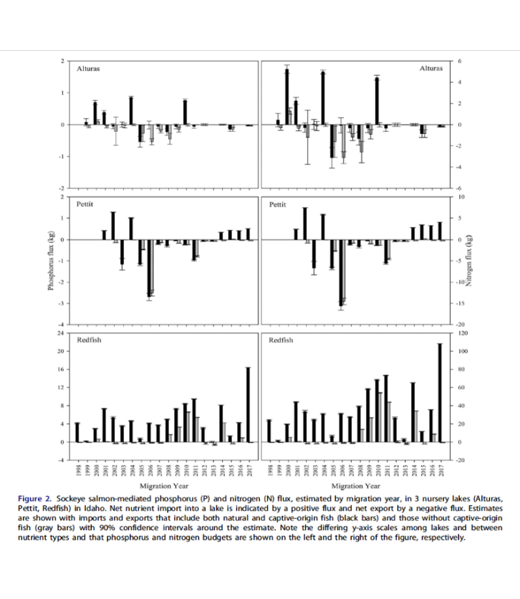
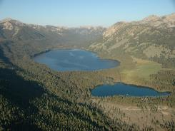
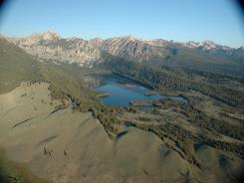
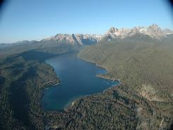
Evans et al. 2019

Slide 35
Net Negative Nutrient Flux
Population Replacement Curve
_
+

Slide 36
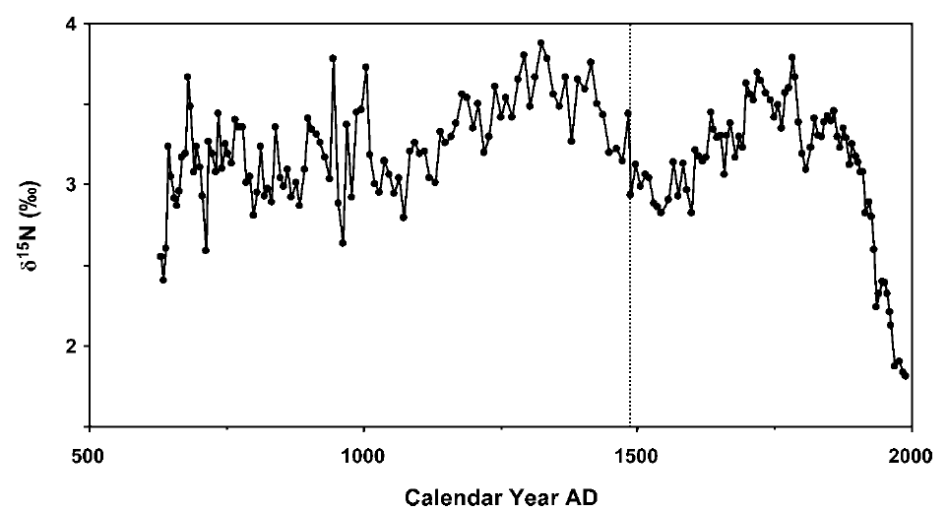
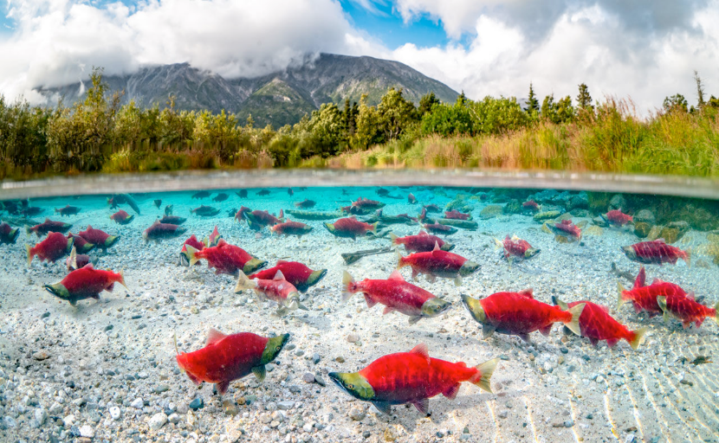
Nitrogen Stable Isotope (per mill)
Redfish Lake, Idaho
Calendar Year
Selbie et al. 2007
Notes:
As you can see, for more than a millennium, Redfish Lake marine-derived Nitrogen stable isotopes, used here as a proxy for salmon abundance, chug along until around the early 20th century when the marine-derived nutrient signal in Redfish Lake starts to fall precipitously. This decline coincides with intense harvest and the development of the Federal Columbia and Snake River Hydrosystem.

Slide 37
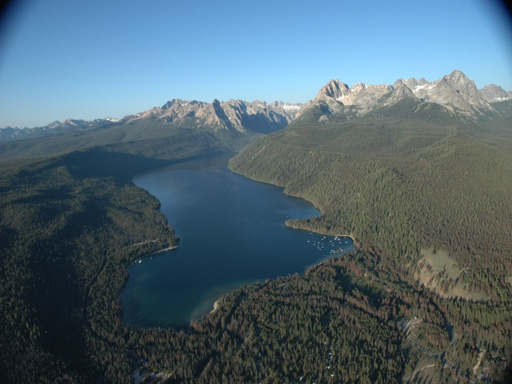
Redfish Lake Snake River Sockeye Salmon abundance estimates from 1808 to 1990 as modeled from paleo-sediment lake core marine-derived nutrient analysis.
Columbia and Snake river
hydrosystem development

Slide 38
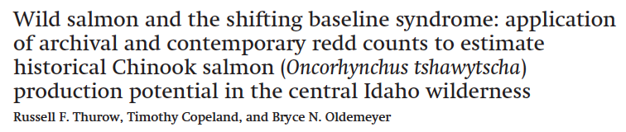
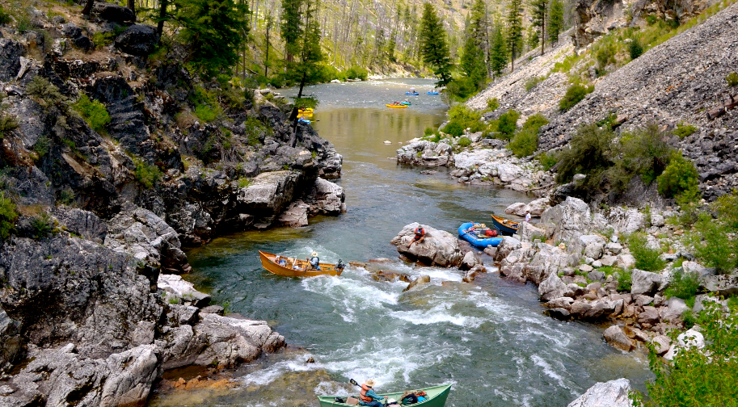

Slide 39
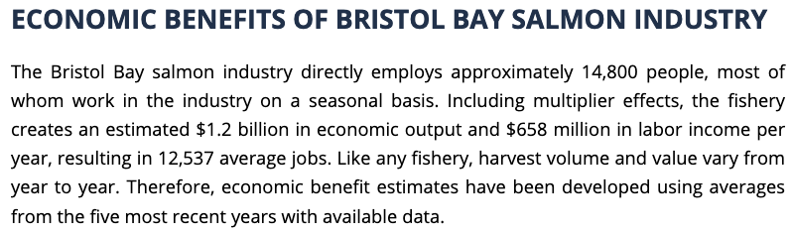
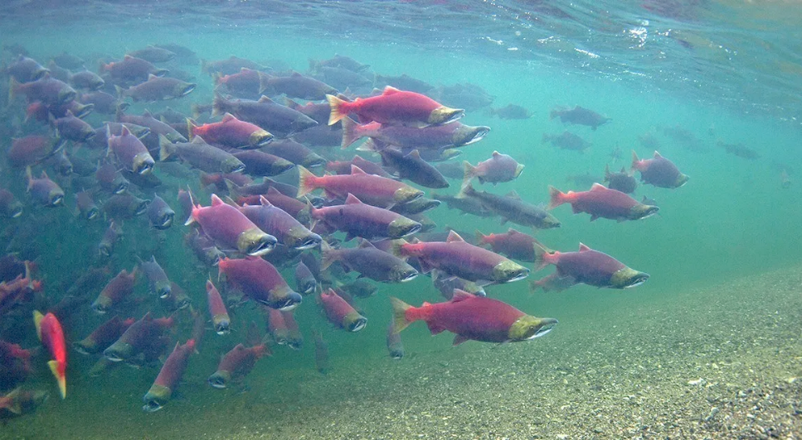

Slide 40
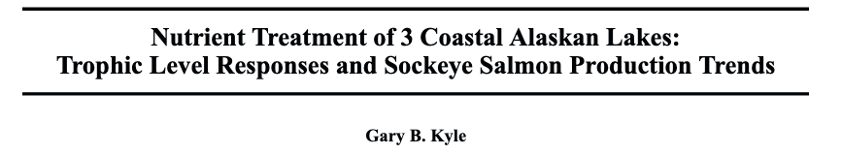
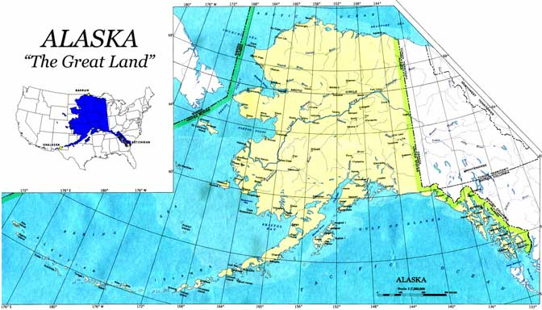

Slide 41
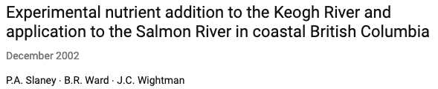
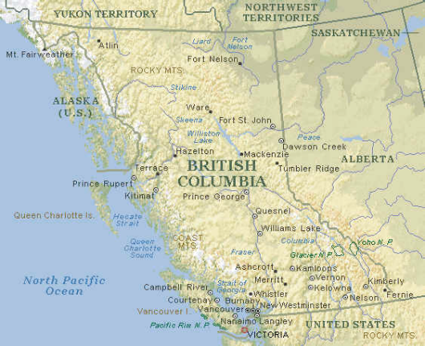

Slide 42
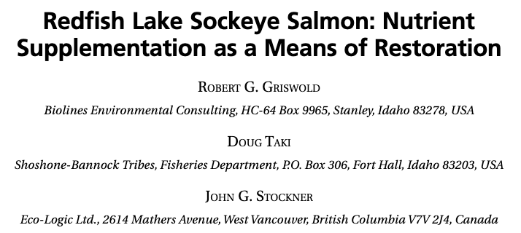
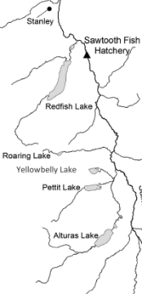

Slide 43
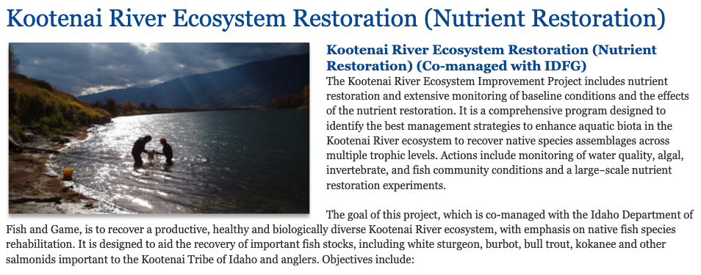


Slide 44



Slide 45


Chinook Salmon carcass additions in the
Yankee Fork Salmon River Watershed

Slide 46


Slide 47

Cultural Oligotrophication
and the Clear-Water Paradox
Stockner et al. 2000 and Anders and Ashley 2007
Notes:
So currently, the contemporary situation across salmon country in the Pacific Northwest has been characterized as landscape scale cultural oligotrophication and the clear-water paradox.
Many aquatic habitats have low levels of dissolved nutrients and low biologically productivity, and although they appear pristine, may no longer support the same numbers of juvenile fishes relative to historical conditions. System productivity and habitat carrying capacities have diminished, growth rates and production of benthic biofilm, invertebrates, and fish have decreased, and this is expressed in reduced survival and downward trends in population dynamics of ESA listed species that make reaching meaningful recovery goals difficult.

Slide 48

‘Wild salmon are the lifeblood of Pacific Northwest rivers.
Letting them disappear would be far more than an environmental tragedy.
It would be a human and spiritual disaster’
~Todd True
Notes:
Despite this type of news, salmon are extremely powerful and resilient creatures, and if provided healthy habitat, from the mountains in central Idaho, through the Snake and Columbia rivers, out to the Pacific Ocean and back again, salmon may well return in sufficient numbers to restore the structure and function of inland aquatic and terrestrial ecosystems.
And in so doing, all of us will benefit ecologically, culturally, and economically.
I hope we can work towards this future while honoring these amazing fish.

Slide 49

THE END
Notes:
Thank you.

