Slide 1
Energy Resiliency Grant Program Round 2
Pre-Application Meeting
Idaho Governor’s Office of Energy and Mineral Resources
Jett Hawk, Project Coordinator
June 17, 2025
This webinar is being recorded.

Slide 2
Disclaimer
This webinar is being recorded.
Please exit the meeting if you do not consent to being recorded.
The webinar slides and recording will be posted on OEMR’s ERGP webpage.
This webinar is being recorded.

Slide 3
Agenda
Critical Reminders
Program Overview
Cost Information
Application Overview
Application Evaluation
Next Steps
Questions
This webinar is being recorded.

Slide 4
Critical Reminders
Applications are due to OEMR no later than 11:59 pm MDT on July 25, 2025.
  Email all Application documents to Jett Hawk at jett.hawk@oer.idaho.gov.
Applications must be submitted in their entirety.
  All Application documents must be complete and submitted, or your Application will not be considered.
  Incomplete applications will be rejected in their entirety.
Required Documents
  Application Form
  Budget Justification Worksheet
  Environmental Questionnaire
  Cost Match Commitment Letter
  Disclosure of Lobbying Activities
This webinar is being recorded.

Slide 5
Program Overview
This webinar is being recorded.

Slide 6
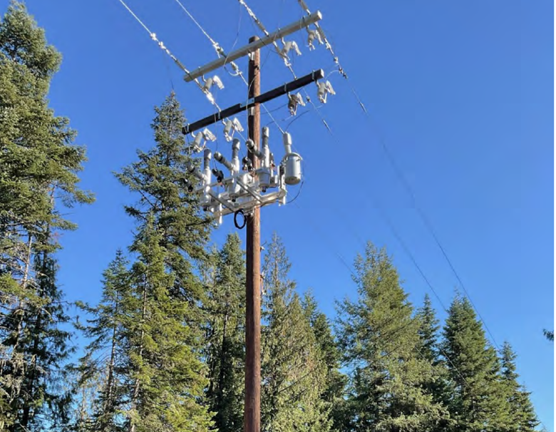
Program Overview
State Pilot Program
Round 1
Section 40101(d) of the Infrastructure Investment and Jobs Act (IIJA): Preventing Outages and Enhancing the Resilience of the Electric Grid Formula Grants to States and Indian Tribes
Competitive Selection Process
This webinar is being recorded.

Slide 7
Program Overview
Program Mission Statement
ERGP fosters strategic investments that demonstrate measurable improvements to grid resiliency, deliver modernized grid infrastructure, and mitigate risks from increased electrification and disruptive events.
This webinar is being recorded.

Slide 8
Program Overview
Round 2 Goals
Fund projects that meaningfully increase Idaho’s electric utility reliability and resilience.
Fund projects that reduce electric utility wildfire risk and increase utility wildfire response.
Fund projects that modernize and improve existing electricity infrastructure.
This webinar is being recorded.

Slide 9
Program Overview
Eligible Entities
Electric grid operators
Electricity storage operators
Electricity generators
Transmission owners or operators
Distribution providers
Fuel suppliers
Other relevant entities as determined by the Secretary of Energy (requires approved “Secretarial Eligible Entity Designation Request” form)
This webinar is being recorded.

Slide 10
Program Overview
Eligible Projects
Including but not limited to:
Vegetation and fuel load management
Replacing old overhead conductors and underground cables
Fire-resistant technologies and fire prevention systems
Weatherization technologies and equipment
Monitoring and control technologies
Undergrounding electrical equipment
Utility pole management
Reconductoring power lines with low-sag, advanced conductors
Hardening power lines, facilities, substations, or other systems
This webinar is being recorded.

Slide 11
Program Overview
Overview of Award Requirements
Competitive award process
Approximate total funding: $7,700,000
Recommended maximum total project cost: $5,000,000
Maximum requested subaward amount: $1,500,000
Project location: State of Idaho (Foreign Work Waiver)
Project duration: Should be completed within three (3) years of Subaward Agreement execution
This webinar is being recorded.

Slide 12
Program Overview
Overview of Award Requirements (continued)
Maximum number of Applications per Applicant: One (1)
Minimum Applicant Cost Match
  Large utilities (sell > 4M MWh/year): At least 100% of the federal award amount
  Small utilities (sell < 4M MWh/year): At least 1/3 of the federal award amount
Reimbursement mechanism: Activity completion payments
This webinar is being recorded.

Slide 13
Program Overview
Applicable Laws & Regulations
Uniform Administrative Requirements (a.k.a. the Uniform Guidance)
Davis-Bacon Act (DBA)
Build America Buy America (BABA)
National Environmental Policy Act (NEPA)
Applicable state and local requirements
All requirements apply regardless of funding source.
See RFA Appendix B and Award Special Terms & Conditions
This webinar is being recorded.

Slide 14
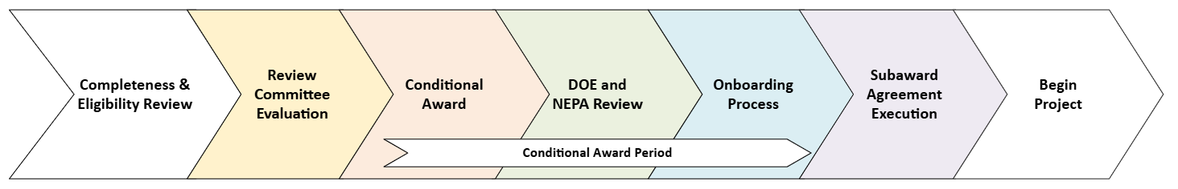
Program Overview
Program Phases
This webinar is being recorded.

Slide 15
Program Overview
Program Timeline
Event | Date & Time
RFA Issue Date | June 6, 2025
Pre-Application Meeting | June 17, 2025, 10:00 AM MT
Applicant Question Deadline | July 18, 2025
Final Answers to Questions and Addenda Timeline | July 23, 2025
Applications Due | July 25, 2025, 11:59 PM MT
Conditional Awardees Selected (Anticipated) | September 1, 2025
This webinar is being recorded.

Slide 16
Cost Information
This webinar is being recorded.

Slide 17
Cost Matching
ERGP subawards are a combination of a federal subaward and state Cost Match
  $100,000 total award ($70,000 federal [70%] and $30,000 state [30%])
Large utilities (sell more than 4 million MWh per year) must match at least 100% of the federal award amount.
Small utilities (sell less than 4 million MWh per year) must match at least 1/3 (NOT 33%) of the federal award amount.
Represents the minimum required Applicant Cost Match.
This webinar is being recorded.
Total Project Cost = Total Subaward (Federal + State) + Applicant Cost Match

Slide 18
Cost Matching Example
Total Project Cost = Total Subaward (Federal + State) + Applicant Cost Match
Large Utilities (100% of the fed. subaward amount)
$200,000 Total Subaward
$140,000 Federal subaward (70%)
$60,000 State Cost Match (30%)
+ $140,000 Appl. Cost Match (equal to fed. amount)
$340,000 Total Project Cost
Small Utilities (1/3 of the fed. subaward amount)
$200,000 Total Subaward
$140,000 Federal subaward (70%)
$60,000 State Cost Match (30%)
+ $46,667.67 Appl. Cost Match ($140,000/3)
$246,666.67 Total Project Cost
This webinar is being recorded.

Slide 19
Cost Share
Cost Share is different from Cost Match
Voluntary: Non-federal funds above the minimum required Cost Match
Mandatory: Projects with large costs not covered by the subaward and Cost Match
Any Cost Share (voluntary or mandatory) will be added to the Applicant Cost Match
This webinar is being recorded.

Slide 20
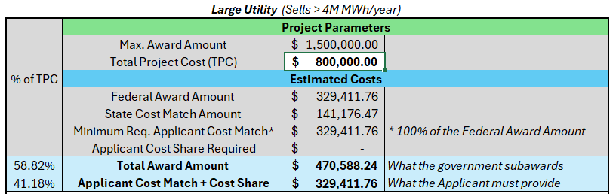
ERGP Cost Calculator
Located on the ERGP webpage
Enter “Total Project Cost” in white box
This webinar is being recorded.

Slide 21
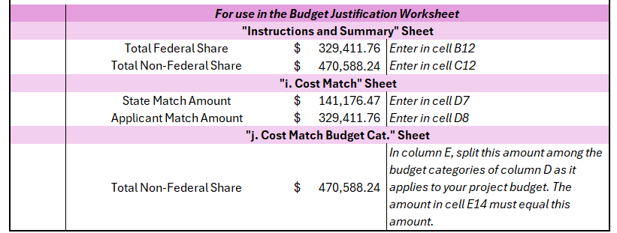
ERGP Cost Calculator
This webinar is being recorded.

Slide 22
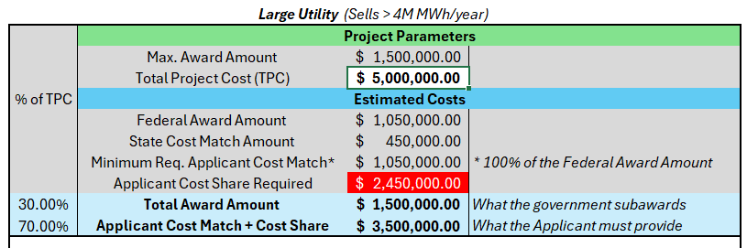
ERGP Cost Calculator – Cost Share
This webinar is being recorded.

Slide 23
Application Overview
This webinar is being recorded.

Slide 24
General Document Questions
Answer all questions. If it does not relevant to your project then please put “N/A” or “Does not apply.”
There are several forms that require a signature. An Authorized Representative of your company must sign all forms that require a signature.
This webinar is being recorded.

Slide 25
Required Documents
Application Form
Budget Justification Worksheet
Environmental Questionnaire
Cost Match Commitment Letter
Disclosure of Lobbying Activities
This webinar is being recorded.

Slide 26
Application Form
Applicant Information
Applicant Eligibility
Project Eligibility
Project Description
Evaluated Criteria
Federal Certifications
Project Build and Resilience Metrics
Note: The Application Form collects information for project evaluation and for OEMR’s federal application submission.
Some information may seem repetitive; it is acceptable to repeat helpful information where possible.
This webinar is being recorded.

Slide 27
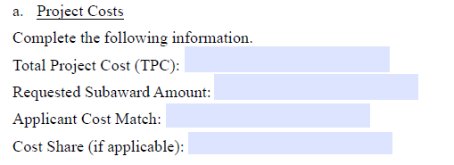
Application Form
Total Project Cost (TPC) : The sum of the Requested Subaward, Cost Match, and Cost Share (if applicable)
Requested Subaward Amount: The total (state Cost Match + federal subaward) amount of funds you are requesting from OEMR.
Applicant Cost Match: The amount you will contribute to the project.
This webinar is being recorded.
Cost Share: Any additional non-federal funds you will contribute (Put $0.00 if you do not intend on contributing Cost Share).

Slide 28
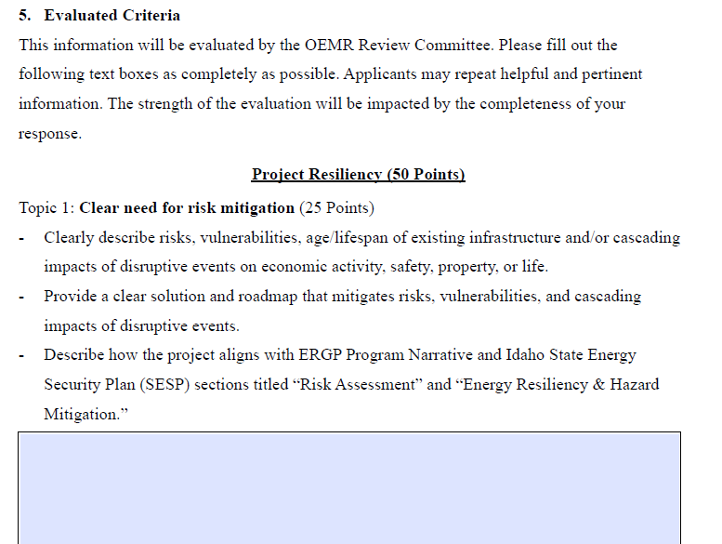
Application Form
The topic is the question’s overall “theme”
These prompts should be answered in the box below
This webinar is being recorded.

Slide 29
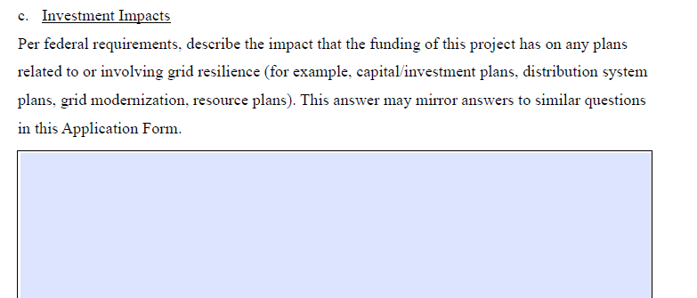
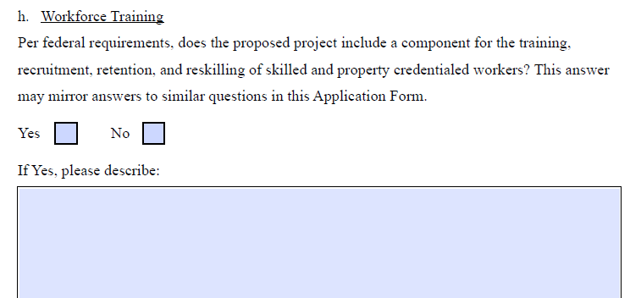
Application Form
This webinar is being recorded.

Slide 30
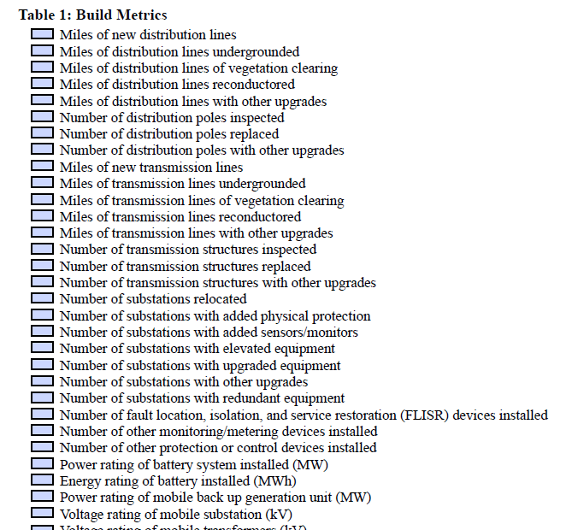
Application Form
Selected metrics should be tracked from before project construction to one year following project completion
Metrics will be reported in quarterly and annual reports and One Year Results Report
This webinar is being recorded.

Slide 31
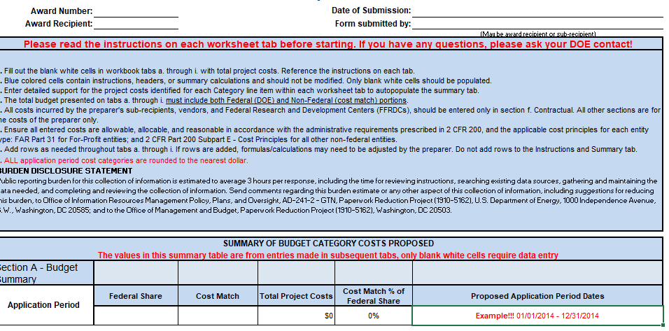
Budget Justification Worksheet
Instructions & Summary tab
Date of submission
On the first tab, only the highlighted areas need to be filled out. Everything else needed will auto populate through formulas tied to other tabs in this workbook.
Federal Share = Federal Subaward amount requested
Cost Match = State Cost Match + Applicant Cost Match
Date of submission
This webinar is being recorded.
Federal share
State share
Example!!! 01/01/2014 – 12/31/2014

Slide 32
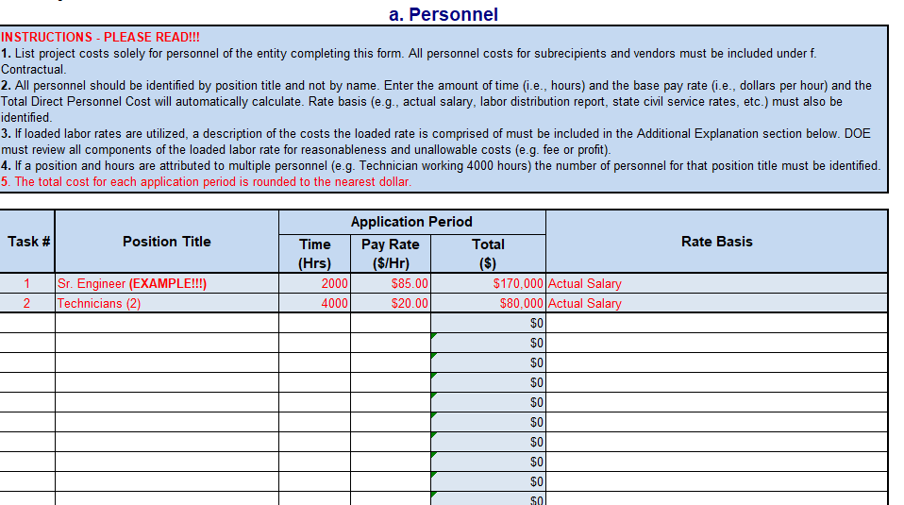
Budget Justification Worksheet
This webinar is being recorded.

Slide 33
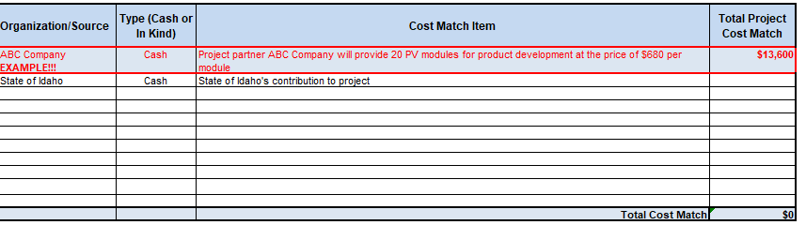
Budget Justification Worksheet
“i. Cost Match” Tab
Both the State Cost Match (part of the total subaward) and Applicant Cost Match must be detailed in this tab
This webinar is being recorded.

Slide 34
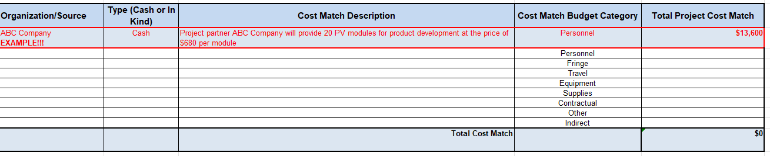
Budget Justification Worksheet
“j. Cost Match Budget Cat.” Tab
Total Cost Match (state + Applicant) must be subdivided among the budget categories in column D. The Total Cost Match amount at the bottom must equal the Cost Match on the Instructions and Summary tab.
This webinar is being recorded.

Slide 35
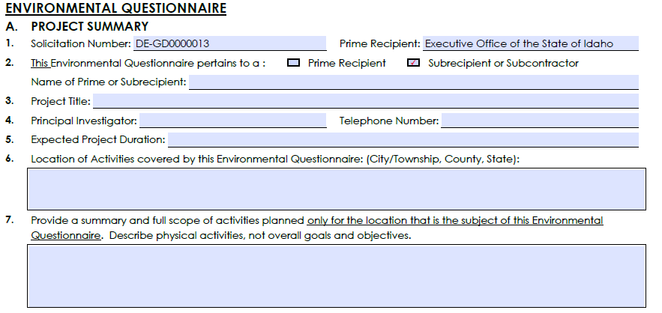
Environmental Questionnaire
This webinar is being recorded.

Slide 36
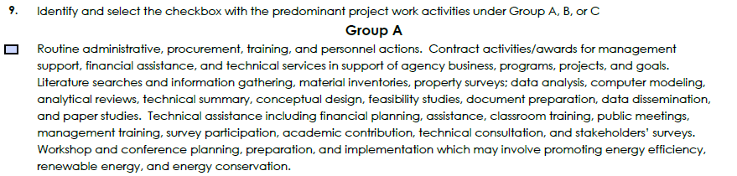
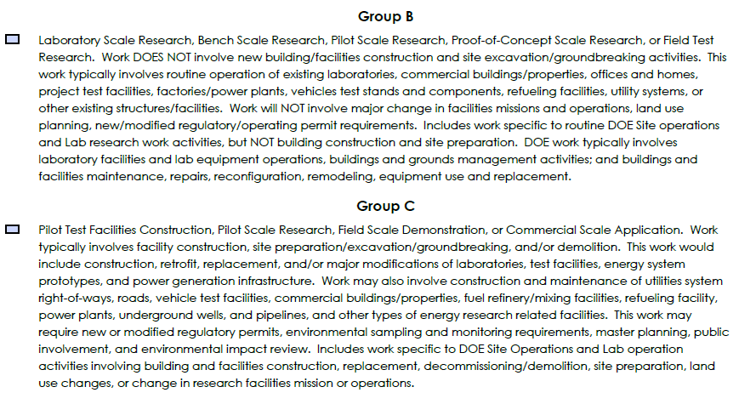
Environmental Questionnaire
This webinar is being recorded.

Slide 37
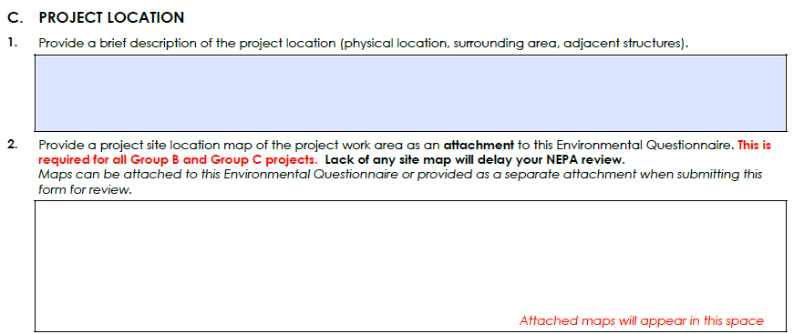
Environmental Questionnaire
This webinar is being recorded.

Slide 38
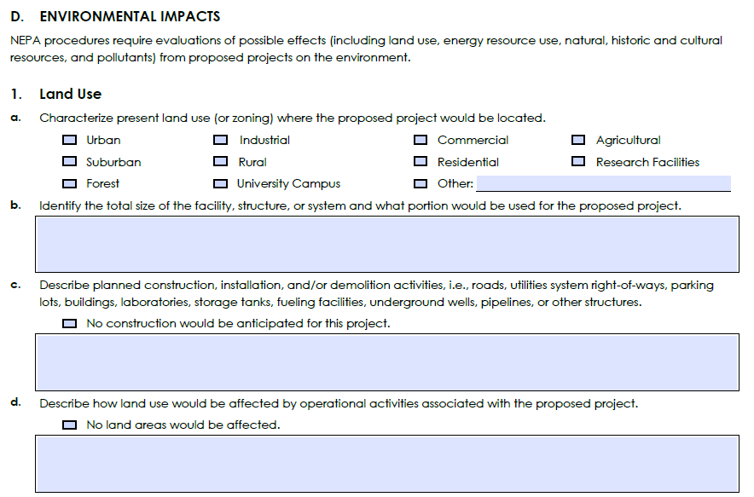
Environmental Questionnaire
This webinar is being recorded.

Slide 39
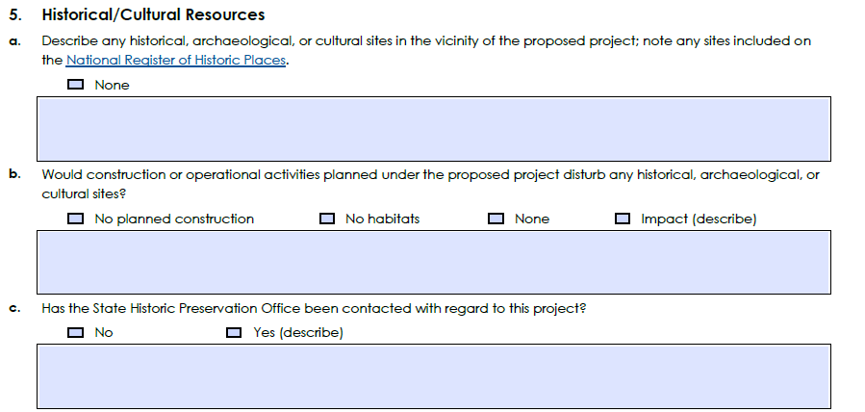
Environmental Questionnaire
This webinar is being recorded.

Slide 40
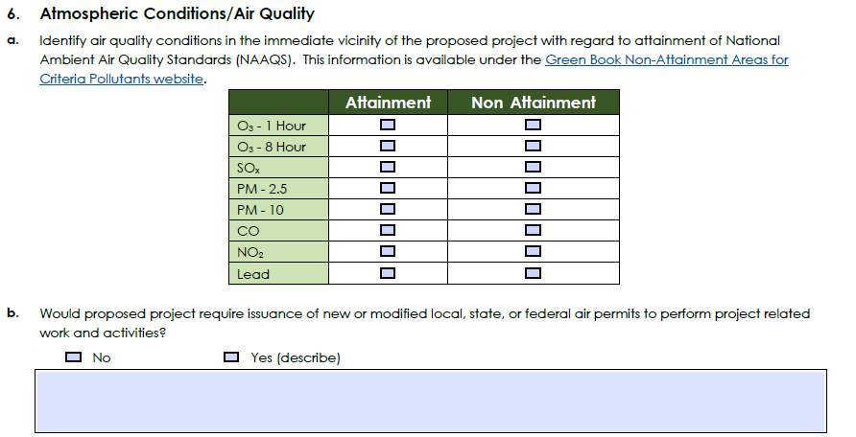
Environmental Questionnaire
This webinar is being recorded.

Slide 41
Environmental Questionnaire Supplemental
Please indicate:
If the project requires relevant land permissions (e.g., USFS, IDL, Tribes, NPS)
Describe any coordination with landowners done to date, if any
Please attached any letters of support from landowners received at this time.
These documents may be necessary for DOE NEPA review and
may expedite the DOE review process.
This webinar is being recorded.

Slide 42
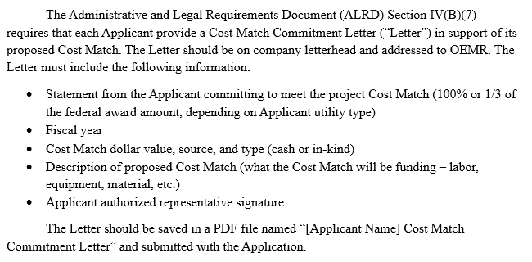
Cost Match Commitment Letter
This webinar is being recorded.

Slide 43
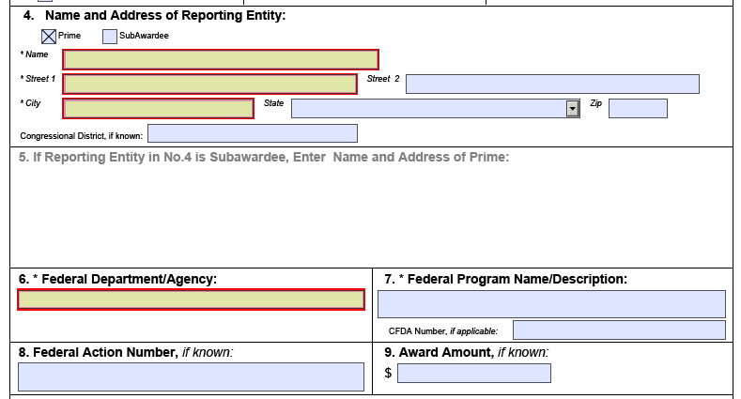
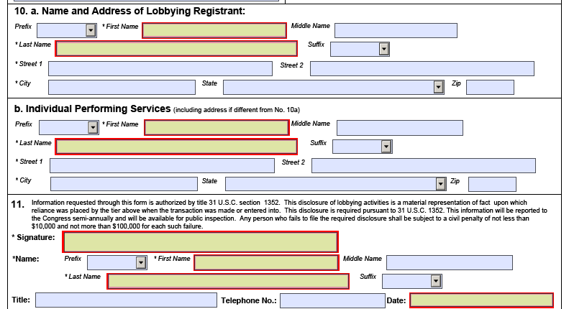
Disclosure of Lobbying Activities
This webinar is being recorded.

Slide 44
Other Application Documents
Potentially required forms
  Secretarial Eligible Entity Designation Request
  Foreign National Participation Document
  Request for Unclassified Foreign National Access
This webinar is being recorded.
Notes:
The Foreign National Participation Document and Request for Unclassified Foreign National Access forms are required if non-US citizens (by birth or naturalization) are participating on the project.
The Secretarial Eligible Entity Designation Request form is required if the Applicant is not one of the listed Eligible Entities in RFA Section VI(A) “Eligible Applicants.”

Slide 45
Common Application Errors
Missing authorized representative’s signatures
Missing answers to form questions
Missing dates
Incomplete/inaccurate/unclear cost calculations
Missing documents
This webinar is being recorded.

Slide 46
Application Evaluation
This webinar is being recorded.

Slide 47
Completeness & Eligibility Evaluation
To be deemed complete, Applicants must
  Answer every question (use “N/A” or “Does not apply” as needed)
  Ensure authorized representative signs dorms
  Complete and submit every form
This webinar is being recorded.

Slide 48
Technical Evaluation
Project Resiliency: 50 Points
Customer Impact: 35 Points
Administrative Compliance: 10 Points
First-time Subrecipients: 5 Points
This webinar is being recorded.

Slide 49
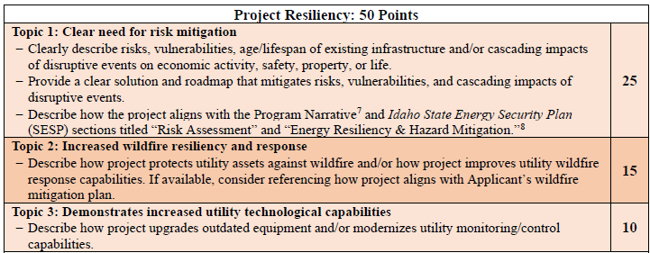
Technical Evaluation
These SESP sections are included as an individual document on the ERGP webpage under “Application Documents.”
This webinar is being recorded.

Slide 50
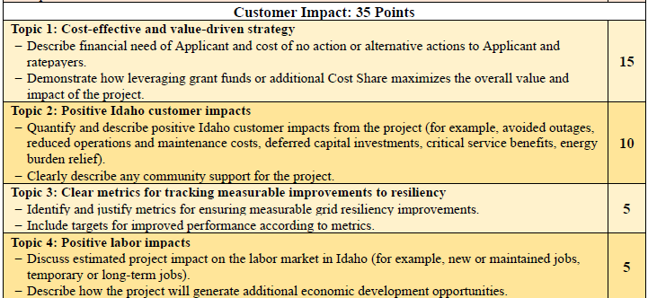
Technical Evaluation
This webinar is being recorded.

Slide 51
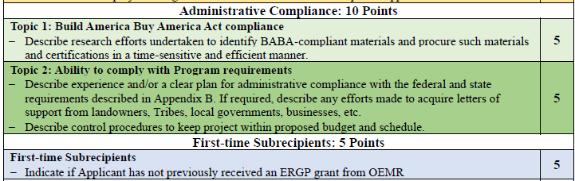
Technical Evaluation
This webinar is being recorded.

Slide 52
Next Steps
This webinar is being recorded.

Slide 53
Applicant Questions
Send Application-related questions to comments@oer.idaho.gov by July 18, 2025.
OEMR will collect questions and post answers on ERGP webpage. Final FAQ document will be posted by July 23, 2025.
Send technical, non-Application-related questions or issues to Jett at jett.hawk@oer.idaho.gov.
This webinar is being recorded.

Slide 54
Next Steps
Applications are due to OEMR by July 25, 2025, at 11:59 PM MST.
Applications must be submitted in full for consideration.
  Incomplete applications will be rejected in their entirety.
Recording of the webinar and slides will be sent and posted on ERGP webpage
Review the FAQ on our website. https://oemr.idaho.gov/programs/idaho-energy-resiliency-grant-program/
This webinar is being recorded.

Slide 55
Questions?
Jett Hawk, Project Coordinator
jett.hawk@oer.idaho.gov
208-332-1677
Meghan Matyas, Project Coordinator
meghan.matyas@oer.idaho.gov
208-332-1676
This webinar is being recorded.

