Slide 1
Wildfire Resilience
Investment Program (WRIP)
Pre-Application Meeting
Idaho Governor’s Office of Energy and Mineral Resources
Jett Hawk, Project Coordinator
September 24, 2025
This webinar is being recorded.

Slide 2
Disclaimer
This webinar is being recorded.
Please exit the meeting if you do not consent to being recorded.
The webinar slides and recording will be posted on OEMR’s ERGP webpage.
This webinar is being recorded.

Slide 3
Agenda
Critical Reminders
Program Overview
Cost Information
Application Overview
Application Evaluation
Next Steps
Questions
This webinar is being recorded.

Slide 4
Critical Reminders
Applications are due to OEMR no later than 11:59 pm MDT on October 10, 2025.
  Email all Application documents to Jett Hawk at jett.hawk@oer.idaho.gov.
Applications must be submitted in their entirety.
  All Application documents must be complete and submitted, or your Application will not be considered.
  Incomplete applications will be rejected in their entirety.
Required Documents
  Application Form (PDF)
  Budget Worksheet (Excel)
  Project Site Map (PDF. No form - Applicant provided)
This webinar is being recorded.

Slide 5
Program Overview
This webinar is being recorded.

Slide 6
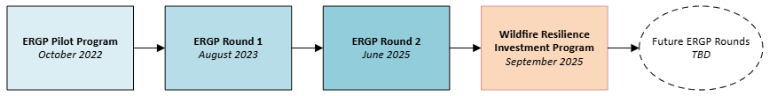
Program Overview
State Pilot Program
Round 1
Round 2
State of Idaho grid resilience appropriations (S.B 1110, 2025)
Competitive Selection Process
This webinar is being recorded.

Slide 7
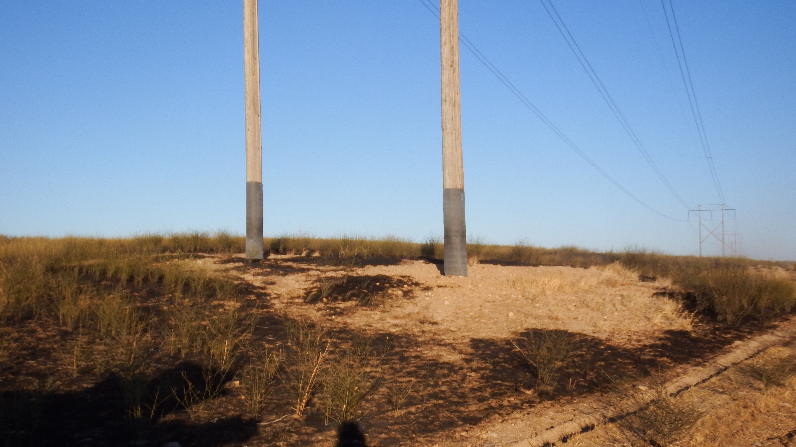
Program Overview
Program Mission Statement
WRIP facilitates investments in Idaho’s electric grid to monitor, mitigate, and mobilize against disruptive wildfire events.
This webinar is being recorded.

Slide 8
Program Overview
WRIP Goals
Invest in long-term strategic projects that mitigate wildfire risk in Idaho
Support utilities with high wildfire risk exposure and capital limitations
Rapidly deploy funding to Idaho’s electric utilities
This webinar is being recorded.

Slide 9
Program Overview
Eligible Entities
Electric utilities that are not currently debarred or suspended with customers in Idaho. For WRIP, OEMR is adopting the requirements of debarred and suspended entities as defined in 2 CFR Part 180.
This webinar is being recorded.

Slide 10
Program Overview
Eligible Projects
Including but not limited to:
Grid design and system hardening (pole and crossarm replacement/reinforcement, installation of automation equipment, conductor improvements, recloser upgrades, undergrounding, etc.)
Vegetation management and vegetation management equipment and technologies (masticators, UAVs*, AI analysis, etc.)
Wildfire condition monitoring technologies (weather stations, cameras, sensors, etc.)
Operational response technologies/Advanced Grid Technologies (SCADA, telecommunications, software and hardware upgrades)
Other projects that meet WRIP goals
* UAVs procured under WRIP must comply with the Prohibition on Certain Telecommunications and Video Surveillance Services and Equipment as defined in 2 CFR §200.216, 2 CFR § 200.471, and section 889 of Public Law 115-232
This webinar is being recorded.

Slide 11
Program Overview
Ineligible Projects
Projects currently under consideration, conditional award, or contract for ERGP Round 1 or 2
Projects not located in the State of Idaho
Projects that do not directly support WRIP goals
Acquisition of real property
Acquisition of covered telecommunications and video surveillance services or equipment
New generation sources
Cybersecurity

Slide 12
Program Overview
Overview of Award Requirements
Competitive award process
Approximate total funding: $4,000,000
Maximum requested subaward amount: $650,000
Project location: State of Idaho
Project duration: Should be completed within two (2) years of Subaward Agreement execution
This webinar is being recorded.

Slide 13
Program Overview
Overview of Award Requirements (continued)
Maximum number of Applications per Applicant: Two (2)
Minimum Applicant Cost Match
  Large utilities (sell > 4M MWh/year): At least 100% of the subaward amount
  Small utilities (sell < 4M MWh/year): At least 1/3 of the subaward amount
Reimbursement mechanism: Activity completion payments
This webinar is being recorded.

Slide 14
Program Overview
Applicable Laws & Regulations
Debarment and Suspension
Prohibition on Covered Telecommunications and Video Surveillance Services and Equipment
Applicable federal and state laws
All requirements apply regardless of funding source.
See RFA Appendix A
This webinar is being recorded.
Notes:
DBA and BABA do not apply, which will reduce administrative burden.

Slide 15
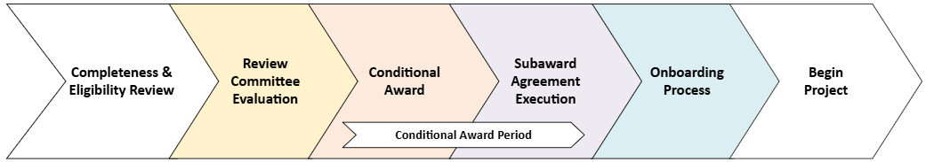
Program Overview
Program Phases
This webinar is being recorded.

Slide 16
Cost Information
This webinar is being recorded.

Slide 17
Cost Matching
WRIP subawards are wholly state funds
Large utilities (sell more than 4 million MWh per year) must match at least 100% of the subaward amount.
Small utilities (sell less than 4 million MWh per year) must match at least 1/3 (NOT 33%) of the subaward amount.
Represents the minimum required Applicant Cost Match.
This webinar is being recorded.
Total Project Cost = Total Subaward + Applicant Cost Match

Slide 18
Cost Matching Example
Total Project Cost = Total Subaward + Applicant Cost Match
Large Utilities (100% of the fed. subaward amount)
$180,000 Total Subaward
+ $180,000 Appl. Cost Match (equal to subaward)
$360,000 Total Project Cost
Small Utilities (1/3 of the fed. subaward amount)
$180,000 Total Subaward
+ $ 60,000 Appl. Cost Match ($140,000/3)
$ 240,000 Total Project Cost
This webinar is being recorded.
Notes:
Fewer calculations!

Slide 19
Cost Share
Cost Share is different from Cost Match
Any Cost Share will be added to the Applicant Cost Match (see RFA Section VIII “Cost Information”)
This webinar is being recorded.

Slide 20
Application Overview
This webinar is being recorded.

Slide 21
General Document Questions
Answer all questions. If it does not apply to your project, then please put “N/A” or “Does not apply.”
  Do not leave evaluated application points on the table!
The Application Form requires a signature.
This webinar is being recorded.

Slide 22
Required Documents
Application Form (PDF)
Budget Worksheet (Excel)
Project Site Location Map (PDF - applicant provided)
This webinar is being recorded.

Slide 23
Application Form
Applicant Information & Eligibility
Project Eligibility & Description
Project Description
Evaluated Criteria
Project Build and Resilience Metrics
This webinar is being recorded.

Slide 24
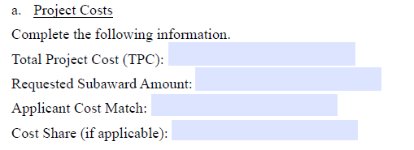
Application Form
Total Project Cost (TPC) : The sum of the Requested Subaward, Cost Match, and Cost Share (if applicable)
Requested Subaward Amount: The total subaward amount you are requesting from OEMR.
Applicant Cost Match: The amount you will contribute to the project.
This webinar is being recorded.
Cost Share: Any additional funds above the minimum Cost Match you will contribute (Put $0.00 if you do not intend on contributing Cost Share).

Slide 25
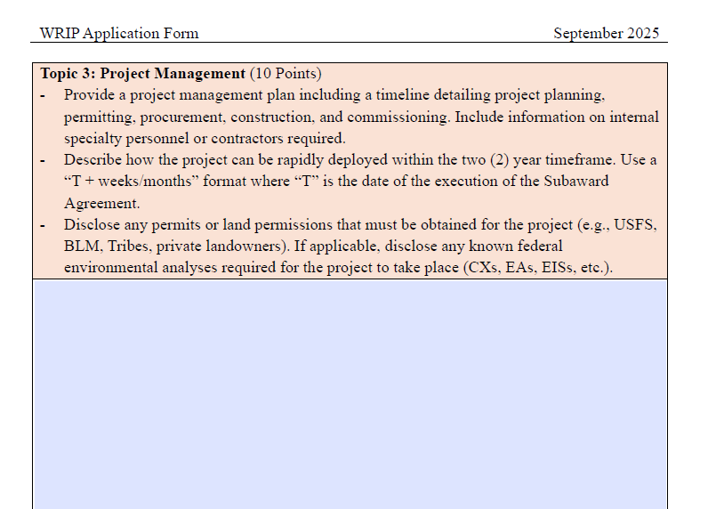
Application Form
The topic is the question’s overall “theme”
These prompts should be answered in the box below
Responses should clearly answer the prompts, then provide supporting details.
This webinar is being recorded.

Slide 26
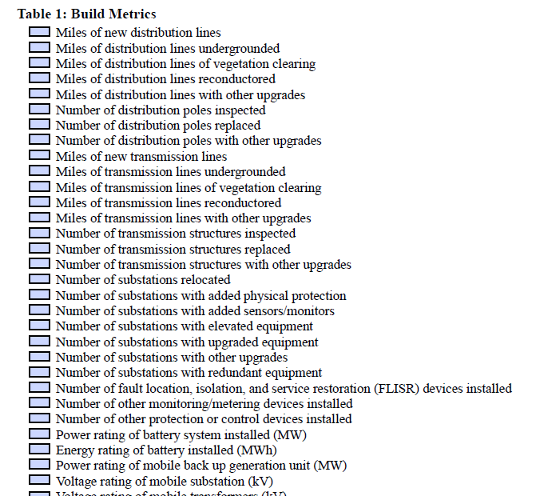
Application Form
Selected metrics should be tracked from before project construction to one year following project completion
Metrics will be reported in quarterly and annual reports and One Year Results Report
This webinar is being recorded.

Slide 27
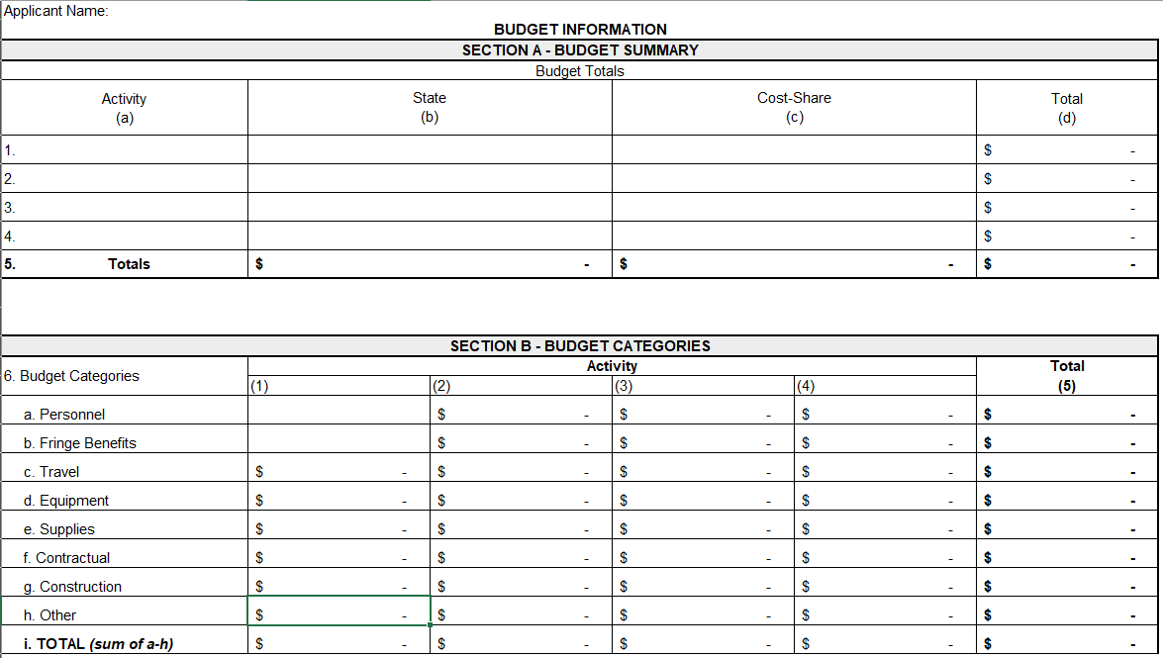
Budget Worksheet
1) The activities are the distinct elements of your project (e.g., AI satellite analysis, VM)
Totals will automatically sum
2) This is the requested subaward per activity
3) This is your Cost Share per activity
Same as Section A – will self-populate
4) Per activity, break down how subaward + Cost Match will be applied
This webinar is being recorded.
5) Check that all Section B totals match Section A totals

Slide 28
Common Application Errors
Missing signatures
Missing answers to Application Form questions
  Do not leave points on the table!
Missing dates
Incomplete/inaccurate/unclear cost calculations
Missing documents
This webinar is being recorded.

Slide 29
Application Evaluation
This webinar is being recorded.

Slide 30
Completeness & Eligibility Evaluation
To be deemed complete, Applicants must
  Answer every question (use “N/A” or “Does not apply” as needed)
  Ensure Application Form is signed
  Complete and submit every form
This webinar is being recorded.

Slide 31
Technical Evaluation
Wildfire Resilience Impact: 50 Points
Customer Benefits: 35 Points
Applicant Need: 15 Points
This webinar is being recorded.

Slide 32
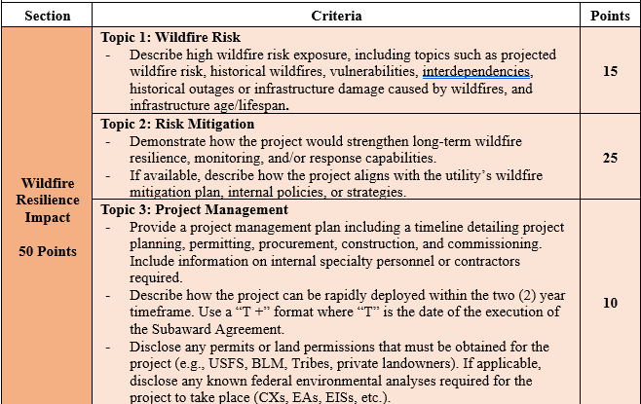
Technical Evaluation
“T + Format” example
Provide schedule as it applies to your project
Subaward agreement execution | T = 0
Equipment procurement | T + 1 month
Contractor procurement | T + 1 month
Construction Completion | T + 12 months
Submission of Completion Report | T + 1 month
This webinar is being recorded.

Slide 33
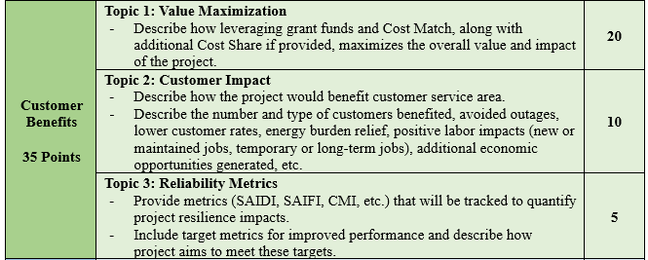
Technical Evaluation
This webinar is being recorded.

Slide 34
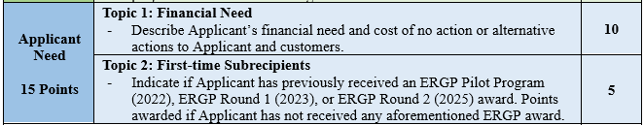
Technical Evaluation
This webinar is being recorded.

Slide 35
Next Steps
This webinar is being recorded.

Slide 36
Applicant Questions
Send Application-related questions to comments@oer.idaho.gov by October 3, 2025.
OEMR will collect questions and post answers on ERGP webpage. Final FAQ document will be posted by October 8, 2025.
Send technical, non-Application-related questions or issues to Jett at jett.hawk@oer.idaho.gov.
This webinar is being recorded.

Slide 37
Next Steps
Applications are due to OEMR by October 10, 2025, at 11:59 PM MST.
Applications must be submitted in full for consideration.
  Incomplete applications will be rejected in their entirety.
Recording of the webinar and slides will be sent and posted on ERGP webpage
Review the Q&A on the ERGP webpage
This webinar is being recorded.

Slide 38
Next Steps
Program Timeline
Event | Date | Time (MT)
RFA issue date | September 12, 2025
Pre-Application Webinar (see Section XIII) | September 24, 2025 | 10:30 AM
Applicant questions deadline (see Section XIII) | October 3, 2025
Final answers to questions and addenda deadline | October 8, 2025
Application Due Date | October 10, 2025 | 11:59 PM
Conditional Awardees selected (anticipated) | November 14, 2025
This webinar is being recorded.

Slide 39
Questions?
Jett Hawk, Project Coordinator
jett.hawk@oer.idaho.gov
208-332-1677
Meghan Matyas, Sr. Financial Specialist
meghan.matyas@oer.idaho.gov
208-332-1676
This webinar is being recorded.

